Slide 1
Ionic Compounds
Forming of Ions
Ionic Compounds
Writing ionic Formula

Slide 2

Some elements are stable exactly as they are
Noble Gases:
Helium 2
Neon 2, 8
Argon 2,8,8
They are found in their elemental form in nature; they are usually unreactive.
They have a full outer shell of electrons

Slide 3
Some elements can donate or accept electrons, in order to achieve a full outer shell
This makes them reactive, and allows them to have a charge
This charged element is called an ION

Slide 4


Ions can be positively charged, or negatively charged
Cation: A positive ion
Mg²⁺, H⁺
Anion: A negative ion
Cl⁻, O²⁻

Slide 5
Forming an Aluminium Ion
Electronic configuration 2,8,3
On your sheet, draw the Electron Transfer Diagram that shows the formation of this ion
13 p

Slide 6
Forming an Aluminium Ion
Net charge 3+
Now a CATION
Symbol Al³⁺
Now 2,8
13 p

Slide 7
Forming an Sulfur Ion
Statistics of an S atom
Electronic configuration 2,8,6
On your sheet, draw the Electron Transfer Diagram that shows the formation of this ion
16 p

Slide 8
Forming an Sulfur Ion
Net charge 2-
Now a ANION
Symbol S²⁻
Now 2,8,8
16 p

Slide 9
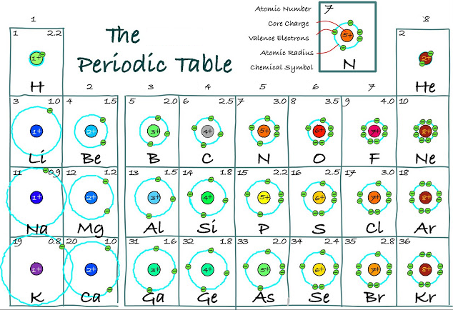
Using an element’s location in the periodic table, we can predict what charge of ion it will form
The diagram below shows the outer shell electrons of the first 26 elements.
What pattern do you notice about the group number, and the number of electrons in the outer shell?

Slide 10
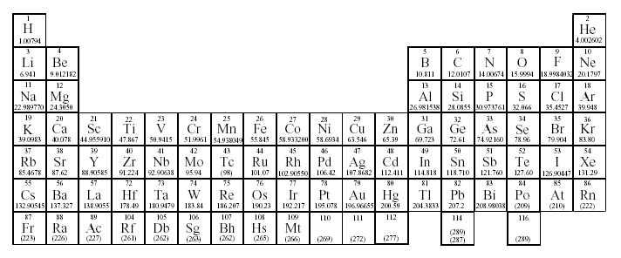
Predicting Ionic Charges
Group 1:
Lose 1 electron to form 1+ ions
H⁺
Li⁺
Na⁺
K⁺

Slide 11
Predicting Ionic Charges
Group 2:
Loses 2 electrons to form 2+ ions
Be²⁺
Mg²⁺
Ca²⁺
Sr²⁺
Ba²⁺

Slide 12
Predicting Ionic Charges
Group 13:
Loses 3 electrons to form 3+ ions
B³⁺
Al³⁺
Ga³⁺

Slide 13
Predicting Ionic Charges
Lose or gain 4
electrons?
Group 14:
Either! But Group 14 elements rarely form ions.

Slide 14
Predicting Ionic Charges
Group 15:
Gains 3
electrons to form 3- ions
N³⁻
Nitride
P³⁻
Phosphide
As³⁻
Arsenide

Slide 15
Predicting Ionic Charges
Group 16:
Gains 2
electrons to form 2- ions
O²⁻
Oxide
Oxide
S²⁻
Sulfide
Se²⁻
Se²⁻
Selenide

Slide 16
Predicting Ionic Charges
Group 17:
Gains 1
electron to form 1- ions
F¹⁻
Fluoride
Br¹⁻
Bromide
Cl¹⁻
Chloride
I¹⁻
Iodide

Slide 17
Predicting Ionic Charges
Group 18:
Stable Noble gases do not form ions!

Slide 18
Predicting Ionic Charges
Groups 3 - 12:
Many transition elements
can form ions with different charges.
Iron(II) = Fe²⁺
Iron(III) = Fe³⁺
Hint: Look at the number in the brackets

Slide 19
Predicting Ionic Charges
Groups 3 - 12:
Some transition elements
have only one possible ion.
Zinc = Zn²⁺
Silver = Ag⁺

Slide 20
Fill in the table to predict to charges when these elements form ions. Use the group numbers to help you out
Element | Ion (remember to add in the charge!)
Ca | Ca²⁺
Ar | Ar Doesn’t form an ion
Sn | Sn ⁴⁺ or Sn ⁴ Usually doesn’t form an ion
Br | Br ⁻
Cs | Cs ⁺
H | H⁺
O | O ²⁻
S | S ²⁻
Mg | Mg ²⁺

Slide 21
Ionic compounds

Slide 22
Forming Sodium Chloride
Sodium is a silvery, highly reactive metal
Chloride is a green, smelly gas
Do they have any “chemistry”??
You bet!……….let have a look Click
Together they form table salt
Lets take a closer look……..
Notes:
Animation: http://www.visionlearning.com/library/flash_viewer.php?oid=1349

Slide 23
Sodium ion
Cation symbol
Na⁺
Now 2,8
Electron configuration: 2,8, 1
Lose/transfer 1e to Chlorine
Now stable but charged
11p+ and 10e-
Net charge 1+
CATION
11p
11n
Notes:
Felix: http://theflagtoday.com/wp-content/uploads/2011/02/felix-the-cat.jpg

Slide 24
Lets look at chlorine
Electronic configuration 2,8,7
Uncharged and unstable:
outer shell isn’t full!
p17
n18

Slide 25
Lets look at chlorine
Anion symbol
Cl⁻
Now 2,8,8
Gain 1e from sodium
Now stable but charged
17p+ and 18 e-
Net charge 1-
ANION
p17
n18

Slide 26
Practise drawing the Electron Transfer Diagram for this reaction

Slide 27
Sodium Chloride : NaCl
The ions are joined by an IONIC BOND
An ionic bond is the electrostatic attraction between a positively charged CATION and a negatively charged ANION
Ions become arranged in a lattice structure

Slide 28
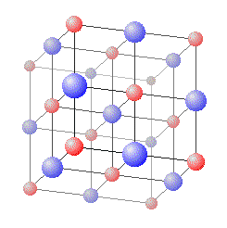
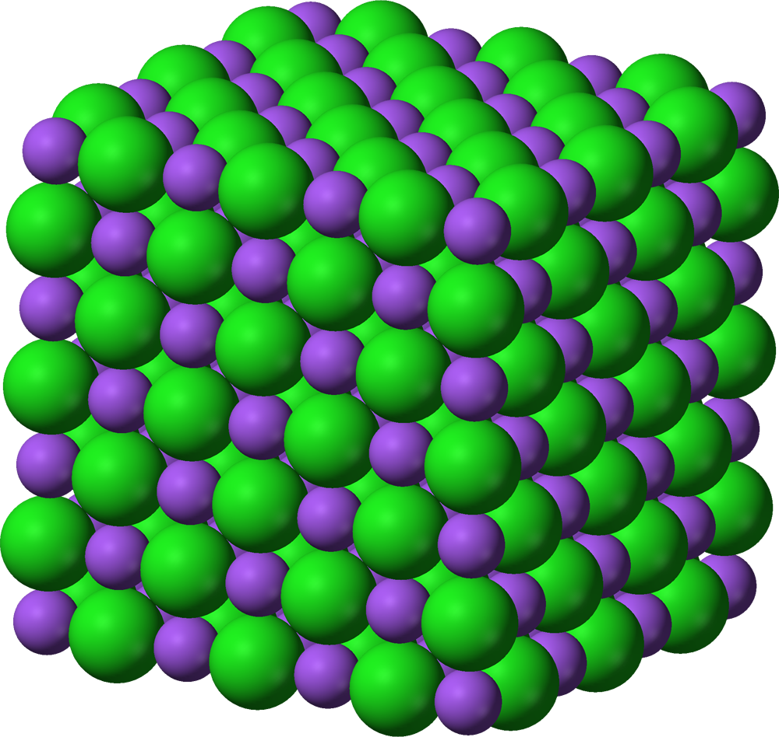
Sodium Chloride Lattice

Slide 29
The Golden Rule
Positive and negative ions can join up to make IONIC COMPOUNDS
The overall charge of an ionic compound must equal zero.
Examples : Na⁺ Cl⁻

Slide 30
Activity: Ionic jigsaw
It’s easy when the charges of ions are equal and opposite—we only need one of each to balance out the charges
What happens when the charges aren’t equal?

Slide 31
Writing Ionic Compound Formulas
Example: Iron(III) chloride
1. Write the formulas for the cation and anion, including CHARGES!
2. Check to see if charges are balanced.
Fe³⁺
Cl⁻
3
3. Balance charges , if necessary, using subscripts.
Not balanced!

Slide 32
Writing Ionic Compound Formulas
Example: Aluminum sulfide
1. Write the formulas for the cation and anion, including CHARGES!
2. Check to see if charges are balanced.
Al³⁺
S²⁻
2
3
3. . Balance charges , if necessary, using subscripts.
Not balanced!

Slide 33
Activity: Ionic jigsaw

Slide 34
Prac: Burning Magnesium in Oxygen

Slide 35
Lesson 2 : Polyatomic Ions

Slide 36
Polyatomic Ion Formulas
Polyatomic ions are groups of atoms that behave as one unit.
The overall charge of the group can be determined.
Eg. One carbon atom and three oxygen atoms can bind tightly to each other, and act as one group. However, this group has an overall charge of 2-

Slide 37
Polyatomic Ion Formulas
Eg. One carbon atom and three oxygen atoms can bind tightly to each other, and act as one group.
O
2-
O
C
O
CO₃²⁻
However, this group has an overall charge of 2-

Slide 38
Polyatomic Ion Formulas
Polyatomic ions are treated as one big group in formulas, but must have brackets only when more than one group is present.
Examples: Ca(NO₃)₂

Slide 39
Ode to Ions
“An ide is a lonely ion,
As lonely as can be.
All it needs is oxygen,
To make an ate happy”

Slide 40
Examples of polyatomic ions
SO₄²⁻
CO₃²⁻
PO₄³⁻
Sulphate ion
Carbonate ion
Phosphate ion
OH⁻
NH₄⁺
NO₃⁻
Hydroxide ion
Ammonium ion
Nitrate ion

Slide 41
Remember, The Golden Rule:
The overall charge of ionic compounds must equal zero.
This still applies to polyatomic ions!

Slide 42
Writing Ionic Compound Formulas
Example: Barium nitrate
1. Write the formulas for the cation and anion, including CHARGES!
2. Check to see if charges are balanced.
Ba²⁺
( )
NO₃⁻
2
3. . Balance charges , if necessary, using subscripts. Use brackets if you need more than one group of polyatomic ions.
Not balanced!

Slide 43
Writing Ionic Compound Formulas
Example: Magnesium carbonate
1. Write the formulas for the cation and anion, including CHARGES!
Mg²⁺
CO₃²⁻
2. Check to see if charges are balanced.
They are balanced!

Slide 44
Homework sheet: Ionic Formulae

Slide 45
Naming Ionic Compounds
Ionic compounds are named according to the following rules:

Slide 46
Rule number 1
If the compound contains a metal and a non-metal:
The name of the metal always comes first, followed by the name of the non-metal, whose ending changes to “ide”
eg. aluminium sulfide
Al³⁺
S²⁻
2
3

Slide 47
Examples
Metal oxide
Metal sulphide
Metal nitride
Metal phosphide
Metal chloride
Metal bromide
Metal iodide

Slide 48
Rule number 2
If the compound contains 2 elements (a metal and a non-metal) and the non-metal is a polyatomic ion
The name of the metal ion always comes first, followed by the name of the non-metal polyatomic ion (which remains unchanged)

Slide 49
Examples :
Metal sulphate
Metal nitrate
Metal phosphate
Metal carbonate
Metal hydroxide

Slide 50
Homework sheet:
Naming Ionic Compounds

