Slide 1
MS EXCEL REVIEWER
Prepared by:
Arlene N. Baratang, Ph.D.

Slide 2
1.
Which of the following represents the first action you should perform in order to copy and paste text or numbers in Excel?
Select the cell or cells that contain the content you wish to copy.
Select the cell or cells where you wish to insert the copied content.
Go to the Clipboard group on the Ribbon and press the Copy button to initialize the copy and paste function.
Press the Paste button to initialize the copy and paste function.

Slide 3
2.
Which of the following is NOT a paste option in Excel?
Paste values – pastes the values of the copied cells only.
Keep source formatting – pastes the copied cells in the same format as what the originals are formatted in.
Paste zeros – replaces copied text with zeros containing the same number of decimals as the originals.
Paste link – pastes a link to the cell containing the original value.

Slide 4
3.
What does the fill handle allow you to do?
Fill empty cells with grey shading to indicate they are not in use.
Complete sentences, words and numbers in cells.
Move the contents of a cell by dragging it to a new position, upwards or downwards.
Copy the contents of a cell by dragging the crosshair downwards, to the left, right or upwards

Slide 5
4.
The shortcut key combination for cutting and pasting data in a cell is:
Control + X to cut and then control + V to paste.
Control + V to cut and then control + C to paste.
Control + C to cut and then control + P to paste.
Control + X to cut and then control + XX to paste.

Slide 6
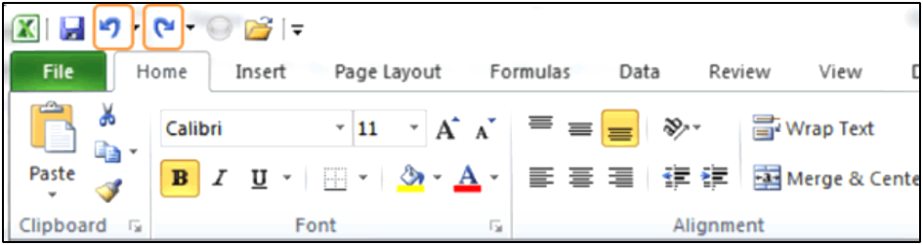
5.
Study the two icons circled in orange above. Which of the following best describes their function?
Go to previous selection, go to next selection.
Undo previous actions, redo previous action.
Go back to previous column, move forwards to the next column.
Undo one action, undo many actions at once.

Slide 7
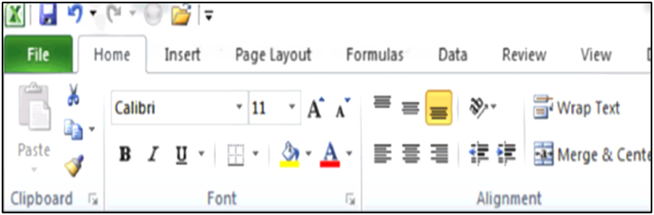
6.
Which action did you not perform if the Paste button is greyed out and you cannot press it - as pictured in the image above?
It is not possible to copy and paste the numbers or text you wish to perform this function for.
You have not selected the cells where you wish to paste the content.
You have selected too many cells to copy and paste and need to select one cell at a time.
You have not copied anything or you have pressed the Escape key before pasting.

Slide 8
7.
Select the correct sequence for cutting and pasting the contents of a cell or cells.
Select the content you wish to cut, move the cursor to where you wish to paste it and press the Paste button.
Press the Paste button, select the Cut option and move your cursor to where you wish to paste the content.
Press the Cut button, select the cells you wish to cut, press the Paste button.
Select the content you wish to cut, press the Cut button, move to where you wish to paste the content, press the Paste button.

Slide 9
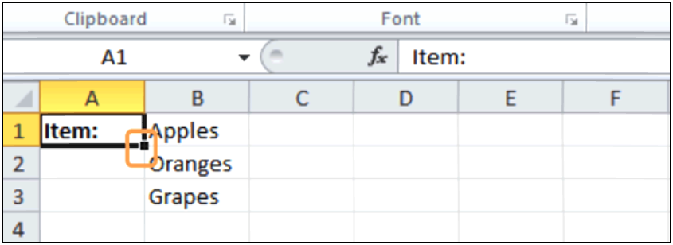
8.
Study the image above. What will happen if you hover your mouse button over the tiny square circled in orange in the image, you press and hold down your left mouse button whilst dragging downwards?
The word "Item:" will be copied down into all the cells you drag your mouse through.
The word "Item:" will be moved down into the cell to which you drag your mouse.
You will change the size of the cell making it bigger.
The word "Item:" will be copied. You then need to move your mouse to where you wish to paste the content and press the Paste button.

Slide 10
9.
How can you review a list of your last actions before undoing them or redoing them?
Keep pressing undo until you've seen all the actions you can undo and then press redo again.
Click the File button and select Recent. This will display a list of your recent actions.
Press the down pointing arrow located next to the Undo and Redo buttons to view a list of previous actions.
Press the dialogue box launcher arrow in the right-hand corner of the Clipboard group to view a list of previous actions.

Slide 11
10.
If I copy cells that contain formulas, but I want to paste the numbers only and not the formulas –how can I do this?
Use the Paste Option to keep the source formatting.
Use the Paste Option to paste values only.
Paste the cells and immediately delete any formulas the cell contains.
It is not possible to paste a cell without the formula.

Slide 12
11.
Study the example above. How can you activate and use the Autofill option to copy the contents of cell B2 down to B50?
Select cells B2 to B50, right click and select Autofill.
Drag the Autofill Handle located at the bottom right-hand corner of the selected cell down to cell B50.
Go to File and select Options – Advanced Options. Go to the General section and select the AutoFill Options button to create this fill.
Autofill can only be used to create series or sequences. You cannot use it to copy data.

Slide 13
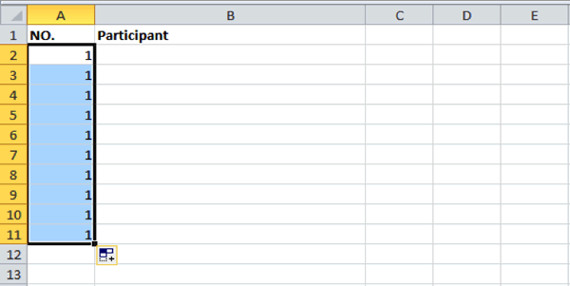
12.
Insert the formula =Sum(1) in the first cell before using the Autofill handle to increment each successive fill by 1 step.
On the Home tab, go to the Editing group and click the Fill button.
Select cells A2 to A11. On the Home tab select Merge and Centre to create a numbered list.
Click on the Autofill Options icon that appears just after completing an Autofill and select 'Fill Series' from the options.
A user wanted to create a numbered list numbered: 1 -10. When they used the Autofill Handle it created a list of 10 number 1s (as pictured above). What is the solution?

Slide 14
13.
For which of the following lists can you NOT use the Autofill function?
Monday, Tuesday, Wednesday, Thursday, Friday, Saturday, Sunday.
Apples, Pears, Oranges, Passion Fruit, Bananas.
January, February, March, April, May, June.
You can use Autofill to create all of the above types of lists.

Slide 15
14.
How would you create a list where you need a word followed by a number? For example Participant 1, Participant 2, Participant 3 all the way to Participant 200, for example?
First type the word 'Participant' in the first cell then use the Autofill handle to copy the word down to 200th cell. Then insert a number in the first cell and copy it down using the Autofill handle again.
Type the word and number 'Participant 1' in the first cell and then copy it down to the 200th cell.
You need to create a customized list to do this using Autofill options located in the Excel Options – General section.
None of the above options are correct.

Slide 16
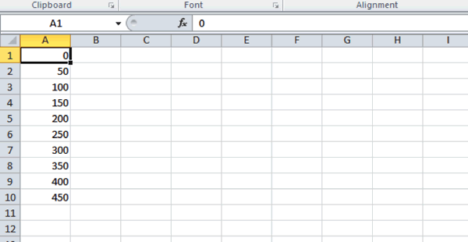
15.
Type the first number in the series, '0', then drag the fill handle down and select 'Series' from the Autofill Options.
Launch the Fill Options dialogue box in the Editing group. Check the options for 'column' and 'linear'. For step value insert '50' and for stop value insert '450' and press OK.
It is not possible to use Autofill to copy down lists of non-sequential numbers.
Type '0' in the first cell and '50' in the second. Select both cells and then use the Fill handle to drag down to the '450' value.
How can you use Autofill to QUICKLY recreate the list pictured in the example above?

Slide 17
16.
To change the font of your entire spreadsheet, to make it bold, italic or underline it, you must first:
Select the font you wish to use.
Go to the Insert tab on the Ribbon and select: "Insert Font Options".
Select all the cells to which you wish to apply the formatting changes.
Click the bold, underline or italic buttons in the home tab.

Slide 18
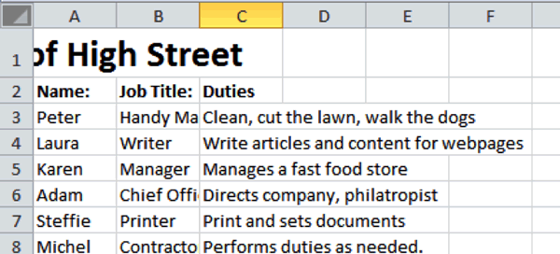
17.
Study the example of a spreadsheet in the image above. Which steps do I need to take to ensure the title that is cut off in row 1 appears centered across column A, B and C?
Resize the cells until the title fits across these columns.
Double click the column divider line in column C to adjust it.
Select the cell containing the title text (A1). Click Merge & Centre.
Select the three cells (A1:C1). Click Merge & Centre.

Slide 19
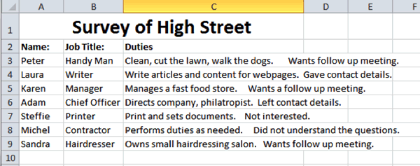
18.
Study the example above. What action would you take to display the second sentence in each cell in column C on a second line?
Select column C and click the Wrap Text button in the Alignment group.
Position the cursor before each second sentence and press: Alt + Enter on your keyboard.
Select column C and click the Wrap Text button in the Alignment group. Position your cursor before each of the second sentences and press: Enter.
None of the above options are correct.

Slide 20
19.
Where will you find options to change the font type, size and color?
On the Home tab in the Text group.
On the Review tab in the Font group.
On the Page Layout group in the Font dialogue box.
On the Home tab in the Font group.

Slide 21
20.
Which of the following two options allow you to copy formatting from one cell to another?
The format painter and the Fill handle.
The copy and paste function and the format painter.
The font group functions and the Wrap Text button.
The format painter and the Copy Formatting button.

Slide 22
21.
What does the cell reference: A10:A13 mean?
It refers to a range of cells located in column A rows 10 to 13 (inclusive).
It refers to two cells located in column A, namely A10 and A13.
It refers to a range of cells located in row A, columns 10 to 13 (inclusive).
It refers to a range of cells located in column A rows 1 to 10 and 10 to 13 (inclusive).

Slide 23
22.
Which of the following option(s) represent the correct formula to multiply two values located in cells A1 and A2 with each other?
Entering the formula: =A1xA2
Entering the formula: =MULTIPLY(A1:A2)
Entering the formula: =A1*A2
All of the above options are correct.

Slide 24
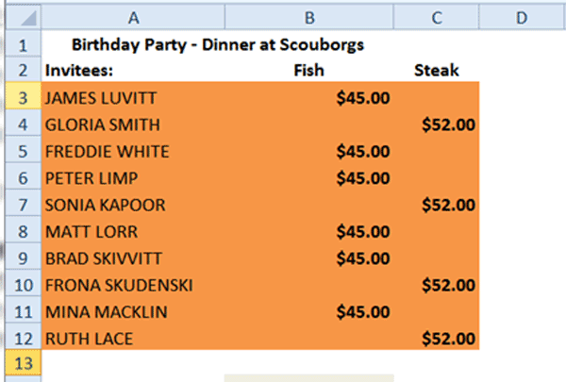
23.
Study the orange highlighted cells in the screenshot above. Which of the following options best represent the cell reference(s) which includes all of the highlighted cells?
The reference: A3:A12
The reference: A3:C12
The reference: A3:A12, B3:B12, C3:C12
The reference: A3:C3

Slide 25
24.
In order to use the Format Painter to replicate formatting over multiple non-adjacent cells, what additional step(s) do I need to take?
Hold down the control button on your keyboard whilst using the Format Painter.
Double click the Format Painter button when copying formatting.
Hold down the left mouse button whilst using the Format Painter.
Hold down the control button on your keyboard and click the Format Painter button when copying formatting.

Slide 26
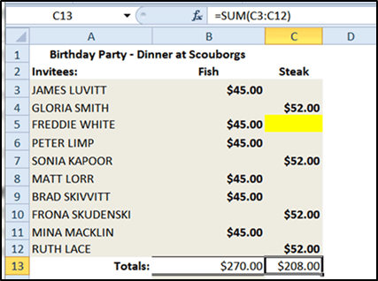
25.
Study the screenshot on the left. What will happen to the formula and/or the result (total) in cell C13 if a value is entered into the highlighted cell (C5)?
The total in C13 will automatically update to include the amount entered.
Nothing will happen. The formula will have to be reinserted to include the new value.
The formula will return an error message as the numbers that were included in the original formula are not the same any longer.
Cell C13 will display the formula instead of the total amount.

Slide 27
26.
Is it possible to use Excel as you would a calculator? For example, what happens if you enter: =1+10 in a cell?
The formula above is incorrect. It will not return any value.
The formula above is incorrect and will return the values of numbers in cells A1 and A10.
The formula above is correct and will return the SUM value of cells in A1 to A10.
The cell will return the value of 1 plus 10 (i.e. 11) as if you entered it into a calculator.

Slide 28
27.
Which of the following is NOT a necessary action when moving the contents of a cell to a different location using the Drag and Drop function?
Hover the mouse over the border of selected cell(s).
Select the cells you wish to move the selected contents to.
Click and hold down the left mouse button whilst dragging the cell(s) to their new position.
Select the cell(s) which contain the values you wish to move.

Slide 29
28.
Which of the formulas below contain the correct syntax (formula arguments) for the VLOOKUP function?
=VLOOKUP(lookup_value, table_array, col_index_num, range_index)
=VLOOKUP(table_array, lookup_value, col_index_num, range_lookup)
=VLOOKUP(lookup_value, table_array, col_index_num, value)
=VLOOKUP(lookup_value, table_array, col_index_num, range_lookup)

