Slide 1
CHAPTER 10
SCHEDULING

Slide 2
Objective: Selecting Thread to Run
Scheduler selects a thread to run
A Single Running Thread
Multiple Waiting Threads
Context Switch
Processor relinquished

Slide 3
Thread States: Initial View
Waiting
Running
Threads waiting for scheduler to give it a turn.
Inactive
Threads unknown to scheduler.

Slide 4
Time-Sliced Scheduling
Each thread runs for a fixed amount of time.
Threads are run in a round-robin sequence.
Appropriate for regular multi-programming environments.
Poor response time performance.
Need better strategy for real-time systems.

Slide 5
Pending Threads
Threads must often wait for an event to occur or some shared resource to become available.
Simply moving the task back to the ready state isn't appropriate because it may run again later only to discover that it must continue to wait, thus adding unnecessary task switching overhead.

Slide 6
Thread States: Revised View
Pending
Wait for Resource or Event
Pending
Pending
Running
Highest Priority
Resource Available or Event Occurs
Terminate Thread
Lower Priority
Ready
Inactive
Ready
Inactive
Ready
Inactive
Activate

Slide 7
Non-Preemptive Context Switch
State of Thread A
Interrupted
Running
Ready
Running
ISR
Return
Yield
ISR
Post
State of Thread B
Pending
Ready
Running

Slide 8
Non-Preemptive Thread States
Pending
Running
Yielding
Interrupted
Ready
Inactive

Slide 9
Preemptive Context Switch
State of Thread A
Running
Ready
Interrupted
ISR
Post
ISR
Return
State of Thread B
Pending
Ready
Running

Slide 10
Preemptive Thread States
Pending
Running
Interrupted
Ready
Inactive

Slide 11
Priority-Based Scheduling
Each thread is assigned a priority number.
Static priorities never change.
Dynamic priorities can vary during execution.
  Required to avoid Priority Inversion Problem.

Slide 12
Priority Inversion
Low-Priority
Thread
High-Priority
Thread
Resource Owned by
Priority Inversion
High-Priority Thread
Running
Pending
Running
Resource Request Blocked
Resource Released
Low-Priority Thread
Ready
Running
Ready

Slide 13
Priority Inversion
Bounded Priority Inversion
  Duration is no longer than that of the critical section where the lower-priority thread owns the resource.
Unbounded Priority Inversion
  Occurs when a third (medium-priority) thread preempts the low-priority thread during the inversion for an indefinite amount of time.

Slide 14
Mars Pathfinder Suffered Unbounded Priority Inversion
Low-priority meteorological thread
  Acquired the (shared) bus.
Medium-priority, long-running, communications thread
  Woke up and preempted the meteorological thread.
High-priority bus management thread
  Woke up and was blocked because it couldn't acquire the bus; when it couldn't meet its deadline it reinitialized the computer via a hardware reset.

Slide 15
Limiting the Duration of an Unbounded Priority Inversion
Objective:
  To prevent low-priority thread from being preempted by medium-priority thread during the priority inversion.
Strategies:
  Priority Inheritance Protocol
  Priority Ceiling Protocol
Technique:
  Manipulate thread priorities at run-time.

Slide 16
Priority Inheritance Protocol
When a high-priority thread attempts to lock a mutex already locked by a lower-priority thread, the Priority Inheritance Protocol (PIP) temporarily raises the priority of the low-priority thread to match that of the blocked thread until the low-priority thread unlocks the mutex.
Advantage: It is transparent to the application.
Disadvantage: Adds complexity to the kernel.

Slide 17
Priority Ceiling Protocol
Priority of the low-priority thread is raised immediately when it locks the mutex rather than waiting for a subsequent lock attempt by a higher-priority thread.
Advantage: Easy to implement.
Disadvantage: The priority ceiling value must be predetermined for use with the mutex; this value must be the highest among all the threads that attempt to lock the same mutex.

Slide 18
Assigning Priorities
Scheduling: Threads with higher priority are scheduled to run first.
Objective: Assign priorities in such a way that all outputs are computed before their deadlines.

Slide 19
Assignment Strategies
Deadline-Driven Assignment
  Assign highest priorities to threads with shortest deadlines.
Rate Monotonic Assignment
  Assign highest priorities to threads that run most frequently without regard to deadlines.

Slide 20
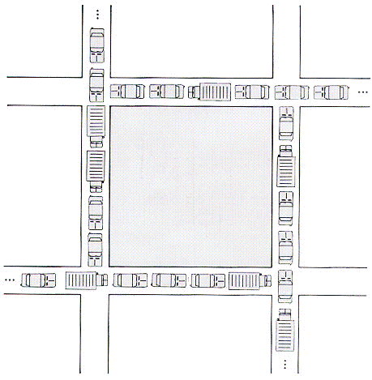
Deadlock

Slide 21
Deadlock
Definition: Two or more threads are blocked waiting on each other's resources.
Necessary Condition: Threads require exclusive access to two or more shared resources simultaneously.

Slide 22
Entering Deadlock
Thread T1:
Running
Ready
Running
Pending on R2
Resource R1:
Locked by T1
Resource R2:
Locked by T2
Thread T2:
Ready
Running
Pending on R1

Slide 23
Preventing Deadlock
Require all threads to acquire resources in the same order.
  Often locks resources longer than necessary.
  Occasionally there is no order that is convenient for all threads.
Require threads to release all resources and start over if any one resource can't be acquired.

