Slide 1
CHAPTER 1 INTRODUCTION

Slide 2
What is an Embedded System?
Electronic devices that incorporate a computer (usually a microprocessor) within their implementation.
A computer is used in such devices primarily as a means to simplify the system design and to provide flexibility.
Often the user of the device is not even aware that a computer is present.

Slide 3
Embedded Rules!
Embedded processors account for 100% of worldwide microprocessor production!
Embedded:desktop = 100:1
1999: #embedded processors in the home estimated at 40-50.

Slide 4

Design Goal: Reliability
Mission Critical
Life-Threatening
24/7/365
Can’t reboot!

Slide 5
Design Goal: Performance
Multitasking and Scheduling
Optimized I/O ➔ Assembly Language
Limits, Inaccuracies of Fixed Precision

Slide 6
Design Goal: Cost
Consumer Market: Minimize Manufacturing Cost.
Fast Time to Market Required
No chance for future modification.

Slide 7
What is a Real-Time System?
Real-time systems process events.
Events occurring on external inputs cause other events to occur as outputs.
Minimizing response time is usually a primary objective, or otherwise the entire system may fail to operate properly.

Slide 8
Hard/Soft Real-Time Systems
Soft Real-Time System
Compute output response as fast as possible, but no specific deadlines that must be met.
Hard Real-Time System
Output response must be computed by specified deadline or system fails.

Slide 9
Multi-Tasking and Concurrency
Most real-time systems are also embedded systems w/several inputs and outputs and multiple events occurring independently.
Separating tasks simplifies programming, but requires somehow switching back and forth among the different threads of computation (multi-tasking).
Concurrency is the appearance of simultaneous execution of multiple tasks.

Slide 10
Three Concurrent Tasks Within a Programmable Thermostat

Slide 11
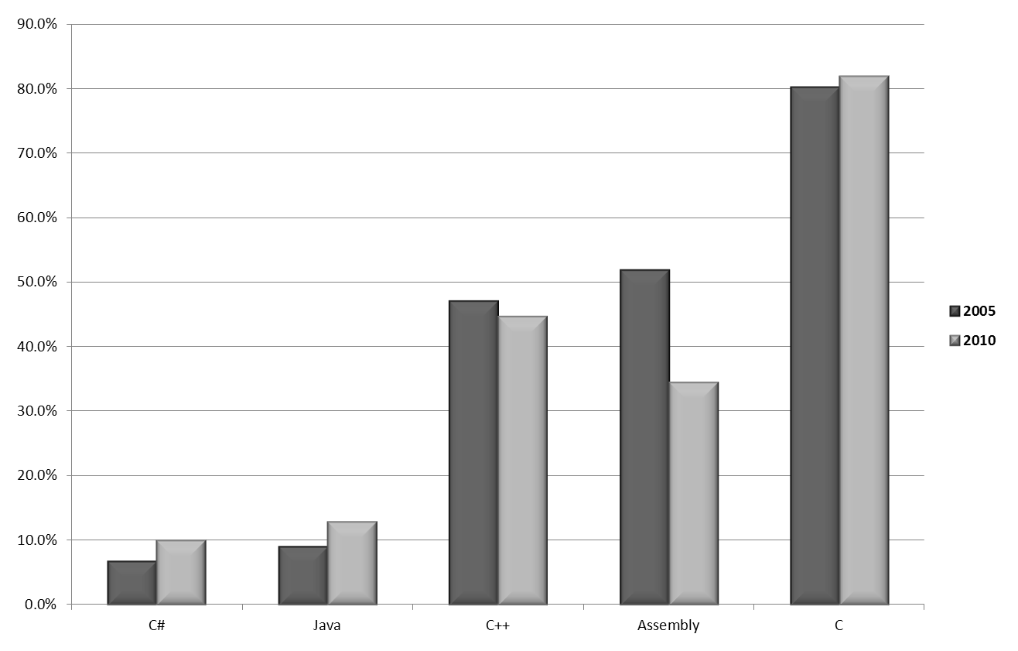
Programming Language Use in Embedded Designs

Slide 12
Desktop Application Development
Object Files
Compiler
Linker
Executable Image File
Loader
Read-Write
Memory (RAM)
Assembler
Run-Time Library:
Boot Process
Operating System Image:

Slide 13
Embedded Application Development
Object Files
Executable Image File
ROM Image File
Compiler
Linker
Locator
Flash EPROM Memory
Assembler
Re-Entrant Library:
Real-Time Kernel:

Slide 14
Use of Real-Time Kernels in New Embedded Designs.

Slide 15
Examples of Embedded Real-Time Software.
Property
FAX Machine
CD Player
Microprocessor:
16-bit
8-bit
Number of Threads:
6
9
Read-Write Memory (RAM):
2048 Bytes
512 Bytes
Total RAM Actually Used:
1346 Bytes (66%)
384 Bytes (75%)
Amount Used by Kernel:
250 Bytes (19%)
146 Bytes (38%)
Read-Only Memory (ROM):
32.0 KB
32.0 KB
Total ROM Actually Used:
28.8 KB (90%)
17.8 KB (56%)
Amount Used by Kernel:
2.5 KB (8.7%)
2.3 KB (13%)

Slide 16
Processor Use in Embedded Designs

Slide 17
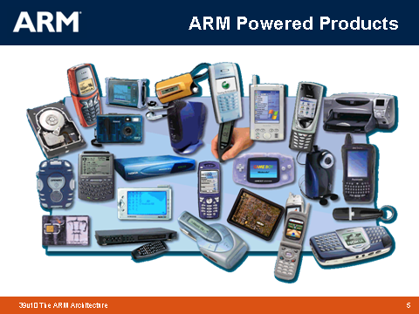

Slide 18
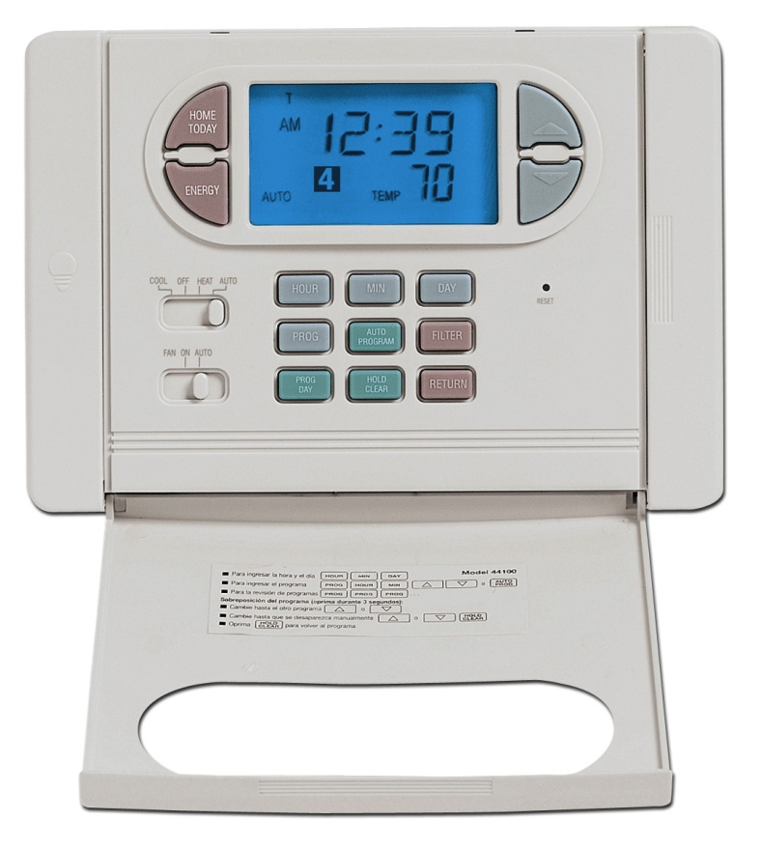
Product: Hunter Programmable Digital Thermostat.
Microprocessor: 4-bit

Slide 19
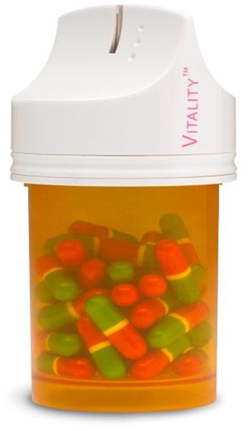
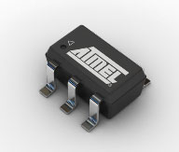
The tiny ATMEL 8-bit picoPower AVR processor in Vitality’s GlowCap™ helps people remember to take their medication on time. It can sense when the bottle is opened, transmit that information wirelessly to a Vitality server, flash its LED, and play a ring-tone.

Slide 20
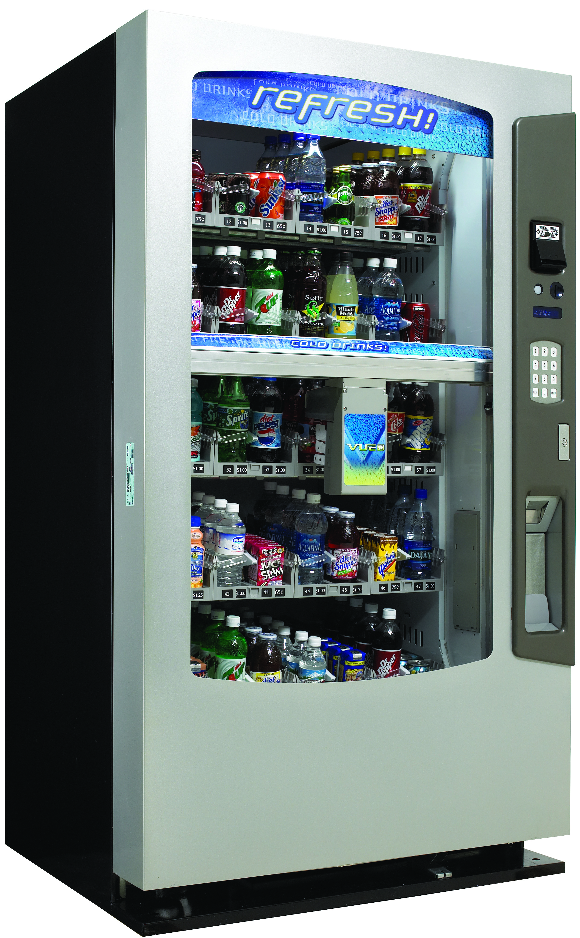
The Vendo Vue40 vending machine uses a 16-bit Hitachi H8/3007 processor.

Slide 21
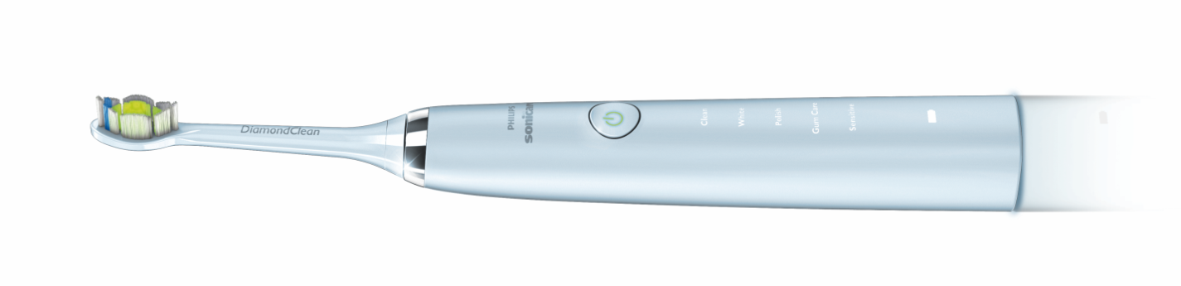
The Sonicare DiamondClean toothbrush uses an 8-bit PIC microprocessor.

Slide 22
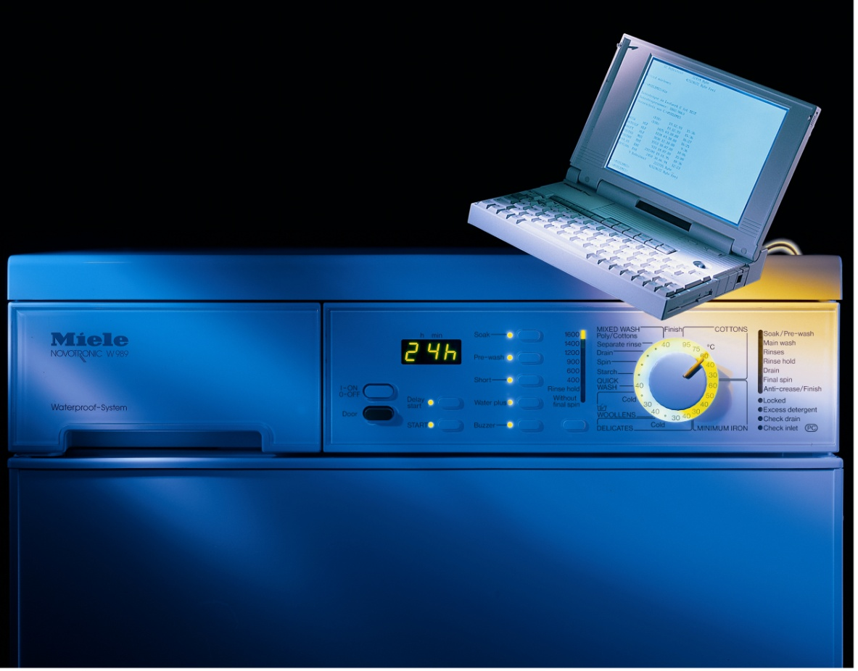
Product: Miele dishwashers. Microprocessor: 8-bit Motorola 68HC05.

Slide 23
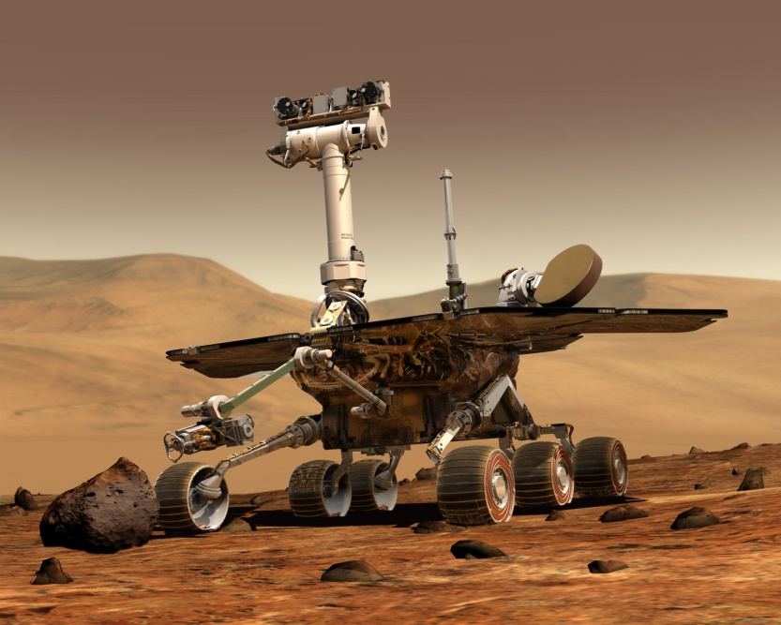
NASA’s 2003 Mars Exploration Rover used an BAE Systems RAD6000 32-bit RISC cpu and Wind River Systems’ VxWorks embedded real-time operating system

Slide 24
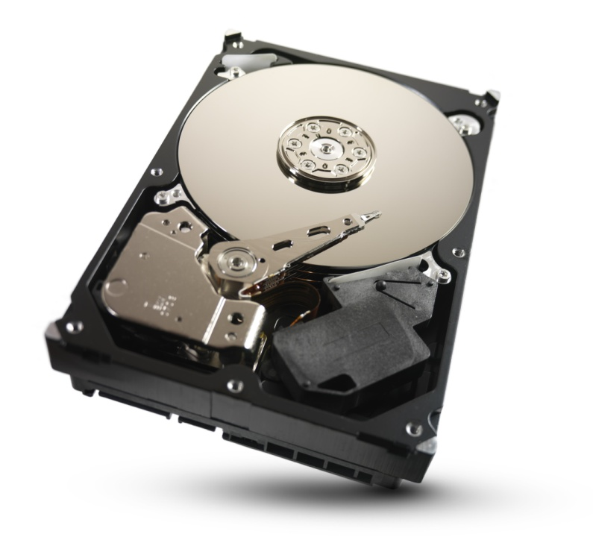
The Seagate Barracuda XT disk drive incorporates two ARM Cortex-R4 processors – one to control the servos, and another to handle the command and data flow.

Slide 25
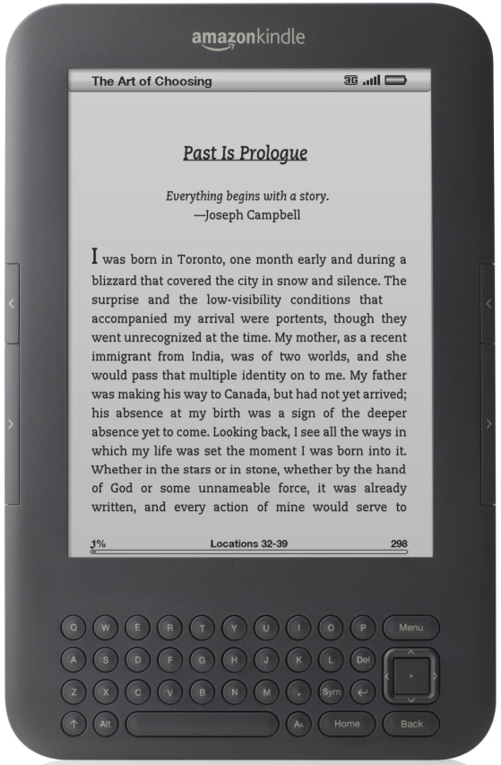
The Amazon Kindle 2 uses a 32-bit ARM processor.

Slide 26
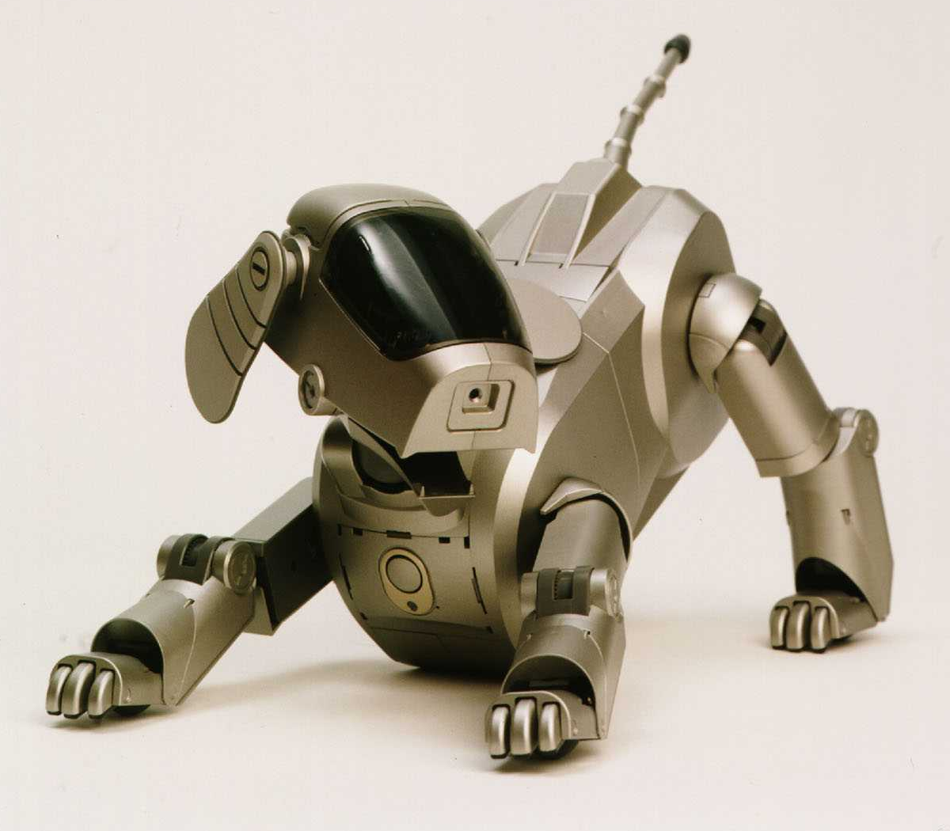
Product: Sony Aibo ERS-110 Robotic Dog. Microprocessor: 64-bit MIPS RISC.

Slide 27
