Slide 1
CHAPTER 5 Programming in Assembly Part 1: Computer Organization

Slide 2
Separate Memory & I/O Busses
Memory Data Transfers
CPU
(Arithmetic and Logic Unit, Control Logic, and Registers)
Memory
(Instructions and Data)
I/O
(Disk, keyboard, display, etc.)
DMA Controller
I/O Transfers

Slide 3
Memory-Mapped Peripherals
Memory and I/O Data Transfers
CPU
(Arithmetic and Logic Unit, Control Logic, and Registers)
Memory
(Instructions and Data)
I/O
(Disk, keyboard, display, etc.)
DMA Controller

Slide 4
Memory
Address Bus: N wires
Data Bus: 4x8 wires
2^{N} bytes
Organized into
groups of 4 bytes
Control Bus:
Read vs Write,
Initiate Cycle,
Data Ready
Content is 1’s and 0’s. Meaning determined by how data is used (context).

Slide 5
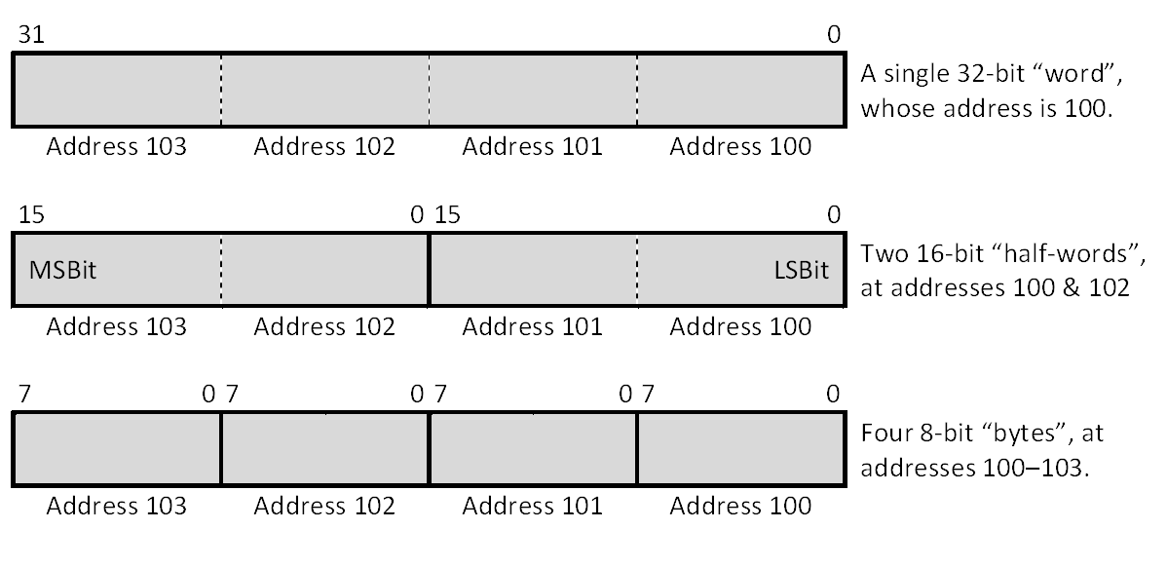
Memory (Little Endian Ordering)

Slide 6
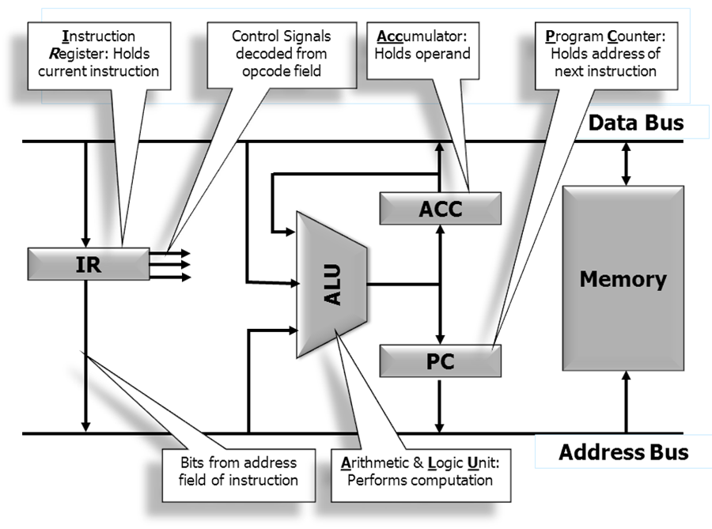
Single Accumulator Architecture

Slide 7
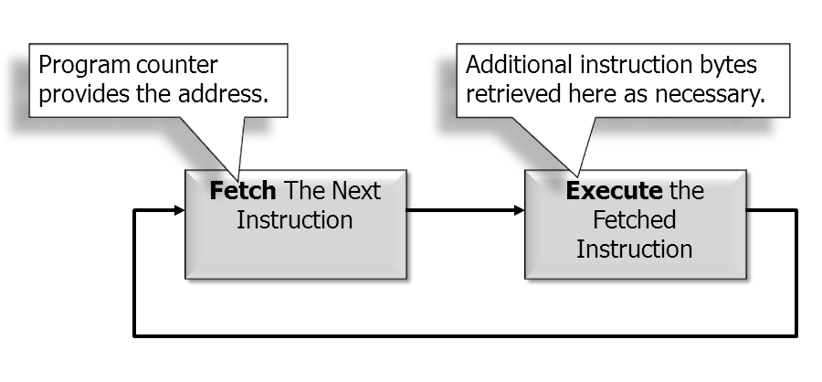
The Fetch-Execute Cycle

Slide 8
Instruction Fetch
Data Bus
ACC
Memory
IR
ALU
PC
Address Bus

Slide 9
The Fetch Phase
1. Memory_Address_Bus ← Program_Counter
2. Start Memory Read Operation
3. Increment Program_Counter
4. Wait for Memory Read to Complete
5. Instruction_Register ← Memory_Data_Bus
6. Go to execute phase.

Slide 10
Execution Phase: Load ACC
Data Bus
ACC
Memory
IR
ALU
PC
Address Bus

Slide 11
Execution Phase: ADD
Data Bus
ACC
Memory
IR
ALU
PC
Address Bus

Slide 12
Execution Phase: Store ACC
Data Bus
ACC
Memory
IR
ALU
PC
Address Bus

Slide 13
Execution Phase: Branch
Data Bus
ACC
Memory
IR
ALU
PC
Address Bus

Slide 14
result ← op1 + op2
Single Accumulator Machine:
ACC ← MEM[adrs_of_op1]
ACC ← ACC + MEM[adrs_of_op2]
MEM[adrs_of_result] ← ACC
Register Machine:
REG[r] ← MEM[adrs_of_op1]
REG[r] ← REG[r] + MEM[adrs_of_op2]
MEM[adrs_of_result] ← REG[r]

Slide 15
The ARM Processor Family

Slide 16
Three Instruction Sets
ARM Instruction Set
Instructions are 32 bits wide
Original RISC (lots of parallelism)
“Load/Store” Architecture
Thumb Instruction Set
Subset of ARM instructions, some restrictions
Instructions are 16 bits wide (more like CISC)
Intended for compilers
Less parallelism, longer instruction sequences
but total code size is 30% smaller
Jazelle Instruction Set
Java byte codes
16-bit Thumb Instruction
Hardware Decoder
32-bit ARM Instruction

Slide 17
Three Instruction Sets
 | ARM | Thumb* | Jazelle
Instruction Size | 32 bits | 16 bits | 8 bits
Core instructions | 58 | 30 | > 60% of Java byte codes in hardware; rest in software
Conditional Execution | most | Only branch instructions or in an IT block | N/A
Data processing instructions | Access to barrel shifter and ALU | Separate barrel shifter and ALU instructions | N/A
Program status register | Read/write in privileged mode | No direct access | N/A
Register usage | 15 general purpose registers + pc | 8 general purpose registers + 7 high registers + pc | N/A
* LM3S811 (a Cortex M3 variation) uses the Thumb2 set

Slide 18
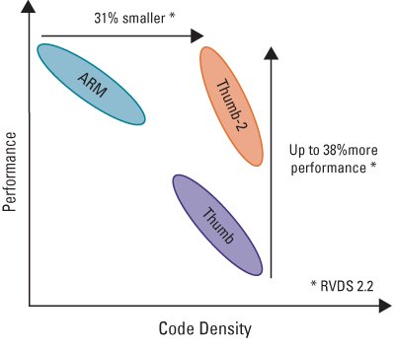
Code Density vs. Performance

Slide 19
The ARMv7-M “Cortex-M3” Architecture used in LM3S811

Slide 20
ARM Cortex-M3 CPU
Data Bus
Sign Extender
R15 (pc)
Registers
R0 – R15
Rd
Rn
Rm
Barrel Shifter
MAC
ALU
Result Bus
Address Register
Incrementer
Address Bus

Slide 21
ARM Registers
R0
R1
R2
R3
R4
R5
R6
R7
R8
R9
R10
R11
R12
R13: Stack Pointer (SP)
R14: Link Register (LR)
R15: Program Counter (PC)
Thumb Mode:
8 general purpose registers
ARM Mode:
15 general purpose registers
7 “high” registers
r8-R12 only accessible with MOV, ADD, or CMP

Slide 22
Status Registers (xPSR)
31 | 30 | 29 | 28 | 27 | 26 | 25 | 24 | 23 |  | 16 | 15 |  | 10 | 9 | 8 |  | 0
N | C | Z | V | Q
 |  |  |  |  |  |  |  |  |  |  |  |  |  |  | 0 or exception #
 |  |  |  |  | ICI/IT |  | T |  |  |  | ICI/IT
APSR
IPSR
EPSR
Bits | Name | Description
31 | N | Negative (bit 31 of result is 1)
30 | C | Unsigned Carry
29 | Z | Zero or Equal
28 | V | Signed Overflow
Most important for application programming

Slide 23
Pipelined Instruction Processing
Fetch
16-bit Instruction fetched from memory
PC
Decode
Decompress thumb instruction, Decode ARM instruction Select registers
PC - 2
Execute
Read register(s) from Register Bank,
Shift and ALU operation,
Write register(s) back to Register Bank
PC - 4

Slide 24
Pipelined Instruction Processing
1st Instruction (Adrs: PC)
Fetch
Decode
Execute
2nd Instruction (Adrs: PC+2)
Fetch
Decode
Execute
3rd Instruction (Adrs: PC+4)
Fetch
Decode
Execute
Time

Slide 25
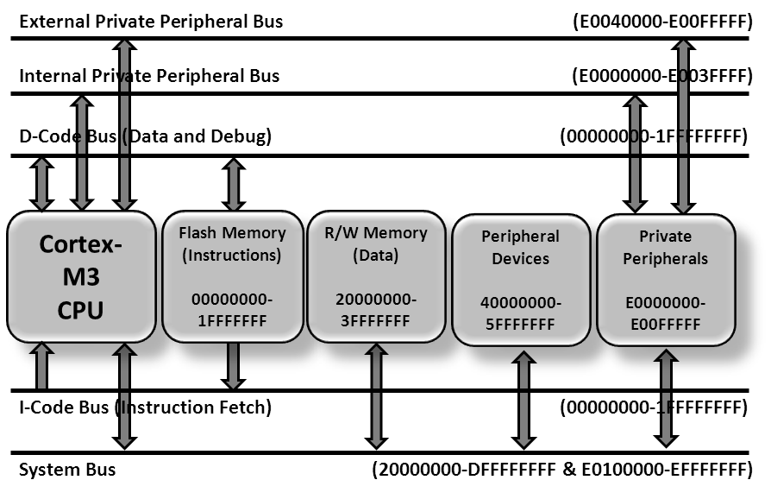
ARM Cortex-M3 Bus Structure

Slide 26
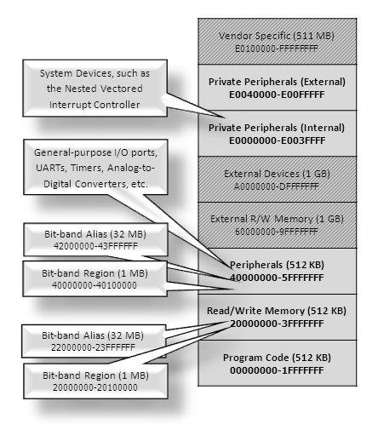
ARM Cortex-M3 Memory

Slide 27
Bit-Banding
1 word (4 bytes) of address space in the bit-band area = 1 bit in the corresponding primary area.
bit-band alias = bit-band base + 128 × word offset + 4 × bit number
For example, if bit 3 at address 20001000₁₆ is to be modified, the bit-band alias is calculated as: 22000000₁₆ + 128₁₀ × 1000₁₆ + 4₁₀ × 3₁₀ = 2208000C₁₆
Address 2208000C allows direct access to only bit 3 of the byte at address 20001000:
Read from 2208000C: All other bits will be 0’s
Write to 2208000C: All other data bits are ignored; hardware performs a read-modify-write.

Slide 28
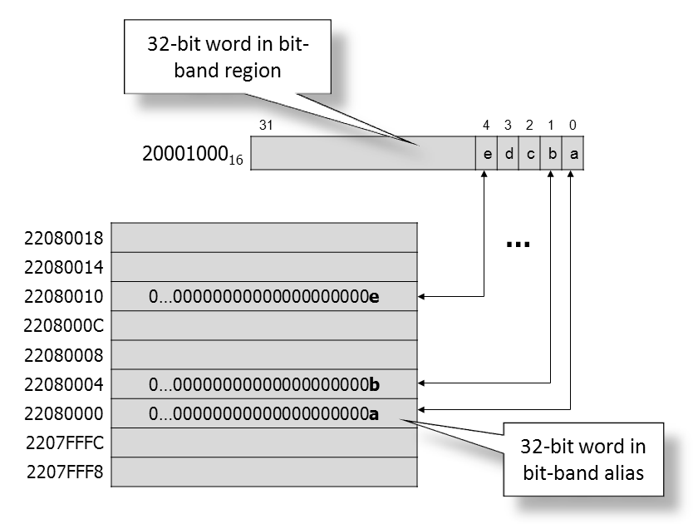
ARM Cortex-M3 Bit-Banding

Slide 29
Assembler Syntax
Label
Opcode
Operands
Comment
L1: ADD R0,R1,#5 ; Replace R0 by sum of R1 and 5

Slide 30
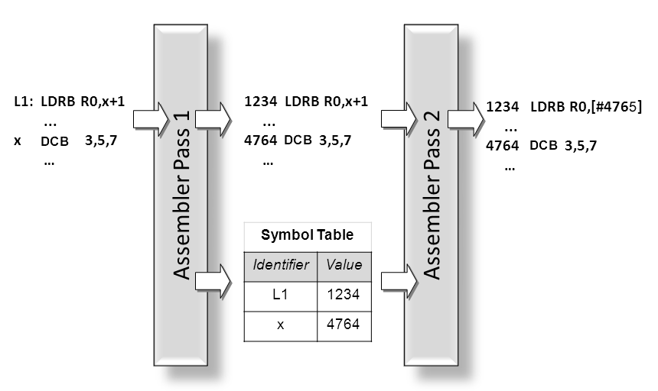
Two-Pass Assembler

