Slide 1
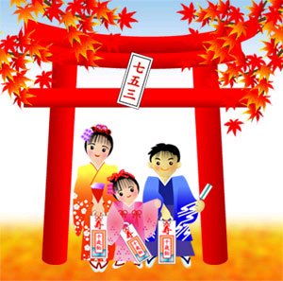
七・五・三
7 – 5 – 3 Festival

Slide 2
七・五・三
A traditional rite of passage and festival for 3 and 7 year old girls and 3 and 5 year-old boys.
It is held annually on November 15 to celebrate the growth and well-being of young children.
It is not a national holiday, so it is generally observed on the nearest weekend.
The ages 3, 5 & 7 are consistent with East Asian numerology, which says that odd numbers are lucky.

Slide 3
七・五・三
Parents celebrate Shichi-go-san as their boys turn 3 and 5 years of age, and as their girls turn 3 and 7. The ages of 3, 5 and 7 are considered critical in a child’s life.
However, some families observe the traditional way of calculating age, (kazoedoshi) - in which children are one year old at birth and gain a year on each lunar new year.
The children will visit Shinto shrines with their families to take part in a Shinto purification ceremony to pray for a long and happy life and to mark their passage into middle childhood.

Slide 4
七・五・三
The boys and girls make their first debut at the local shrine wearing traditional Japanese clothes.
The age of 3 marks the first time that both boys and girls are allowed to let their hair grow.
During the samurai era, it was customary for children to have their heads shaved at birth. It was kept short until the age of three. The Shichi-go-san festival marked the time when children could start growing their hair, referred to as “kamioki” (literally ‘putting on hair’). Although this custom is no longer observed, families still celebrate the day which marked this custom.

Slide 5
七・五・三
3-year-old girls usually wear hifu (a type of padded vest) with their special ceremonial kimono and the boys will wear haori jackets when making their Shichi-go-san visit
At age 5, a young boy celebrates wearing his first hakama pants in public, and at 7, a young girl celebrates wearing her first obi.
Today, you may also see Western-style formal wear (suits & dresses) worn by some children.
Photography has also become an important part of the Shichi-go-san festival

Slide 6
Chitose Ame (千歳飴)
Children receive gifts including chitose-ame
Chitose-ame = “one thousand year candy”.
The candy is long & thin, and shaped like a stick. It is made of rice, barley and water – these symbolise healthy growth & longevity.
It is red/pink and white in colour – these are considered lucky colours in Japan.

Slide 7
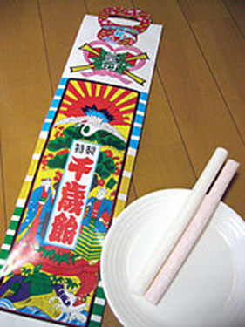
Chitose Ame (千歳飴)
They are placed in a bag decorated with turtles and cranes which, with their long life spans, are Japanese symbols of a long life.
The candy and the bag are both expressions of parents' wish that their children lead long and prosperous lives.

Slide 8
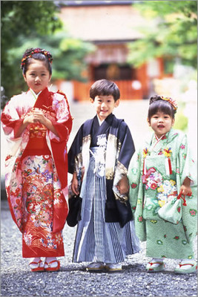

Slide 9
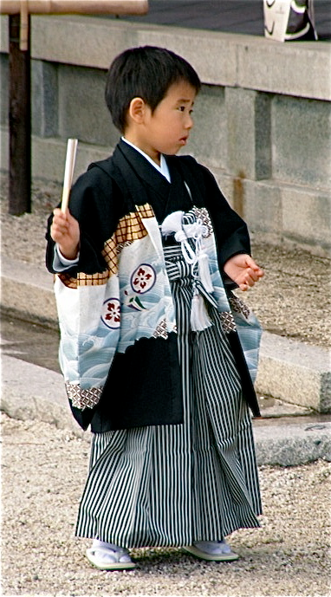
Haori jackets
Hakama pants

Slide 10
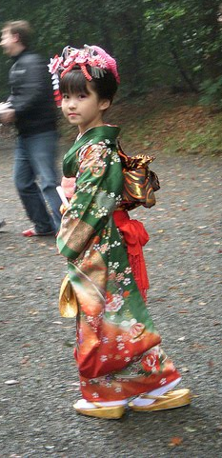
Kimono
Obi
Tabi
Geta

Slide 11
