Slide 1
Lesson 10.1
Jefferson Takes Office

Slide 2
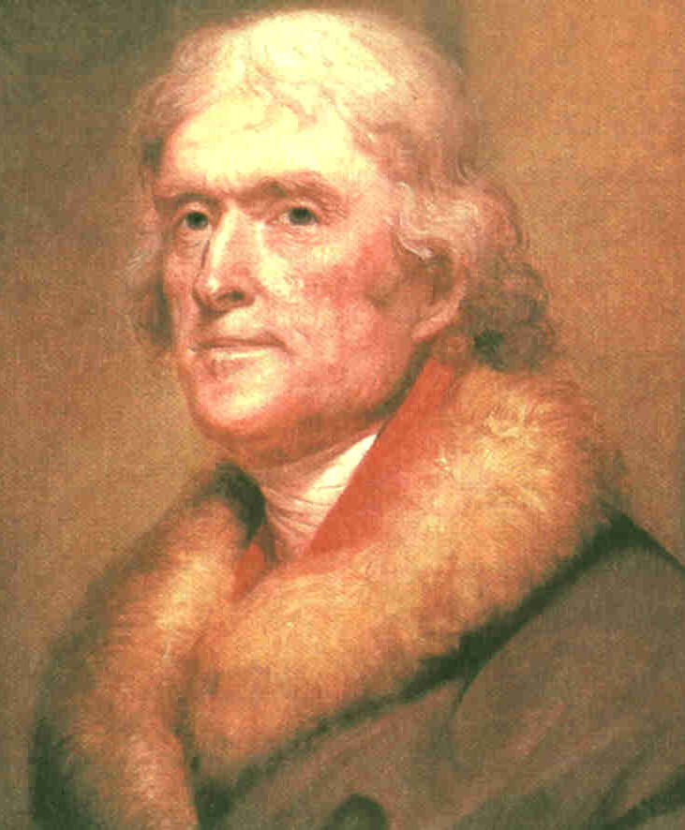
Essential Question
Today we will analyze Jefferson’s election and discuss the importance of Marbury v. Madison.

Slide 3
VOCABULARY
radical:
a person who holds extreme political views
judicial review:
the power of a court to review the constitutionality of laws and governmental actions
illegal or unlawful; not according to the constitution.
unconstitutional:

Slide 4
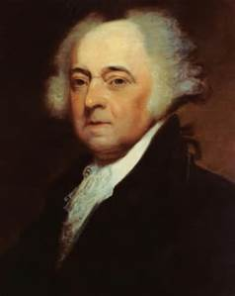
What We Already Know
At the beginning of the nation’s history, the man receiving the second highest number of votes became vice president. John Adams was George Washington’s Vice President.

Slide 5
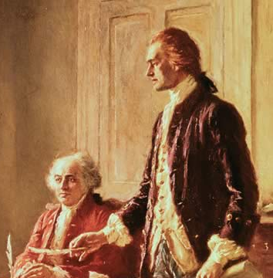
What We Already Know
John Adams became President after Washington in 1796, with his close personal friend (but political enemy) Thomas Jefferson serving as his vice president.

Slide 6
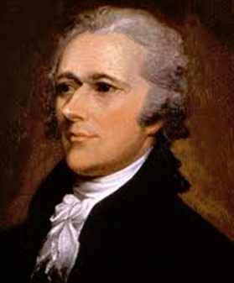
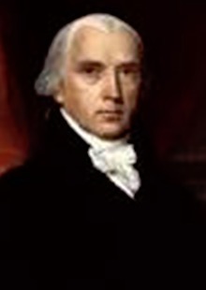
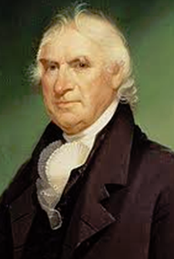
What We Already Know
John Adams’ unwillingness to go to war with France had made him unpopular with his own Federalist supporters like, Alexander Hamilton,
James Madison and George Clinton.

Slide 7
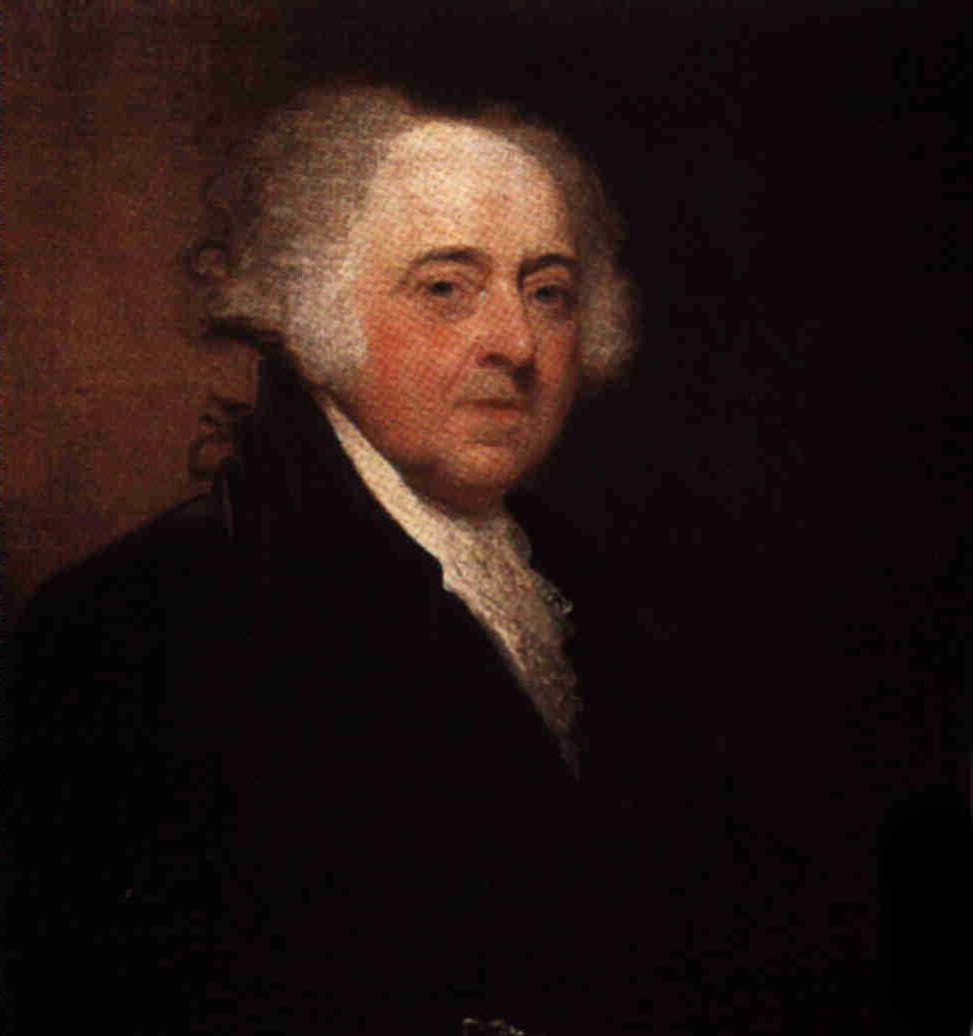
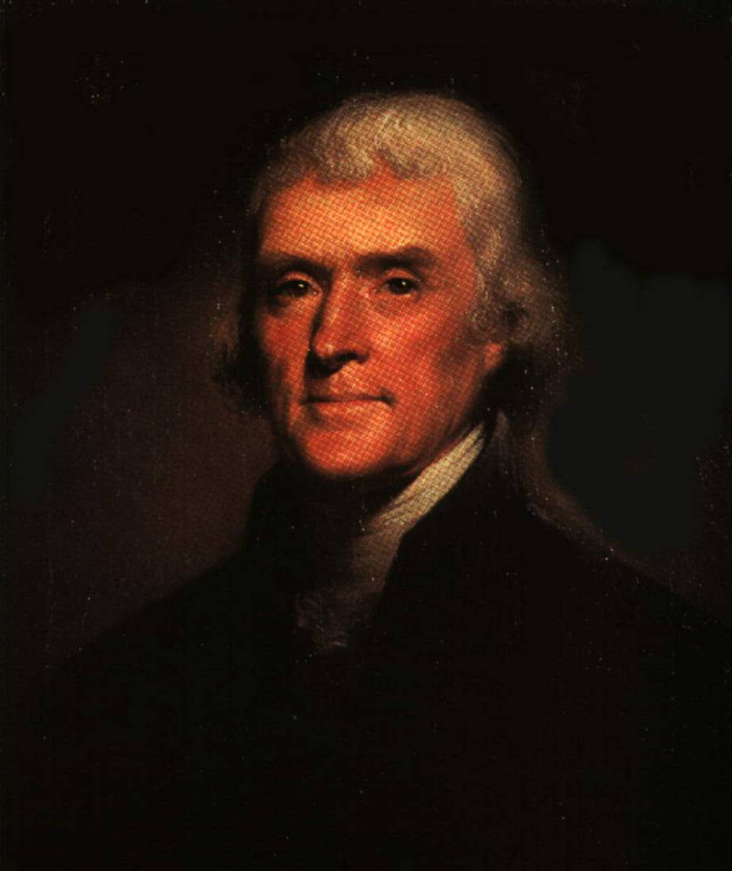
The Election of 1800
In the election of 1800, President John Adams of the Federalists faced the Democratic-Republicans, represented by Thomas Jefferson.

Slide 8
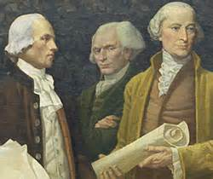
What We Already Know
The Alien and Sedition Acts, and the decline in Adam’s popularity within his own party swung the election to the Democratic – Republicans.

Slide 9
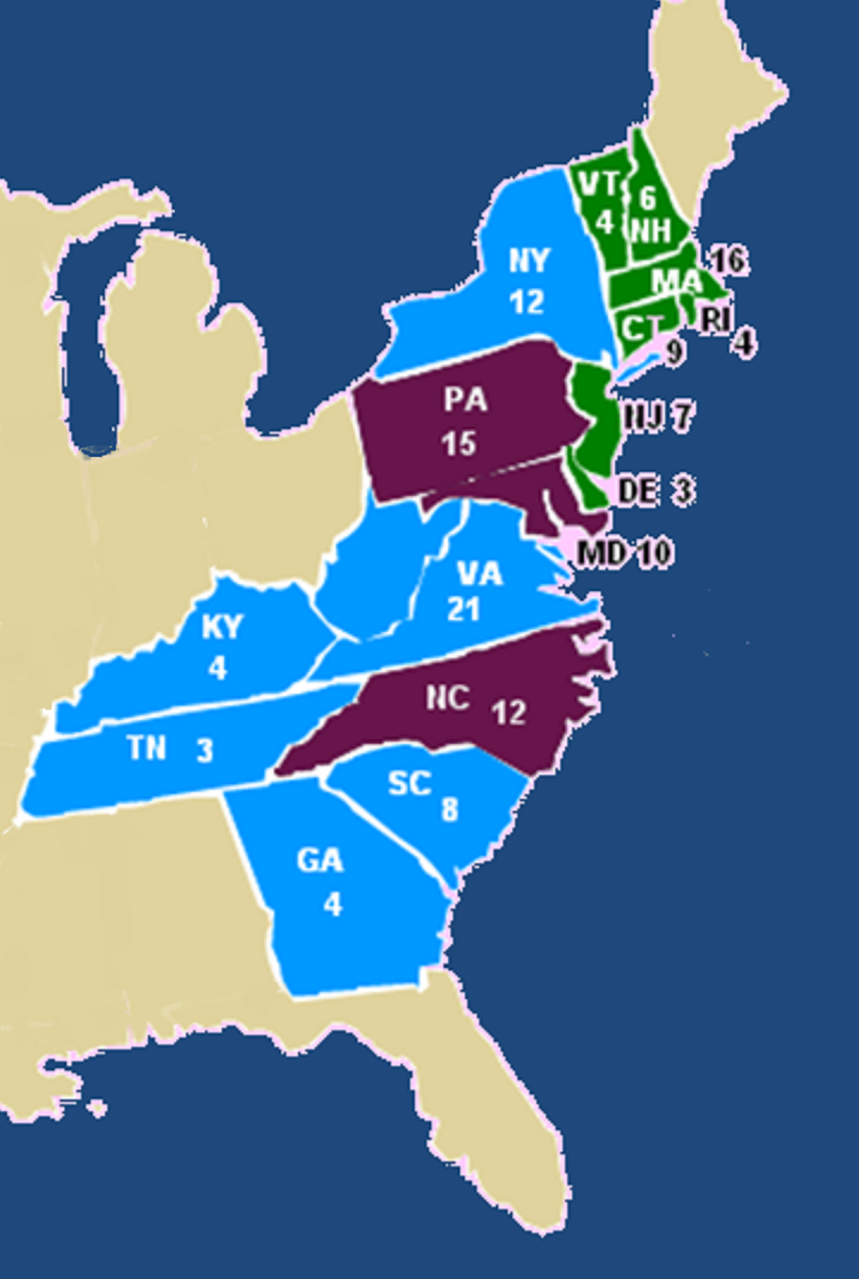
Election of 1800
When election day came, Jefferson received 73 votes in the electoral college, and Adams earned 65. But Aaron Burr, whom the Democratic-Republicans wanted as vice president, also received 73 votes.

Slide 10
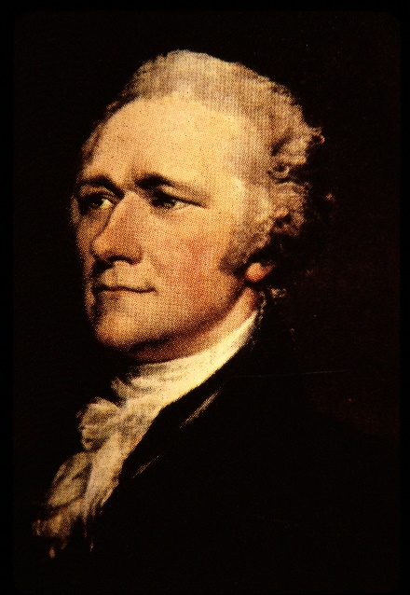
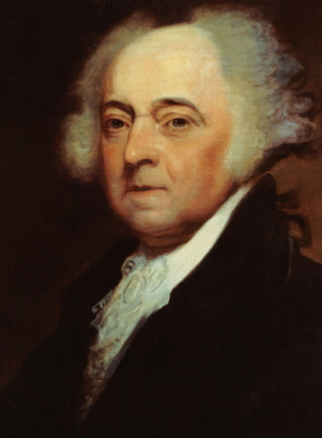
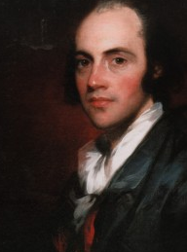
The Election OF 1800
Thomas Jefferson
73
Democratic-Republican Party
John
Adams
65
Federalist
Party
Aaron
Burr
73
Democratic-Republican Party

Slide 11
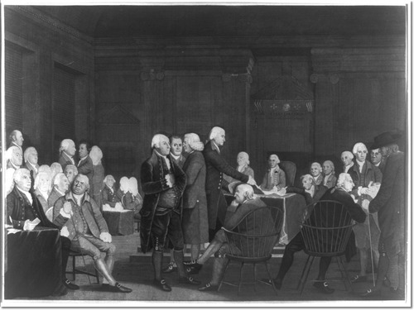
Election of 1800
According to the Constitution, the House of Representatives would have to choose between Burr and Jefferson. Federalists
still held a majority in the House of Representatives, and their votes would decide the winner.

Slide 12
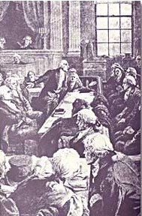
Election of 1800
The Federalists in Congress wanted Aaron Burr because they were afraid of Jefferson.
Hamilton considered Burr an unreliable man and urged the election of Jefferson.

Slide 13
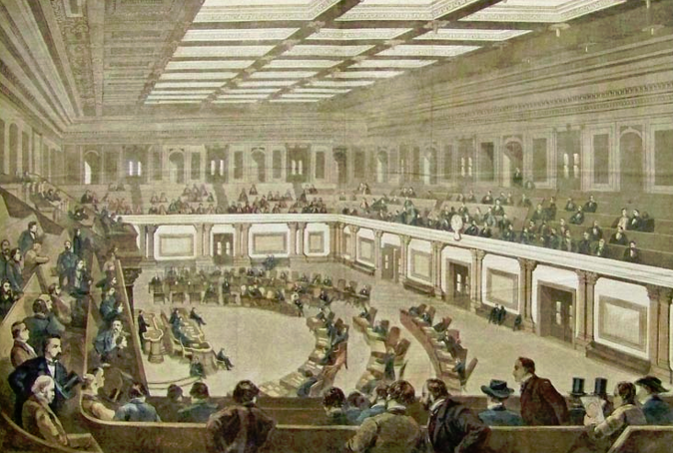
Breaking the Tie
Over a period of seven days, the House voted 35 times without determining a
winner. But on the thirty-sixth ballot, Jefferson was elected president

Slide 14
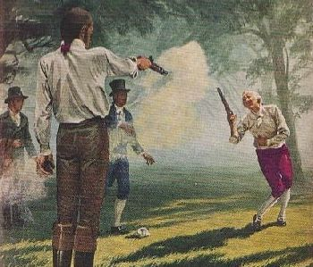
Breaking the Tie
Aaron Burr, who became vice president, would never forget Hamilton’s insults against him in Congress. He would later kill Alexander Hamilton in a famous pistol duel.

Slide 15
Get your sticks ready.

Slide 16
Who was Aaron Burr?
A. the person the Democratic-Republicans hoped would be Jefferson’s Vice President.
B. the individual many Federalists preferred to be President over a much stronger Jefferson.
C. the Presidential candidate for the Federalist Party.
D. Vice President under John Adams.
(Choose all that are correct.)

Slide 17
In the election of 1800 how was the tie between Jefferson and Burr decided?
A. through a decision by the Supreme Court.
B. by a run off election.
C. by a vote in the House of Representatives
D. by a duel with pistols.

Slide 18

A and B Discuss
The person with the most votes becomes President and the person with the second highest vote count becomes Vice President. What do you think was good about this arrangement and what may have been bad?

Slide 19
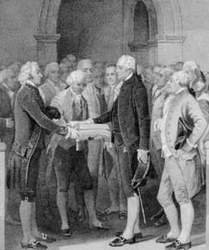
Jefferson’s Philosophy
In his inaugural address, Jefferson tried to ease the nation’s political quarrels.
“Let us, … unite with one heart and one
mind. . . . Every difference of opinion is not a difference of principle. . . . We are all Republicans, we are all Federalists.”

Slide 20
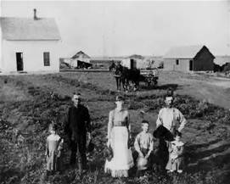
Jefferson’s Philosophy
Jefferson wanted the United States to remain a nation of small independent farmers, who would uphold the strong
morals and democratic associated with country living.

Slide 21
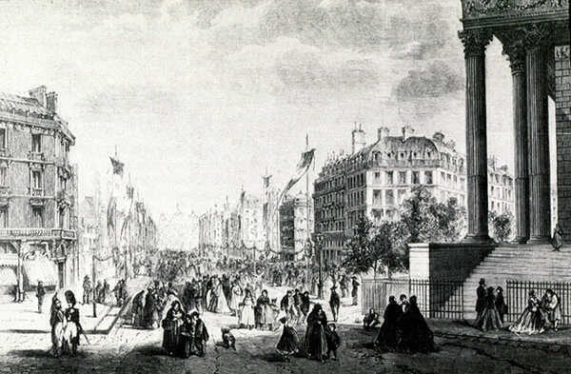
Jefferson’s Philosophy
He hoped that the enormous amount of available land would prevent Americans
from crowding
into cities, as
people had in
Europe.

Slide 22
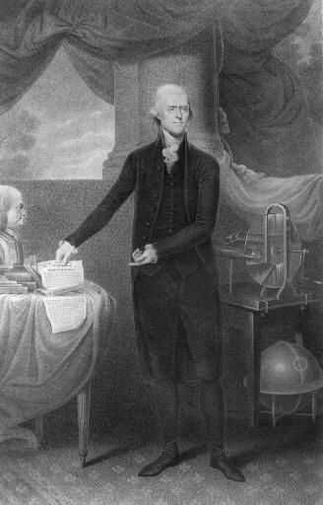
Jefferson’s Philosophy
As president, Jefferson behaved more like a gentleman farmer than a privileged politician.

Slide 23
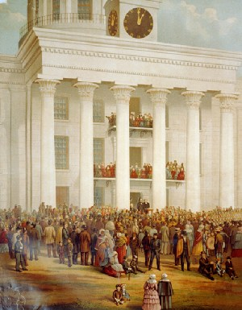
Jefferson’s Philosophy
Instead of riding in a fancy carriage to his inauguration, Jefferson walked the two blocks from his boarding house to the Capitol.

Slide 24
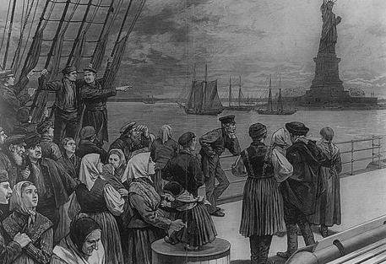
Jefferson’s Philosophy
Being against a large Federal government, Jefferson ended many Federal programs.
He directed Congress to allow the Alien and Sedition Acts to end.
Congress also ended many taxes, including the unpopular whiskey tax.

Slide 25
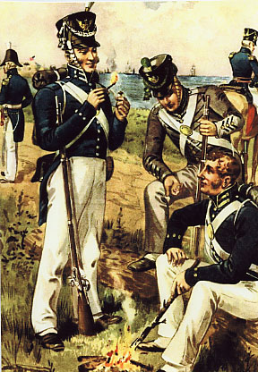
Jefferson’s Philosophy
With less revenue from taxes, Jefferson reduced the number of federal employees to cut costs, and he also cut the size of the military.

Slide 26

Jefferson’s Philosophy
Hamilton believed that people who were owed money would take a greater interest in how the government was run.
But Jefferson opposed public debt and used revenues from tariffs and land sales to reduce the amount of money owed by the government.

Slide 27
A and B Discuss
Jefferson’s over turned many of the programs put in place by Adams and the Federalists. What changes do you agree with and which would you not agree with?
Be prepared to share your answers
and reasons with the class.

Slide 28
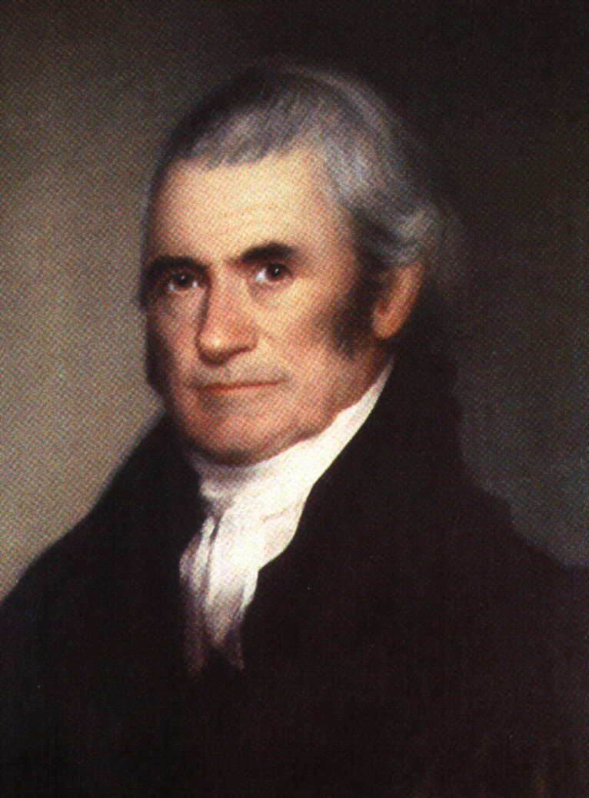
Marshall and the Judiciary
President Adams also appointed John Marshall as the Chief Justice of the Supreme Court.

Slide 29
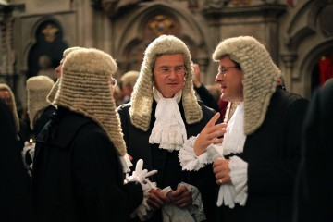
Marshall and the Judiciary
Before leaving office, President Adams had appointed as many Federalist judges as he could before Jefferson’s inauguration in 1801. These ‘midnight judges’ would create a court that would rule favorably in the
Federalist point of view and slow the power of Jefferson and the Democratic Republicans

Slide 30
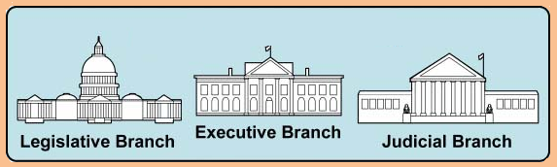
What We Already Know
Our government is divided into three branches to maintain a balance of power.
Makes the laws.
Enforces the laws.
Interprets the laws.

Slide 31
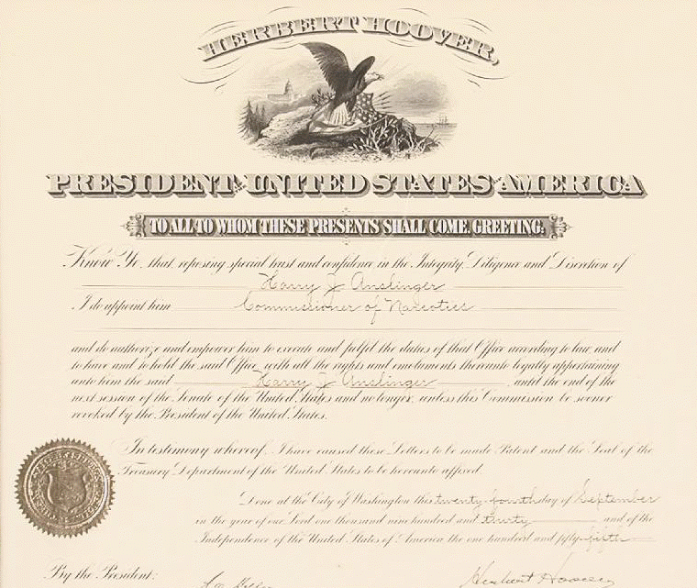
Marbury v. Madison
For the judges who were appointed at the last minute, their commissions were approved by the Senate, signed by the president, and affixed with the official
seal of the government. But the commissions (official papers) were never delivered.

Slide 32
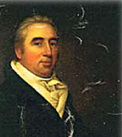
Marbury v. Madison
When Thomas Jefferson became President he ordered his Secretary of State, James Madison, not to deliver the commissions. William Marbury, one of the
State, James Madison, not to deliver the commissions. William Marbury, one of the affected judges, then asked the Supreme Court for a legal order to receive his commission.

Slide 33
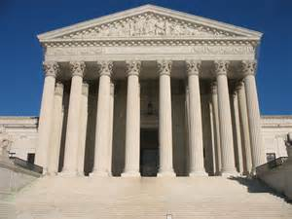
Marbury v. Madison
John Marshall ruled that the law under which Marbury sued was unconstitutional. This decision established the principle of
judicial review. By establishing judicial review, Marshall helped to create a lasting balance among the three branches of government.

Slide 34
Get your sticks ready.

Slide 35
How did Jefferson and Hamilton in opinion regarding the public debt ?
A. Jefferson believed people who were owed money would make sure the government was run properly.
B. Hamilton thought some public debt gave citizens an interest in good government.
C. Hamilton was opposed to public debt.
D. Jefferson was reluctant to sell public land to reduce the amount of money owed by the government.

Slide 36
Why was the significance of John Marshall’s decision in
Marbury v. Madison?
A. The power of judicial review made the Supreme Court and equal amongst the three branches od government.
B. It determined the outcome of the election of 1800.
C. It increased the number of federal judges, allowing President John Adams to fill most of the new posts with Federalists.
D. It gave Congress the constitutional authority to settle eminent domain questions.

Slide 37
How did the principle of judicial review change the Supreme Court?
A. It changed the process by which the new Supreme Court appointments are made.
B. It changed the process by which the Supreme Court hears appeals.
C. It established the Supreme Court's power to declare a law unconstitutional.
D. It confirmed the power the Supreme Court has to try impeachment cases.

Slide 38
A and B Discuss
The Person with the most votes becomes President and the person with the second highest vote count becomes Vice President. What was good about this arrangement and what was bad?

