Slide 1
Teacher Notes
None

Slide 2
Lesson 18.2b: Reconstruction and Daily Life

Slide 3
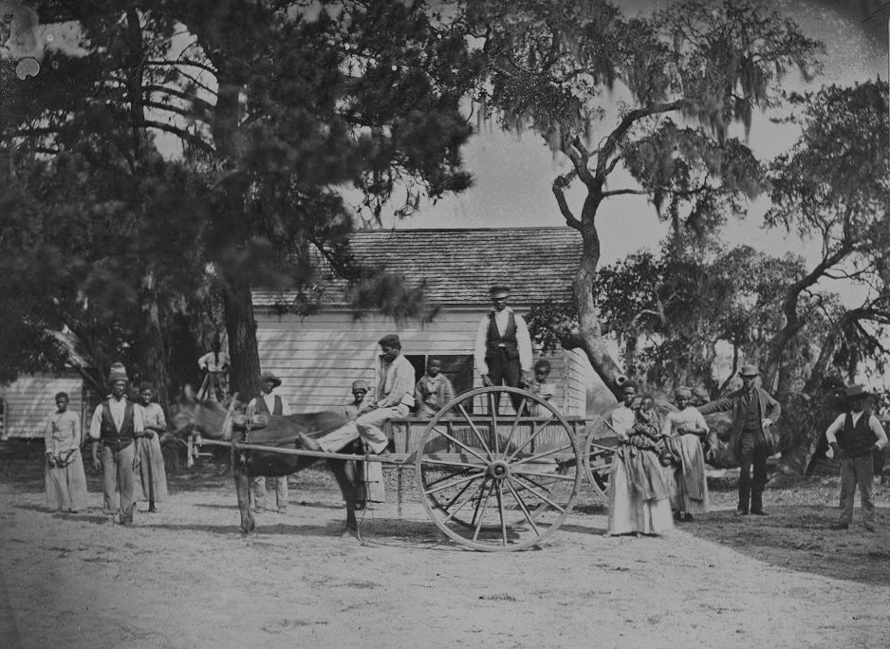
Essential Question
How did the
4 million slaves freed as a result of the Civil War make the transition from slave to free.

Slide 4
Vocabulary
tenant:
a person that uses another's house, or land, in exchange for rent.
sharecropper:
a tenant farmer who gives a portion of his or her crop to the owner of the land as rent.
accumulation:
an amount that collects or piles up.
contract:
a piece of paper or document that outlines the terms of an agreement.

Slide 5
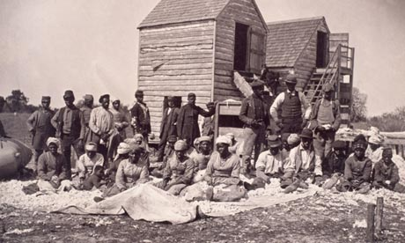
What we Already Know
With the adoption of the Thirteenth Amendment, slavery was abolished and approximately four million former slaves were free to make new lives for themselves.
Notes:
Mayflower Compact = self rule

Slide 6
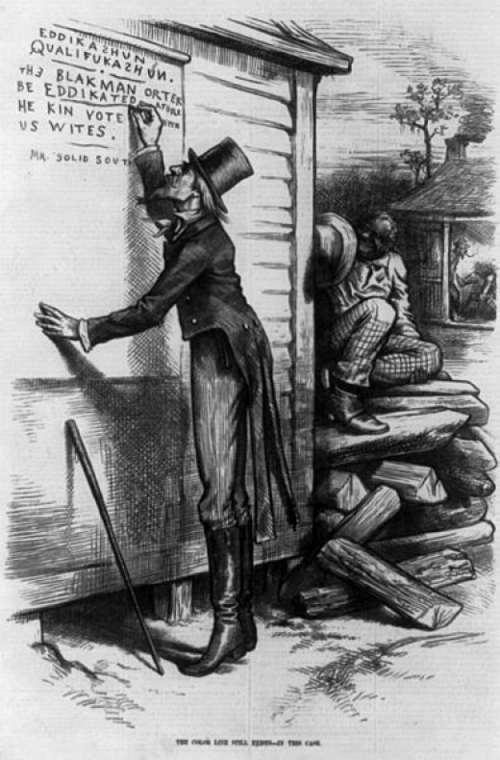
What we Already Know
The Fourteenth Amendment and other laws had been passed to protect the civil rights of freedmen.
Notes:
Mayflower Compact = self rule

Slide 7
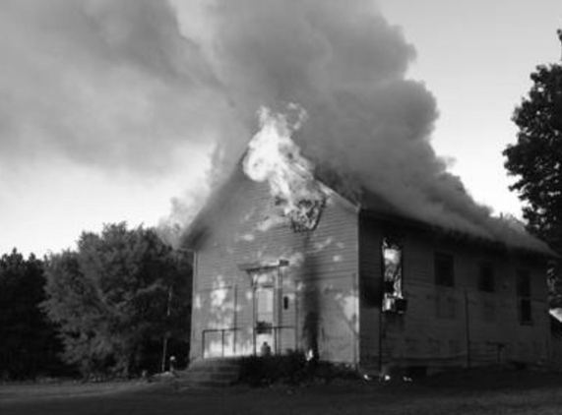
What we Already Know
Many Southern whites were resentful about the economic and political gains African Americans were making after the Civil War.
Notes:
Mayflower Compact = self rule

Slide 8
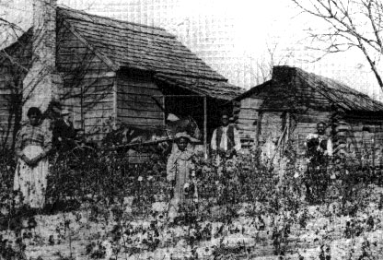
40 Acres and a Mule
More than anything else freed people wanted to own land. Land ownership could make freedmen self-sufficient, but
without land, the old masters could hire them or starve them as they pleased.
Notes:
Mayflower Compact = self rule

Slide 9
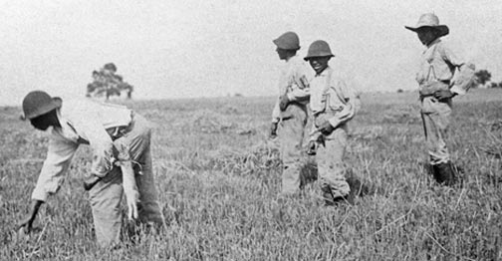
40 Acres and a Mule
Some freedmen felt that since they and their families had been sold over and over again to purchase plantation land, and
since they had cleared the land and raised the crops, they were entitled to own some of it.
Notes:
Mayflower Compact = self rule

Slide 10
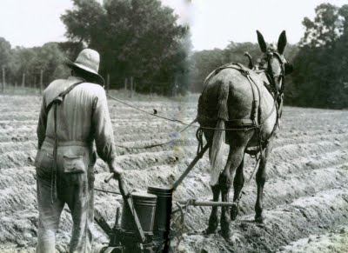
40 Acres and a Mule
A rumor spread that all freedmen would get 40 acres and a mule, but most freedmen never received either.

Slide 11
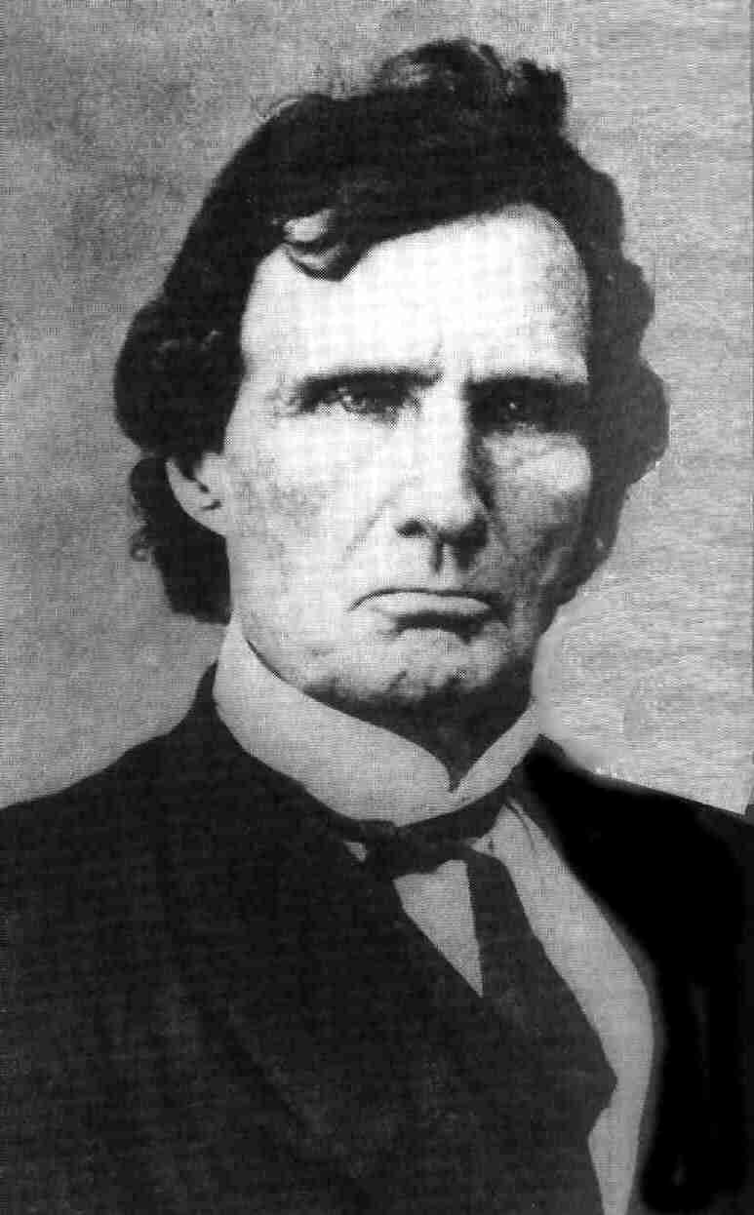
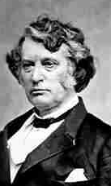
40 Acres and a Mule
Radical Republican leaders Thaddeus Stevens and Charles Sumner pushed to make land reform part of the Reconstruction Acts of 1867.

Slide 12
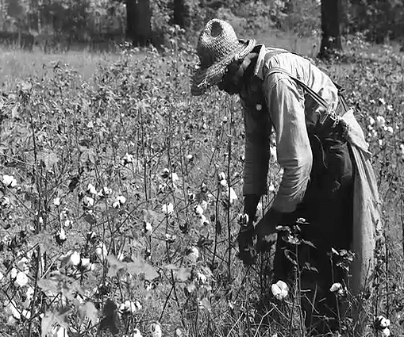
40 Acres and a Mule
Stevens proposed a plan to Congress that would have taken land from plantation owners and given it to freed people.

Slide 13
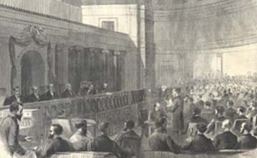
40 Acres and a Mule
Many moderate Republicans and even some Radicals were against the plan because they believed that new civil and voting rights were enough to give African
Americans a better life.

Slide 14
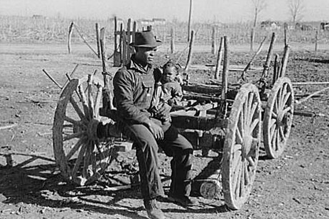
40 Acres and a Mule
Although supporters of the plan argued that civil rights meant little without economic independence. Congress did not pass the land reform plan.

Slide 15

Get your whiteboards and markers ready!

Slide 16
Which is NOT true why African Americans wanted their own land?
A. Taking land from their former masters was an excellent way to get revenge for having been enslaved.
B. Land ownership was the only way to guarantee that they would not be oppressed by white employers.
C. It was their right to own land that had been purchased by themselves being sold over and over again.
D. They wanted to become economically independent and take care of their families.

Slide 17
Why did many in Congress oppose the land reform plan?
A. It would be too expensive to purchase all the necessary acres.
B. It didn't go far enough to help the freedmen.
C. They believed that suffrage and new civil rights were enough to give African Americans a better life.
D. They felt it was illegal and immoral to give one man's land to someone else.

Slide 18
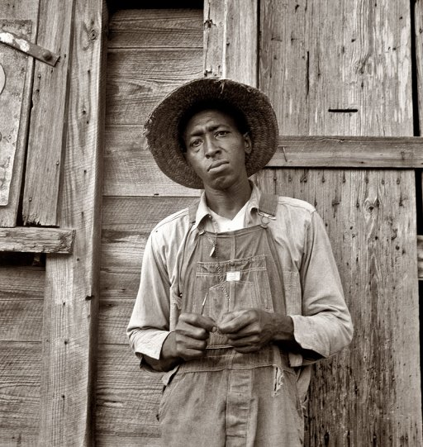
The Contract System
Without their own property, many African Americans returned to work on plantations, not as slaves but as wage
earners. They and the planters both had trouble getting used to this new relationship.

Slide 19
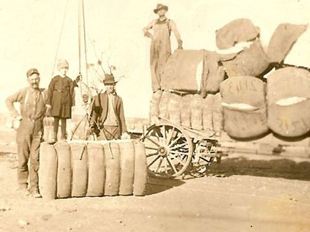
The Contract System
After the Civil War, planters desperately needed workers to raise cotton, still the South’s main cash crop.

Slide 20
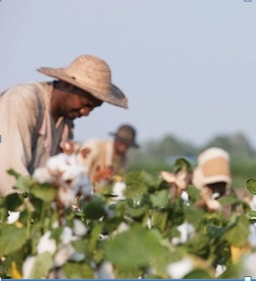
The Contract System
African Americans reacted to this demand by agreeing to a contract and working on the plantation for a wage.

Slide 21
The Contract System
The contract system was far better than slavery.
The workers could shop around for the best contracts.
They could decide who to work for.
They would be paid.
They would not be abused.
The planters could not split up families.

Slide 22
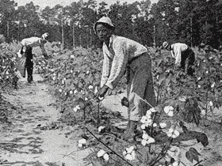
The Contract System
The contract system still had drawbacks.
Even the best contracts paid very low wages.
Workers often could not leave the plantations without permission.

Slide 23
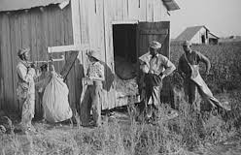
The Contract System
Many owners cheated workers out of wages and other benefits. Worse yet, laws punished workers for breaking their contracts, even if the plantation owners were abusing or cheating them. These
drawbacks made many African Americans turn to sharecropping.
Notes:
Mayflower Compact = self rule

Slide 24
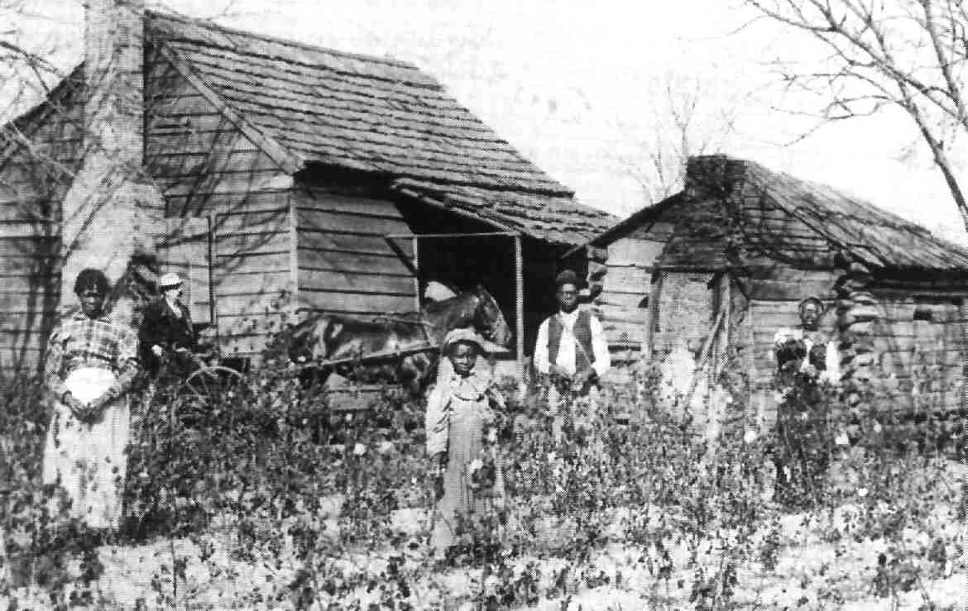
Sharecropping
Under the sharecropping system, a worker rented a plot of land to farm, and the land–owner provided the tools, seed, and housing.
Notes:
Mayflower Compact = self rule

Slide 25
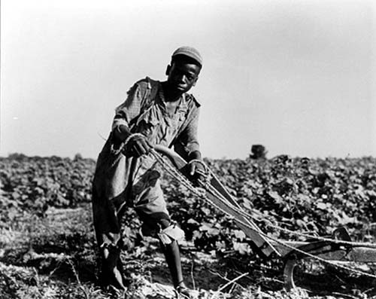
Sharecropping
When harvest time came, the sharecropper gave the landowner a share of the crop.
This system gave families without land a place to farm and gave landowners cheap labor.
Notes:
Mayflower Compact = self rule

Slide 26
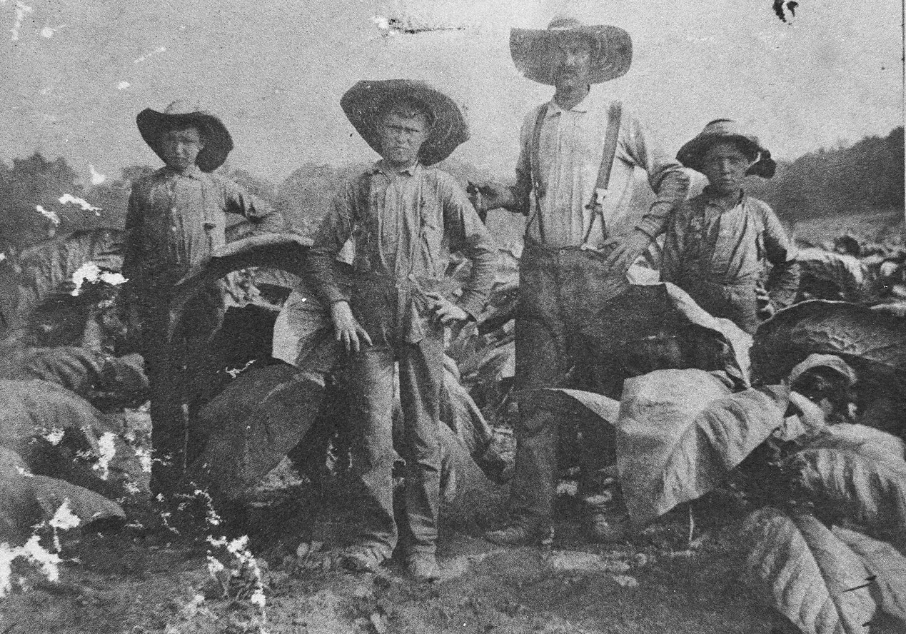
Sharecropping
White farmers also became sharecroppers. Many had lost their land in the war, and others had lost it to taxes. By 1880, nearly
one-third of the white farmers in the Deep South worked someone else’s land.
Notes:
Mayflower Compact = self rule

Slide 27
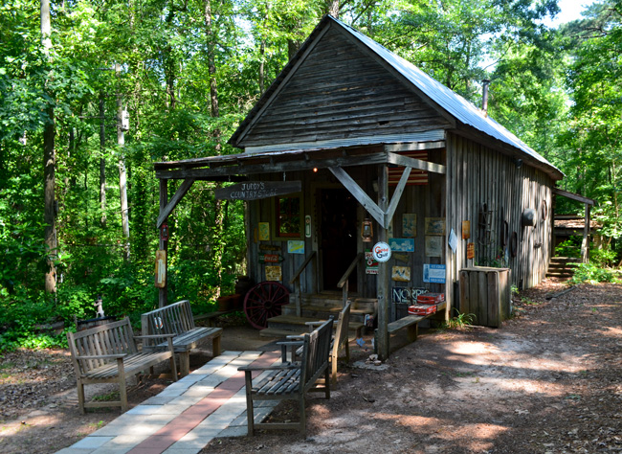
Sharecropping and Debt
Farmers wanted to grow food to feed their families, but landowners forced them to grow cash crops, such as cotton.
As a result, farmers had to buy food from the local store, which was usually owned by the landlord.
Notes:
Mayflower Compact = self rule

Slide 28
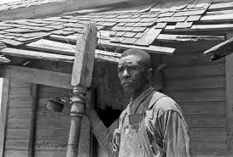
Sharecropping and Debt
Most farmers did not have the money to pay for goods. As a result, many were caught in a cycle of debt. Often farmers had to use one year’s harvest to pay the previous year’s bills.
Notes:
Mayflower Compact = self rule

Slide 29
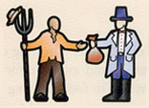
Sharecropper Debt
Farmer gets land, seed, tools and home from owner.

Slide 30
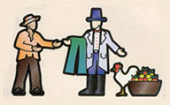
Sharecropper Debt
Farmer buys food and clothing from owner’s plantation store on credit.

Slide 31

Sharecropper Debt
Farmer plants and harvests crops.

Slide 32
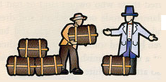
Sharecropper Debt
As per agreement, half the harvest would go to the owner, half to the farmer.

Slide 33
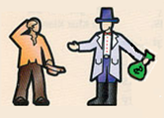
Sharecropper Debt
Farmer doesn’t have enough from his share to pay off the store loans.

Slide 34
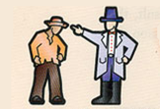
Sharecropper Debt
Farmer promises owner a larger share of next year’s harvest to repay store loans.

Slide 35
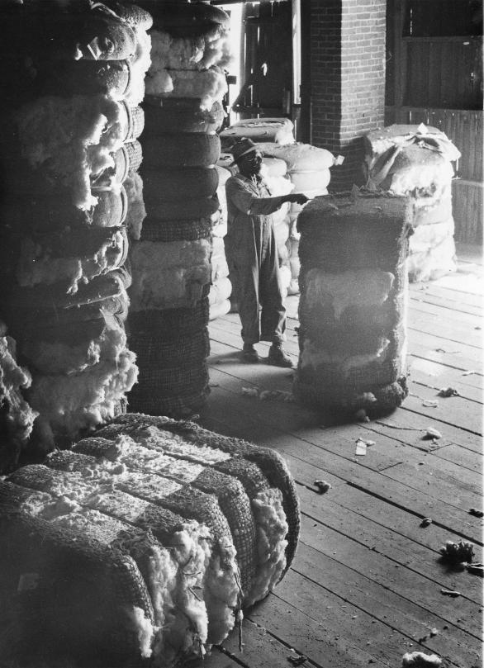
Sharecropping and Debt
Much of what was grown on the plantations was cotton, which wasn’t worth as much after the war.
Southern planters responded by trying to produce more of the cash crop - a move that drove down prices even further.
Notes:
Mayflower Compact = self rule

Slide 36
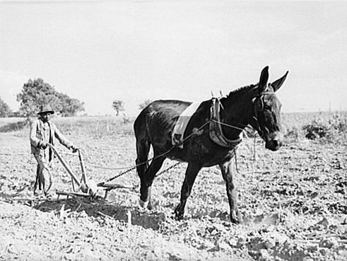
Sharecropping and Debt
Growing cotton exhausted the soil and reduced the amount of land available for food crops. As a result, the South had to
import half its food. Relying on cotton
was one reason the Deep South experienced years of rural poverty.
Notes:
Mayflower Compact = self rule

Slide 37

A and B Discuss
Compare and contrast the cycle of debt accumulated by the sharecropper’s use of the plantation store credit and the modern consumer’s debt accumulation through modern day credit card usage.

Slide 38
Get your whiteboards and markers ready!

Slide 39
Which was NOT true of the contract system.
A. Workers could choose who to work for.
B. If a worker was abused in any way they could leave and work for someone else.
C. Plantation owners needed workers and recently freed slaves needed work.
D. Workers had to give a share of their harvest to the owner.
E. Families would not be broken up.

Slide 40
Which of the following was NOT true about sharecropping?
A. A worker rented a plot of land to farm.
B. Workers gave the landowner a share of the crop at harvest time.
C. Over the years, most sharecroppers managed to save enough money to buy their own land.
D. Workers bought food and clothing from the landowner on credit.
E. Workers gave the landowner a share of the crop at harvest time.

Slide 41
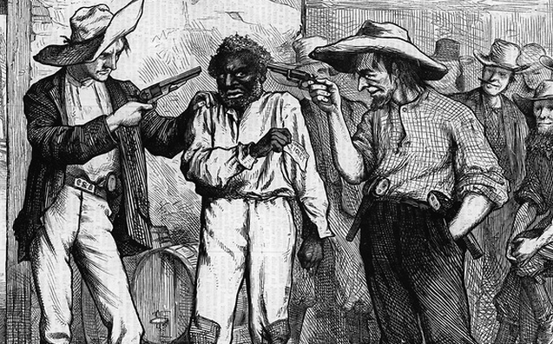
The Ku Klux Klan
African Americans in the South faced other problems besides poverty. They also faced violent racism.
Many planters and former Confederate soldiers did not want African Americans to have more rights.
Notes:
Mayflower Compact = self rule

Slide 42
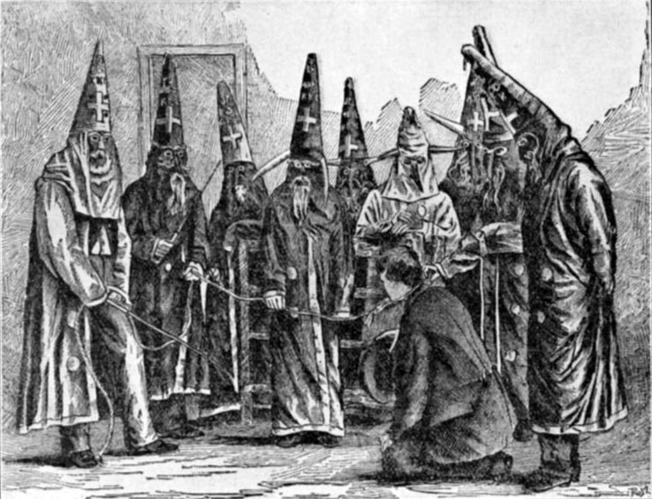
The Ku Klux Klan
In 1866, such feelings spurred the rise of a secret group called the Ku Klux Klan.
The Klan’s goals were to restore Democratic
control of the South and keep former slaves powerless.
Notes:
Mayflower Compact = self rule

Slide 43
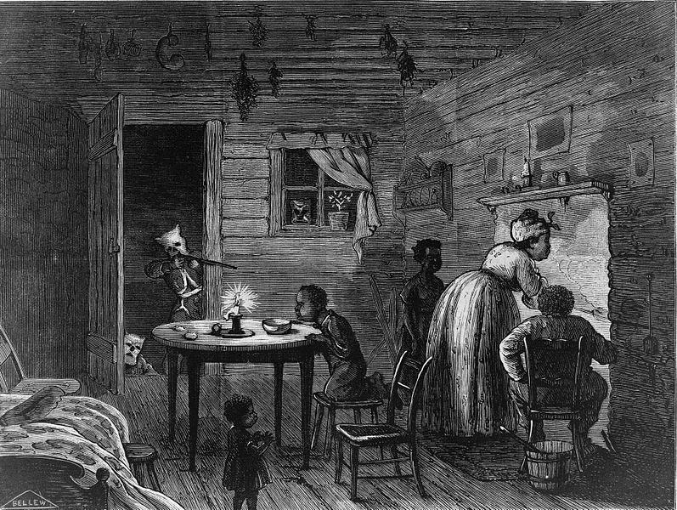
The Ku Klux Klan
The Klan attacked African Americans, targeting those who owned land or had become prosperous.
Notes:
Mayflower Compact = self rule

Slide 44
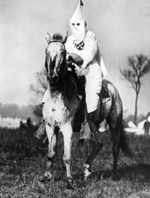
The Ku Klux Klan
The Klan attacked African Americans, targeting those who owned land or had become prosperous.
Klansmen rode on horseback and dressed in white robes and hoods.
They beat people and burned homes.
Notes:
Mayflower Compact = self rule

Slide 45
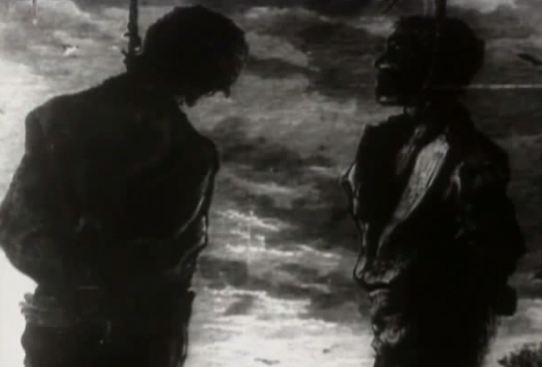
The Ku Klux Klan
They even lynched some victims, killing them on the spot without a trial as punishment for a supposed crime. The Klan also attacked white Republicans.
Notes:
Mayflower Compact = self rule

Slide 46
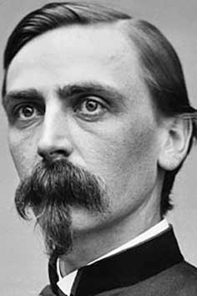
The Ku Klux Klan
Klan victims had little protection.
Military authorities in the South often ignored the violence.
President Johnson had appointed most of these authorities, and they were against Reconstruction.
Notes:
Mayflower Compact = self rule

Slide 47
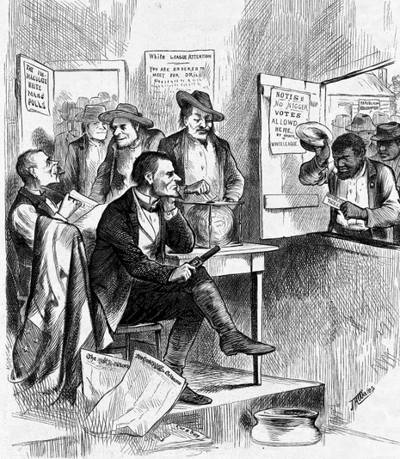
The Ku Klux Klan
The Klan’s terrorism served the Democratic Party.
As armed Klansmen kept Republicans away from the polls, the Democrats increased their power.
Soon, planter class took back control of the South.
Notes:
Mayflower Compact = self rule

Slide 48
The Ku Klux Klan was formed
A. by Northern whites angry about blacks moving North after the Civil War.
B. by Northern whites who supported slavery, and wanted it to continue.
C. by Southern whites angry about freed slaves getting political power.
D. by Southern whites who wanted to steal land from blacks.

Slide 49
How did the Ku Klux Klan affect the South during Reconstruction?
A. It brought about the change from contract farming to sharecropping.
B. It enabled Radical Republicans to gain power in the South.
C. It caused a second economic collapse or the South.
D. It helped bring about Democratic control or the South.

Slide 50
A and B Discuss
Many historians refer to Reconstruction as the Second Civil War. What evidence do you think they may use to support their statement ?

