Slide 1
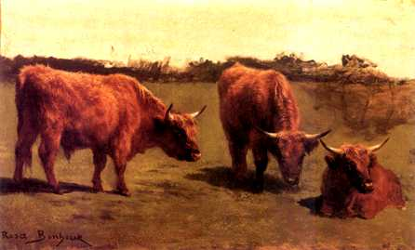
Understanding Quality Features of Beef, Pork, and Poultry
Objective: 4.02

Slide 2
Quality Standards
The United States Department of Agriculture sets forth quality features for beef, pork and poultry.
The quality features are classified into grades as determined by the USDA.
Grades indicate quality NOT sanitation.

Slide 3
Beef Quality Grades

Slide 4
Beef Cattle Classes
Age classes
  Calves
    less than one year of age
  Cattle
    One year or older
  Veal calves
    Less than three months old

Slide 5
Beef Cattle Classes
Age classes continued
  Slaughter calves
    3 months to one year old
  Feeder calves
    6 months to one year old

Slide 6
Beef Cattle Classes
Sex Classes
  Steer
    Male castrated before sexual maturity
  Heifer
    Has not had a calf or matured
  Cow
  Bull
  Stag
    Male castrated after sexual maturity

Slide 7
Feeder Cattle Grades
Feeder Cattle Grades
  Determined by:
    Frame size
    Muscle thickness
    Thriftiness
Slaughter Cattle Grades
  Both quality and yield grades

Slide 8
  USDA Feeder Steer & Heifer Grades
USDA No. 1.
USDA No. 2.
USDA No. 3.
  Each USDA grade also has a large, medium and small frame category.

Slide 9
Slaughter Cattle Grades
Quality Grades
  Prime
  Choice
  Select
  Standard
  Commercial
  Utility
  Cutter
  Canner
High Quality
Low Quality

Slide 10
Beef Cattle Grades
Yield Grades
  Yield Grade 1
  Yield Grade 2
  Yield Grade 3
  Yield Grade 4
  Yield Grade 5

Slide 11
Feeder Steer & Heifer Grades
  Animals are divided into three groups- calves, yearlings and older feeders based on their age and weight.
  Feeder animals weigh between 350 to 1,000lbs.
  Feeder cattle grades are the basis for reporting market prices for cattle.

Slide 12
Factors Used to Determine Grade
Thriftiness- the apparent health of the animal and its potential to fatten and grow normally.
Frame Size- the size of the animal’s skeleton (height & body length).
    Large- tall and long bodied for their age.
    Medium- slightly large in size for their age.
    Small- shorter bodied and not as tall as medium frame cattle.

Slide 13
Factors Used to Determine Grade
Thickness- development of muscle in relation the size of the skeleton.
  US No. 1- slightly thick throughout, moderate width between legs.
  US No. 2- narrow throughout, legs set close together, back and loin have sunken appearance.
  US No. 3- less thickness and width between legs than No. 2.

Slide 14
Feeder Cattle Grade Examples
Large Frame No. 1- animal that is taller in size compared to others and displays thick muscling throughout body.
Medium Frame No. 2- same frame size as No. 2, but less muscling as compared to No. 1. Loin and back have a sunken appearance.

Slide 15
Feeder Cattle Grade Examples
Small Frame No. 3- same frame size as No. 2, but less thickness and width than No. 2
Inferior- feeder cattle that are unthrifty and not expected to grow or fatten normally. Usually indicative of disease, parasites, etc

Slide 16

Quality Grades
1. Quality Grades
  Determined by the class or kind of animal (steer, heifer, cow, bull), age or maturity, firmness and marbling of the carcass.

Slide 17
Quality Grades
Prime
Choice
Select
Standard and Commercial
Utility, Cutter, and Canner

Slide 18

Quality Grades
Prime grade
  Produced from young, well-fed beef cattle. It has abundant marbling and is generally sold in restaurants and hotels
Choice grade
  High quality, but has less marbling than Prime

Slide 19

Quality Grades
Select grade
  Very uniform in quality and normally leaner than the higher grades
  Fairly tender, but, because it has less marbling, it may lack some of the juiciness and flavor of the higher grades

Slide 20
Quality Grades
Standard and Commercial grades
  Frequently are sold as non-graded or as "store brand" meat
Utility, Cutter, and Canner grades
  Are seldom, if ever, sold at retail but are used instead to make ground beef and processed products

Slide 21
Quality Grades
There is no Prime grade for slaughter cows
Prime grades have maximum marbling
Low choice or higher grades are the most desirable
About 80% of grain fed beef is graded as choice

Slide 22
Maturity
A - 9 to 30 Months
B - 30 to 42 Months
C - 42 to 72 Months
D - 72 to 96 Months
E - More Than 96 Months

Slide 23
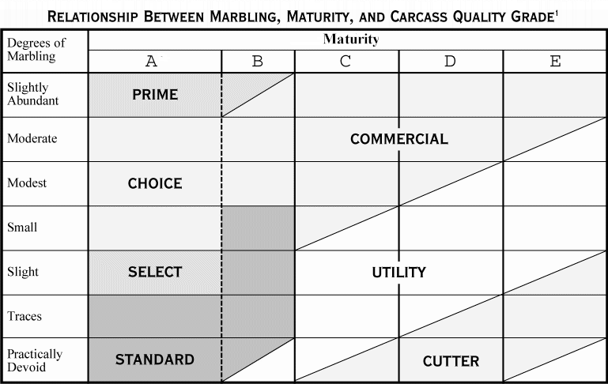

Slide 24
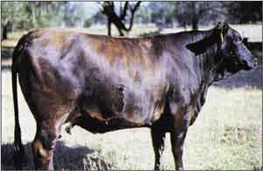
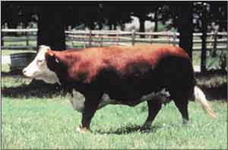
What do you think?
Which cow do you think is the best?
A
B

Slide 25
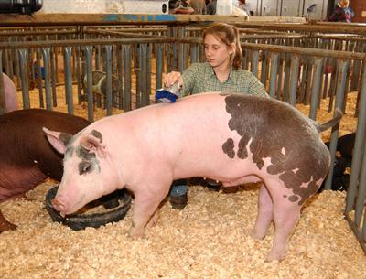
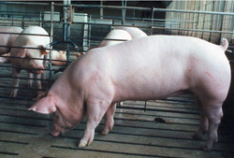
What do you think?
Which pig do you think is the best?
A
B

Slide 26
What is Cutability?
The term ‘cutability’ describes the proportion of an animal which is saleable meat.
  Dressing percentage
    Percentage of the live animal which forms its carcass
  Saleable meat yield or retail yield
    Percentage of the carcass which is saleable meat.

Slide 27
What is Cutability?
No two animals are the same
Cutability varies widely between individual animals
This variation affects financial returns to producers, wholesalers and retailers.

Slide 28
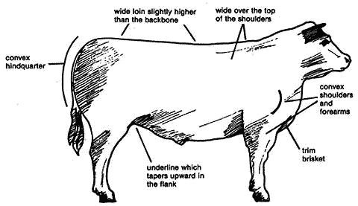
High Cutability

Slide 29
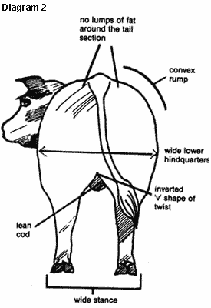
High Cutability
Wide stance
Convex shoulders and hindquarters
Trim brisket
Wide over the shoulders
Convex rump

Slide 30
Low Cutability
Animals with low cutability do not look muscular, indicating a low ratio of muscle to bone.
  a narrow stance, especially through the lower hindquarters;
  a prominent gut that is the widest point of the animal when it is viewed from behind;
  flat forearms and shoulders;
  narrow, poorly developed loins sloping down from the backbone.

Slide 31

Low Cutability
Animals that are overfat and have an uneven distribution of fat have:
  lumpy deposits of fat in the brisket flank and tailhead
  a smooth appearance;
  a level underline;
  a deep body;
  flatness over the top of the rump;
  a smooth tail setting;
  a soft, spongy feel

Slide 32
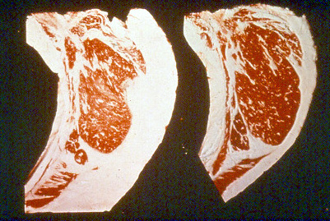
Which will yield more meat?

Slide 33
Yield Grades (Beef)
Percentage of the carcass that is boneless, closely trimmed retail cuts from the round, loin rib, and chuck
Numbered 1 to 5
  Yield 1
    Best muscling with least amount of fat
  Yield 5
    Worst grade with the less muscle and more fat waste

Slide 34
Yield Grades (Beef)
The terms "yield" and "yield grade" should not be confused.
"Yield" alone means dressing percentage (carcass weight divided by live weight multiplied by 100), and is not directly related to yield grades or cutability.

Slide 35
Yield Grades (Beef)
Relationship of Yield Grades and Cutability
Yield Grade- % Boneless, Closely Trimmed Retail Cuts
From the Round, Loin, Rib and Chuck
1 52.6 - 54.6
2 50.3 - 52.3
3 48.0 - 50.0
4 45.7 - 47.7
5 43.3 - 45.4

Slide 36
Yield Grades (Beef)
Adjusted fat thickness- External fat is measured at the 12th rib
Percentage of Kidney, Pelvic and Heart Fat (KPH)- A subjective estimate of fat
Rib Eye Area
Hot Carcass Weight

Slide 37
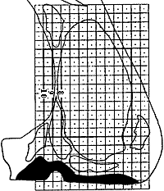
Yield Grades (Beef)
USDA yield grades estimate the quantity of edible meat from the major wholesale cuts--round, loin, rib and chuck

Slide 38
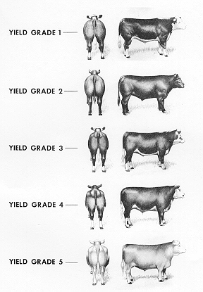
Yield Grades (Beef)

Slide 39
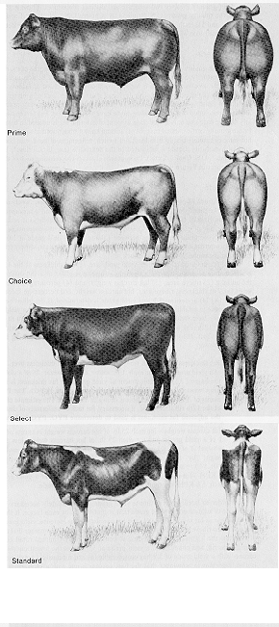
Examples of Quality Grade (Beef)
Prime
Choice
Select
Standard

Slide 40
Marbling
Intermingling of fat with muscle fibers
Observed in the ribeye muscle between the 12th and 13th rib
Adequate marbling must be present for tenderness and high quality grades
The fat should not be soft and oily

Slide 41

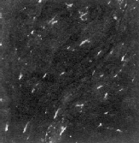
Marbling (Beef)
Very Abundant
Slight

Slide 42
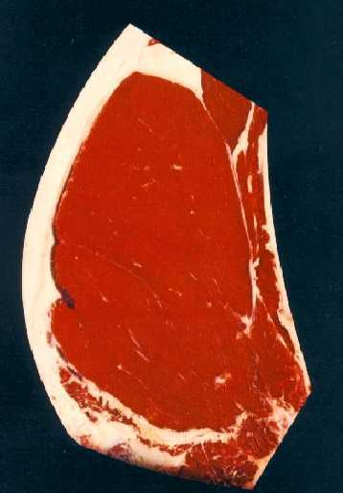
Marbling (Beef)
Slight Marbling

Slide 43
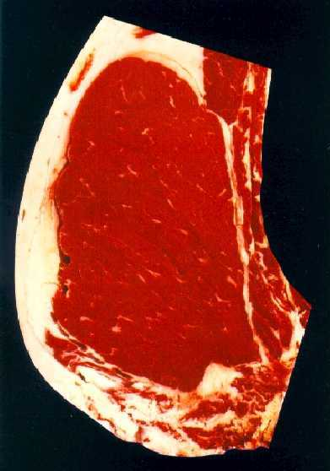
Marbling (Beef)
Small Marbling

Slide 44
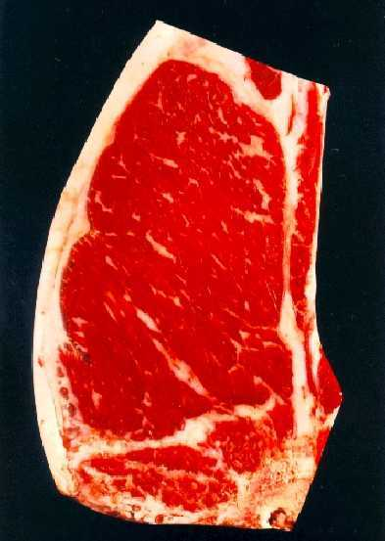
Marbling (Beef)
Modest Marbling

Slide 45
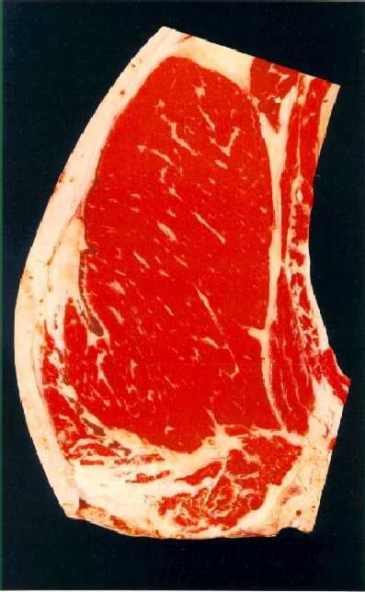
Marbling (Beef)
Moderate Marbling

Slide 46
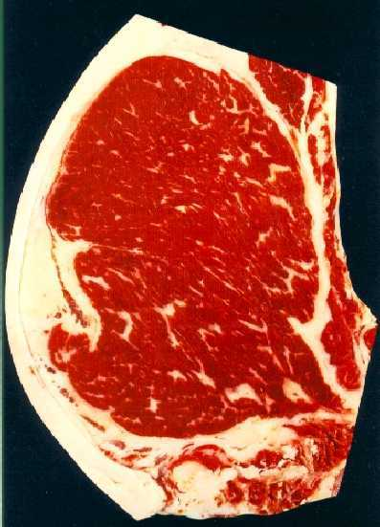
Marbling (Beef)
Slightly Abundant Marbling

Slide 47
Swine Quality grades

Slide 48
Swine Classes
Use Classes
  Slaughter
    To be killed and sold as meat
  Feeder
    To be feed to heavier weights before slaughter

Slide 49
Swine Classes
Sex Classes
  Barrow
    Male castrated before sexual maturity
  Gilt
    Young female that has not had pigs
  Sow
  Boar
  Stag

Slide 50
Feeder Pig Grades (Sample)
USDA No. 1 Feeder Pig – Large frame, thick muscle, legs set wide apart and ham is wider than loin.
USDA No. 3 Feeder Pig – Slightly smaller than frame with think muscling. Ham and Loin are about the same width. Back is flat.
USDA Utility Feeder Pig – Unthrifty, diseased, poor care, skin wrinkles, head appears larger than body.

Slide 51
Grading Meat
Swine
  1. Quality grade is determined by quality of lean meat and yield.
  2. Quality of lean is determined by firmness of lean, firmness of fat, and distribution of external finish (fat).
  3. Yield is evaluated by thickness of backfat and degree of muscling.
  4. Thick muscling helps offset backfat thickness

Slide 52
Grading Meat
Swine (continued)
  5. US No. 1 Hog must have at least average muscling
  6. US No. 1 Should yield 60.4% or higher
  7. Grade is determined by the percent of carcass weight made up of ham, loin, boston butt, and picnic shoulder
  8. Backfat and degree of muscling are used to evaluate live hogs for yield.

Slide 53
Slaughter Barrows and Guilts
USDA grades:
  U.S. No. 1
  U.S. No. 2
  U.S. No. 3
  U.S. No. 4
  U.S. Utility

Slide 54
Calculating Grades
The estimated backfat thickness over the last rib and the muscling score are used to determine the USDA slaughter barrow and gilt grade.
  Degrees of Muscling are Thick, Average, Thin
    Thick Muscle Score =3.0
    Average Muscle Score = 2.0
    Thin Muscle Score = 1.0

Slide 55
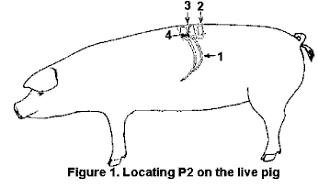
Backfat

Slide 56
Calculating Grades
The formula used to calculate slaughter barrow and gilt grades is:
  Grade = (4.0 x backfat)-(1.0 x muscling score)

Slide 57
Poultry Carcass Evaluation

Slide 58
Why Grade Poultry Carcasses?
To insure quality before it is sold
Prevent the selling of an unwholesome product
Did you know?
Grading is voluntary and paid for by the meat packer?

Slide 59
Grading Poultry Carcasses
USDA Grades indicate quality not sanitation
Ready-to-cook means that certain parts have been removed
  head
  feet and feathers
  blood
  viscera (soft internal organs)

Slide 60
What are the Grades?
Poultry Carcass Grades:
  Grade A
    Sold in stores
  Grade B
    Often not a grade sold in stores
  Grade C
    Usually used for processing into other food products

Slide 61
Evaluation Factors
Poultry carcasses are graded on the following factors:
  confirmation
  fleshing
  fat covering
  exposed flesh
  discoloration
  disjointed and broken bones
  missing parts
  freezing defects

Slide 62
Other Evaluation Factors
Confirmations
  normal breastbone, back, leg and wings
Fleshing
  well fleshed or muscled is ideal
Fat covering
  well covered is ideal

Slide 63
Evaluation Factors
Exposed Flesh
(2 pound to 6 pound birds)
  Grade A
    Breast and leg can not have over 1/4 inch
    Other parts can have a maximum of 1 and 1/2 inches

Slide 64
Evaluation Factors
Exposed Flesh (continued)
  Grade B
    No more than 1/3 of the total flesh of each particular part can be exposed
    Meat yield cannot be affected (i.e. no cuts into the meat)
  Grade C
    No limit

Slide 65
Evaluation Factors
Disjointed and broken bones
(2 pound to 6 pound birds)
  Grade A
    1 disjointed and no broken
  Grade B
    2 disjointed and no broken or 1 disjointed and 1 broken non-protruding

Slide 66
Evaluation Factors
Disjointed and broken bones
(continued)
  Grade C
    No limit
    Protruding bones automatic Grade C

Slide 67
Evaluation Factors
Missing Parts
(2 pound to 6 pound birds)
  Grade A
    Wing tips and tail (removal of the preen gland
  Grade B
    Wing tips to the 2nd wing joint
    Back area not wider than base of tail and extending half way between the base of tail and hip joints

Slide 68
Evaluation Factors
Missing Parts
(continued)
  Grade C
    Wing tips, wings and tail
    Back area not wider than the base of tail extending to area between the hip joints

Slide 69
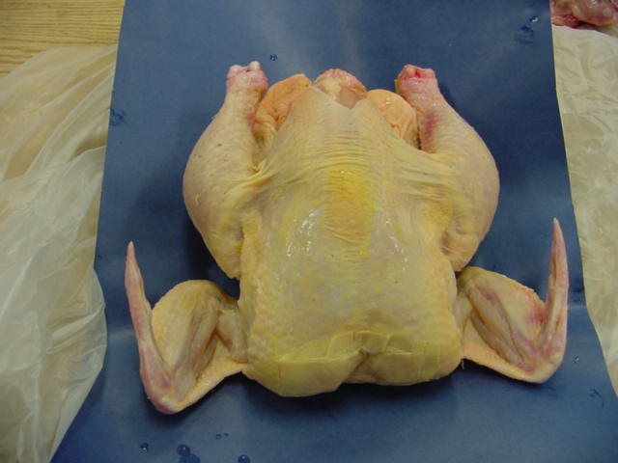
What Grade is this?
Grade A
No Defects

Slide 70
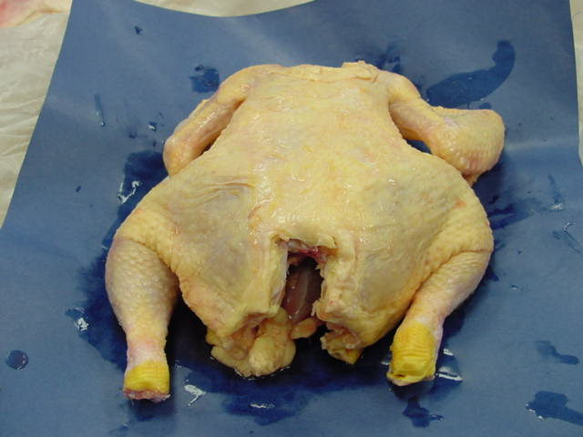
What Grade is this?
B Grade
Back is cut out halfway between the base of the tail and the hip joints

Slide 71
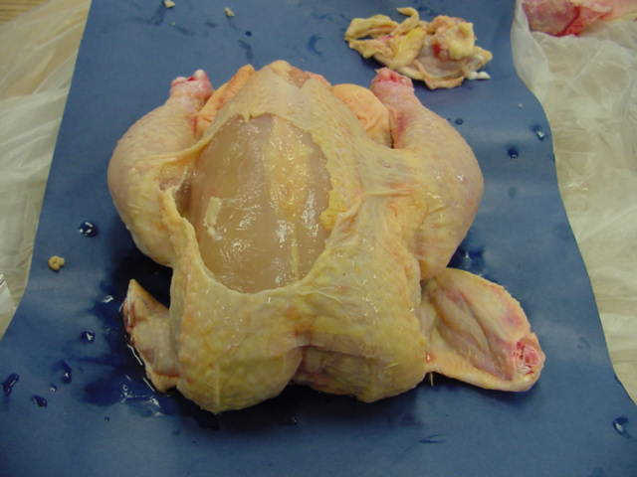
What Grade is this?
C Grade.
More than 1/3 of flesh exposed on breast

Slide 72
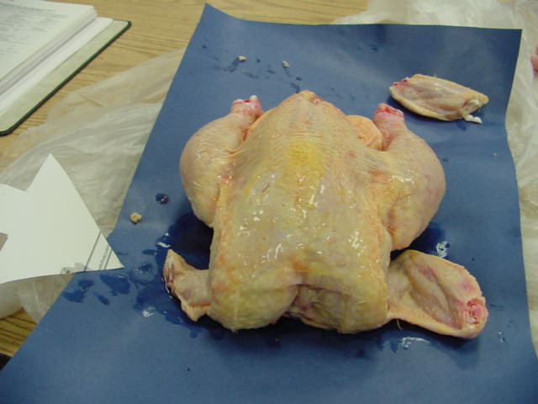
What Grade is this?
B Grade.
Parts of wing removed beyond the second joint

Slide 73
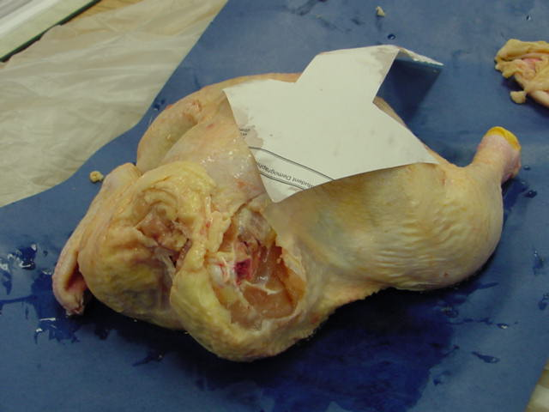
What Grade is this?
C Grade.
Entire wing removed

Slide 74
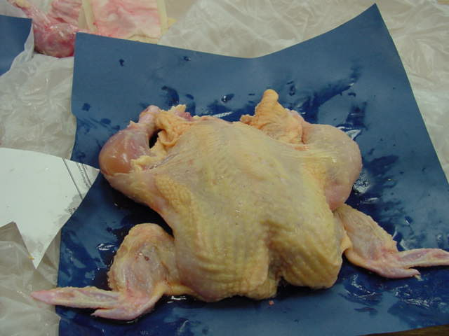
What Grade is this?
C Grade.
Over 1/3 of the drumstick flesh is exposed

Slide 75
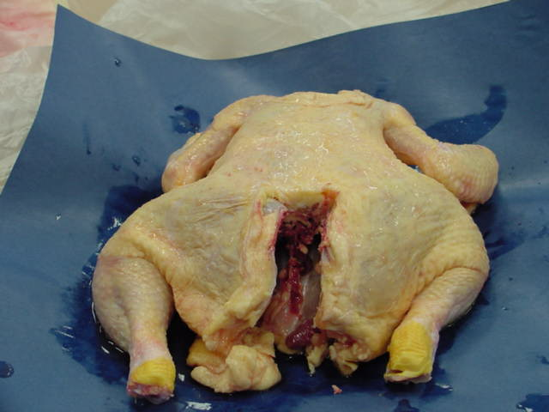
What Grade is this?
C Grade
Trimmed more than halfway between base of tail and hip joints

Slide 76
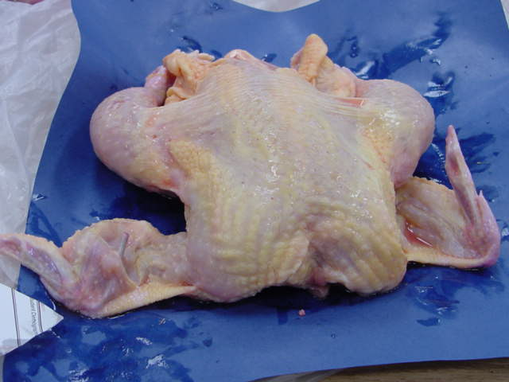
What Grade is this?
C grade
Protruding broken bone in wing tip

