Slide 1
Animal Digestion and Nutrition
Objective 7.02: Understand the digestive process

Slide 2
Ruminants

Slide 3
Ruminant Animals
Animals with complex digestive systems
Capable of digesting material with a high fiber concentration
Uses microbial fermentation
Cattle
Sheep
Goats
Deer

Slide 4
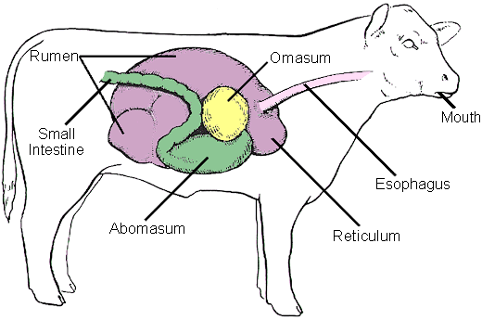
Ruminants
Ruminant Digestive System

Slide 5
Parts and Functions
Mouth
Bites and chews
Esophagus
Connection
Four Compartment Stomach
Rumen
Reticulum
Omasum
Abomasum
85% of the capacity

Slide 6
Parts and Functions
Rumen
Largest of the four parts “room-in-it”
Filled with bacteria
Converts large amounts of roughage to amino acids
Fact!!!!
The average cow rumen can hold over 160 liters (40 gallons)

Slide 7
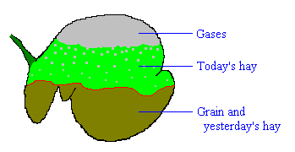
Ruman

Slide 8
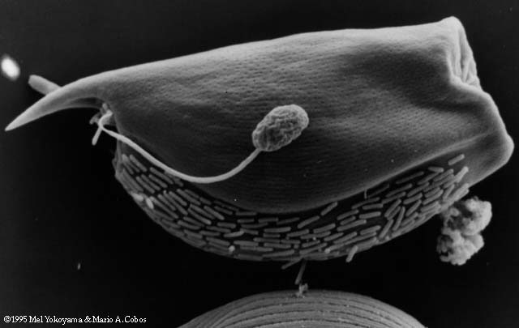
Ruman Microbe

Slide 9
Ruman Microbe
The large microbe is a type of protist
The creature that looks like a tadpole attached to the side of the protist is a fungal spore
The smaller, rod-shaped organism lining the underside of the protist are bacteria.

Slide 10
Parts and Functions
Reticulum
Compartment where liquid goes
Honeycomb in structure
Omasum
Grinds and squeezes
Removes some liquid
Abomasum
True stomach
Enzymes and acids

Slide 11
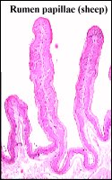
Parts and Functions
Small Intestine
Partially digested feed is mixed
Bile
Pancreatic juice
Intestinal juice
Most of the food nutrient is absorbed
Villi or Papillae

Slide 12
Parts and Functions
Cecum
Serves little to no function in most animals
Horses, Rabbits, and Guinea Pigs have an enlarged cecum that helps breakdown roughages
Large intestine
Main function is to absorbed water
Add mucus to undigested feed
Feces

Slide 13
Non-Ruminant

Slide 14
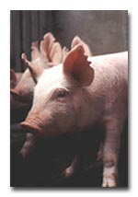
Non-Ruminant
Simple digestive system
(Monogastric)
Feed must be high quality concentrates
Cannot digest large amounts of fiber
Human
Dogs
Cats
Rabbits (COPROPHAGY)
Pigs
Horses????

Slide 15
Non-Ruminant Parts & Functions
Mouth
Esophagus
Stomach
Enzymes acts on feed
Churns and mixes
Small intestine
Cecum
Large intestine

Slide 16
Non-Ruminant Parts & Functions
Accessory system
Liver
Produces bile that acts on fat
Pancreas
Produces insulin
Gall Bladder
Produces bile that aids in digestion
Anus
End of the digestive tract

Slide 17
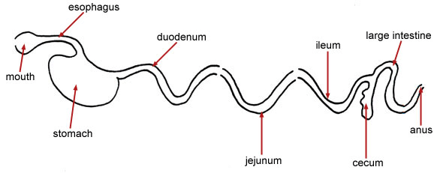
Monogastric
Dorsal
Posterior
Anterior
Ventral
Simple Digestive System

Slide 18
Poultry Digestive Systems

Slide 19
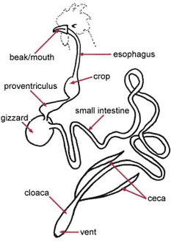
Poultry
Chickens
Turkeys
Ducks
Geese

Slide 20
Poultry Digestive System
Poultry have monogastric digestive systems as well.
But their digestive system is different enough from the other monogastric animals to discuss separately.

Slide 21
Poultry Digestive Systems
Mouth or beak
Can not chew food
Esophagus
Connects mouth to crop
Crop
Stores feed

Slide 22
Poultry Digestive Systems
Gizzard
Crushes feed
Contains grit and gravel
Mixes feed with digestive juices
Liver
Small and Large Intestine
Vent
Removes solid and liquid waste

Slide 23
Inspecting Animal Digestive Systems
Esophagus
Tube like structure
Stomach
Pouch with undigested feed
Liver
Large brown organ beneath the stomach or crop

Slide 24
Inspecting Animal Digestive Systems
Small intestine
Long tube
Gray colored partially digested feed
Large intestine
Large relatively short compartment
Contains fecal material

