Slide 1
Animal Reproduction
Objective 8.01: Understand animal reproduction and parturition

Slide 2
Terminology
Castration
Removing the testicles of the male to prevent breeding
Colostrum
First milk
Gestation
Time an animal is pregnant

Slide 3
Terminology
Estrus
When a female is receptive to be bred
Lactation
Period of time that milk is secreted by the mammary glands
Parturition
Than act of giving birth

Slide 4
Terminology
Estrus Cycle
The length of a females cycle from one estrus to the next
Puberty
Age at which animals reach sexual maturity and begin to come into heat

Slide 5
Terminology
Ovulation
The release of the egg from the ovary
Fertilization
The union of the sperm and the egg cells

Slide 6
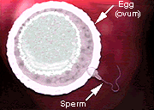
Fertilization

Slide 7
The Female Reproductive System

Slide 8
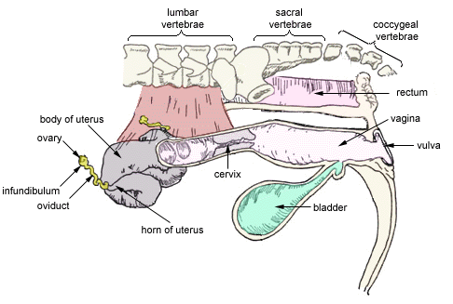
Female Tract

Slide 9
Female Reproductive System
Ovary - the ovary is comparable to the male testicle and is the site of gamete production.
A bovine animal has 20,000 potential eggs per ovary, while a human female has 400,000 potential eggs per ovary.
Ova are fully developed at puberty and are not continuously produced as in the male.
All species contain two functional ovaries except for the hen which has only a left functioning ovary.

Slide 10
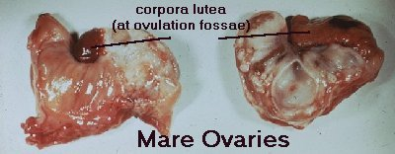
Female Reproductive System

Slide 11
Female Reproductive System
The ovaries have three major functions:
Gamete production
Secrete estrogen (hormone)
absence of muscle development
development of mammary glands
development of reproductive systems and external genitalia
fat deposition on hips and stomach (source of energy)
triggering of heat
Form the corpus luteum

Slide 12
Female Reproductive System
Infundibulum - the funnel shaped portion of the fallopian tube near the ovary that catches the ovulated egg.
Fallopian Tubes (or Oviducts) - pair of small tubes leading from the ovaries to the horns of the uterus (5 - 6 inches).
Fertilization occurs in the oviduct.
Egg travels from ovary to uterine horn in 3 - 4 days.

Slide 13
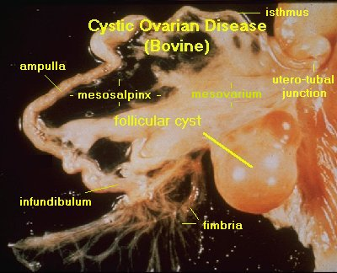
Female Reproductive System

Slide 14
Female Reproductive System
Uterine Horn - The anterior, divided end of the uterus in the cow, ewe, and mare. Sow has only 2 horns, no body, woman has no horns, only body.

Slide 15
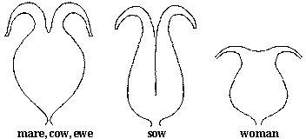
Female Reproductive System

Slide 16
Female Reproductive System
Uterus - Muscular sac connecting fallopian tubes and cervix
1. Sustains the sperm and aids in its transport 2. Supports embryo and fetus during gestation
3. Expels fetus at parturition

Slide 17
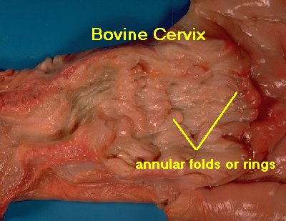
Female Reproductive System
Cervix
Area between the uterus and vagina
Normally closed
Opens at estrus and parturition
(2 -3 inches)

Slide 18
Female Reproductive System
Vagina - the female organ of copulation
1. admits penis
2. receives semen (except in sow)
3. passageway for fetus at parturition
Bladder - storage organ for urine
Vulva - extended genitalia; opening for both urinary and genital tracts

Slide 19
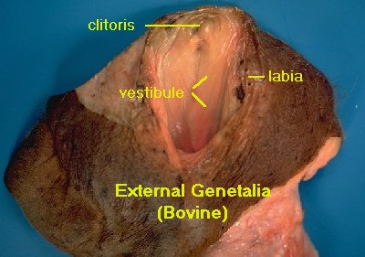
Female Reproductive System

Slide 20
Reproductive Functions (Female)
Steps in the female reproductive process:
1. Ovulation
Produce gamete (ova or ovum)
Release of egg(s)
Infundibulum pushes the ovum into the fallopian tube

Slide 21
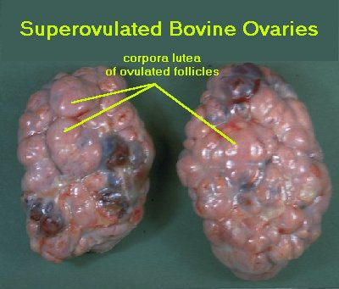
Reproductive Functions (Female)

Slide 22
Reproductive Functions (Female)
2. Estrus (heat, estrous period)
Period of time when a female will accept a male in copulation
The female must stand (standing heat) to be mounted before the reproductive process can begin

Slide 23
Reproductive Functions (Female)
3. Gestation
Fertilization to parturition
Develop embryo in uterus
4. Parturition
Expel fully developed young at birth
5. Lactation
Milk production

Slide 24
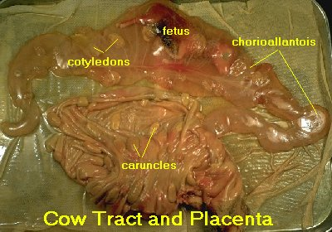
Reproductive Functions (Female)

Slide 25
Ovulation Rates
Ovulation Rates by Species
Cow- 1 egg per estrus
Ewe- 1 to 3 eggs per estrus
Sow- 10 to 20 eggs per estrus
Mare- 1 egg per estrus
Hen- Approx. 28 eggs per month

Slide 26
Reproductive Terminology
Species Act Offspring
Cows calving calf
Ewes lambing lamb
Sows farrowing pig
Hens hatching chick
Mares foaling foal
Goats kidding kid

Slide 27
Reproductive Functions (Female)
Gestation and Lactation Periods:
Species Gestation Period Lactation(Milking)
Cow 283 days beef 180 - 270 days dairy 305 - 365 days
Ewe 148 days 60 - 90 - 120 days
Sow 114 days 21 - 42 days
Mare 330 - 345 days 90 - 150 days

Slide 28
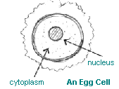
Reproductive Functions (Female)
Estrous period length by species:
Cow 16 - 18 hours
Ewe 24 - 36 hours
Sow 48 - 72 hours
Mare 90 - 170 hours
Hens & Women none

Slide 29
Reproductive Functions of the Female
Estrous cycle - time from one heat period (or menstrual cycle) to the next.
Length of estrous cycle by species:
Cow 21 days
Ewe 22 days
Sow 21 days
Mare 22 days
Hen none

Slide 30
The Male Reproductive Tract

Slide 31
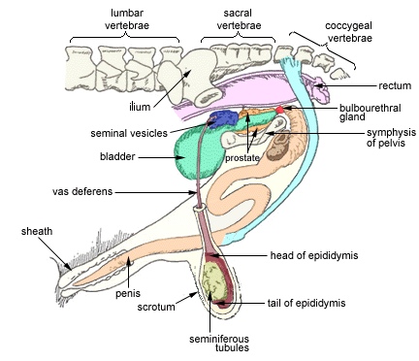
Male Reproductive Tract

Slide 32
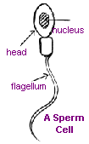
Male Reproductive Tract
Scrotum - external sac that holds testicles outside of the body to keep sperm at 4-5ºF cooler than the body temperature
Testicles - the primary male organs of reproduction
to produce sperm
to secrete testosterone

Slide 33
Male Reproductive Tract
Epididymis - Long coiled tube that is a path for sperm
Provide passageway for sperm out of the seminiferous tubules
Storage for sperm
Fluid secretion to nourish sperm
Place for sperm maturation

Slide 34
Male Reproductive Tract
Vas Deferens - slender tube from epididymis to urethra which moves sperm to the urethra at ejaculation
Urethra - long tube from bladder to penis; passageway for urine and sperm out of the body

Slide 35
Male Reproductive Tract
Penis - male organ of copulation which conveys semen and urine out of the body
Penis retractor muscle - allows extension and retraction of the penis; sigmoid flexure extends in copulation

Slide 36
Male Reproductive Tract
Accessory Glands:
Seminal vesicles- add fructose and citric acid to nourish the sperm
Prostate Gland - located at the neck of the bladder
cleans the urethra prior to and during ejaculation
provides minerals for sperm
provides the medium for sperm transport
provides the characteristic odor of semen

Slide 37
Male Reproductive Tract
Cowper’s gland
Also called the Bulbourethral gland
Paired organs
cleans the urethra prior to semen passage

Slide 39
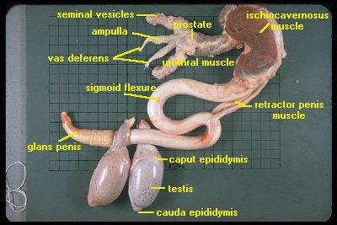
Male Reproductive Tract

Slide 40
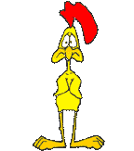
Reproduction in Poultry

Slide 41
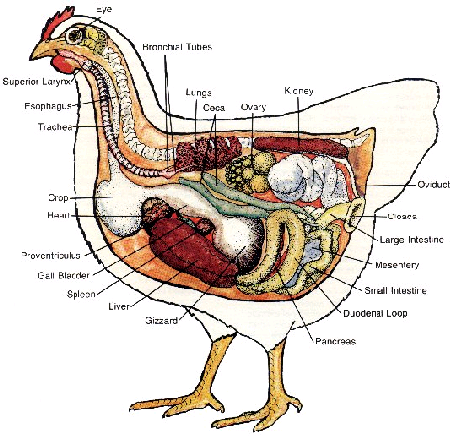

Slide 42
Reproduction in Poultry
The poultry oviduct has five parts:
1) Vagina
Holds the egg until laid
2) Uterus
Secretes the shell
3) Isthmus
Adds the two shell membranes
4) Magnum
Secretes the albumen
5) Infundibulum
Where fertilization takes place

Slide 43
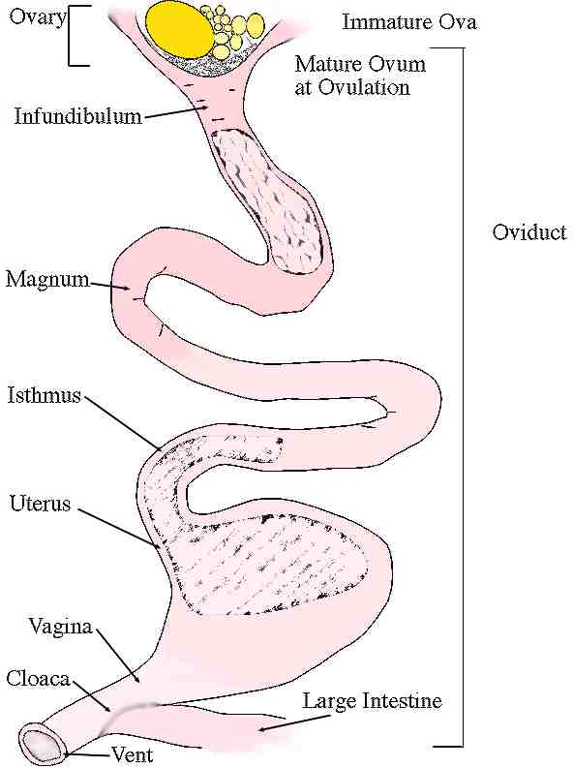

Slide 44
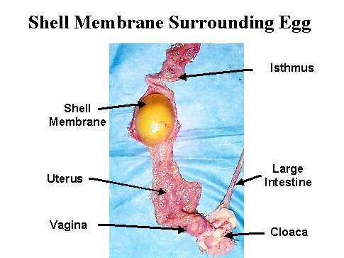

Slide 45
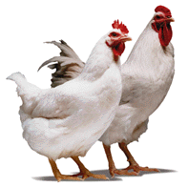
Reproduction in Poultry
Major difference:
Embryo of livestock develop inside the female’s body while the embryo of poultry develops inside the egg.
Poultry only have the left ovary and oviduct when mature
The yoke is the ovum
Chicken Incubation
21 days

Slide 46
Poultry Reproduction
In your notes, define the following poultry reproductive terms and tell how they differ from livestock we have studied so far:
Papilla
Testicles
Cloaca
Vent
Ovary
Magnum
Isthmus
Uterus
Vagina
Use page 190 in your textbook

Slide 47
Assignment:
Build a crossword puzzle containing 12 reproductive terms from your class notes. Have another student complete and sign your crossword puzzle. The assignment as well as your other assignment from the handout is due at the end of class.

Slide 48
Parturition of Animals

Slide 49
Parturition
Normal Position
Front feet first
Nose tucked between front legs
Shoulders
Body
Hips
Back legs
Any other presentation can cause serious problems for the animal

Slide 50
Parturition
Process
Increased Estrogen causes contractions
First water bag emerges and breaks
Second water bag emerges and breaks (contains fetus)
Several hours later, the placenta and other membranes (afterbirth) are expelled

