Slide 1

Programming Presentation Manitoba

Slide 2
Why is Programming Important
Programming a power wheelchair is an important step in the delivery process to customize the wheelchair’s performance to meet the needs of the end user.
Programming can include adjusting a variety of parameters such as speeds and rates to provide optimal performance and improve how the chair drives.
When a power wheelchair is programmed specifically for an individual it has significant benefits, such as:
Increased Independence in Various Environments
Functional Mobility
Increased Safety
Comfort

Slide 3
Where Do I Start
A thorough assessment of their body functions, environment, wheelchair skills, and transportation will help guide what programming needs they have during the delivery of their chair.
Wherever possible, set programming in the clients common environments (Home, Outdoors, Office, etc)
Understanding that regular follow-up assessments are essential to address any changes the user may experience and changes in their settings. When you adjust the parameters you are able to fine tune the wheelchair’s behaviour to accommodate the user’s abilities and preferences.

Slide 4
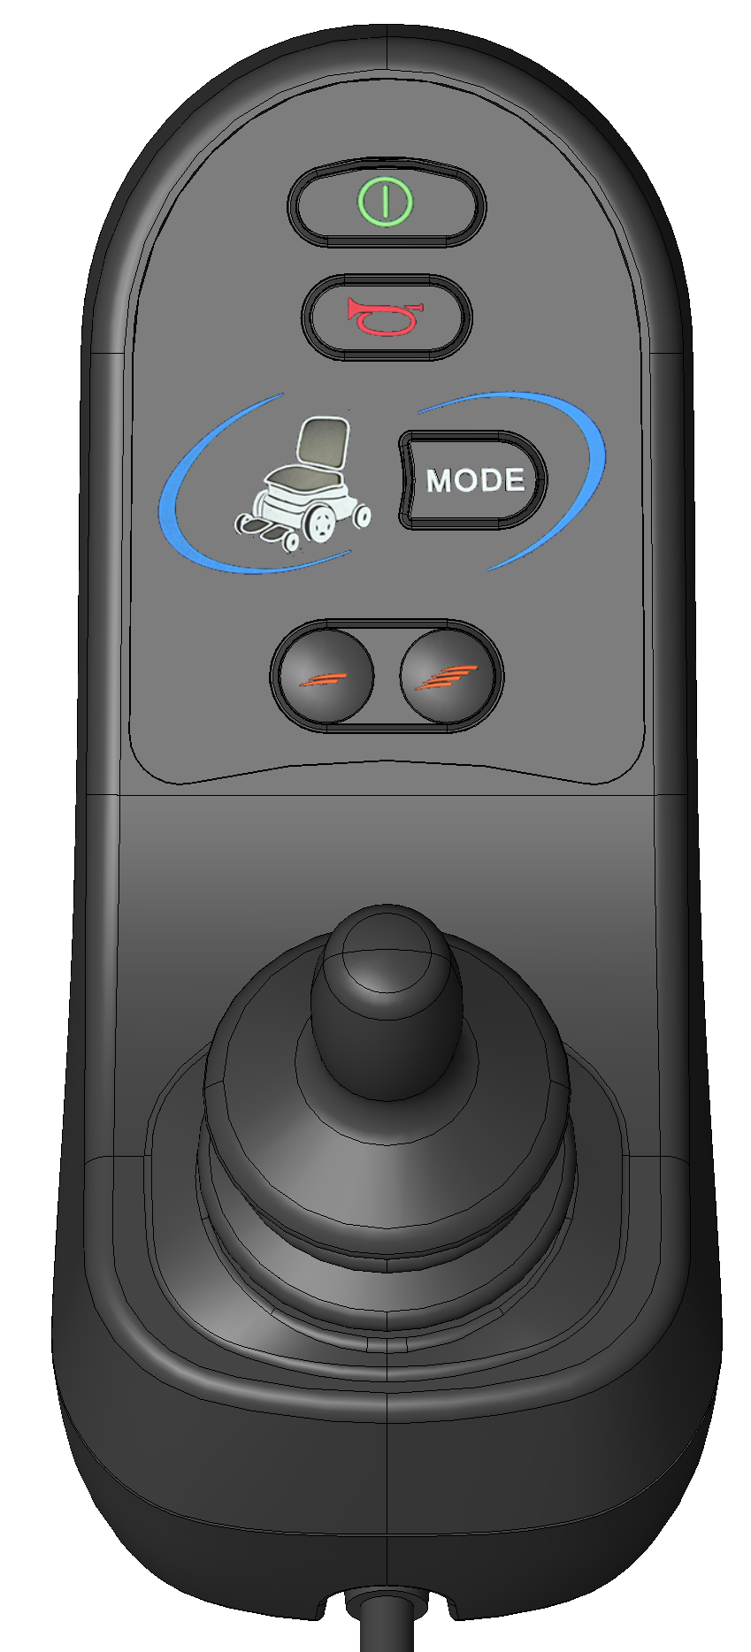
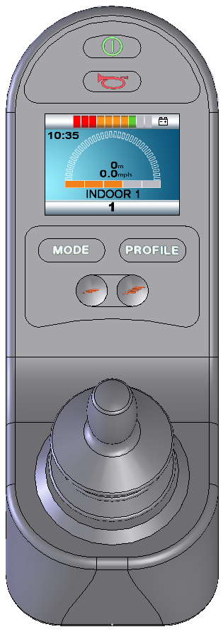
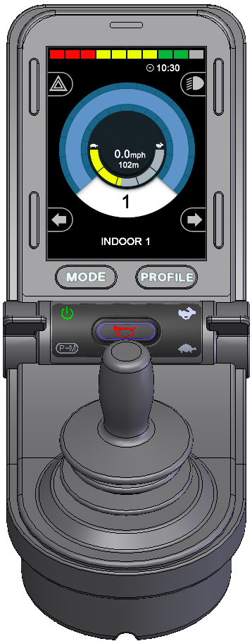
Accessing Programming
Programming can be accessed a variety of ways, all of which are dependent on the joystick option you’ve selected.
RNET LED
RNET COLOUR SCREEN
RNET ADVANCED BLUETOOTH

Slide 5
Accessing Programming
Most commonly prescribed joystick in Manitoba
Can access programming using:
RNET Dongle + PC Computer
DTT Programmer
RNET Wifi Dongle + Laptop/Phone/Tablet
RNET LED

Slide 6
Accessing Programming
Less commonly prescribed joystick in Manitoba
Can access programming using:
RNET Dongle + PC Computer
DTT Programmer
RNET Dongle [On-board Programming (OBP)]
RNET Wifi Dongle + Laptop/Phone/Tablet
RNET COLOUR SCREEN

Slide 7
Accessing Programming
Rarely prescribed joystick in Manitoba
Can access programming using:
RNET Dongle + PC Computer
DTT Programmer
RNET Dongle [On-board Programming (OBP)]
RNET Wifi Dongle + Laptop/Phone/Tablet
RNET ADVANCED BLUETOOTH

Slide 8
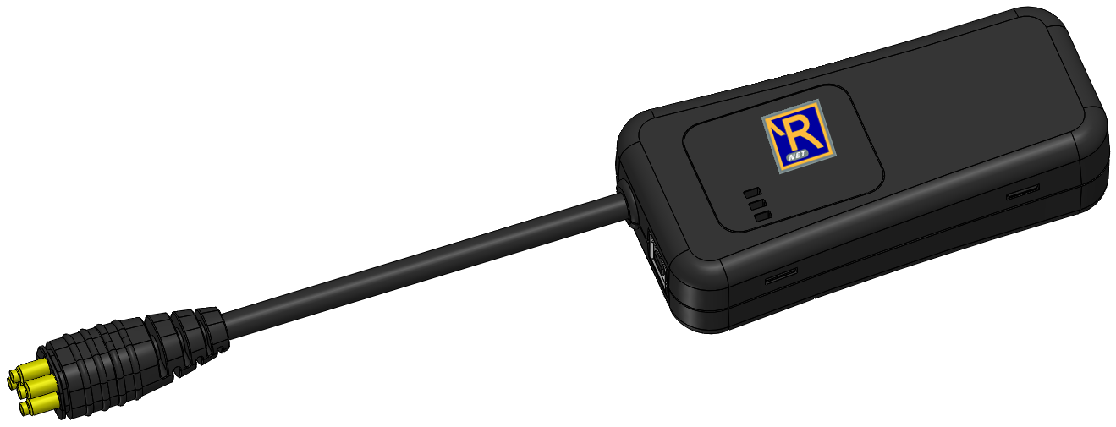
Types of Programmers
RNET Dongle
DTT Programmer
RNET Wifi Dongle

Slide 9
Basic Parameters
Programming a power wheelchair is how we configure the chair’s settings to meet the specific needs and goals of the end user. The most common programming parameters that are adjusted and customized to ensure safety and independence are:
Speeds (forward, reverse, turning)
Rates (acceleration, deceleration)
Sensitivity (tremor dampening)
Throw
Deadband
Power
Torque
Profiles

Slide 10
Speeds
Capable of adjusting the Forward, Reverse and Turning Speeds
Speed parameters allow you to set the minimum and maximum speed the chair can achieve
Consider the environments the client uses most commonly when setting min/max speeds.
Josyticks that allow for multiple profiles will allow you to have different parameters set for various environments,

Slide 11
Rates
Capable of adjusting the Acceleration and Deceleration for Forward, Reverse and Turning.
Acceleration is how quickly the power chair reaches the programmed maximum speed, while deceleration is the rate at which the power chair will come to a stop after the joystick gimble is released. Forward acceleration, for example, can be set to provide a slow, smooth start or it can be set to be a very quick start, which can be jerky – or somewhere in between the two. Likewise, depending upon the programming, forward deceleration can be slow, coasting stop (that might not be quick enough to avoid sudden obstacles) or it can be a sudden stop that pitches the client forward – or somewhere in between the two. Client postural control and balance are two factors that will influence optimal programming in acceleration and deceleration for a given client.

Slide 12
Sensitivity (Tremor Dampening)
Capable of adjusting how sensitive the overall joystick is to movement.
This allows the sensitivity of the input device (joystick) to be adjusted to dampen the effects of a tremor. In essence, tremor dampening reduces the responsiveness of the wheelchair to the small, unintended movements made on the input device, lessening the effects of the tremor, so that the wheelchair responds to the intended, directed movements made on the joystick gimble.
The higher the value, the longer you will have to hold the joystick in a given direction before the chair moves.

Slide 13
Joystick Throw
Active throw is used to decrease the distance that a client must deflect the joystick gimble to achieve the maximum programmed speed. For example, if active throw is set to 50%, the client has to push the gimble forward by only half as much distance, compared to factory pre-sets, to achieve maximum speed. This may be a good solution for a client who has muscle weakness and has difficulty maintaining full deflection of the input device.

Slide 14
Deadband
Deadband is the neutral zone around the centre of the gimble through which the joystick must pass before the motors are engaged. The size of the deadband can be programmed to suit the needs of the individual. For example, a client who uses a joystick gimble to operate a power chair may unintentionally deflect the gimble away from centre due to the weight of the hand on the joystick gimble and gravity pulling the joystick to either side. Increasing the size of the deadband increases the size of the neutral zone and means that the client must move the joystick gimble through the neutral zone before the wheelchair will start to move.

Slide 15
Power
Power refers to the maximum amount of power that can be drawn from the battery. The amount of power influences the speed and torque that are available. The higher the power limit, the more power that is drawn from the battery. It is important to note that even when the Power is programmed to 100 per cent, normal driving does not pull 100 percent power from the controller. The maximum power is available when needed in certain stalled out conditions, such as when the power chair is stuck in a ditch and requires the use of maximum power to overcome the situation.
Typically, when a client is a new power wheelchair user, the power is decreased in the programming as the client becomes accustomed to driving a power chair. Decreasing the power, to 30 per cent for example, while a client is in the initial learning phase can decrease the damage that is done to walls, doorways and furniture!

Slide 16
Torque
Torque helps the power chair to climb obstacles, such as curbs; to perform maneuvers from a stopped position, such as turning; and to perform maneuvers from low speeds, such as climbing a steep ramp. With insufficient torque, the client may be unable to climb a curb cut-out without having a "running start" (i.e. backing up and having the power wheelchair in forward motion before attempting to climb a small obstacle, rather than climbing a small curb from a stopped position).
Torque is a function of power; therefore, if the programmed setting for power is decreased, the available torque also will be decreased. Torque in power chairs is needed in low speeds.

Slide 17
Profiles
Only available with RNET Colour Screen or RNET Advanced Bluetooth joysticks
Up to 8 profiles can be turned on
Each profile has its own set of parameters (speeds, acceleration, etc)
Commonly used to have different parameters set for each environment the client drives in (i.e. indoor, outdoor, bathroom, etc)
If the client is driving the wheelchair in different environments, the client may need to have the programming optimized for each environment. For example, the parameters may be lower for an indoor environment and higher for an outdoor environment. If the client regularly fatigues during the day or participates in different activities, specific programming can be made in different profiles to accommodate the different needs.

Slide 18
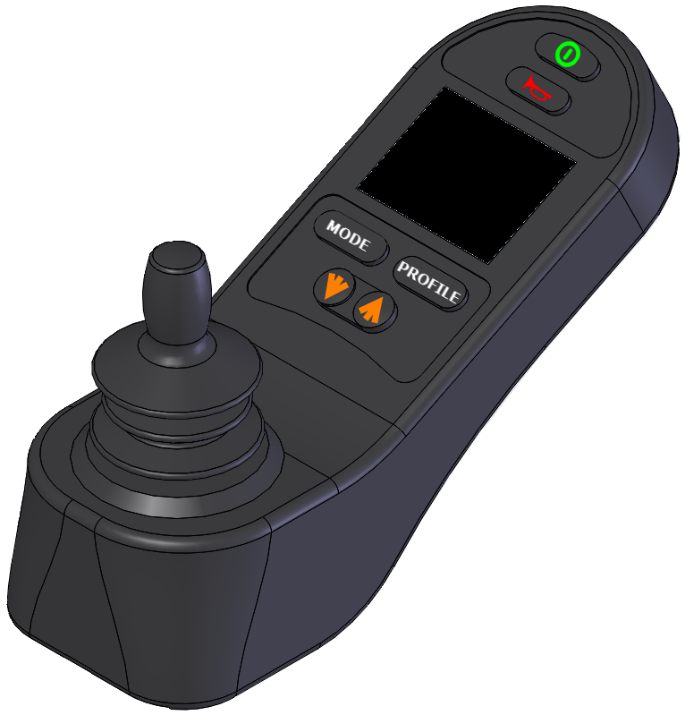
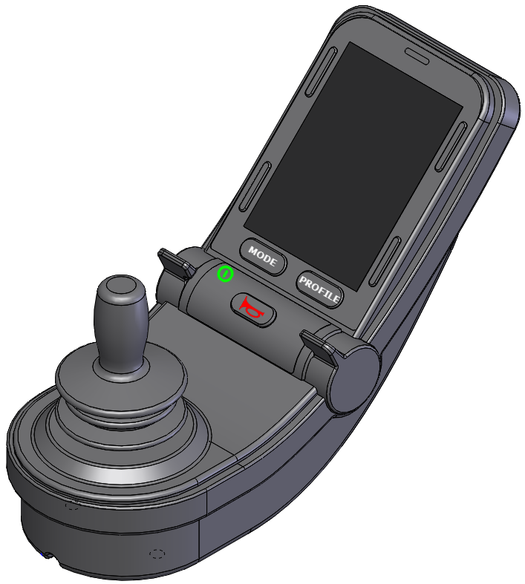
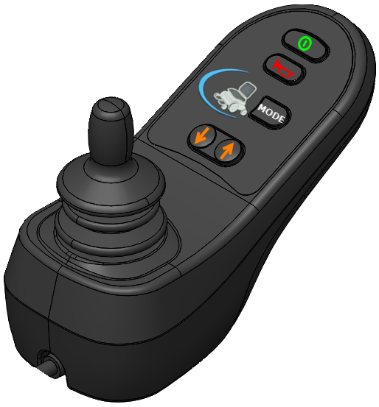
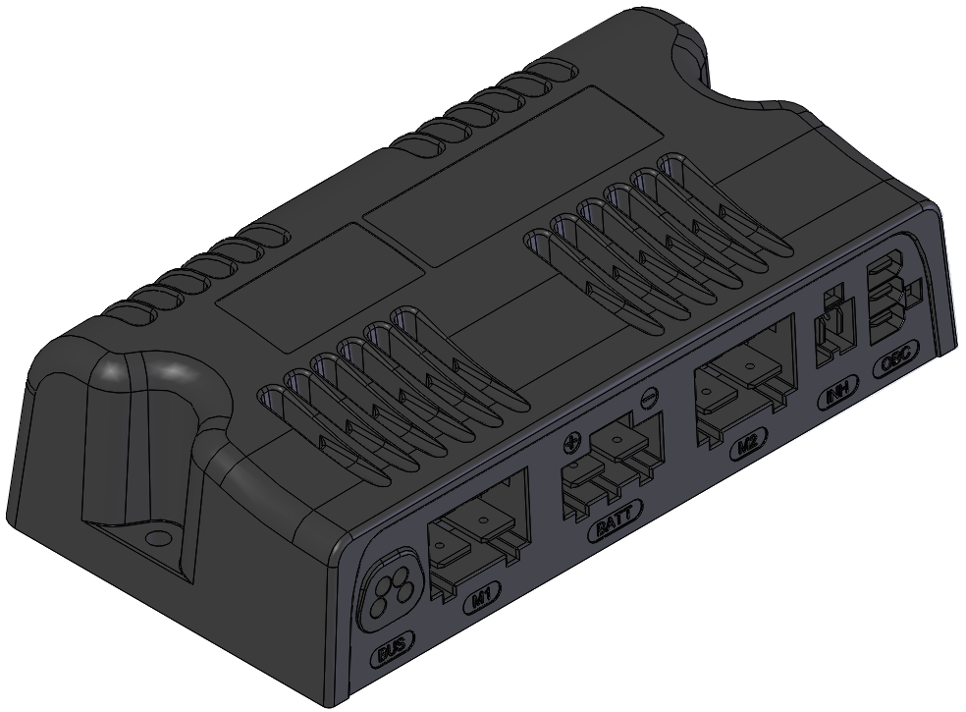
Connecting the Dongle
CONNECT THE DONGLE IN LINE WITH THE JOYSTICK

Slide 19
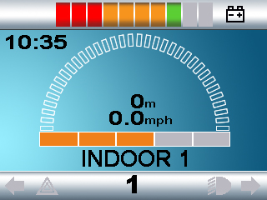
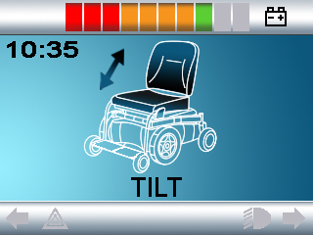
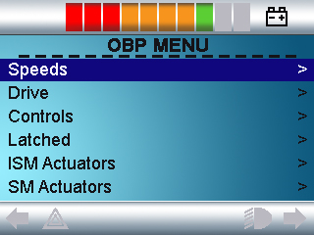
OBP PROGRAMMING ACCESS
TURN ON CHAIR
PRESS MODE BUTTON UNTIL OBP ACCESS
NAVIGATE MENU WITH JOYSTICK
USE SPEED BUTTONS TO ADJUST VALUES
COLOR JOYSTICK

Slide 20
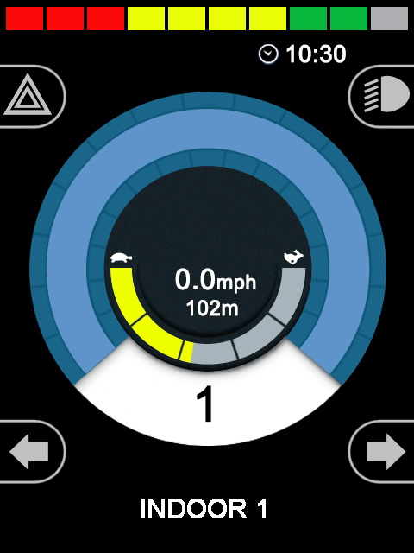
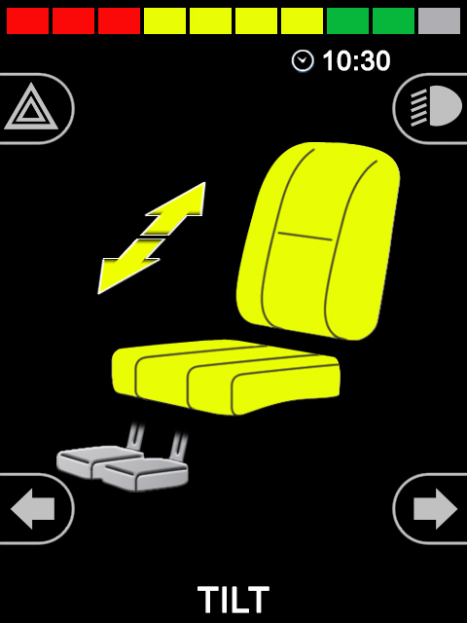
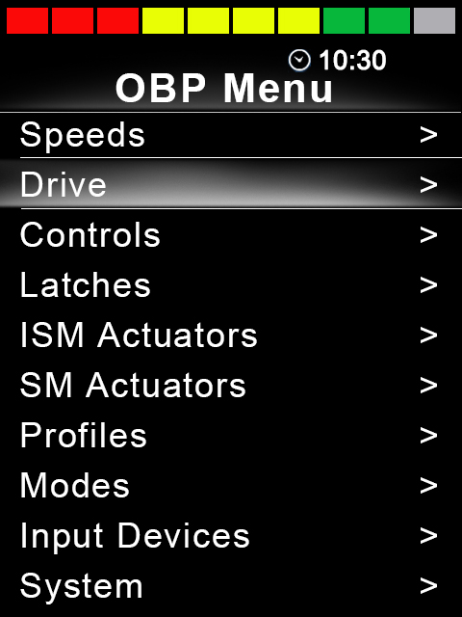
OBP PROGRAMMING ACCESS
TURN ON CHAIR
PRESS MODE BUTTON UNTIL OBP ACCESS
NAVIGATE MENU WITH JOYSTICK
USE SPEED TOGGLE TO ADJUST VALUES
ADVANCED JOYSTICK

Slide 21
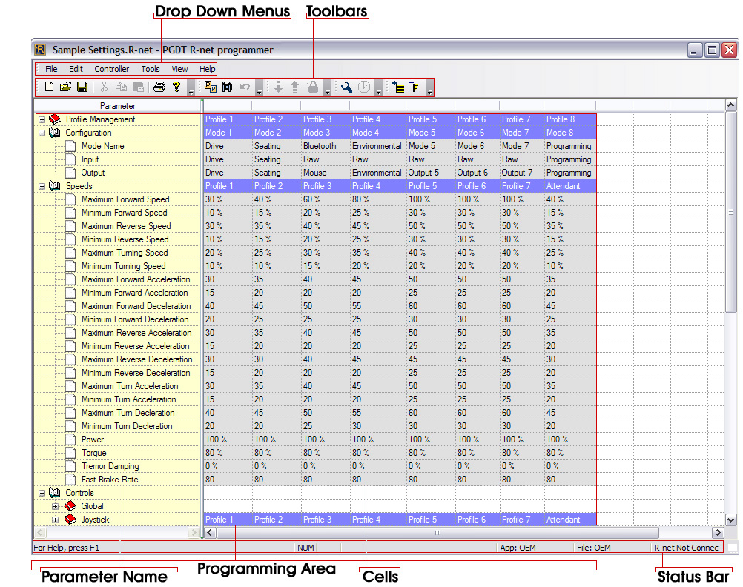
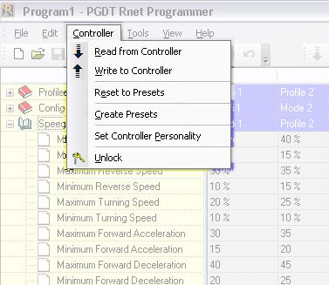

PC PROGRAMMER
MUST USE AMYLIOR RNET SOFTWARE WHEN PROGRAMMING WITH PC
CAN DOWNLOAD THIS FROM AMYLIOR WEBSITE

Slide 22

QUESTIONS
Contact
brandon@medsupplysales.com

Slide 23

HANDS ON PROGRAMMING
ADJUST SPEED & ACCELERATIONS
TEST DRIVE, PUT CRAZY NUMBERS AND FEEL THE DRIVING DIFFERENCE
ADJUST TREMOR DAMPENING & DEADBAND
TEST TO FEEL THE DIFFERENCE
TURN OFF PROFILES AND MODES
**NEVER TURN OFF MODE 8

