Slide 1
Friday, September 28th
Warm up –
  Unit 2 Test
  Current Event
  Unit 3 Vocabulary Activity
Unit 3 – Marketing Information Management
  Slide Show/Notes

Slide 2
Monday, October 1st
Unit 3 Marketing Info Mgmt
Warm up –
  Unit 3 Vocabulary Activity
Unit 3 – Marketing Information Management
  Slide Show/Notes
6 WEEKS TEST ON FRIDAY!!!

Slide 3
Tuesday, October 2nd
Unit 3 Marketing Info Mgmt
Warm up –
  Unit 3 Vocabulary Activity
Unit 3 – Marketing Information Management
  Slide Show/Notes
6 WEEKS TEST ON FRIDAY!!!

Slide 4
Wednesday, October 3rd
Unit 3 Marketing Info Mgmt
Warm up –
  Unit 3 Vocabulary Activity
Unit 3 – Marketing Information Management
  Review
  Open Note Quiz - Elements
6 WEEKS TEST ON FRIDAY!!!

Slide 5
Thursday, October 4th
Unit 3 Marketing Info Mgmt
REVIEW
  Everything since 8/27
  QUIA Reviews
6 WEEKS TEST ON FRIDAY!!!
  41 QUESTIONS

Slide 6
Friday, October 5th
Warm Up
  6 Weeks Test
  Current Event
Skittles Activity
Obj. 4.08 – Use of Technology in MIM
  Slide show/Notes

Slide 7
Monday, October 8th
Warm Up
  Review 6 Weeks Test
Obj. 4.08 – Use of Technology in MIM
  Slide show/Notes
LAST DAY of 1st 6 WEEKS
  Grades!

Slide 8
Unit 3 –
Marketing Information Management.
  4.06 & 4.08 Acquire foundational knowledge of marketing-information management to understand its nature and scope.

Slide 9
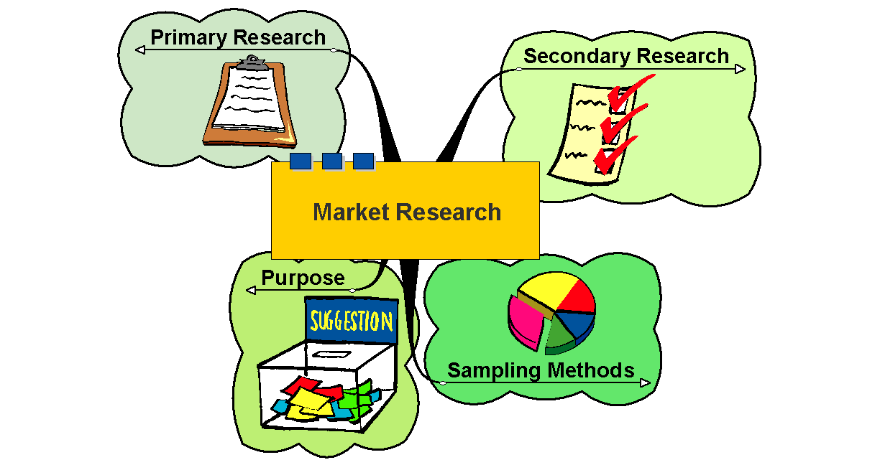

Slide 10
MIM Vocabulary
Define the following terms: marketing information, marketing-information management system, and marketing research.
Marketing Information
  Information gleaned from talking with the customer
Marketing-Information Management System
  Method for collecting and analyzing/interpreting data
Marketing Research
  Methodology for discovering the customer’s wants and needs – links consumer, customer and public to marketer

Slide 11
MARKETING INFORMATION MANAGEMENT
= MARKETING FUNCTION THAT:
GATHERS, RECORDS, ANALYZES & DISSEMINATES INFORMATION
FORECASTS WHAT TYPES OF MERCHANDISE WILL BE SOLD
FOR THIS YOU NEED MARKETING INFORMATION

Slide 12
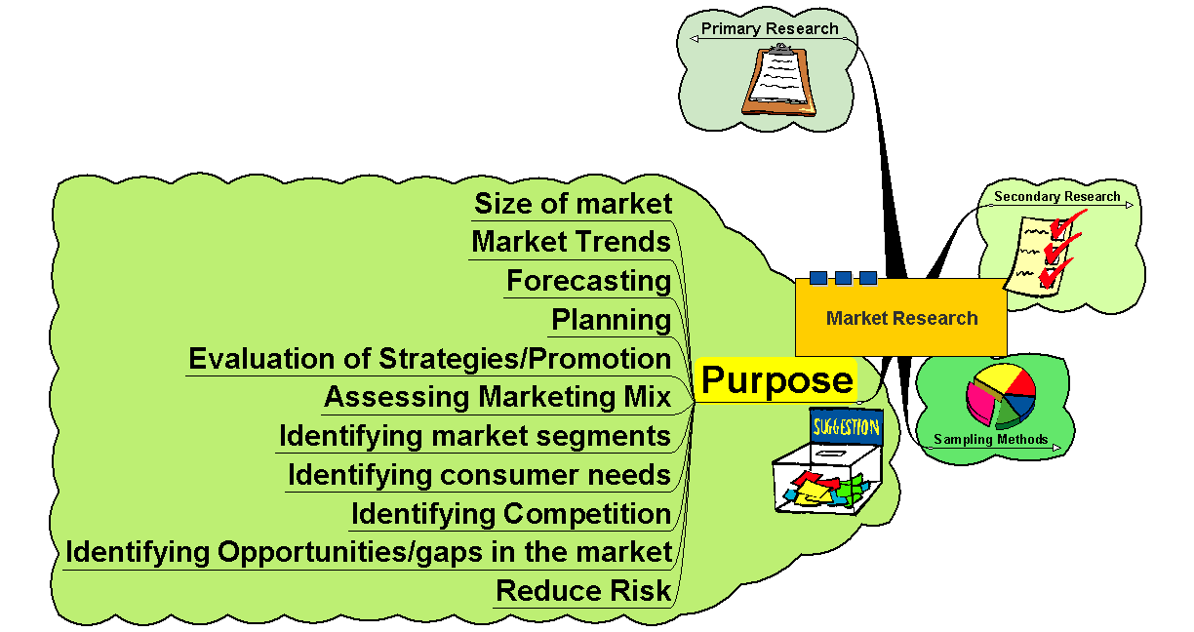

Slide 13
What Information is Important in the areas of:
PRODUCTION
PRICING
PROMOTION
DISTRIBUTION
SALES

Slide 14
Who uses marketing research?
Marketing research may be formal or informal
Marketing research may be internal or external
Depending on the size of the business it may be done in house (internal department) or outsourced (hire an expert)
Government, opinion polls, associations and businesses use marketing research

Slide 15
Describe the need of marketing information.
  To meet a customer’s needs/wants, a company must know what s/he needs
  To better adapt to changing markets

Slide 16
Explain why marketers should collect information
To stay ahead of the competition
To better serve current customers
To successfully expand into new markets
To better understand the economy’s effect on its customers
Answers: what should be produced, where it should be sold, how best to promote product, and at what price to sell the product

Slide 17
Classify types of marketing information as primary or secondary.
  Primary is information the company collects directly from its own surveys – first time collected; expensive
  Secondary is information the company collects from other sources (libraries, online, Federal publications, etc.) – desk research – already exists

Slide 18
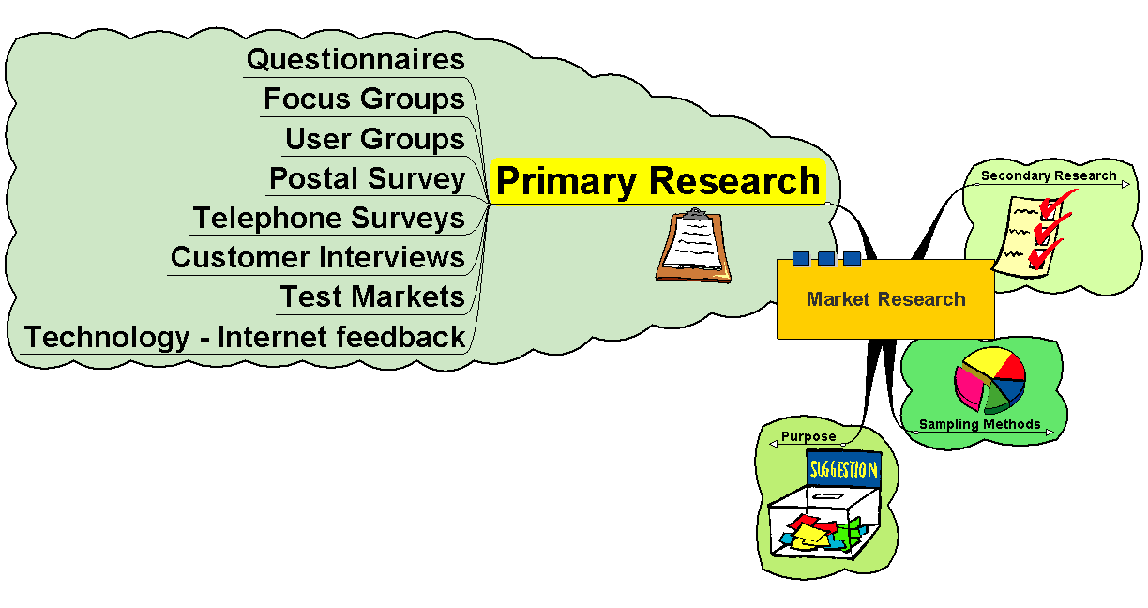

Slide 19
Primary Research
First hand information
Expensive to collect, analyse and evaluate
Can be highly focussed and relevant
Care needs to be taken with the approach and methodology to ensure accuracy
Types of question – closed – limited information gained; open – useful information but difficult to analyse

Slide 20
Quantitative and Qualitative Information:
Quantitative – based on numbers
  56% of 18 year olds drink alcohol at least four times a week
  doesn’t tell you why, when, how
Qualitative – more detail
  tells you why, when and how!

Slide 21
Examples of Primary Sources
Past sales
want slips (shows what’s NOT in stock)
comparison shopping (competitors prices/products
Customer opinion:
  comment cards
  food left on plate
Fashion
  who is wearing what
info from sales reps.

Slide 22
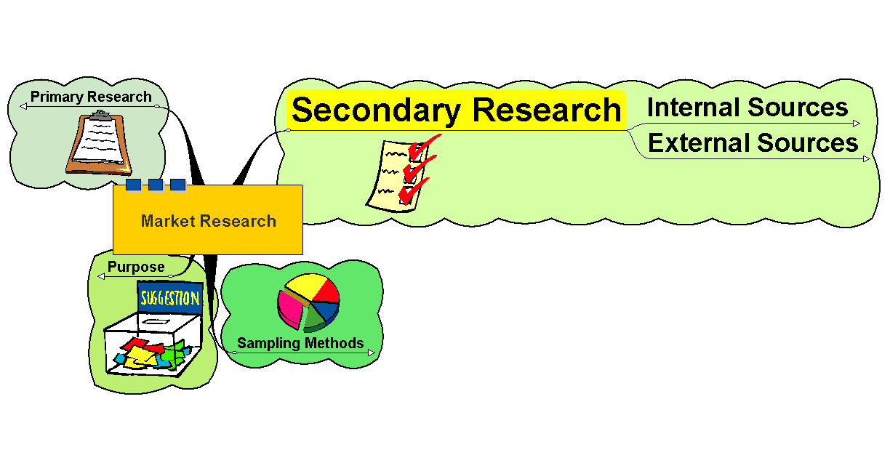

Slide 23
Internal Sources
Company Accounts
Internal Reports and Analysis
Stock Analysis
Retail data - loyalty cards, till data, etc.

Slide 24
External Sources
Government Statistics (ONS)
EU - Euro Stat
Trade publications
Commercial Data - Gallup, Mintel, etc.
Household Expenditure Survey
Magazine surveys
Other firms’ research
Research documents – publications, journals, etc.

Slide 25
Types of MIM
  Attitude Research – opinion research = feelings
  Market Research – info related to marketing a good/service
    Sales Forecasting = project future sales
    Economic Forecasting = predict economic future
  Media Research – media selection & frequency (media mix)
    Researching print advertisements, broadcast media, online
  Product Research – product design, packaging, usage
    New product acceptance
    Existing product research

Slide 26
Describe the types of information marketers should obtain.
  Customer preferences and opinions
  Competitors actions and effects on potential customers
  Buying habits (how often a customer repurchases)
  Is the correct message getting to the customers?

Slide 28
MARKET ANALYSIS
STUDIES THE BEHAVIOR OF CUSTOMERS AS A GROUP:
COLOR PREFERENCES
STYLE PREFERENCES
PREFERENCES BY GENDER, AGE, INCOME, ETC.

Slide 29
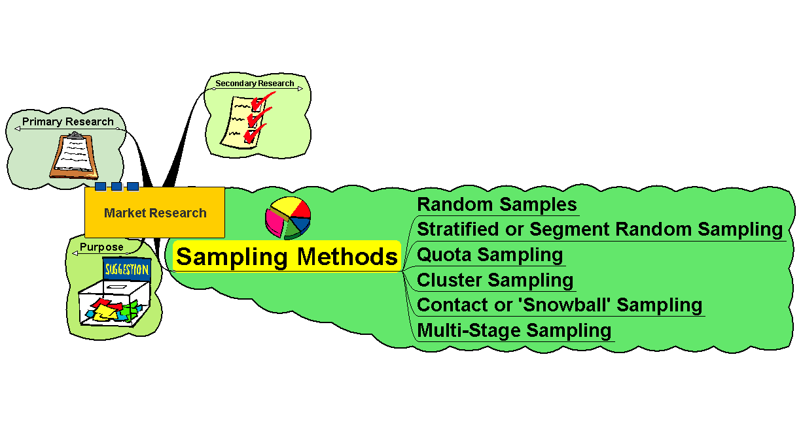

Slide 30
Sampling Methods
Random Samples – equal chance of anyone being picked
  May select those not in the target group – indiscriminate
  Sample sizes may need to be large to be representative
  Can be very expensive

Slide 31
Sampling Methods (cont)
Stratified or Segment Random Sampling
  Samples on the basis of a representative strata or segment
  Still random but more focussed
  May give more relevant information
  May be more cost effective

Slide 32
Sampling Methods (cont)
Quota Sampling
  Again – by segment
  Not randomly selected
  Specific number on each segment are interviewed, etc.
  May not be fully representative
  Cheaper method

Slide 33
Sampling Methods (cont)
Cluster Sampling
  Primarily based on geographical areas or ‘clusters’ that can be seen as being representative of the whole population
Multi-Stage Sampling
  Sample selected from multi-stage
  sub-groups
Snowball Sampling
  Samples developed from contacts
  of existing customers – ‘word of mouth’ type approach!

Slide 34
Categorize internal sources of marketing information
  Customer surveys
  Sales people feedback
  Database of customers and their purchases
  Sales reports
  Company records

Slide 35
Discuss external sources of marketing information.
  Federal/State/Local government
  Published reports from other sources (competitors, industry research, news sources)
  Trade reports

Slide 36
1. INTERNAL SOURCES
INFORMATION WITHIN THE BUSINESS:
  SALES RECORDS (VERY, VERY IMPT.)
  INVENTORY RECORDS
  SALES REPORTS
  CUSTOMER REQUESTS
  CUSTOMER COMPLAINTS
  MERCH. RETURNS
  PROMOTION RECORDS
  MARKDOWN RECORDS
  INCOME STATEMENTS & BALANCE SHEETS

Slide 37
2. EXTERNAL SOURCES OF INFO.
INFORMATION FOUND OUTSIDE THE BUSINESS:
  TRADE ASSOC. & business PUBLICATIONS
  MARKET RESEARCH COMPANIES (DUNN & Bradstreet, Neilson,etc.
  Government

Slide 38
MORE EXTERNAL SOURCES
COMPARISON SHOPPING AT COMPETING BUSINESSES
SALES REPS
CHAMBER OF COMMERCE
CONSUMER SURVEYS

Slide 39
GOVERNMENT SOURCES OF INFO
VOTER REGISTRATION DATA
CENSUS DATA (shows changes in populations)
LABOR STATISTICS
ECONOMIC INDICATORS

Slide 40
Describe the characteristics of useful marketing information
Can be interpreted correctly
Accurate
Relevant (current and useful)

Slide 41
Describe reasons that marketers need to gather accurate information.
  All business decisions are based on the information collected and how that info is interpreted/analyzed

Slide 42
MARKETING
INFORMATION
SYSTEM

Slide 43
MARKETING INFORMATION SYSTEM
ANY INFORMATION THAT HELPS THE MOVEMENT OF GOODS & SERVICES
ORGANIZED WAY OF CONTINUALLY GATHERING, SORTING, ANALYZING EVALUATING & DISTRIBUTION INFORMATION TO MGRS
AKA: MIS OR MKIS

Slide 44
Explain the functions of a marketing-information management system.
  Collect accurate and useful data
  Analyze and interprets the data into usable information
  Shows trends and clearly explains why the market is the way it is
  Helps the managers make good business decisions (expand/delete a product line, enter new markets, set pricing and service policies, etc._

Slide 45
Contrast marketing research with a marketing-information system.
  Research is the collecting of data
  An MIM system can include research but also is responsible for assisting with making decisions
  Improve the level of satisfaction consumers feel with the company’s products
  Build sales and profitability
Describe the use of a marketing-information system.

Slide 46
Explain the benefits of a marketing-information management system
  Happier customers
  Less threat from competitors
  Higher profits (in the long-run)

Slide 47
Discuss the requirements of a marketing-information management system.
  Collection of accurate data
  Effective analysis
  Relevant
  Helps the company better understand its current and potential customers
Explain the role of marketing-information management in marketing.

Slide 48
Describe limitations of marketing-information management systems
  Benefits of the information must be greater than the expenses of the MIM system – small businesses can’t afford the expense
  Significant investment of time and money
  The information being managed is only as good as what is collected and how it is analyzed (Garbage In, Garbage Out - GIGO)

Slide 49
Credibility and Ethics
Describe the importance of credibility and objectivity in marketing-information management.
  Credibility is whether the data can be trusted - Is it accurate?
  Objectivity addresses whether there is bias in what is collected
    Do we show all the information, even the stuff that makes our past decisions look bad?
    Do we only collect information that supports our goals or points of view?

Slide 50
Credibility and Ethics (cont)
why the integrity of the marketing information must be protected.
  Personal information (that can be used to identify specific people) that is collected must be protected from unauthorized use.
  The integrity of the data is critical to its accurate analysis and interpretation
  Information collected unethically must be handled according to the law

Slide 51
Ethics in MIM (cont)
types of ethical conflicts in mim
  Keeping collected information confidential
ethical issues associated with obtaining information about competitors.
  Corporate spying is illegal and immoral
  A company is allowed to use published data about competitors that is available for public use
  A company may not use information obtained unethically.

Slide 52
Ethics in MIM (cont)
ethical issues created by the use of technology in data collection.
  Just like with law enforcement, technology may not be used to obtain information that the company has no right to
  Information collected by the company must be protected from inappropriate use or distribution
  Information collected from research surveys taken for one specific purpose (i.e. consumer credit) may not be used for marketing campaigns (i.e. direct mail)
  Use of “cookies”

Slide 53
4.08

Slide 54
Technology
How does use of technology impact the marketing-information management function?
  Makes it easier to collect and store certain information
  Information can be analyzed using specialized software
  Many more details can be tracked

Slide 55
Technology (cont)
How do we track and monitor customer website activities for MIM?
  Use of “cookies”
  Accurate count of hits to a website

Slide 56
Technology (cont)
How can customer-to-business communications on the Internet be used in MIM?
(e.g., email reminders, popup notices, online focus groups, etc.)
  Computers track details well and software can provide reminders to customers
  Customers can choose to go to company websites and/or join online groups and submit their opinions and suggestions

Slide 57
Technology (cont)
How does the Internet provide services for conducting research?(e.g., search engines, tools for online surveys, database access, blogs, etc.)
  There are many sources of information available on the Internet
    General and specialized libraries
    Search engines for finding specific sites or information
    Paid services that assist with locating research information

Slide 58
Technology (cont)
How do marketers’ use virtual realties and simulations in MIM?
  Marketers use games and online simulations to engage the customer and glean preference information
  Customers can make choices based on preset simulations and the information can be recorded to help the company better understand the mind of the consumer.

Slide 59
Technology (cont)
How can the use of Global Positioning Systems (GPS) facilitate MIM?
  Because customers aren’t always stationary
  some move from one area of the state or country to another,
  GPS helps companies understand who is making the buying decisions

Slide 60
Technology (cont)
Explain the use of data analysis software in marketing-information management.
  Specialized software allows data to be analyzed properly
  Can be set up to give the information in a specified format

Slide 61
Advantages of MIM
Helps focus attention on objectives
Aids forecasting, planning and strategic development
May help to reduce risk of new product development
Communicates image, vision, etc.
Globalisation makes market information valuable (HSBC adverts!!)

Slide 62
Disadvantages of MIM
Information only as good as the methodology used
Can be inaccurate or unreliable
Results may not be what the business wants to hear!
May stifle initiative and ‘gut feeling’
Always a problem that we may never know enough to be sure!

Slide 63
Important Points
An example of marketing information that a business could gather by surveying its customers is the location of the company’s market.
Marketers are continually gathering information because the marketing environment is constantly changing.
Marketing information must be cost-effective and interpreted correctly.
Ethically information must be kept confidential; only used for the original purpose it was gathered.

Slide 64
Important Points (cont)
Cookies placed on a user’s hard drive when the user visits the business’s web site help a business to customize its marketing efforts.
By creating a database of information about customers’ purchases, brand preferences, dollar amounts spent, preferences and buying habits a business can track the number of times the user buys a product and builds strong, loyal customer relationships.

