Slide 1
Monday, May 3rd
Unit E9 – Analyze Pricing
Warm up – Unit E8 Test – Quia
Unit E9 – Vocabulary – Write Terms and Definitions
Complete Coke paper if needed
Obj. E9.01 – Foundations of Pricing
  Slide Show/Notes

Slide 2
Tuesday, May 3rd
Unit E9 – Analyze Pricing
Review Unit E8 Test Results
Obj. E9.01 – Foundations of Pricing
  Review Slide Show/Notes
  Activity – Price Range Acceptance
Obj. E9.02 – Exemplify Pricing
  Slide Show/Notes

Slide 3
UNIT E
PRODUCT/SERVICE MANAGEMENT AND PRICING
9.01 Understand the foundations of pricing.

Slide 4
Price
The dollar value (or its equivalent) placed on a good or service.
Rent
Fee
Premium
Toll
Fine
Tuition

Slide 5
Importance of Price
A critical marketing mix element
  Most clearly establishes / identifies company’s image in the minds of potential customers
  Has great impact on company’s
    Competitive edge
    profit

Slide 6

Price is a measure of quality
If an item is priced too low, customers perceive that the quality is low.
Customers expect certain items to cost more.

Slide 7
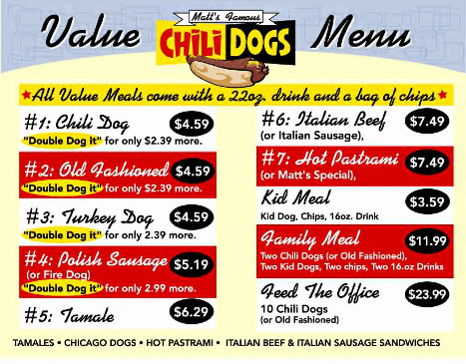

Price is a form of competition
Business prices must be competitive or the customer will buy elsewhere.
Businesses sometimes price items below cost to match competitors.

Slide 8
Importance of Price
A factor in the customer’s assessment of product value in meeting a need/desire
  Customer determines usefulness of available products, then choose which to purchase based on assessment of relationship between the price of the product and its suitability for their purpose

Slide 9
Price Range Acceptance Activity
How much would you pay for a 12oz soft drink?
  A. From a Vending Machine?
  B. At the Movie Theatre?
  C. In a Restaurant?

Slide 10
Price Range Acceptance Activity
How much would you pay for a steak dinner?
  A. at a cafeteria style restaurant?
  B. at an elegant restaurant?
  C. at a charity benefit dinner?

Slide 11
Price Range Acceptance Activity
How much would you pay to have a flat tire repaired?
  A. On a lonely stretch of highway?
  B. In a town where public transportation is readily available?
  C. When schools and stores are within walking distance?

Slide 12
Price Range Acceptance Activity
How much would you pay for a duplicate car key?
  A. Just to have an extra key around?
  B. At night in a mall parking lot when your keys are locked in your car?
  C. When your nonrefundable airline ticket is in your locked car, and your flight leaves in 30 minutes, and your car keys are lost?

