Slide 1
Wednesday, January 25th – 1st
Warm up – MM 1.01 Quiz
MM 1.02 – Foundational Knowledge of customer/client/business behavior to understand what motivates decision-making
Slide Show/Guided Notes
Activity
Warning – LOTS of NOTES today! –
TEST on FRIDAY!!

Slide 2
Wednesday, January 25th – 2nd
Warm up – Review MM 1.01 Quiz Results
MM 1.02 – Foundational Knowledge of customer/client/business behavior to understand what motivates decision-making
  Slide Show/Guided Notes
  Activity
Warning – LOTS of NOTES today! –
TEST on FRIDAY!!

Slide 3
Thursday, January 26th
Warm up – Slide show on Touch Points
MM 1.02 – Foundational Knowledge of customer/client/business behavior to understand what motivates decision-making
  Slide Show/Guided Notes – complete Slide show
  Activity – Take Action Worksheet
  Review for Unit test – Quia Activities
TEST on FRIDAY!!

Slide 4

Indicator 1.02
Acquire foundational knowledge of customer/client/business behavior to understand what motivates decision-making

Slide 5
Definitions
Behavior – a response of an individual or group to action, environment, person, or stimulus
Perception - The process by which people translate sensory impressions into a coherent and unified view of the world around them.
Drive – an internal force that results in action
Cues – something that happens or is said which makes something start happening

Slide 6
Definitions
Attitudes –evaluations, feelings, and tendencies toward an object or idea
  Learned through experience and interactions
Beliefs – a descriptive thought about a brand or service
Expectations – what people think will happen/want to happen

Slide 7
Role of Needs and Wants
Want is a conscious desire for something learned during life…based on personal experience, culture, or education
Customers may not shop for particular product
  Ex: Most people transform hunger into want for a certain food. They shop for need satisfying qualities of product.
  Need satisfying quality often referred to as a benefit.
Sometimes you are not aware of your needs, just your wants.

Slide 8
Role of Needs and Wants
Marketers can use understanding of customers’ need to develop products and marketing mixes that satisfy unconscious needs as well as conscious wants.
Can have needs that will be developed with invention of new products
  When customers perceive a need, feel a drive, or have a want, they seek a way to satisfy it.

Slide 9

Selective processes consumers use to respond to stimuli
Marketers believe consumers follow at 6-step decision making process:
  Awareness of need or problem
  Information search
  Evaluation of options
  Decision to buy
  Purchase
  Post-purchase evaluation

Slide 10
Selective processes contd.
There are 4-levels of purchase decisions:
  Impulse – made with no prior planning or research (example: soda @ checkout on a hot day)
  Routine – made quickly and without much thought (example: purchasing same deodorant)
  Limited – made with some research and planning (example: checking reviews & Consumer Reports before purchasing a new laptop)
  Extensive – involves a great deal of research and planning (example: purchasing your first car)

Slide 11

Attitudes vs Beliefs
Attitudes
  Are more subjective
  Can change from person to person
  A state of mind
  An opinion
Beliefs
  What we think the facts are
  What you take to be true
  Beliefs can be mistaken
  Beliefs can change over time
  Most will defend their beliefs to the end

Slide 12
Cultural influences on buying behavior
The ethnic group that you grew up in:
  provides you with an initial set of values, beliefs, and behaviors.
  Provides you with attitudes toward products, buying, credit, and shopping
  May also affect your ideas of what is appropriate to buy, wear, and do
Don’t just think of ethnic cultures…. There is a teenage culture, California, a Southern, East Coast, Corporate, etc.

Slide 13

Social influences on buying behavior
Social class – the ranking of people based on wealth, education, ancestry, and power
Conveyed through your family, friends (peer pressure), classmates, and other social or professional groups. Also includes TV and movies

Slide 14


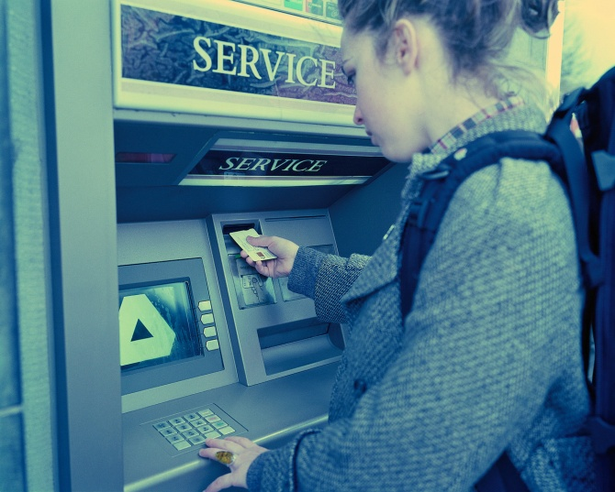
Person’s individual differences impact consumer behavior
Age – life stage
Occupation
Economic situation
Lifestyle
Personality
Self-conception

Slide 15
Psychological influences impact consumer behavior
Influences that come from within a person
According to psychologists our needs are responsible for many of our purchases
A need is a lack from within. If the need is not satisfied, it turns into a drive
Think of Maslow’s Hierarchy of needs

Slide 16
Situational influences that impact consumer behavior
Influences that come from the environment
Weather, physical location of the store
Time of day
Visibility of advertising and other promotions
The buyer’s mood, physical condition, and financial condition at the time

Slide 17
Consumer vs. business buying behavior
Consumer
Business
Major influences
  External – groups, culture, situation
  Marketing – 4Ps and service
  Internal – perception, attitude, knowledge, personality, lifestyle, roles, and involvement
  Impulse buying is prevalent
Major influences:
  How decisions are made
  Existence of experienced purchasers
  Time needed to make a decision
  Size of purchases
  Number of buyers
  Type of promotional effort needed to reach the buyer
  Decisions can take weeks, months, years

Slide 18
How do environmental influences affect business customers’ behavior?
Economic trends
  Hybrid vehicles
  Going “green”
Supply conditions
  Fewer but larger customers geographically concentrated
  Demand fluctuates more due to consumer purchases (increase/decrease)
Technological, political, and competitive changes
  Bidding process between competitors offer similar products/services
Culture and customs

Slide 19
How do organizational influences affect business customers’ behavior?
Objectives
Policies
Procedures
Organizational Structure
System

Slide 20
Why do marketers attempt to satisfy both a company’s needs and those of individuals when working with business customers?
If don’t satisfy and persuade the individual at a business, won’t be able to work with the business.
Must appeal to authority and status of individual while being empathetic to their situation at their business.

Slide 22
What actions can companies take to contribute to their success?
Align all company activities and strategies with business goals
Provide proper training for employees
Protect business’s reputation
Communicate honestly and clearly within and outside business
Provide excellent customer service
Utilize touch points to reinforce company image
Utilize both rational and emotional motivation to convince customers to buy
Demonstrate corporate responsibility

Slide 24
The importance of aligning company activities and strategies with business goals
Outline a clear set of goals and objectives
Must have a PLAN to reach those goals and then STICK to the plan
The plan MUST encompass all of the company’s activities and strategies

Slide 25
The need for businesses to provide proper employee training
Employees need time to adjust to new jobs and work environments
Each company is unique and has specific processes and procedures that employees must learn
Successful companies take the time and spend the money to provide proper training and ongoing professional development

Slide 26
The importance of protecting the business’s reputation
Once ruined, hard to recreate or get back to what it was
If steps aren’t taken to protect it, it can be destroyed
Must put controls in place to stop mistakes
  IF mistakes happen, be honest and apologize ASAP
  FIX IT ASAP!!!

Slide 27
The importance of honest, clear communication within and outside the business
Must have this to build a great reputation
Must be honest and straightforward with customers AND employees
No one wants to do business with a dishonest company or one that sends an unclear message

Slide 28
The need to provide excellent customer service for business success
Success is only possible with a STRONG emphasis on great customer service
Must provide friendly, helpful advice, AND support BEFORE, DURING, and AFTER the sale
Must provide customer service by utilizing technology WITHOUT losing the human touch

Slide 29
Touch point situations can contribute to business success
Touch point is a chance for company to connect with potential or existing customers
Use touch points to reinforce desired image to the public
  Ex: When you walk into a Verizon store with a friend
  Ex: A bill comes to your home in the mail
  Ex: You hear a radio ad on the way to school

Slide 30
Why use both rational and emotional motivation to close sales?
A combination (but not an equal one) will finally convince customers to make the purchase
Rational motives appeal to the customers’ sense of logic/judgment
Emotional motives appeal to the customers’ feelings (ie trust)

Slide 31
Demonstrating corporate responsibility contributes to company success
Businesses are part of society, which include certain interests and obligations
Businesses have an impact on the communities around them…it’s up to the business to see that it is a positive impact
Responding to customer issues and concerns
Must do more than just comply with government rules and regulations

Slide 32
Ways can businesses demonstrate corporate responsibility
Sponsor a little league team
Accept toys for the Toys for Tots program
Offering healthier options on a restaurant menu
Accommodating employees’ modern lifestyles with flexible hours, onsite workout facilities or childcare

Slide 33
Results businesses may achieve from taking positive actions
Increased efficiency
Increased brand value
Increased market share
Excellent business reputation
Increased customer loyalty

Slide 34
Negative company actions that businesses should strive to avoid
Not keeping promises
Delivering low-quality goods and services
Using high pressure sales techniques
Acting unethically
Responding inappropriately to crises
Failing to provide what customers want

Slide 35
Negative consequences that may result from businesses’ negative actions
Poor business reputation and brand value
Decreased efficiency
High employee turnover
Decreased sales and market share

Slide 36
The difference between customer satisfaction and customer loyalty
Customer satisfaction is a measure of how well your business or product meets or exceeds customer expectations.
  How HAPPY is the customer?
Customer loyalty is a customer’s preference to a business.
  Do you prefer Lowe’s Foods or Food Lion?

