Slide 1
Unit 3 – Economic Trends
Includes objectives: 2.04, 6.01, 6.02, 6.03

Slide 2
Monday, February 6th
Warm up – Review 3.01 & 3.08 Test Results
Unit 3 – Economic Trends
  Obj. 2.04 - Impact of Government
  Slide Show/notes
  Video – economic cycle!
Class work – Which Government Program should be cut – and why

Slide 3

2.04 Acquire knowledge of the impact of government on business activities to make informed economic decisions

Slide 4
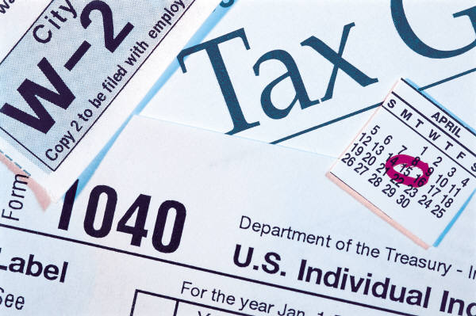
Definitions
Tax – legally mandated payment to the government that is not made in exchange for a good or service. Taxes are used to fund projects that benefit society
Revenue – Income
Expenditure – money paid out; spending
Excise tax – tax placed on a specific good. Examples = gasoline, cigarette, beer, liquor

Slide 5
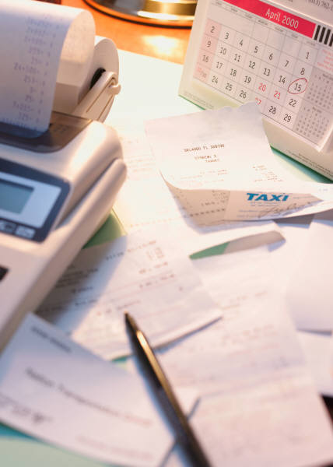
Definitions contd.
Income tax – tax that is based on the amount of money a person earns or receives
Property tax – tax placed on real estate, and in some cases, on personal possessions
Sales tax – tax placed on the retail sale of almost all goods purchased. Certain types of good (i.e. food, medicine) are sometimes excluded from sales tax

Slide 6
Importance of taxes in a market economy
Taxes are the primary source of revenue for the government sector
Some services such as national defense, roads, and education can be more efficiently produced by the government instead of private individuals
The government is responsible for creating the infrastructure necessary for commerce
Without taxes, these services would likely not exist

Slide 7

Sources of tax monies paid to different levels of government
Federal Government
  Sources of Tax Monies: Income taxes, Excise taxes
  Expenditures: National defense, Education, Transportation systems, Judicial system, Social Security and Medicare, Medicaid, Veterans services, etc.

Slide 8

Sources of tax monies contd.
State Governments
  Sources of Tax Monies: Income taxes, Sales taxes, Excise taxes
  Expenditures: State police protection, Education, Operation of state government, etc.

Slide 9



Sources of tax monies contd.
Local Governments:
  Sources of Tax Monies: Property taxes, Sales taxes, Income taxes
  Expenditures: Education, Public health and safety (local fire and police protection), Sanitation, etc.

Slide 10
Describe tax structures
Proportional: everyone pays the same percentage of income in taxes, regardless of income level. (Few taxes are completely proportional in nature.)
Progressive: those who earn more pay a higher percentage of income taxes. The Federal Income tax is an example
Regressive: those who earn more income pay a lower percentage of income taxes. Sales and excise taxes are considered regressive.

Slide 11

Explain the role of the IRS
To collect federal income taxes
To enforce federal revenue law
To help tax payers with tax law
To pursue taxpayers who are not in compliance with tax law

Slide 12
The impact of taxation on the circular flow of income
The circular flow model illustrates the constant movement of product inputs, goods, services, and money in the economy.
See tutorial at http://www.fgn.unisg.ch/eurmacro/tutor/circularflow.html

Slide 13
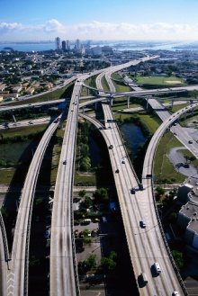

How certain government expenditures are financed through taxes
Roads, highways, and bridges are financed through the gasoline excise tax. Only those people who purchase gasoline – those who use the transportation system – pay the gasoline tax
The Social Security system, which provides income to retired workers, receives its monies from retirement taxes

Slide 14
You be the government!!
http://www.usgovernmentspending.com
Look at government Spending for 2010.
How would you fix it??

