Slide 1
Monday, March 28th
Unit C – Economic Foundations & Financing
Warm up – Go to www.businesstown.com/accounting/basic.asp Go to Sec website – link on quia page
  Read section on income statements and balance sheets
Choose a large corporation and go to their website
Unit 6 – Introduction
Obj. 6.01 – Records Used in Business
PROGRESS REPORTS!!!

Slide 2
UNIT C
ECONOMIC FOUNDATIONS AND FINANCING
6.01 Compare records used in business.

Slide 3
Business Records
Annual Report
Balance Sheet
Income Statement

Slide 4

Annual report
A profile of the health of a company.
By law, a company must provide information to shareholders about the business’s finances.

Slide 5
Annual report
Report issued annually (once a year!) to the company’s stockholders..
Includes financial information as well as other information about company’s operations, plans for future, etc.
Also includes letter from auditor and other information required by law!

Slide 6
Annual report (cont.)
Components of the annual report
  A letter from the chairman
  Philosophy of the business
  Reports on operations
  Balance sheet
  Profit and loss statement (Income statement)
  Auditor’s letter attesting to report accuracy
Mailed to all shareholders and accessible on a company’s web site

Slide 7
Balance sheet
A financial statement that lists the assets, liabilities, and capital (equity) of a business as of a specific date.
Assets = Liabilities + Capital

Slide 8
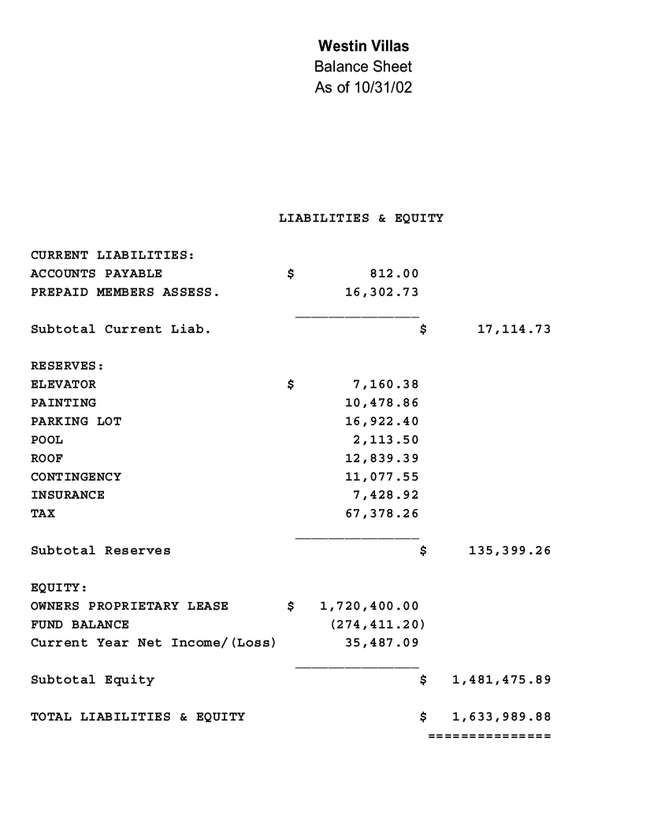
Balance sheet

Slide 9
Balance sheet (cont.)
Assets: Resources of monetary value owned by the business.
Current assets:
Fixed assets:
Intangible assets:

Slide 10
Balance sheet (cont.)
Assets: Resources of monetary value owned by the business.
Current assets: Assets that can be changed into cash in a short period of time.(< 1 year)

Slide 11
Balance sheet (cont.)
Current assets
  Cash
  Cash equivalents such as money market funds and short-term investments
  Accounts receivable: Money that is owed to the company by clients.
  Inventory

Slide 12
Balance sheet (cont.)
Assets: Resources of monetary value owned by the business.
Fixed assets: Assets which cannot be quickly converted to cash. (> 1 year)

Slide 13
Balance sheet (cont.)
Fixed assets
  Buildings
  Equipment
  Property

Slide 14
Balance sheet (cont.)
Assets: Resources of monetary value owned by the business.
Intangible assets: Items such as insurance policies, copyrights, franchises, and patents with values that are difficult to ascertain.
Example: Celebrity endorsements

Slide 15
Balance sheet (cont.)
Liabilities: Debts owed by the company.
Current liabilities:
Long-term liabilities:

Slide 16
Balance sheet (cont.)
Liabilities: Debts owed by the company.
Current liabilities: Debts that are usually paid within one year.
  Accounts payable
  Taxes
  Dividends

Slide 17
Balance sheet (cont.)
Liabilities: Debts owed by the company.
Long-term liabilities: Debts that will take longer than one year to pay off.
  Mortgage
  Loans

Slide 18
Balance sheet (cont.)
Equity (aka capital, net worth, or shareholders’ capital):
The value of a business to its owners (shareholders) after all the commitments have been met.

Slide 19
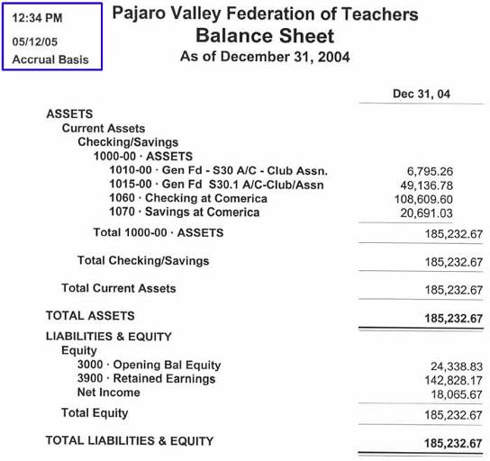
Balance sheet (cont.)
Equity =
Assets - Liabilities

Slide 20
Income statement
Income statement (Profit and loss statement):
A financial statement that reports total revenue, expenses, and profit or loss for a specific period of time. (such as a month, quarter or year!)

Slide 21
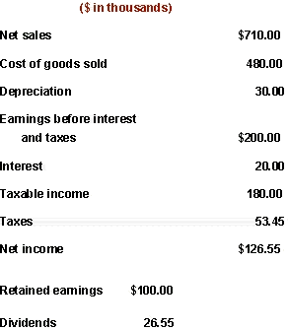
Income statement (cont.)
Components
  Sales
  Cost of goods sold
  Gross profit:
  Depreciation.
  Operating expenses
  Taxes
  Net income (or loss)

Slide 22
Income statement (cont.)
Components
  Sales: The total income from sales of all products and services.
  Sales may also called Income, Revenue, etc depending on the type of business

Slide 23
Income statement (cont.)
Components
  Cost of goods sold (cost of inventory purchased, manufactured, etc)
  Sometimes referred to as COGS

Slide 24
Income statement (cont.)
Components
  Gross profit: Sales minus the cost of goods sold.
  This is money used to pay other operating expenses

Slide 25
Income statement (cont.)
Components
  Operating expenses: includes expenses such as payroll, rent, utilities, depreciation, taxes, etc
  Depreciation: The decrease in value of tangible assets.

Slide 26
Income statement (cont.)
Components
  Net income (or loss): Gross profit minus operating expenses and taxes.

Slide 27
Income statement (cont.)
Components
  Retained Earning – money held by the company to use as operating capital
  Dividends – part of the income/profit shared with stockholders.

