Slide 1
Thursday, May 5th
Unit E9 - Pricing
Warm up – Complete worksheet (both sides) from yesterday!
Review Income statement Worksheet
Obj. 9.03 – Implement Pricing
  Slide Show/Notes
  Worksheet – Breakeven analysis
  Slide Show/Notes
  Unit Activity – Pricing Merchandise

Slide 2
UNIT E
PRODUCT/SERVICE MANAGEMENT AND PRICING
9.03 Implement pricing objectives, policies, and strategies.

Slide 3
Steps in setting a price
Establish pricing objective.
Determine costs.
Estimate demand.
Study competition.
Decide on a pricing strategy.
Set price.

Slide 4
Steps in setting a price
Establish pricing objective.
  Example – increase profits by15% over last year

Slide 5
Steps in setting a price
Determine costs.
  Make sure ALL costs are discussed and covered
  Make sure making a profit is possible

Slide 6
Steps in setting a price
Estimate demand.
  Utilize market research to make sure product can be successful in current market

Slide 7
Steps in setting a price
Study competition.
  Staying in line with competitors is crucial for success.
    Too high – customers buy from competition
    Too low – customers may think product is inferior

Slide 8
Steps in setting a price
Decide on a pricing strategy.
  Know target market
  Choose pricing strategy that will maximize sales of product

Slide 9
Steps in setting a price
Set price.

Slide 10
Break-even point
The point at which sales revenue equals the costs and expenses of making and distributing a product.

Slide 11
Break-even point
(Costs + Expenses) ÷ (Selling price-cost per item)
Anything sold over break even point is PROFIT!

Slide 12
Breakeven Point Activity
Worksheets Calculating BE point
Using Algebra!

Slide 13
Friday, May 6
Unit E9 - Pricing
Warm up – Current Event
Obj. 9.03 –
  Review Breakeven point
  Slideshow/notes
  Unit E9 Activity
Review on Monday
Unit E9 Test – TUESDAY!!!

Slide 14
Pricing policies
One-price policy
Flexible-price policy
Skimming-price policy
Penetration-price policy
Unit pricing

Slide 15

One-price policy
All customers are charged the same prices.

Slide 16
Flexible-price policy
Customers pay different prices for the same type of merchandise.
Allows customers to bargain for their purchase
ex,. – Car dealers, flea markets

Slide 17

Skimming-price policy
Sets a very high price for a new product.
Remains effective for a short time period while the product is “hot” on the market

Slide 18

Penetration-price policy
        Sets the price for a new product very low to attract a large portion of the market thus, penetrating a market that may be highly competitive

Slide 19
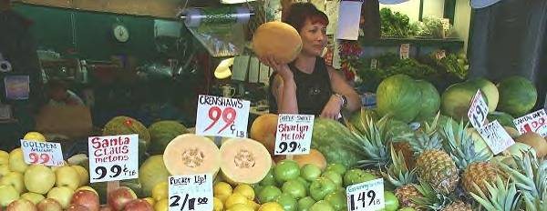
Unit pricing
Pricing items per standard unit, such as per ounce or per pound, to make price comparison easier for consumers

Slide 20
Unit Activity
Handout

Slide 21
Monday, May 9
Unit E9 - Pricing
Warm up – Break even point
Review for unit E9 Test
  Vocabulary (include 9.03)
  Rags to Riches (3) – Show ME!!
  Challenge Board – Score 2000
  Group Review
Unit E9 – Test – Today!!!

