Slide 1

What is Pragmatics?
Group 1
Asep Aprianto
Bobby Sander
Richo Arifianto
Sandi Juandi
English Language and Literature Studies
Indonesia University of Education
Notes:
This template can be used as a starter file for presenting training materials in a group setting.
Sections
Right-click on a slide to add sections. Sections can help to organize your slides or facilitate collaboration between multiple authors.
Notes
Use the Notes section for delivery notes or to provide additional details for the audience. View these notes in Presentation View during your presentation.
Keep in mind the font size (important for accessibility, visibility, videotaping, and online production)
Coordinated colors
Pay particular attention to the graphs, charts, and text boxes.
Consider that attendees will print in black and white or grayscale. Run a test print to make sure your colors work when printed in pure black and white and grayscale.
Graphics, tables, and graphs
Keep it simple: If possible, use consistent, non-distracting styles and colors.
Label all graphs and tables.

Slide 2


Welcome to the World of Meaning!

Slide 3
The Discussion
1
2
Definitions of Pragmatics
3
Abstract to Contextual Meaning
History of Pragmatics
5
Questions & Answers
4
Utterance and Force Meaning
Notes:
This is another option for an Overview slide.

Slide 4
1. History of Pragmatics
The weather is nice, isn’t it?

Slide 5

Classical
Pragmatics
1. Far-side Pragmatics: Beyond Saying
a. Austin, Searle, and Speech Acts
b. Grice and Conversational Implicatures
c. Bach, Harnish, and a Unified Theory
Notes:
This is another option for an Overview slides using transitions.

Slide 6
Syntax
…the study of the relationship between linguistics forms, how they arranged… (Yule, 1996)
Notes:
This is another option for an Overview slides using transitions.

Slide 7
Classical
Pragmatics
2. Near-side Pragmatics
a. Kaplan on Indexical and Demonstratives
b. Pragmatic Puzzles of Referentialism
c. Stalnaker on Context and Content

Slide 8
Semantics
…the study of the relationship between linguistics forms and entities in the world… (Yule, 1996)

Slide 9

Contemporary Pragmatic Theory
1. Two models of Linguistic Communication
2. Relevance Theory
2.1 The Principles of Relevance
2.2 Implicated Premises and Conclusions
3. Levinson's Theory of Utterance-Type-Meaning
4. Literalists, Minimalists, Contextualists and Others

Slide 10
Pragmatics
…the study of meaning as communicated by a speaker and interpreted
by a listener… (Yule, 1996)

Slide 11
2. Definition of Pragmatics
When a diplomat says yes, he means ‘perhaps’;
When he says perhaps, he means ‘no’;
When he says no, he is not a diplomat.
Voltaire (Quoted, in Spanish, in Escandell 1993.)
Notes:
Use a section header for each of the topics, so there is a clear transition to the audience.

Slide 12
Some Definition of Pragmatics
Morris, 1938. Pragmatics concerns the relation of signs to their interpreters.
Gazdar, 1979. Pragmatics = Meaning-Truth conditions.
Thomas, 1995. Pragmatics is meaning in use or meaning in context.
Yule, 1996. The study of meaning as communicated by a speaker and interpreted by a listener.

Slide 13
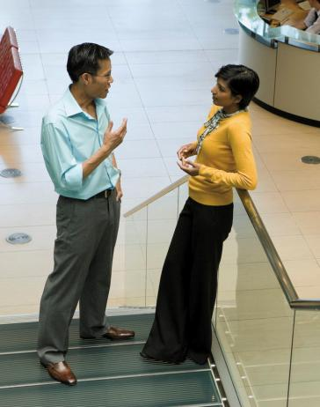
3. Abstract to Contextual Meaning
Abstract
Existing as an idea, feeling or quality, not as a material object.
Contextual
Related to the context of something.
Notes:
What will the audience be able to do after this training is complete? Briefly describe each objective how the audience will benefit from this presentation.

Slide 14
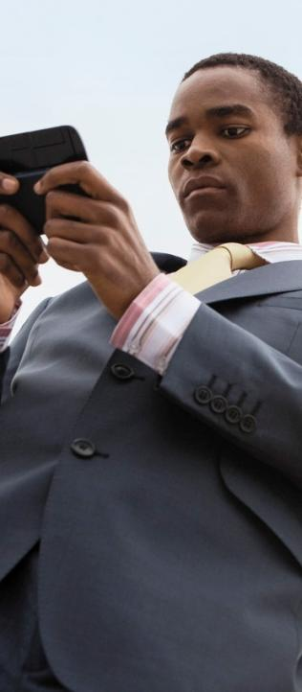
In the Context
Sense
Reference
Structural Ambiguity
Interaction Sense, Reference and Structural Ambiguity
Ambiguity and Intentionality
Notes:
Add slides to each topic section as necessary, including slides with tables, graphs, and images.
See next section for sample table, graph, image, and video layouts.

Slide 15
4. Utterance and Force Meaning
Notes:
Keep it brief. Make your text as brief as possible to maintain a larger font size.

Slide 16
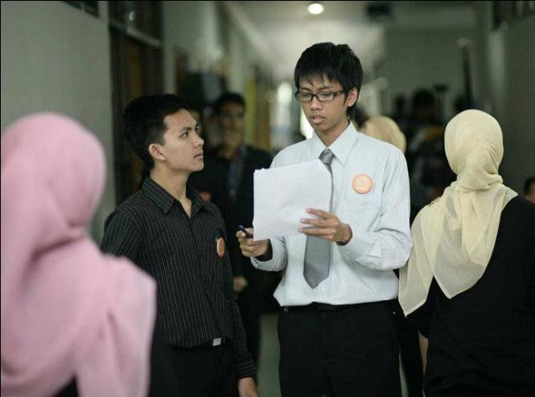
“She wasn’t came…”
Notes:
If there is relevant video content, such as a case study video, demo of a product, or other training materials, include it in the presentation as well.

Slide 17
Utterance Versus Force Meaning
Utterance Meaning
The first level of speaking meaning.
A sentence context pairing.
Force Meaning
The speaker communicative intention.

Slide 18
Understanding Speech
Force Meaning
Utterance Meaning
Paradigm of speaking in pragmatics
Speech
Time Spent

Slide 19
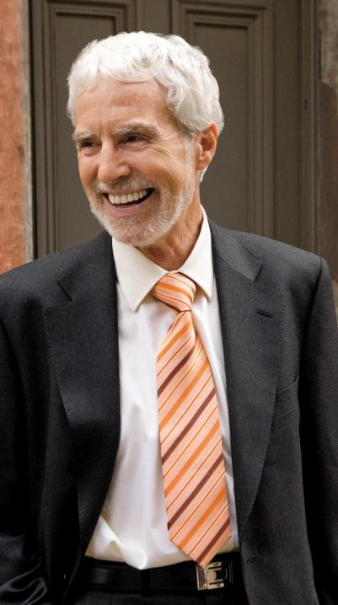
Case Study
Jeremy
His first day
Mistakes made
Successes achieved
The moral of the story
Notes:
Add a case study or class simulation to encourage discussion and apply lessons.

Slide 20
Discussion
What we can learn from Jeremy
Best practices
Take-aways
Notes:
Discuss outcomes of the case study or class simulation.
Cover best practices.

Slide 21
Questions?

Slide 22
Summary
Define your challenges
Technological as well as personal
Set realistic expectation
Mastery is not achieved overnight
Keep your eye on the goal
Mentorship programs
Notes:
Summarize presentation content by restating the important points from the lessons.
What do you want the audience to remember when they leave your presentation?
Save your presentation to a video for easy distribution (To create a video, click the File tab, and then click Share. Under File Types, click Create a Video.)

Slide 23
References
Thomas, J. (1995). Meaning in Interaction: An Introduction to Pragmatics. London: Longman
Yule, G. (1996). Pragmatics. Oxford: Oxford University Press.
Notes:
Is your presentation as crisp as possible? Consider moving extra content to the appendix.
Use appendix slides to store content that you might want to refer to during the Question slide or that may be useful for attendees to investigate deeper in the future.

Slide 24
Online Resources
MONASH University, Linguistics Program
http://arts.monash.edu.au/linguistics/
Stanford Encyclopedia of Philosophy
http://plato.stanford.edu/entries/pragmatics/
<Emeritus Professor Keith Allan> http://arts.monash.edu.au/linguistics/staff/kallan.php
Other Resources
http://www.textetc.com/theory/linguistics.html
http://www.gxnu.edu.cn/Personal/szliu/definition.html

Slide 25
Thank You…

