Slide 1
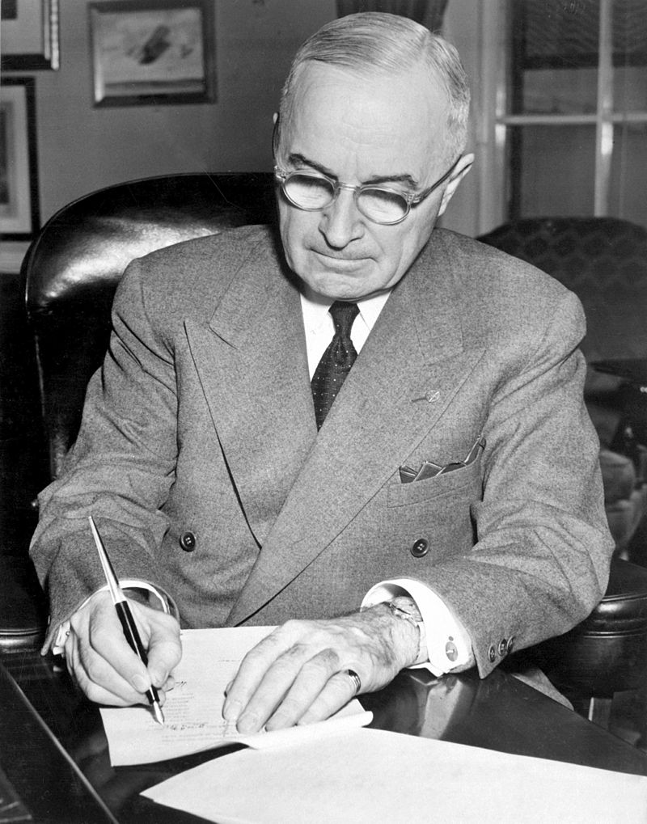
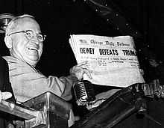
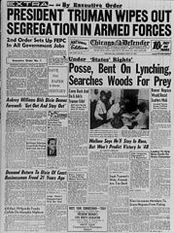

President Harry S. Truman
1945-1953

Slide 2
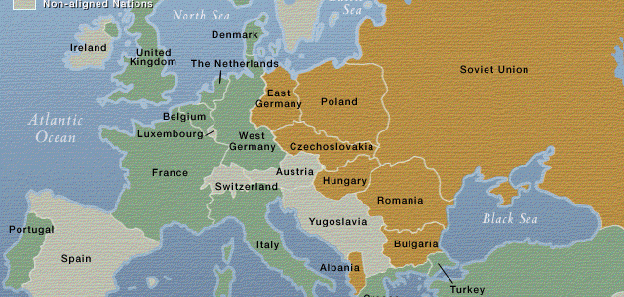
Map of the World after World war II

Slide 3
Foreign Policy issues
First goal of Truman was to rebuild Europe and contain the spread of Communism (Containment). Total shift from the idea of isolationism.
  Marshall Plan- Economic recovery help to rebuild Europe. The US gave $13 billion, with the majority of it going to Great Britain, France and West Germany.
  Truman Doctrine- The United States would support and country that was being threaten with Communist invasion. Two countries this was put in to protect was Greece and Turkey. Did not involve sending military soldiers.\
  NATO- (North Atlantic Treaty Organization) Agreement between countries that were against the spread of Communism. Broke Europe into West and East
  Creation of the United Nations- Peace keeping organization which the US, Soviet Union, China, France and Britain were the security council.

Slide 4
Conflicts between US and Communist forces:
  Berlin Airlift- Conflict between Communist forces in East Berlin and Democratic forces in West Berlin. Explanation:
  Chinese Civil War- After World War II is over there is civil war between Communist and Nationalist in the country. US supports the Nationalist led by Kai-Shek, Communist led by Zedong.
    2 outcomes- Nationalist lose and they retreat and start the country of Taiwan. Truman vows to support any country threaten by Communist with money and military force.
  Korean War (1950-1953):
    4 phases

Slide 5
Truman Domestic Policies
Proposes the Fair Deal:
  increase in the minimum wage, expansion of the Social Security program, a housing bill, national health insurance, liberalized immigration laws, and ambitious civil rights legislation for African-Americans.
Desegregates the armed forces
Truman takes over the steel industry. He does this because he did not want them to strike during the Korean War.
Presidential re-election of 1948.
McCarthyism

