Slide 1
All About Me
Neil Barbalato
Period 2/5 Exploring Career Decisions

Slide 2
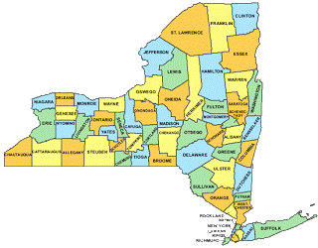
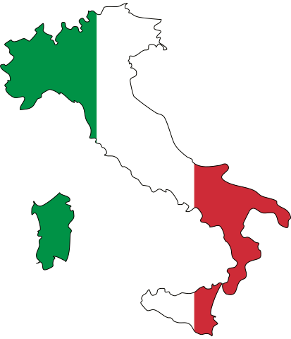


Where was I born?
I was born in New York
Neil = Warrior or Leader
Barbalato Surname originated in Northern Italy
Italy is famous for food, opera, ferrari cars and fashion

Slide 3

Favorite meals
Breakfast – toast with peanut butter
Lunch - Fruit/salads
Dinner – pizza
Favorite restaurant MELLOW MUSHROOM
THE MUSHROOM HAS THE BEST PIZZA CRUST
THE BEST PRETZELS FOR AN APPETIZER

Slide 4

Favorite hobby/activity
I like to relax and chill out
Watch sports
Read
Why? Work hard and like to relax when possible

Slide 5

My favorite television show
my favorite show
  The first 48
  I like crime stories and I find it very interesting how detectives solve cases
    Creeps my family out, so I have to watch it alone

Slide 6
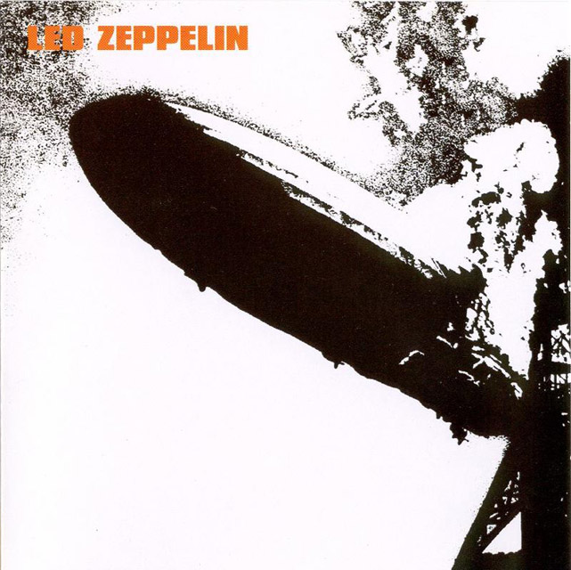
My favorite musical group
Led zeppelin
  I grew up in late 70’s early 80’s
  Did not like disco music
  Was loud and sounded better even louder
  Parents did not like it

Slide 7
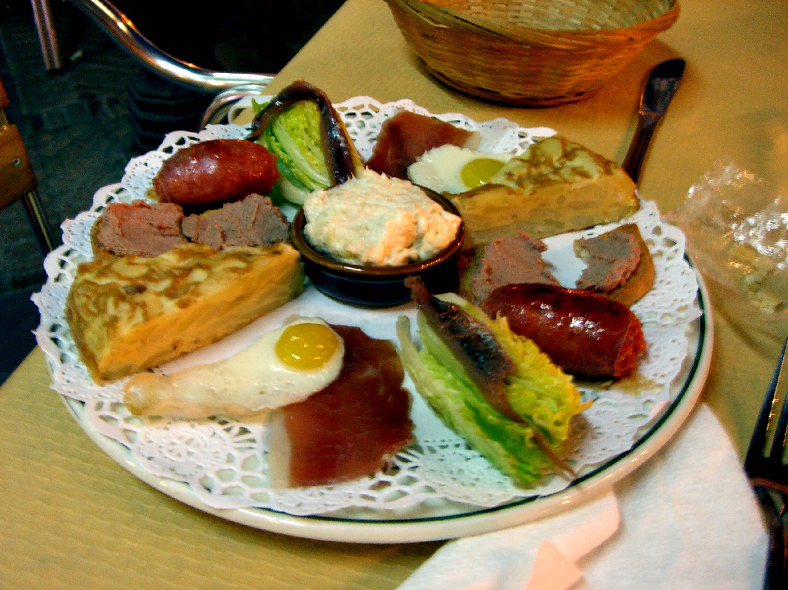
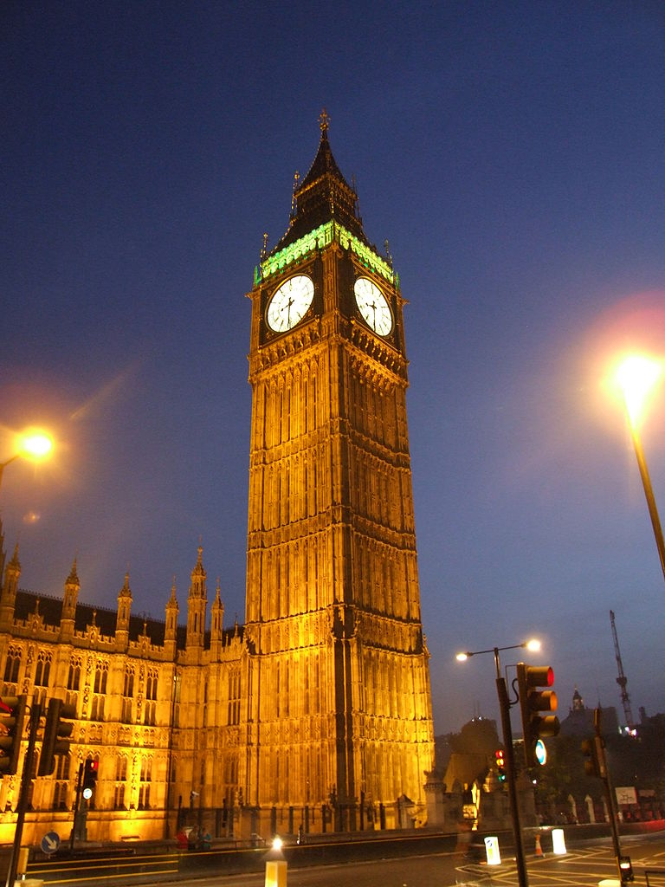
Favorite travel location
England and spain
I find it special because I like history, and the cultures of both countries
I like the weather in England
I like the food in spain

Slide 8

career
Teaching – I like showing people better ways of doing things
I like sharing my experience and knowledge
Duties
  Instruction
  Grading
  Creating projects

Slide 9

Where in 10 years?
I would like to be an assistant principal
Live in the mountains
No children at home!

Slide 10
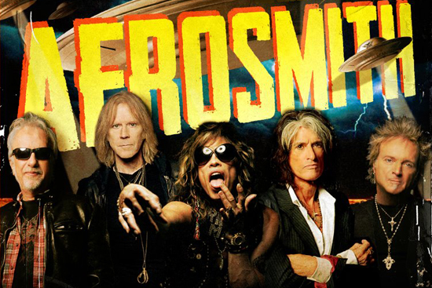
Interesting mr. b facts
Been on television 2 times interviewed on channel 5 and news 14
Growing up my next door neighbor was steven tyler’s (aerosmith) parents. He was much older than me, but I get concert tickets from him to see his shows

