Slide 2
Objectives
To examine the basics of Web authoring tools (text-based editing or graphical-based editing programs).
To discover which web authoring software is best suited for each user’s needs.
To learn the basics of the various web languages.

Slide 3
Main Menu
Web Publishing
Markup Language
Web Authoring Software

Slide 4
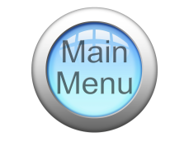
Web Publishing

Slide 5
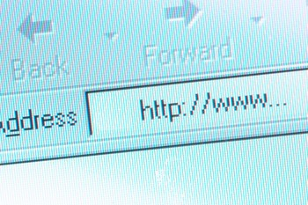
Web Publishing
Allows Internet users to view HTML through the use of a web browser
Is the process of using a web browser to view a document stored on another computer or server
web browsers are programs such as
Internet Explorer®
Safari®
FireFox®

Slide 6
Web Publishing
Is usually accomplished by using two methods:
designing a web page manually using a text editor
user’s encode or markup the plain text in a document turning it into a markup language
designing a web page authoring tool or software such as Adobe® Dreamweaver®
authoring tool: software used in creating a web document
markup: (or encoding) the symbols or characters added to plain text in a document to indicate different attributes and elements
markup language: a coding system used to structure text files in a document translating it into a web document

Slide 7
Introduction
Web Publishing
web authoring software
Adobe® Dreamweaver®
Creating a web page
Using Markup language
Cascading Style Sheets

Slide 8
Web Publishing Technology
Has advanced in the last decade making it easier to author web pages with software opposed to manually writing or coding
this has created a decreasing reliance on using markup languages in a text-based document
Has advanced with the creation of What You See Is What You Get (WYSIWYG) web page editors and software
the most common approach to web page authoring
HyperText Markup Language (HTML): a complex authoring language which converts text to a language so one may display materials (text, graphics, video) on a web page

Slide 9
Web Publishing Software
For Windows includes:
Microsoft® Expression Web®
Adobe® Dreamweaver®
For Mac includes:
iWeb®
BBEdit®
Aqua Data Studio®
Microsoft® SharePoint®
Some free authoring tools include Beyond Press 3.0®, Composer® and Freeway 2.0®.

Slide 10
Markup Language

Slide 11
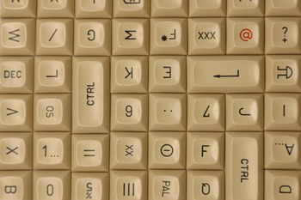
Markup Languages
Are a series of symbols combined with text to encode or format plain text in a document so a web browser can interpret the text and display it as a web page
Include:
HTML
XML
PHP

Slide 12

Markup Languages
Are document based
this means the markup languages interpret plain text documents
such as WordPad®
this means they will only be translated into a web page if written in a text-based document

Slide 13
Hypertext Markup Language
Commonly known as HTML
Is a markup language
Was created in 1991 as a solution to web presentation challenges SGML could not cover
SGML was not compatible with the concept of the Internet and moving information across different channels
Is “client side”
this means it is translated through the web browser
Standard Generalized Markup Language (SGML): an international standard markup language giving the browser the ability to read a text file and display it to other users

Slide 14
Hypertext Markup Language
Was created by the web community to facilitate the transfer of text documents to web pages
Is a simplified form of SGML
Can be used to develop a web page
Requires a parser to be installed in a web browser
Example: You can use HTML to specify which words you want to be bolded. The word bold in HTML would look like this: <b>bold</b>.

Slide 15
Parsers
Interpret the marked up text document and display it as a web page
Check the document to ensure the markup or encoding is done correctly
Are generally built into browsers
parser or processor: a computer program interpreting web page code and then separating it into the functional components, usually built into a browser

Slide 16

HTML Files
Are plain text documents encoded for interpretation by a browser into a web page
Are embedded with code
the code indicates different elements, tags, attributes
HTML files are documents comprised of HTML elements
HTML elements are comprised of HTML tags
a tag is therefore the basic ‘item,’ and an attribute is some extra detail such as how to align the content

Slide 18
Objectives
To examine the basics of Web authoring tools (text-based editing or graphical-based editing programs).
To discover which web authoring software is best suited for each user’s needs.
To learn the basics of the various web languages.

Slide 19
Main Menu
Web Publishing
Markup Language
Web Authoring Software

Slide 20
Web Publishing

Slide 21
Web Publishing
Allows Internet users to view HTML through the use of a web browser
Is the process of using a web browser to view a document stored on another computer or server
web browsers are programs such as
Internet Explorer®
Safari®
FireFox®

Slide 22
Web Publishing
Is usually accomplished by using two methods:
designing a web page manually using a text editor
user’s encode or markup the plain text in a document turning it into a markup language
designing a web page authoring tool or software such as Adobe® Dreamweaver®
authoring tool: software used in creating a web document
markup: (or encoding) the symbols or characters added to plain text in a document to indicate different attributes and elements
markup language: a coding system used to structure text files in a document translating it into a web document

Slide 23
Introduction
Web Publishing
web authoring software
Adobe® Dreamweaver®
Creating a web page
Using Markup language
Cascading Style Sheets

Slide 24
Web Publishing Technology
Has advanced in the last decade making it easier to author web pages with software opposed to manually writing or coding
this has created a decreasing reliance on using markup languages in a text-based document
Has advanced with the creation of What You See Is What You Get (WYSIWYG) web page editors and software
the most common approach to web page authoring
HyperText Markup Language (HTML): a complex authoring language which converts text to a language so one may display materials (text, graphics, video) on a web page

Slide 25
Web Publishing Software
For Windows includes:
Microsoft® Expression Web®
Adobe® Dreamweaver®
For Mac includes:
iWeb®
BBEdit®
Aqua Data Studio®
Microsoft® SharePoint®
Some free authoring tools include Beyond Press 3.0®, Composer® and Freeway 2.0®.

Slide 26
Markup Language

Slide 27
Markup Languages
Are a series of symbols combined with text to encode or format plain text in a document so a web browser can interpret the text and display it as a web page
Include:
HTML
XML
PHP

Slide 28
Markup Languages
Are document based
this means the markup languages interpret plain text documents
such as WordPad®
this means they will only be translated into a web page if written in a text-based document

Slide 29
Hypertext Markup Language
Commonly known as HTML
Is a markup language
Was created in 1991 as a solution to web presentation challenges SGML could not cover
SGML was not compatible with the concept of the Internet and moving information across different channels
Is “client side”
this means it is translated through the web browser
Standard Generalized Markup Language (SGML): an international standard markup language giving the browser the ability to read a text file and display it to other users

Slide 30
Hypertext Markup Language
Was created by the web community to facilitate the transfer of text documents to web pages
Is a simplified form of SGML
Can be used to develop a web page
Requires a parser to be installed in a web browser
Example: You can use HTML to specify which words you want to be bolded. The word bold in HTML would look like this: <b>bold</b>.

Slide 31
Parsers
Interpret the marked up text document and display it as a web page
Check the document to ensure the markup or encoding is done correctly
Are generally built into browsers
parser or processor: a computer program interpreting web page code and then separating it into the functional components, usually built into a browser

Slide 32
HTML Files
Are plain text documents encoded for interpretation by a browser into a web page
Are embedded with code
the code indicates different elements, tags, attributes
HTML files are documents comprised of HTML elements
HTML elements are comprised of HTML tags
a tag is therefore the basic ‘item,’ and an attribute is some extra detail such as how to align the content

Slide 33
HTML Files
Attributes: are combined with tags and further specify the tag, for example, the tag <table> (which would create a table) has several attributes such as height, border, width and cell spacing
Tags: tags indicate different structural parts of a web page or different formatting elements, such as a heading or a table; they usually begin with a left-angle bracket < and end with a right angle bracket >
Elements: are different objects in a text document such as the title and body of a page

Slide 34

HTML Code
Includes tags
think of a tag as a core element and an attribute as an extra detail such as how the content of the web page is aligned
Allows users to create a web page with predefined tags.
users cannot make up their own

Slide 35
HTML Example
Displaying the word Hello in HTML:
<html>
2. <body>
3. Hello
4. </body>
5. </html>
indicates to the browser this is an HTML file
indicates what structural element it is
Content
/ end tag

Slide 36
HTML Exercise
Exercise – Creating a document using HTML:
Start Notepad by clicking on the start menu, then move your mouse over All Programs, then over Accessories, then click on Notepad.
Type the following text into Notepad: <html><head><title>Title of page</title></head><body>This is my first homepage. <b>This text is bold</b></body> </html>
Then save the file as mypage.htm
Open your Internet browser
Select “Open” in the File menu
Click “Browse” or “Choose File” and find your document
Select it and click “Open” and view your HTML document

Slide 37
Extensible Markup Language
Also known as XML
Is a series of guidelines allowing users to create their own language, creating custom tags and then allows them to share it on the World Wide Web
Was created in 1996 to help send richly structured documents over the web
HTML is very structured and provides limitations as to what and how things can be displayed
Is a more simple, condensed and flexible version of HTML

Slide 38
XML
Is designed to structure, carry and store data
HTML was designed to display data on a web page
Concentrates on what data is
HTML concentrates on how the data looks
Contains tags not predefined like in HTML
allows users to create their own tags
Does not replace HTML, but is its counterpart
Requires a processing application to translate and ensure all tags are the correct format
such as a parser

Slide 39

XML Documents
Have four basic components:
XML Schema or Document Type Definition (DTD)
Style sheets
XML Parser
a document marked up (or encoded) using XML language

Slide 40
XML Schema or DTD
Identify the elements and the rules for their use in the language
only some XML languages use DTD
a program defining all the elements of the document and the corresponding attributes, then checking the markup to make sure to follow its own code
DTD is based on SGML
some XML languages use XML schemas
which have the same function as DTD but are based on XML

Slide 41

Style Sheets
Are concerned with how the document looks
markup languages only define the structure and different elements in the document
Allow web page designers to design how a document is presented without having to add several new tags to indicate different elements on the page
style sheet: sheet used by web designers describing how documents should be presented on a screen

Slide 42
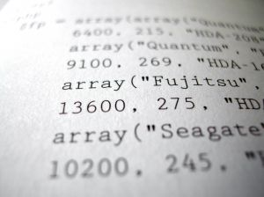
PHP
Is an acronym for Hypertext Preprocessor
Is typically read by all browsers by a parser already installed in the browser
Is referred to as middleware
because it is a program allowing the web browser and the computer user to communicate

Slide 43
PHP
Is server side
this means it is preprocessed through the server before being displayed to the user
Is more flexible than HTML
because it allows for greater customization

Slide 44
PHP example
<?php
echo “PHP is very thrilling”;
?>
Opening tag, gives the parser a indication there are PHP instructions on their way
Closing tag; tells parser there are no more php instructions
echo command; lets the browser know what to display; usually commands end with a semicolon (;)

Slide 45
PHP
Echo Command: php command telling the browser what to display on the web page
Opening Tag: php command indicating to the browser there is php script to be interpreted
Closing Tag: php command indicating to the browser there is no more php script to be interpreted on the page

Slide 46

Markup Language vs. Web Authoring Software
Markup languages
are independent and can be transferred to various software and programs
allow more flexibility and customization
software contains predefined tags restricting the user from creating unique tags to fit their needs
users are also at liberty to specify the rules used by the tags

Slide 47

Markup Language vs. Web Authoring Software
Markup languages
have a reputation of being slow because of the large file size
must pass through parsing and conversions increasing processing time and power

Slide 48
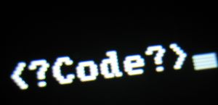
Markup Language Example
If you have a MySpace® page with a background other than the standard format provided for you, then you can see a markup language (HTML in particular) in action.

Slide 49

Cascading Style Sheets
Also known as CSS
Allow users to control the layout and design of a web page
Is the device for supplying types of style instructions to elements in a XML (or any other markup language) document
Is a different language than HTML, but works with HTML to make it more visually appealing

Slide 50

Cascading Style Sheets
Example: If you were creating a web page, you would use HTML to indicate a certain sentence is a primary heading, however you would then use CSS to format the heading. You used CSS to make the heading bold, underlined, green font and positioned in the middle of the page.
style: a guideline explaining how to format a segment of a web page

Slide 51

Advantages of CSS
CSS:
allows more formatting than HTML
applied to a background of a document allows a user to decide how and if it is tiled
takes up less space than HTML
a web page formatted with CSS will take less time to load

Slide 52
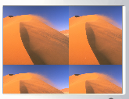
Advantages of CSS
Makes updating a website easier
because you apply the same formatting to each sheet
basically a user only has to update one sheet and the changes to the remaining sheets
Example of tiling: tiling the background on your computer screen is a good representation of tiling
tile: repeating the image in different segments in a background

Slide 53
Cascading Style Sheets
Example
This sheet contains two rules:
The first makes all of the headings blue
The second makes the font 12pt and Arial
H1= References the heading
P = References the paragraph in a document
H1 { color: blue }
P { font-size: 12pt;
font-face: Arial, sans-serif;}

Slide 54
Cascading Style Sheets
Keep style instructions separate from the actual content and structure of the document
Have two main parts:
the selector
the declaration

Slide 55
The Selector
Detects which elements are effected by the specifications
in the example the H1 and P are the selectors; the selector H1 indicates the font of heading 1 in the document is blue
H1 { color: blue }
P { font-size: 12pt;
font-face: Arial, sans-serif, }

Slide 56
The Declaration
Is the actual set of instructions applied to the selector
In the example above is everything except H1 and P
Can indicate several different traits to be administered to the selector
Must be separated by a semi colon if it contains more than one instruction
H1 { color: blue }
P { font-size: 12pt;
font-face: Arial, sans-serif; }

Slide 57
Web Authoring Software

Slide 58

Web Authoring Software
Has advanced recently providing users WYSIWYG web page editing
enables users to create web pages with little or no HTML knowledge because of built in advanced design tools and controls
Is popular with the use of the following programs:
Microsoft® Expression®
Adobe® Dreamweaver®

Slide 59
WYSIWYG Programs
Are easier to use because they make decisions for you
when designing a web page there are numerous specifications needed to be made in order for a page to look as the designer desires
these programs assume many decisions in the process of designing which makes them work faster than programs not enabled with WYSIWYG technology
this can also be a limitation

Slide 60
Microsoft® Expression®
Is a widely used authoring tool for personal and professional use
FrontPage® was discontinued in 2006 to make way for the new authoring tools available
this was previously the widely used publishing tool
Is the next generation of authoring tools
Enables users to create a web page with more sophisticated attributes

Slide 61
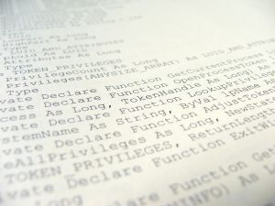
Adobe® Dreamweaver®
Is the most popular authoring tool
Is a good choice for professional web designers
Offers the option of designing and using a visual layout interface or a streamlined coding environment

Slide 62
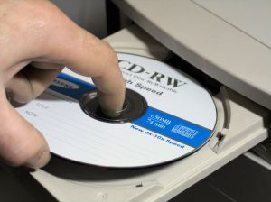
Web Authoring Software Advantages
Include:
saving time
not having to know intricately HTML, XML or PHP
looks professional
easily manipulated
users can modify attributes on the page quicker and easier than working with a web authoring language

Slide 63
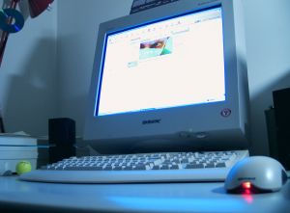
Web Authoring Software Disadvantages
Include:
more customization
base and intricate knowledge of HTML, XML or PHP
can design a page to exact specifications

Slide 64
Resources
(1994-2008). Retrieved October 28, 2008, from World Wide Web Consortium: http://www.w3.org/
A Gentle Introduction to SGML. (1994). Retrieved October 28, 2008, from http://www.isgmlug.org/sgmlhelp/g-sg.htm
ADE Glossary. (1996-2005 ). Retrieved October 28, 2008, from Accessibility in Distance Education: http://www.umuc.edu/ade/glossary.html
Introducing Microsoft Office SharePoint Designer 2007. (2008). Retrieved October 28, 2008, from Microsoft Office Online: http://office.microsoft.com/en-us/sharepointdesigner/HA100740831033.aspx
Lau, P. Y. (2003). Practical Web Technologies. . Addison-Wesley.
McFarland, D. S. (2006). CSS: The Missing Manual. O'Reilly.
Megginson, D. (2005, March 25). XML Performance and Size. Retrieved October 28, 2008, from informIT: http://www.informit.com/articles/article.aspx?p=367637

Slide 65
Resources
Richmond, A. (2008). Introduction to HTML . Retrieved October 28, 2008, from Web Developer's Virtual Library: http://www.wdvl.com/Authoring/HTML/Intro/
Robbins, J. N. (2006). Web Design in a Nutshell. O'Reilly.
Standards for HTML Authoring for the World Wide Web. (1996 - 2006). Retrieved October 28, 2008, from WDG Web Design Group: http://htmlhelp.com/design/standards.html
Stark, J. (2007). Web Publishing with PHP and FileMaker® 9 . Sams.
Windows WWW Related Tools . (n.d.). Retrieved October 28, 2008, from http://www.Webcom.com/html/win_index.shtml
XML Advantages & Disadvantages. (2003-2004). Retrieved October 28, 2008, from The UK Web Design Company: http://www.theukWebdesigncompany.com/articles/xml-advantages-disadvantages.php
XML Tutorial SGML, HTML and XML. (2000-2008 ). Retrieved October 28, 2008, from C# Computing: http://csharpcomputing.com/XMLTutorial/Lesson2.htm

Slide 66
Acknowledgements
Production Coordinators
Amy Hogan
Jessica House
Meghan Blanek
Brand Manager
Megan O’Quinn
Graphic Designer
Daniel Johnson
Technical Writer
Jessica Odom
V.P. of Brand Management
Clayton Franklin
Executive Producer
Gordon W. Davis, Ph.D.
© MMXIV
CEV Multimedia, Ltd.

