Slide 1
ADOBE PREMIERE BASICS
Part 1
GETTING STARTED
HOW TO NAME YOUR PROJECT
WHERE TO SAVE
TURNING OFF THE GPU ACCELLERATOR
THE ADOBE PREMIERE INTERFACE
LOCATING, SELECTING & IMPORTING FILES
BRINGING CLIPS TO TIMELINE
RENDERING
HOW TO ADD TITLES TO YOUR CLIPS

Slide 2
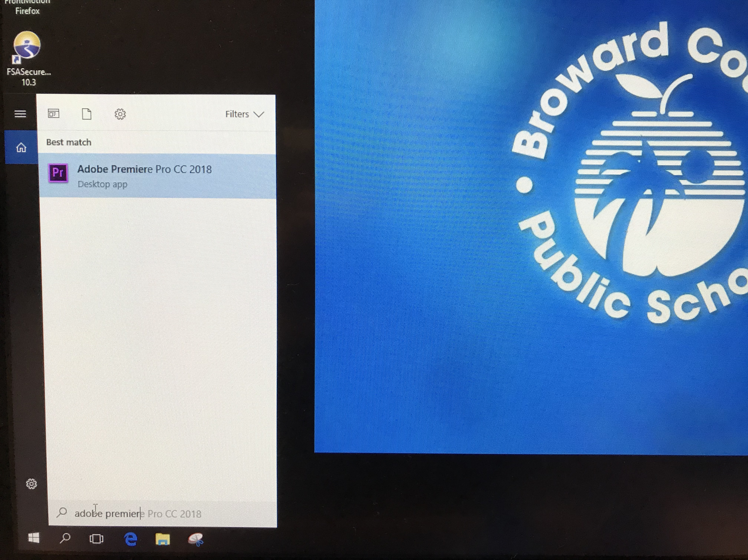
Search for Adobe Premiere Pro CC 2018 - Use search tab on bottom left corner.

Slide 3
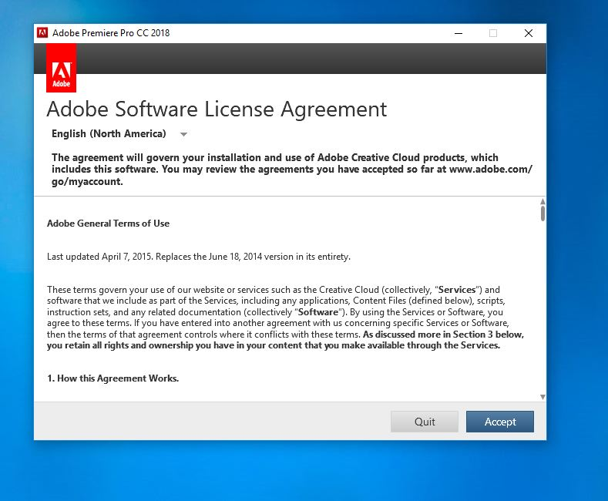
Search for Adobe Premiere 2018 – Click ENTER. Click ACCEPT License agreement.

Slide 4
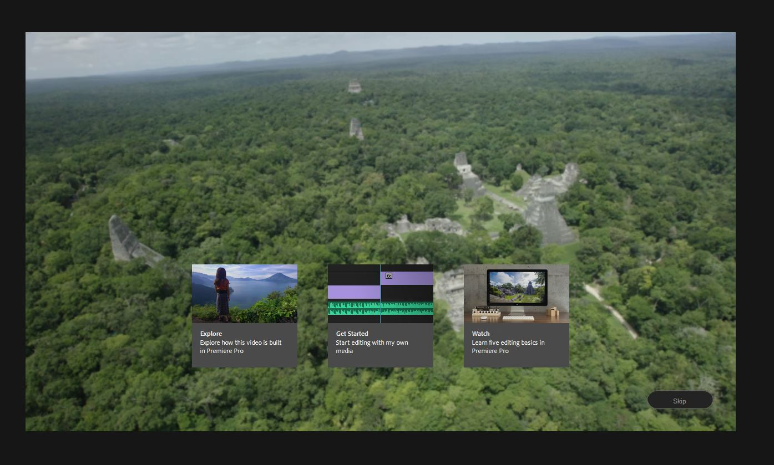
Bring curser to right hand corner of preview video - Click SKIP.

Slide 5
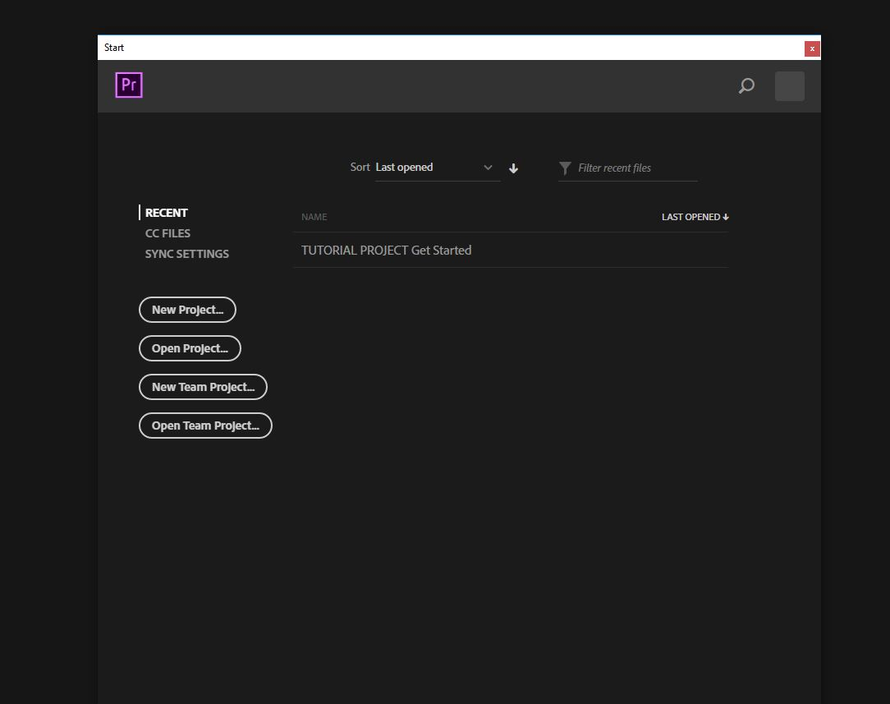
Click NEW PROJECT.

Slide 6
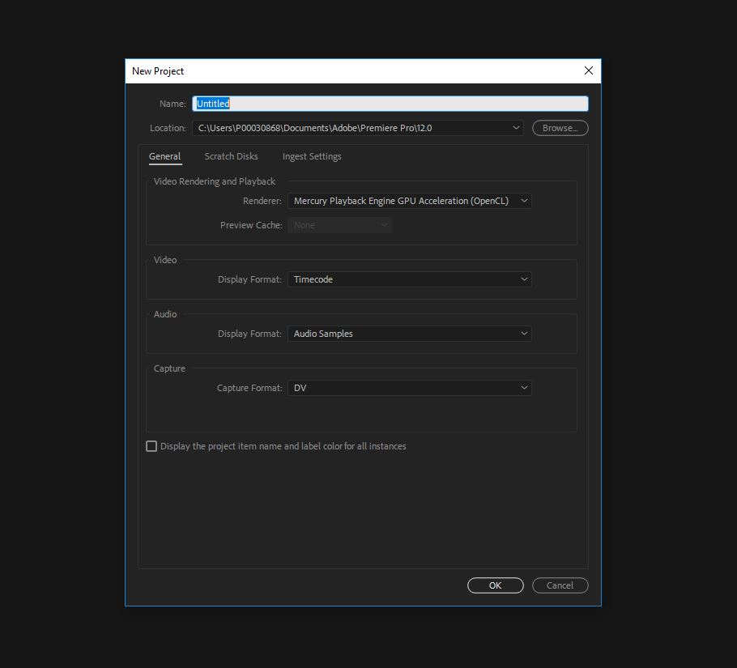
Title your project by : Name of project – Period # - and group names

Slide 7
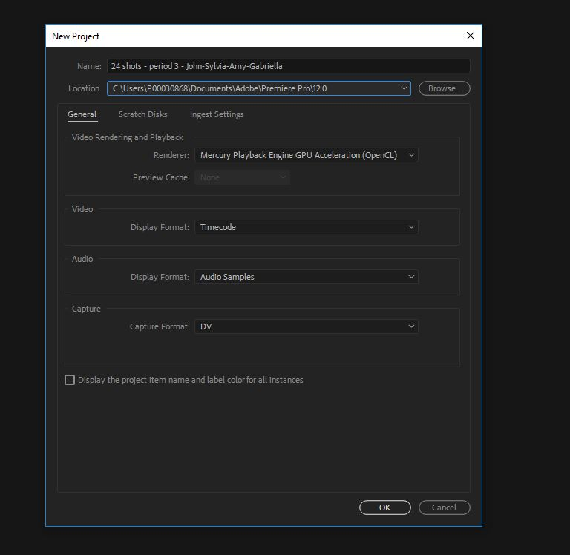
Go to LOCATION. Click BROWSE.

Slide 8
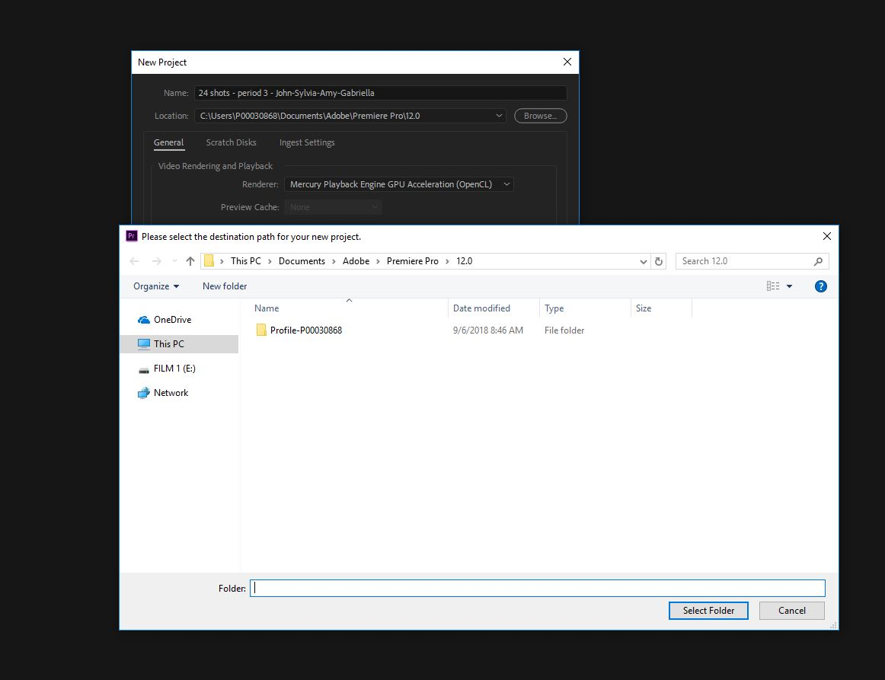
Locate your FLASHDRIVE. Click FLASHDRIVE.

Slide 9
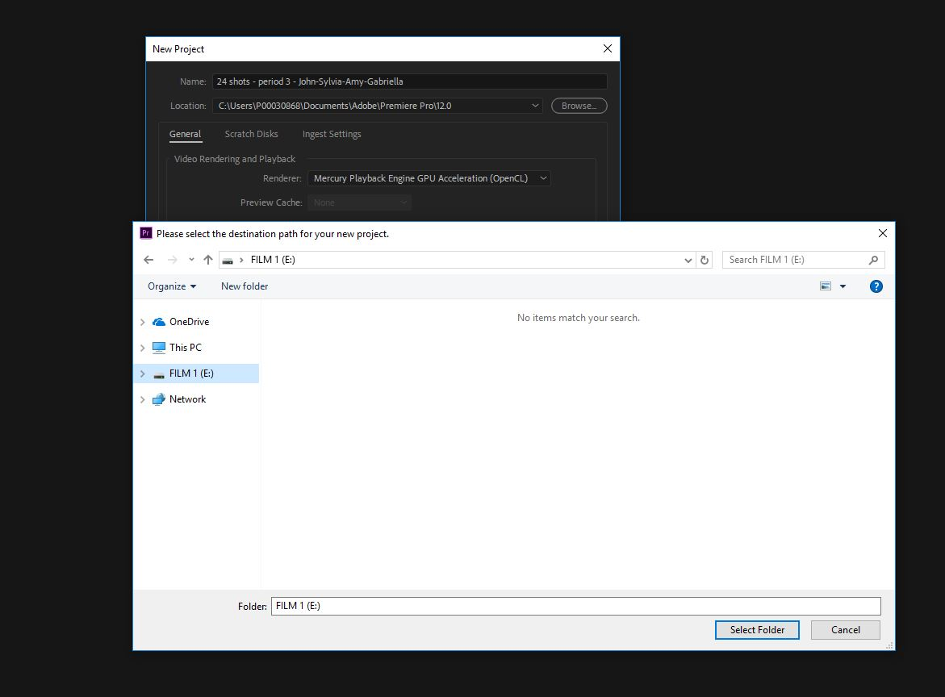
Click SELECT FOLDER.

Slide 10
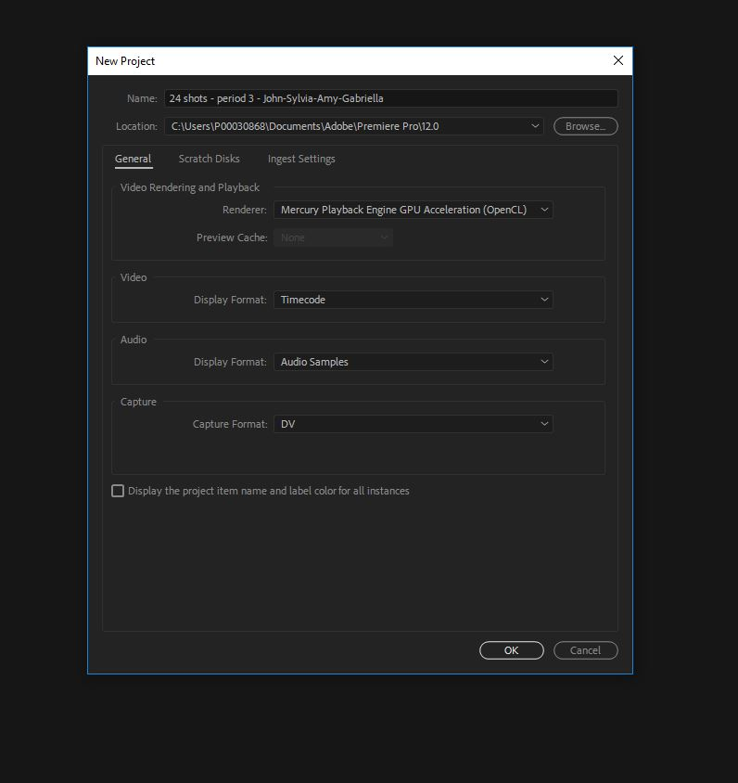
Go to RENDERER. Click dropdown arrow…

Slide 11
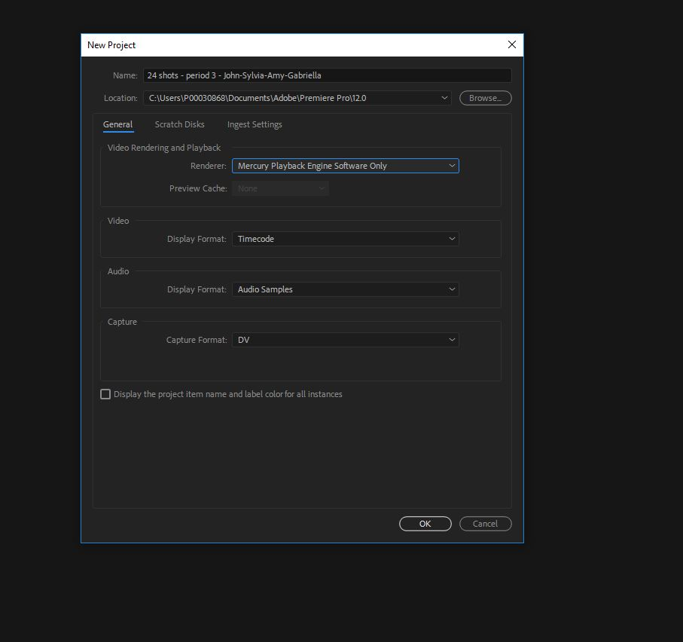
Choose: MERCURY PLAYBACK SOFTWARE ENGINE ONLY.
WARNING!!!!
Leaving the GPU ACCELLERATOR on
will CRASH your computer if setting is left on! (In room 105/106 – Our computers are not powerful enough to run that setting. BEWARE!!

Slide 12
Click OK

Slide 13
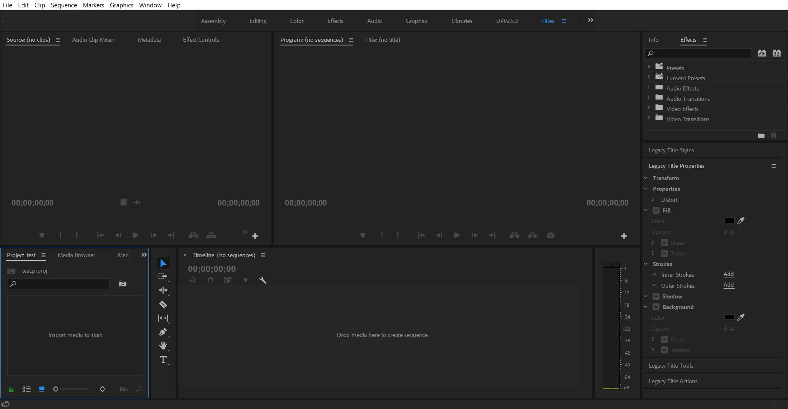
Welcome to the ADOBE PREMIERE 2018 interface
SOURCE PANE
PROGRAM PANE
IMPORT BIN
TIMELINE

Slide 14
Click FILE > IMPORT

Slide 15
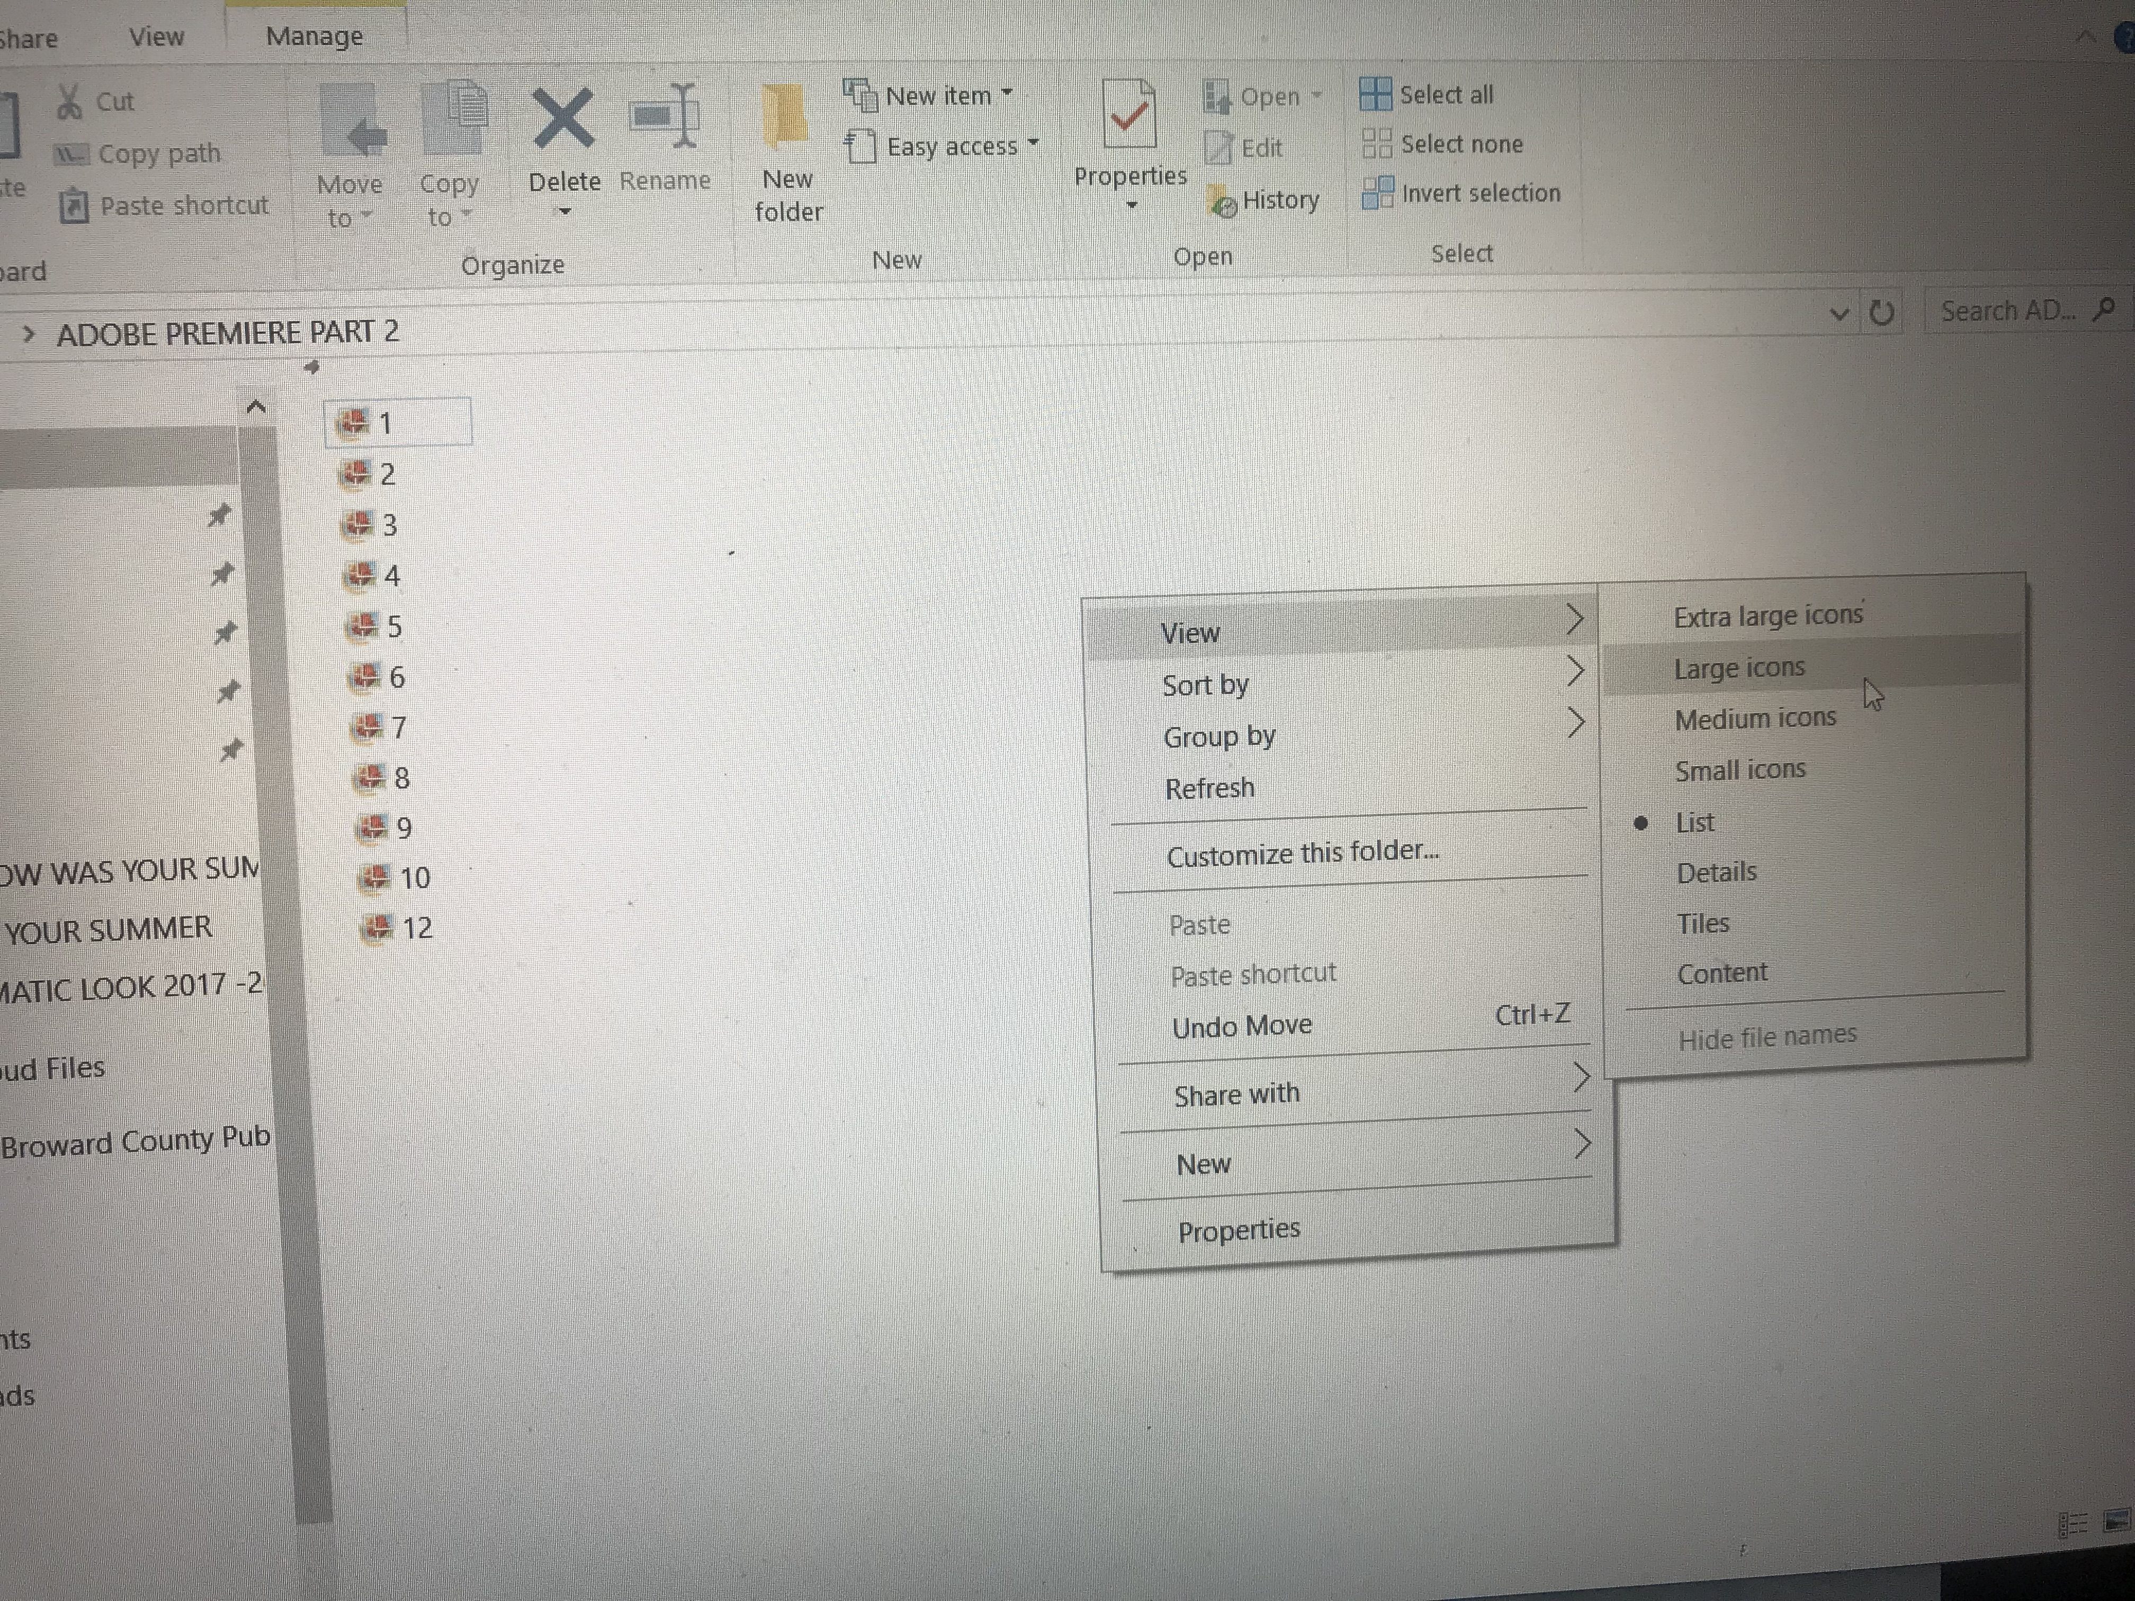
Locate your files within your FLASHDRIVE. Select the files you want to import (they will turn highlighted blue)
TIP: If you do not see thumbnails for your files, move your cursor over to a blank, white area, right click on mouse and left click: VIEW > LARGE ICONS

Slide 16
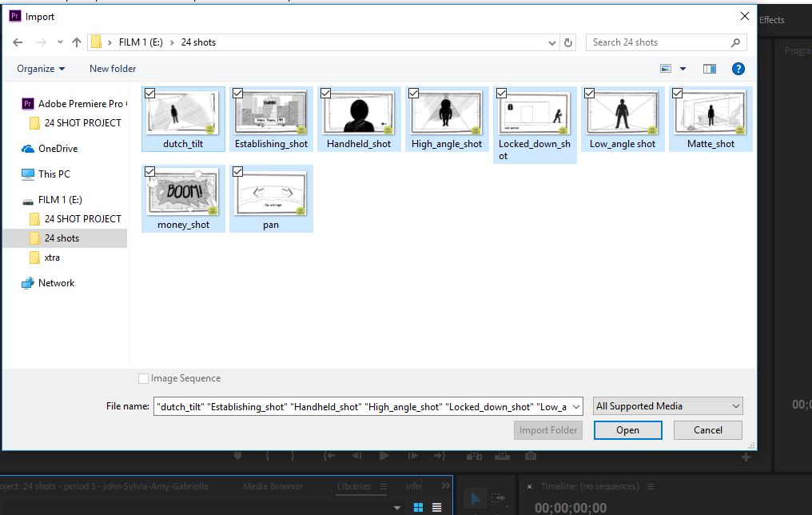
Hold down the Ctrl button and click all files you need (turning everything you need highlighted blue). Then click OPEN.

Slide 17
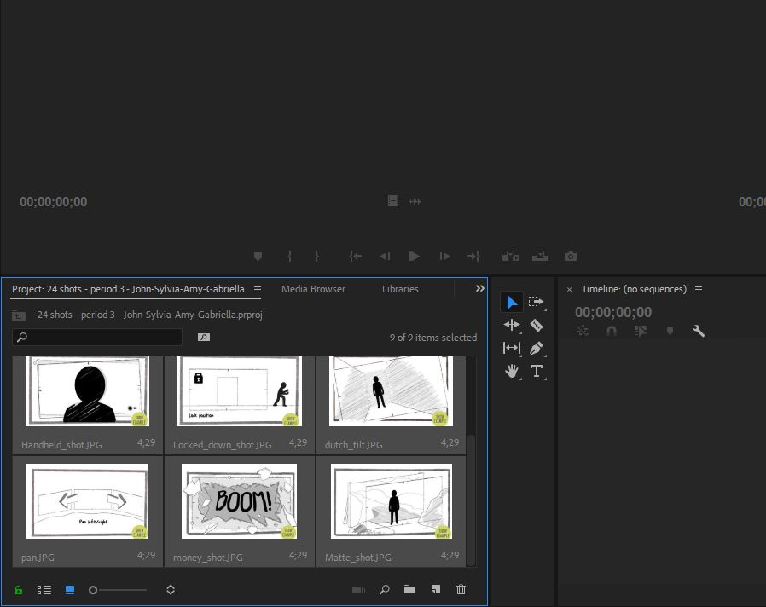
Your files will appear in the Adobe Premiere import bin in the bottom left corner of the interface. They will all be highlighted grey.

Slide 18
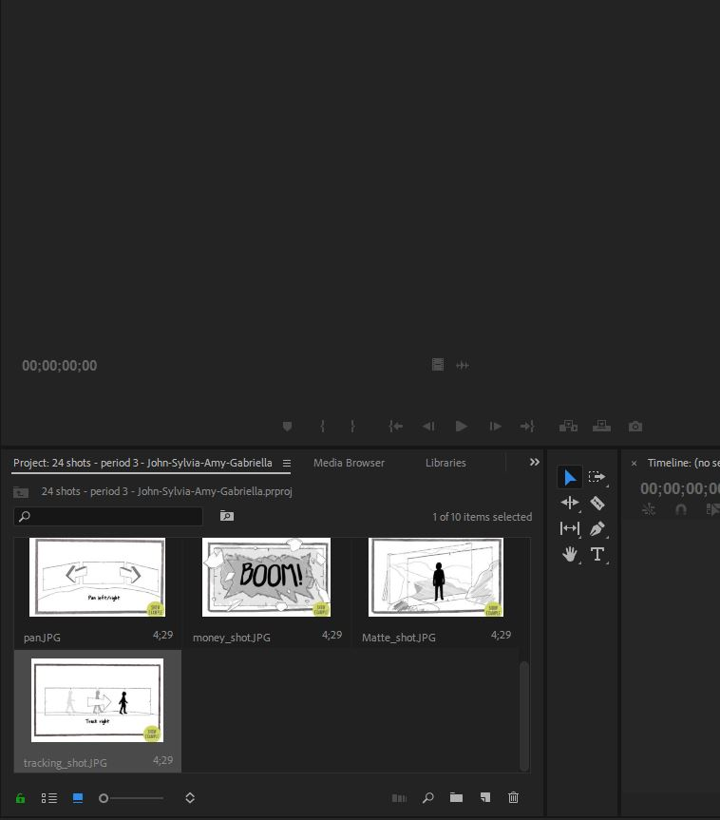
Click on one of your files to undo all grey selections.

Slide 19
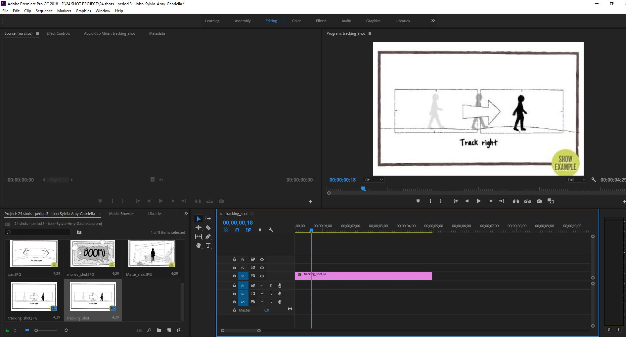
Drag and drop (left click, hold and move) your first image/video into timeline.

Slide 20
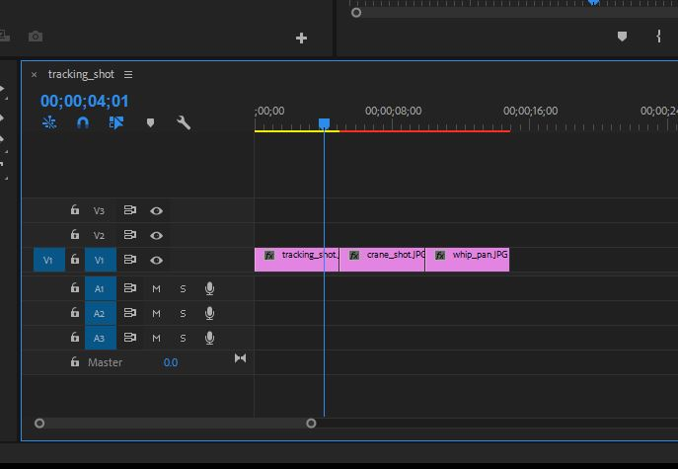
Continue to drag and drop picture/video files into timeline one after the other.

Slide 21
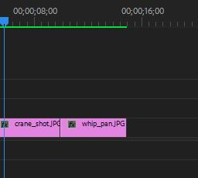
Regularly hit ENTER button to render your videos. Red bar will turn green.
Why render?
So you can have the:
smoothest possible playback in preview !
So, render often!
Q: Why can’t I render my video?
A: You may not have much room left on your flashdrive!

Slide 22
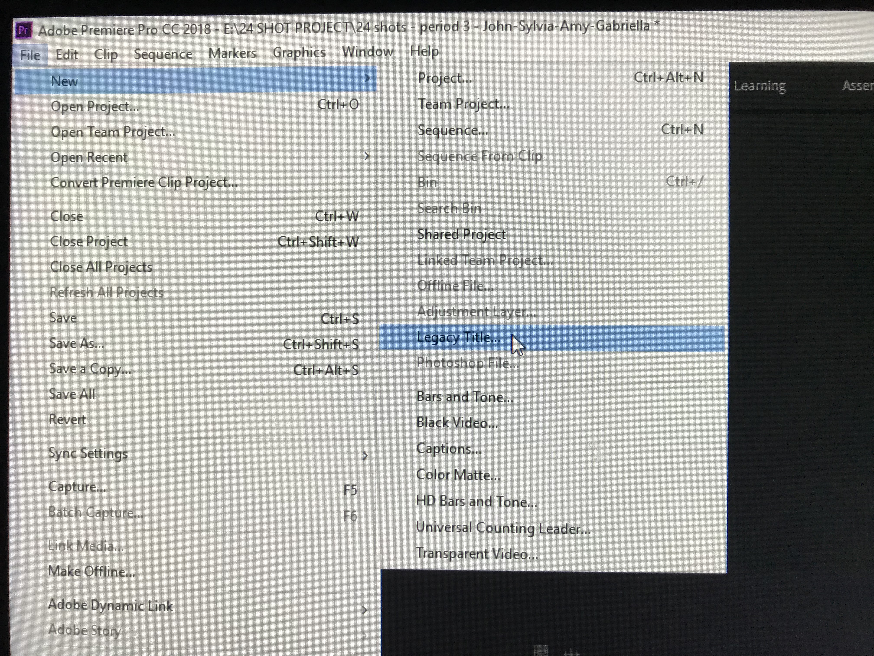
To add Titles to your clip: Go to FILE, click: NEW > LEGACY TITLE.

Slide 23
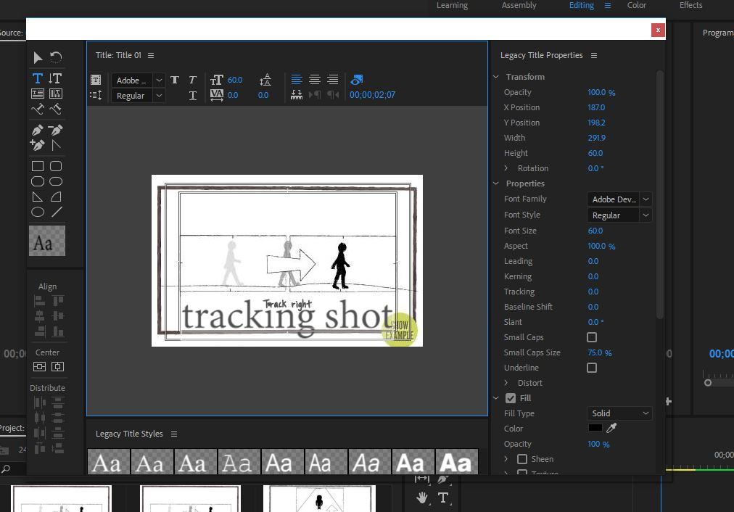
Mover cursor to where you want to type and left click. Begin typing.

Slide 24
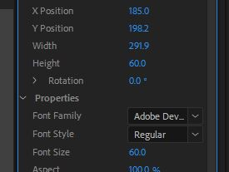
Change your X and Y coordinates to move TITLE left and right, up and down.

Slide 25
Here is where you can also change color of font, add dropshadow, change font style, etc. Click X when done.
Click X when done.

Slide 26
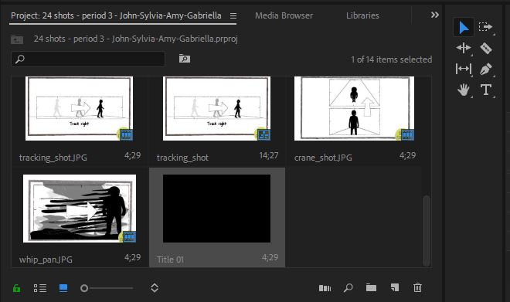
Locate your title in the import bin.

Slide 27
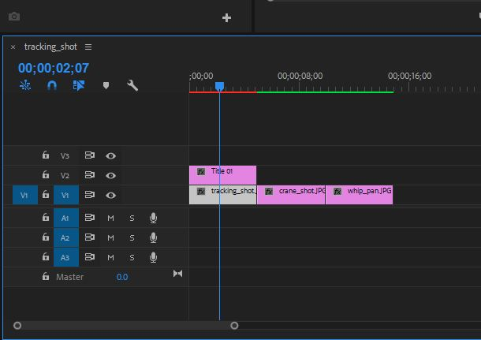
Drag and drop your title ABOVE the clip you want.

