Slide 1
Cold War

Slide 2
What were the political, economic, and social consequences of World War II?

Slide 3
Post World War II
The end of World War II found Soviet forces occupying most of Eastern and Central Europe and the eastern portion of Germany.
Germany was partitioned into East and West Germany.
West Germany : democratic state and resumed self-government after a few years of American, British, and French occupation.
East Germany remained under the domination of the Soviet Union and did not adopt democratic institutions.

Slide 4
Following her defeat, Japan was occupied by American forces. It soon adopted a democratic form of government, resumed self-government, and became a strong ally of the United States.
Europe lay in ruins, and the United States launched the Marshall Plan, which provided massive financial aid to rebuild European economies and prevent the spread of communism.
The United Nations was formed near the end of World War II to create a body for the nations of the world to try to prevent future global wars.

Slide 5
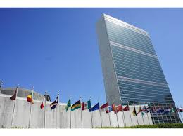
United Nations
The United Nations was formed near the end of World War II to create a body for the nations of the world to try to prevent future global wars.

Slide 6
Questions to Consider
How did the United States respond to the threat of communist expansion?
What are the origins of the Cold War?
What were the early significant events of the Cold War?
What was the impact of the Cold War on Americans at home?
What was the impact of the Vietnam War on Americans at home?

Slide 7
Origins of the Cold War
The Cold War lasted from the end of World War II until the collapse of the Soviet Union.
The United States and the Soviet Union represented starkly different fundamental values. The United States represented democratic political institutions and a generally free market economic system. The Soviet Union was a totalitarian government with a communist (socialist) economic system.
The Truman Doctrine of “containment of communism” was a guiding principle of American foreign policy throughout the Cold War, not to roll it back, but to keep it from spreading and to resist communist aggression into other countries.

Slide 8
NATO vs. Warsaw Pact
The North Atlantic Treaty Organization (NATO) was formed as a defensive alliance among the United States and western European countries to prevent a Soviet invasion of Western Europe. Soviet allies in Eastern Europe formed the Warsaw Pact, and for nearly 50 years, both sides maintained large military forces facing each other in Europe

Slide 9
Red China
The communist takeover in China shortly after World War II increased American fears of communist domination of most of the world. Rather than becoming strong allies, however, the communist nations of China and the Soviet Union eventually became rivals for territory and diplomatic influence, a split that American foreign policy under President Nixon in the 1970s exploited.

Slide 10
Arms Race
After the Soviet Union matched the United States in nuclear weaponry in the 1950s, the threat of a nuclear war that would destroy both countries was ever-present throughout the Cold War. America, under President Eisenhower, adopted a policy of “massive retaliation” to deter any nuclear strike by the Soviets.

Slide 11
Korean War
American involvement in the Korean War in the early 1950s reflected the American policy of containment of communism.
After communist North Korea invaded South Korea, American military forces led a United Nations counterattack that drove deep into North Korea itself. Communist Chinese forces came into the war on the side of North Korea, and although the war threatened to widen, it eventually ended in a stalemate with South Korea free of communist occupation.

Slide 12
Vietnam
American involvement in Vietnam also reflected the Cold War policy of containment of communism.
Beginning in the 1950s and continuing into the early 1960s, the communist government of North Vietnam attempted to install through force a communist government in South Vietnam. The United States helped South Vietnam resist.

Slide 13
Vietnam
The American military buildup in Vietnam began under President John Kennedy. After Kennedy’s assassination in 1963, the buildup was intensified under President Lyndon Johnson.
The scale of combat in Vietnam grew larger during the 1960s. American military forces repeatedly defeated the North Vietnamese forces in the field, but by fighting a limited war, could not force an end to the war on favorable terms.

Slide 14
America became bitterly divided over the issue. While there was support for the American military and conduct of the war among many Americans, others opposed the war, and active opposition to the war mounted, especially on college campuses.
After Johnson declined to seek re-election, President Nixon was elected on a pledge to bring the war to an honorable end. He instituted a policy of “Vietnamization,” withdrawing American troops and replacing them with South Vietnamese forces while maintaining military aid to the South Vietnamese.

Slide 15
Ultimately “Vietnamization” failed when South Vietnamese troops proved unable to resist invasion by the Soviet-supplied North Vietnamese Army. President Nixon was forced out of office by the Watergate scandal. In 1975, North and South Vietnam were merged under communist control.

Slide 16
Cuba and the Cold War
Fidel Castro led a communist revolution that took over Cuba in the late 1950s. Many Cubans fled to Florida and later attempted to invade Cuba and overthrow Castro. This “Bay of Pigs” invasion failed.
In 1962, the Soviet Union stationed missiles in Cuba, instigating the Cuban Missile Crisis. President Kennedy ordered the Soviets to remove their missiles, and for several days the world was on the brink of nuclear war. Eventually, the Soviet leadership “blinked” and removed their missiles.

Slide 17
The Domestic Side of the Cold War
During the 1950s and 1960s, American schools regularly held drills to train children what to do in case of a nuclear attack, and American citizens were urged by the government to build bomb shelters in their own basements.
The convictions of Alger Hiss and Julius and Ethel Rosenberg for spying for the Soviet Union and the construction of nuclear weapons by the Soviets, using technical secrets obtained through spying, increased domestic fears of communism.

Slide 18
McCarthyism
Senator Joseph McCarthy played on American fears of communism by recklessly accusing many American governmental officials and other citizens of being communists, based on flimsy or no evidence. This led to the coining of the term McCarthyism—the making of false accusations based on rumor or guilt by association.

Slide 19
Cold War and Politics
The Cold War made foreign policy a major issue in every presidential election during the period.
The heavy military expenditures throughout the Cold War benefited Virginia’s economy proportionately more than any other state, especially in Hampton Roads, home to several large naval and air bases, and in Northern Virginia, home to the Pentagon and numerous private companies that contract with the military.

Slide 20
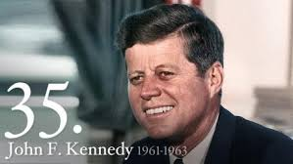
Kennedy and the Cold War
President Kennedy pledged in his inaugural address that the United States would “pay any price, bear any burden, meet any hardship, support any friend, oppose any foe, in order to assure the survival and the success of liberty.” In the same address, he also said, “Ask not what your country can do for you; ask what you can do for your country.”

Slide 21
US Military and the Cold War
During the Cold War era, millions of Americans served in the military, defending freedom in wars and conflicts that were not always popular. Many were killed or wounded. As a result of their service, the United States and American ideals of democracy and freedom ultimately prevailed in the Cold War struggle with Soviet communism.

Slide 22
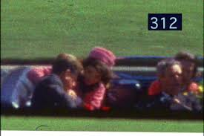
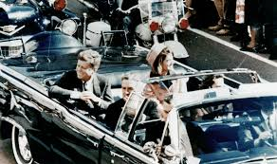
November 22, 1963
President Kennedy, a World War II veteran, was assassinated in 1963 in Dallas, Texas, in an event that shook the nation’s confidence and began a period of internal strife and divisiveness, especially spurred by divisions over United States involvement in Vietnam.

Slide 23
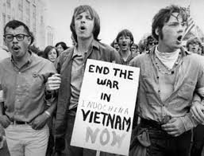
Rejection of Veterans of Vietnam
Unlike veterans of World War II, who returned to a grateful and supportive nation, Vietnam veterans returned often to face indifference or outright hostility from some who opposed the war.

Slide 24
It was not until several years after the end of the Vietnam war that the wounds of the war began to heal in America, and Vietnam veterans were recognized and honored for their service and sacrifices.

Slide 25
Internal Problem of the USSR
Increasing Soviet military expenses to compete with the United States
Rising nationalism in Soviet republics
Fast-paced reforms—market economy
Economic inefficiency
Gorbachev’s glasnost and perestroika (openness and economic restructuring)

Slide 26
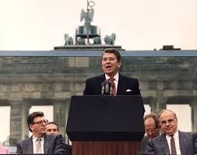
Ronald Reagan and the Cold War
Challenged moral legitimacy of the Soviet Union, for example, in a speech at the Berlin Wall (“Mr. Gorbachev, tear down this wall!”)
Increased United States military and economic pressure on the Soviet Union

Slide 27
Post Cold War Era Policies
Foreign aid
Humanitarian aid
Support for human rights

Slide 28
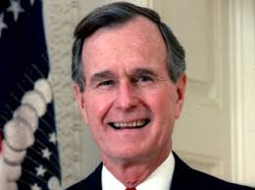
George H.W. Bush 1989-1993
Fall of communism in Eastern Europe
Reunification of Germany
Collapse of Yugoslavia
Breakup of the Soviet state
Persian Gulf War of 1990–1991
First war in which American women served in a combat role
Operation Desert Storm

Slide 29
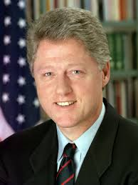
William J. (Bill) Clinton 1993-2001
North American Free Trade Agreement (NAFTA)
Full diplomatic relations with Vietnam
Lifting of economic sanctions against South Africa when her government ended the policy of apartheid
NATO action in former Yugoslavia

Slide 30
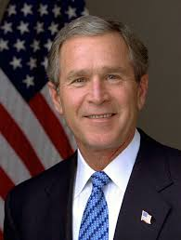
George W. Bush 2001-2009
Terrorists attacks on United States soil on 9/11/2001
War in Afghanistan
War in Iraq

