Slide 1

Introduction to the Raspberry Pi OS
Dr. Lisa Suarez Caraballo
Notes:
‹#›

Slide 2
EET1195
Agenda
Introduction to Raspberry Pi Operating System
RPi OS
Terminal Window/Command Prompt

Slide 3
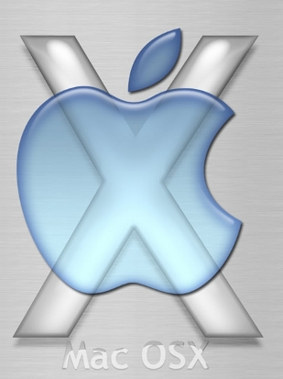

OS=Operating System
Software that makes the hardware usable
OS Examples?

Slide 4

The First OS - UNIX

Slide 5
Screen Flip Procedure
From the Command Prompt type and then press Enter:
sudo nano /boot/config.txt
Once in the file press enter to create a new line
Go up to the blank line then type:
lcd_rotate=2
To Save press:
Ctrl O, Enter, Ctrl X

Slide 6
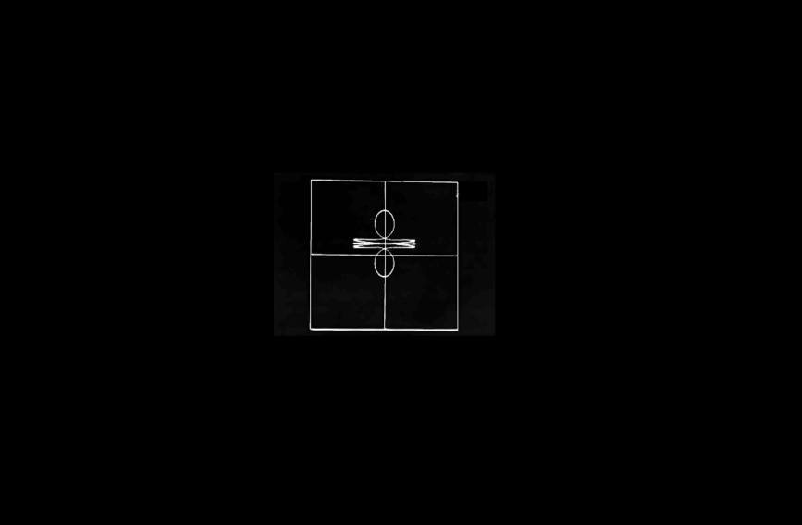



UNIX Origins
1950’s Bell Laboratories , GE and MIT – MULTICS – the ‘Multiplexed Information and Computing Service’
A system that allows the computer to run more than one program at a time – but criticized for being over complicated and “bloated”
Late 60’s programmers at Bell Labs wanted to play a game on a leaner version - UNIX

Slide 7
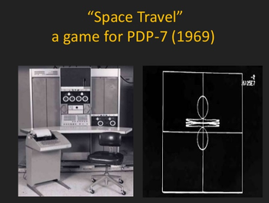
https://www.youtube.com/watch?v=Rmvb4Hktv7U

Slide 8
UNIX
Versions of it are still used today
  Internet
  Corporations
  Super Computers

Slide 9
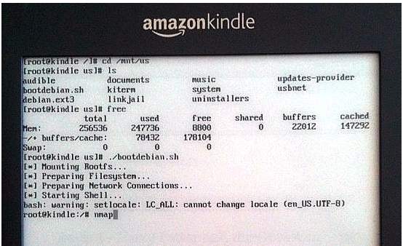


UNIX 2 Notable Updates
MAC OS X – where X is used to honor UniX
1991 Linus Torvalds from Sweden updated and gave it away for FREE LINUX Kernel
Led to – GNU/Linux (also called Linux2) “GNU’s Not UNIX”
Who uses LINUX?

Slide 10
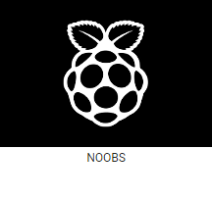
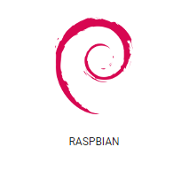
2 Main Raspberry Pi OS
NOOBS
New Out of the Box
For beginners
Raspbian Stretch
Official supported Raspberry Pi OS

Slide 11

Linux Vocablary

Slide 12
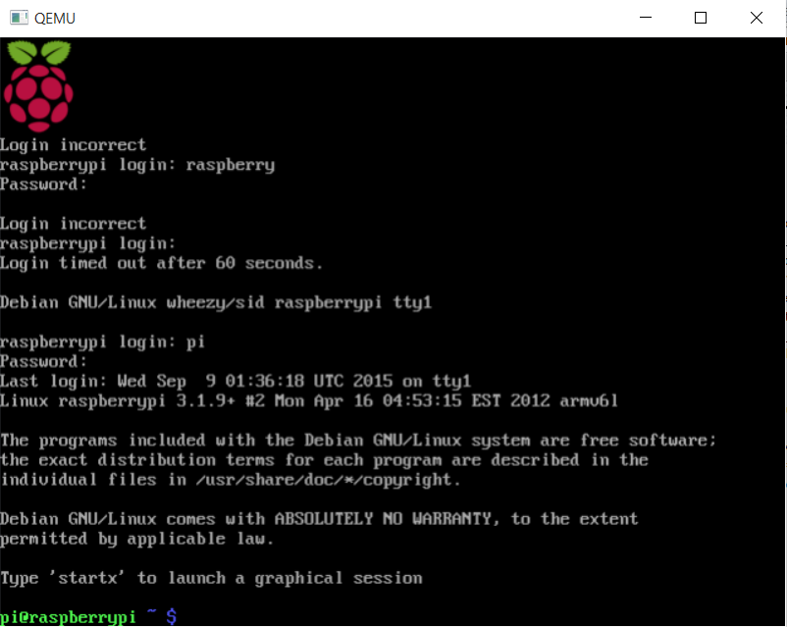
Command Prompt
Log in
When the RPi boots up you get a Command Line
pi
raspberry
The Command Prompt is a textual command-line

Slide 13
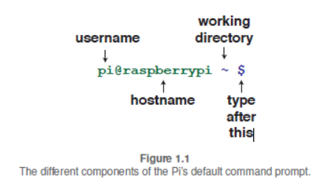
Command Prompt
tilde
$ Means “type something at the command prompt and press enter”

Slide 14
Terminal Window
a text-only window that emulates a console.
A console is a display mode that contains only text, no images and occupies the entire screen of the display device

Slide 15
Shell
A program that prompts the user for commands, accepts them, executes them and displays the results
Not built in

Slide 16
Processes
Tasks performed by the Central Processing Unit (CPU) of a Computer
Process Family Tree – new processes are thought of as the ‘child’ of the shell’s process.

Slide 17
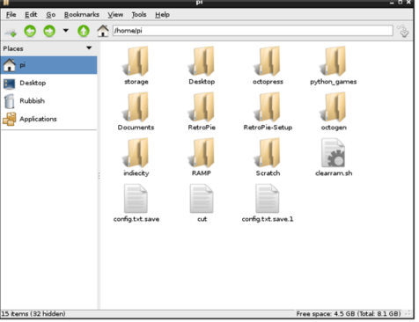
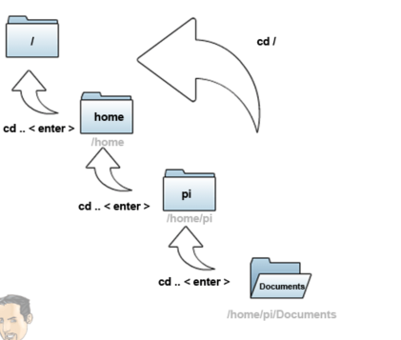
Directories
The ‘folders’ that contain files in Unix OS

Slide 18
Files
Things that you’ve created or downloaded that are placed in folders (directories)
  Documents
  Images
  Movies
  …

Slide 19
GUI
Graphical User Interface

Slide 20

Common Linux Commands

Slide 21
pwd
Print working directory

Slide 22
cd xxx
change to the directory named xxx
Change directory to…
  cd / change directory to the root directory
  cd .. Move up (go back) one directory

Slide 23
ls
List contents of the current directory
man ls – would list the contents of the user manual

Slide 24
sudo
Super user Do – Provides Admin Rights

Slide 25
sudo halt
Shut down

Slide 26
sudo reboot
Reboot

Slide 27
nano
Text Editor like…...

Slide 28
Wormy game
Let’s use the commands to get to the Wormy Game
Can you get back to and play the wormy game by yourself?
Find the games directory and type in name of game with an extension of py
  python wormy.py

Slide 29
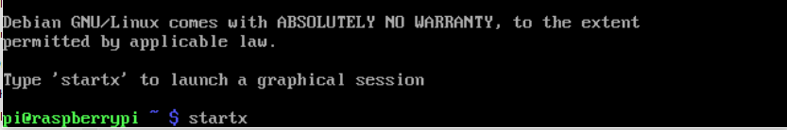
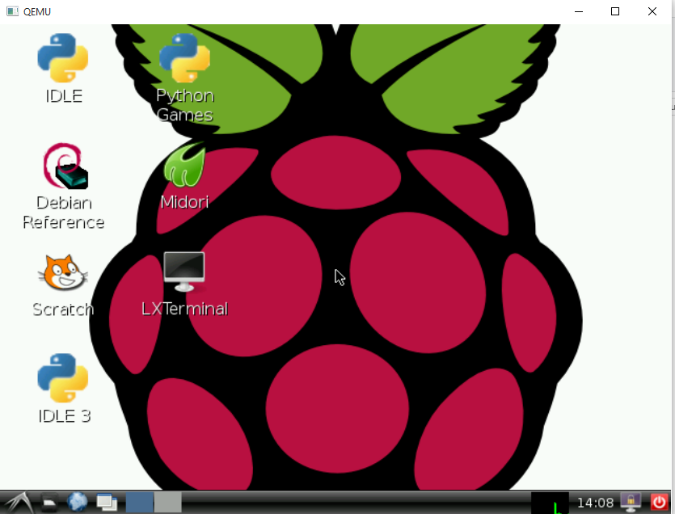
startx
Start the GUI (Graphical User Interface)
Textual command line
GUI – like the Windows Desktop

