Slide 1
Conflicting Viewpoints
Page 403-412

Slide 2
Conflicting Viewpoints
Usually labeled:
- Hypothesis 1 and Hypothesis 2
- Scientist 1 and Scientist 2
Do not worry about who’s right or wrong. You will not be asked which scientist is correct but you may be asked to identify evidence to support the viewpoint.
You will be asked to identify points of agreement and disagreement

Slide 3
Tips
Identify the disagreement
Remember – you can underline or star something
Ask yourself:
- what is the position of each?
- what evidence is there for each?
- what flaws are there in each?

Slide 4
Tips
Look in the introduction paragraph for the agreement.
The disagreement will be found in Scientist 2’s paragraph.
1st sentence of each scientist is often their view.
Mark important key words

Slide 5
Passage 7 - B
592

Slide 6
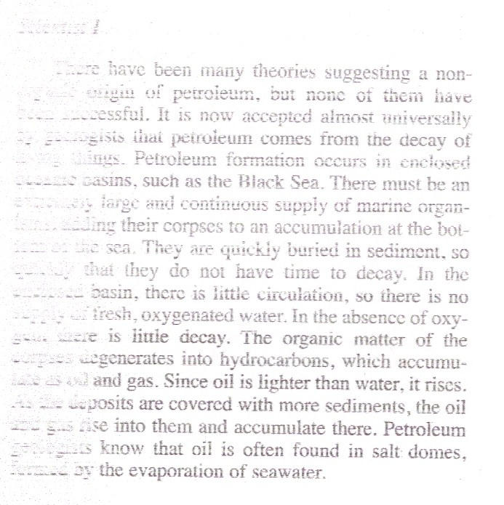
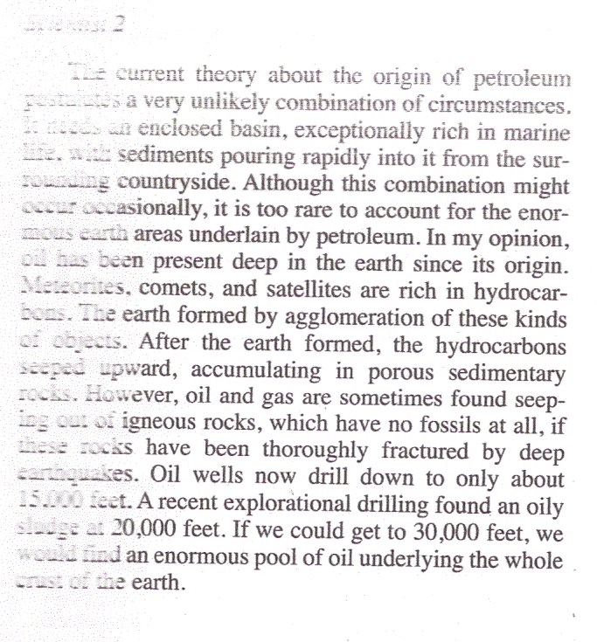
Passage 7 - B
Scientist 1
Scientist 2
34. Both scientists agree that petroleum:
F. Forms at the bottom of the sea.
G. Seeps upward into sedimentary rocks.
H. Is present in great quantities below 30,000 feet.
J. Has always been present on earth.

Slide 7
Passage 7 - B
Scientist 1
Scientist 2
35. Which of the following discoveries would greatly weaken the argument of Scientist 2?
A vast oil deposit is found in sedimentary strata 20,000 feet deep.
A meteorite is analyzed and found to contain few hydrocarbons.
The sludge discovered at 20,000 feet turns out to be contamination from drilling oil.
A large accumulation of oil is found in highly fractured igneous rock.

Slide 8
Passage 7 - B
Scientist 1
Scientist 2
36. According to Scientist 2, what strategy would be most likely to increase world supplies of petroleum?
F. Drill wells to greater depths.
G. Increase exploration of offshore sedimentary strata.
H. Drill wells in igneous rocks.
J. Develop techniques of extraction from meteorites.

Slide 9
Passage 7 - B
Scientist 1
Scientist 2
37. Exploration of the Persian Gulf reveals that it is an enclosed body of water rich in marine life. According to the hypothesis of Scientist 1, what additional condition would be necessary in order for petroleum deposits to develop?
Vertical circulation to carry oxygen downward
High concentration of salt in the water
An accumulation of meteorites
Rapid deposition of sediments

Slide 10
Passage 7 - B
Scientist 1
Scientist 2
38. Scientist 2 considers that oil seepage from igneous rocks is damaging to Scientist 1’s theory because igneous rocks:
F. Are easily fractured by earthquakes
G. Never contain fossils
H. Are always located deep in the crust
J. Contain many meteorites

Slide 11
Passage 7 - B
Scientist 1
Scientist 2
39. What evidence given by Scientist 1 was not refuted by Scientist 2?
There have been many theories of a nonorganic origin of petroleum, and all of them have failed.
Petroleum is very often found associated with salt domes.
All petroleum deposits are in porous sedimentary rock.
Meteorites come to earth in the ocean just as often as on land.

Slide 12
Passage 7 - B
Scientist 1
Scientist 2
40. The chief objection that Scientist 2 has to the theory of Scientist 1 is that it:
F. Postulates the formation of petroleum in a highly unusual set of conditions.
G. Cannot account for the accumulation of petroleum in sedimentary rocks.
H. Arbitrarily rejects the theory of nonorganic origin.
J. Places a limit on the amount of petroleum that can be extracted from the earth.

Slide 13
Passage 7 - C
662

Slide 14
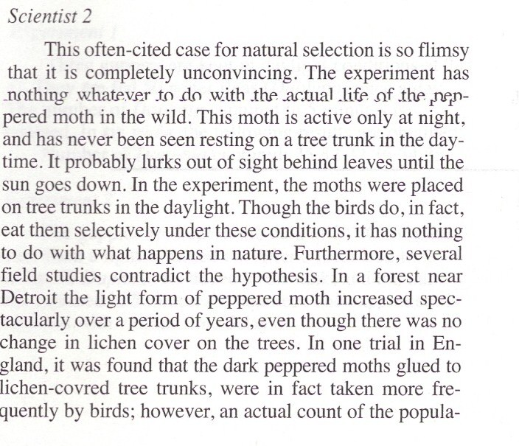
Passage 7 - C

Slide 15
Passage 7 - C
Look at the introduction paragraph – it usually states the agreement.
34. The two scientists agree that:
f. in nature, birds choose one form or the other from tree trunks.
g. the relative frequency of the two forms in a population sometimes changes drastically.
h. the dark form tends to be more frequent in the population
j. the reason for the shifts in frequency is unknown.

Slide 16
Passage 7 - C
What is the disagreement?
35. The hypothesis in dispute is that:
a. the change in frequency is commonly the result of changes in air quality
b. natural selection controls the relative frequency of the two forms.
c. the color of a moth is controlled by its heredity.
d. the ability of birds to find the moths on tree trunks is limited by camouflage.

Slide 17
Passage 7 - C
36. How might Scientist 1 account for the discrepant results of other field studies?
f. they might have been done with a different species of moth.
g. moths with intermediate color might have been misidentified
h. the samples taken were too small to be meaningful
j. there might be other causes for the frequency shift, but in some cases, the air quality relationship is proven

Slide 18
Passage 7 - C
37. What discovery would tend to strengthen the position of Scientist 2?
a. Dark-colored moths tend to mate selectively with other dark moths.
b. breeding experiments show that the gene for black color is dominant to the gene for light color.
c. there is a permanent distribution of patterns such that the black form is more common in the north.
d. In periods of prolonged drought, more of the light phase die during the larval stage.

Slide 19
Passage 7 - C
38. What evidence in support of the hypothesis given by Scientist 1 was questioned by Scientist 2?
f. when moths are raised in captivity, their color depends on the color of their cage boxes.
g. Birds find light peppered moths more easily on tree-blackened tree bark.
h. the frequency of dark moths generally increases when the trees are dark and decreases when the color is light.
j. the changes in color frequencies are due to natural selection based on the color of tree bark.

Slide 20
Passage 7 - C
39. The chief objection that Scientist 2 has to the work of Scientist 1 is that:
a. the observed changes in frequency were not observed in other studies.
b. the experiment took no account of the behavior of the moths in nature.
c. only one kind of bird was used in the experiment.
d. it did not prove that the color is inherited.

Slide 21
Passage 7 - C
40. Scientist 1’s position regarding this controversy might be that
f. Scientist 2 has shown that the hypothesis has been disproved.
g. in spite of criticisms, there is enough evidence for the hypothesis that it has some validity.
h. more work is necessary to test the validity of the hypothesis.
j. there is no validity to the objections raised by Scientist 2.

