Slide 1
Data Representation
Practice Problems from Barrons Test B and C

Slide 2
Data Representation
Read the introduction paragraph
  Know what the passage is all about
Look briefly at the charts, tables or graphs

Slide 3
Data Representation
Look for the following:
  What are the units of measure (top of chart or bottom and sides of graph)
  What are the values of the variables (entries in the chart or axis of graphs)
  Are there any trends? (i.e.. increase or decrease)
  Are there any correlations? (relationship to each trends)

Slide 4
GRAPHS & TABLES ONLY
What exactly do these charts mean?
Remember to look for trends

Slide 5
Reading Tables
  Do variables increase/decrease with x?
  As the value of x increases
  A increases and B decreases linearly
  C increases and D decreases exponentially

Slide 6
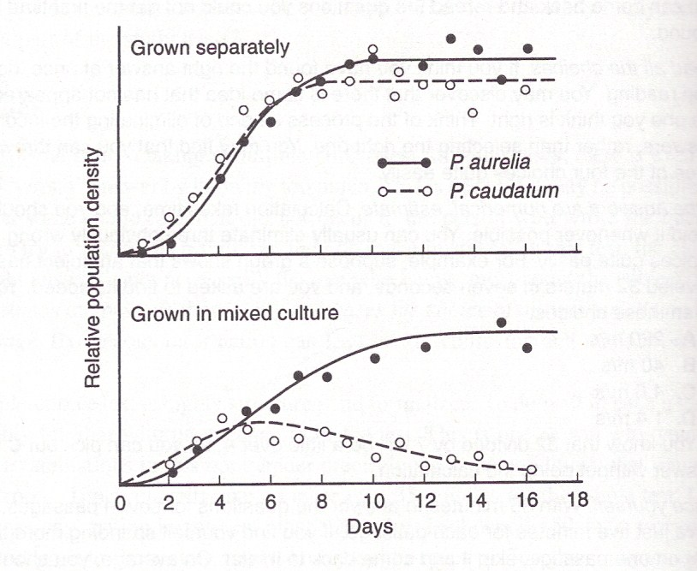
Warm-Up page 392
Two species of the microorganisms Paramecium are grown in cultures, and the population density is measured daily. The upper graph shows the results if the two species are raised in separate cultures. The lower graph shows the results if the two species are grown together in a single culture.

Slide 7
Warm-Up Question 1
When the two species are grown separately,
  A. Both species reach maximum population density in 18 days
  B. Both species stop reproducing after 12 days
  C. Populations of both species grow fastest after 3 days
  Both species reproduce fastest after 2 days

Slide 8
Warm-Up Question 1
When the two species are grown separately,
  A. Both species reach maximum population density in 18 days
  B. Both species stop reproducing after 12 days
  C. Populations of both species grow fastest after 3 days
  Both species reproduce fastest after 2 days
  Use elimination:
  B & D refer to reproduction – the graphs don’t indicate reproduction
  A is wrong because graph levels at 10 days not 18

Slide 9
Warm-Up Question 2
When the two species are cultured together.
F) P. aurelia is unaffected, but it inhibits the population of P. caudatum
G) P. aurelia reproduces more rapidly than P. caudatum
H) it takes about a week for the populations to begin to interfere with each other.
J) each species inhibits the population growth of the other.

Slide 10
Warm-Up Question 2
When the two species are cultured together.
F) P. aurelia is unaffected, but it inhibits the population of P. caudatum
G) P. aurelia reproduces more rapidly than P. caudatum
H) it takes about a week for the populations to begin to interfere with each other.
J) each species inhibits the population growth of the other.
Eliminate wrong answers
- F is wrong – P aur. grows more slow with P caud.
- G wrong – other factors besides reproduction rate may affect pop size
- H wrong – the growth of P. caud. Pop starts to drop in less than 5 days

Slide 11
Warm-Up Question 3
Comparison of the two graphs seems to imply that
a) the two species of Paramecium are competing for the same resources.
b) no two microorganisms can live successfully in the same culture.
c) P. caudatum could not survive in the wild.
d) P. aurelia is a more common species than P. caudatum

Slide 12
Warm-Up Question 3
Comparison of the two graphs seems to imply that
a) the two species of Paramecium are competing for the same resources.
b) no two microorganisms can live successfully in the same culture.
c) P. caudatum could not survive in the wild.
d) P. aurelia is a more common species than P. caudatum
It seems logical P. caud. Is losing out in competition with P. aur.
What conclusions can be drawn?
- B wrong – exp. Deals with only 2 organisms, doesn’t mention the combinations
- C and D wrong – conditions in wild are nothing like those in a culture dish

Slide 13
Passages
Passage 1 – test c
Passage 3 – test c
Passage 5 – test c
Passage 1 – test b
Passage 2 – test b
Passage 4 – test b

Slide 14
Test C
Remember
  Read the introduction
  Take a quick look at the axis and keys
  Go right to the questions
  Look for key words

Slide 15
Test C passage 1
Page 666

Slide 16
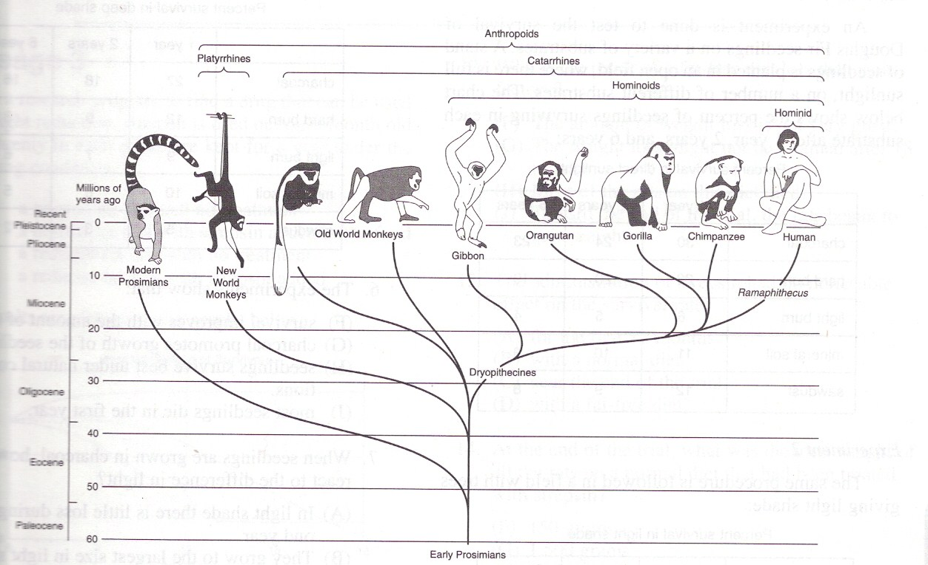
Passage 1 - C
The diagram below shows the probable evolutionary relationships of the primates.

Slide 17
Passage 1 - C
The most recent common ancestor of human beings and the gorilla lived about:
A. 10 million years ago
B. 19 million years ago
C. 25 million years ago
D. 33 million years ago
The place where the lines meet and extend from is where the most recent common ancestor is.

Slide 18
Passage 1 - C
2. The diagram proposes that the largest group that descended from Dryopithecines is:
F. the gibbons.
G. the Catarrhines.
H. the Hominoids
J. the great apes.
Look for Dryopithecines and look at the top – the top shows the groups.
Length of this line does not indicate a larger group, it indicates time.

Slide 19
Remember, you must look at each answer to eliminate them.
A. lines join at ~40
B. lines join at ~53
C. lines join at ~19
D. lines join at ~25
3. Two organisms are sometimes said to be closely related if they have a recent common ancestor. By this criterion, which of the following pairs are most closely related?
A. Old World and New World monkeys
B. Modern prosimians and New World monkeys.
C. Human and orangutan
D. Orangutan and gibbon

Slide 20
Passage 1 - C
4. What does the diagram tell us about the relationships of the lemurs, which are the modern prosimians?
F. Lemurs have existed unchanged for 60 million years.
G. Lemurs are the ancestors of all primates.
H. Of all primates, lemurs are most similar to the ancestors of the whole group.
J. Lemurs have evolved to a greater extent than any of the other primates.
Don’t stop reading after lemurs.
Use process of elimination
Nothing is said about changes in each group
Lemurs are not ancestors to all or all lines would lead to them.
Nothing is said about the evolution of lemurs
Lemurs are most similar to ancestor because their line is closest to the ancestor of all.

Slide 21
Passage 1- C
largest
5. Australopitheccus is a genus of primates, more recent and humanlike than Romapithecus. Of the taxonomic groups named on the chart, which is the smallest to which Australopitheccus belongs?
A. Anthropoids
B. Hominoids
C. Catarrhines
D. Hominids
smallest

Slide 22
Test C passage 3
Page 669

Slide 23
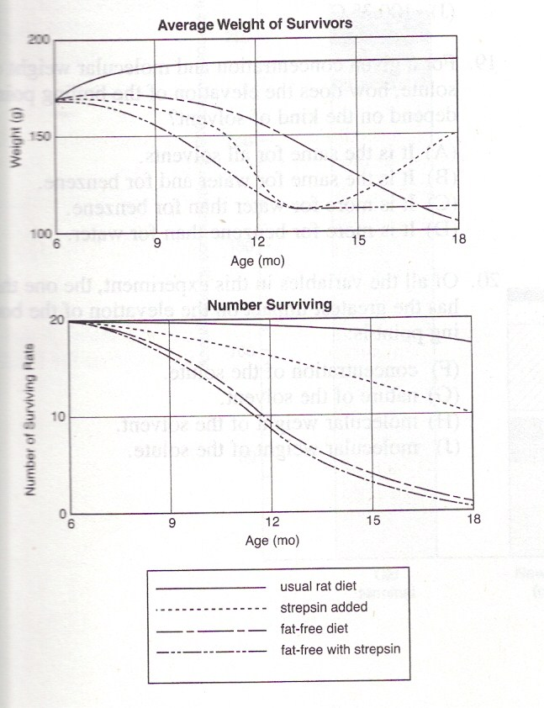
Passage 3 - C
In a research program to find a drug that can be used for weight reduction, strepsin is tried out on 6-month old rats. Twenty in each group are kept for a year under the following conditions:
  A normal rat diet
  A normal rat diet with strepsin added to the food
  A reduced fat diet with no treatment
  A reduced fat diet with strepsin added
  Always look at the axis to see what’s measured but you do not need to study every point on the graph. Wait until you see a question to analyze the data.

Slide 24
Passage 3 - C
12. Why is the result of a fat-free diet less satisfactory?
F. the amount of weight loss is not very great
G. the weight loss might not be retained after 18 months
H. Most of the rats on this diet died.
J. Toward the end of the trial, the rats began to gain weight.

Slide 25
Passage 3 - C
12. Why is the result of a fat-free diet less satisfactory?
F. the amount of weight loss is not very great
G. the weight loss might not be retained after 18 months
H. Most of the rats on this diet died.
J. Toward the end of the trial, the rats began to gain weight.
Only look at the line for a fat-free diet.
All died, even with strepsin.

Slide 26
Passage 3 - C
13. The administration of strepsin had no noticeable effect on the survival rate:
A. for the first 12 months
B. with a normal diet
C. near the end of the trial
D. with a fat-free diet.

Slide 27
Passage 3 - C
13. The administration of strepsin had no noticeable effect on the survival rate:
A. for the first 12 months
B. with a normal diet
C. near the end of the trial
D. with a fat-free diet.
Compare diet with strepsin and without
All die on fat-free even with strepsin.
Could have noticed this from question 12

Slide 28
Passage 3 - C
14. At the end of the trial, what was the total weight of the rats on a normal diet that had been treated with strepsin?
F. 150 grams
G. 1,500 grams
H. 3,000 grams
J. 4,500 grams

Slide 29
Passage 3 - C
14. At the end of the trial, what was the total weight of the rats on a normal diet that had been treated with strepsin?
F. 150 grams
G. 1,500 grams
H. 3,000 grams
J. 4,500 grams
Looking at the normal diet with strepsin line and at the end of graph, you must look at both graphs.
Only 10 rats survived, with a weight of
~ 150g each

Slide 30
Passage 3 - C
15. A careful experimenter might conclude that the average weight of the rats on a normal diet treated with strepsin increased after the12th month because:
A. the surviving rats are those that are least affected by strepsin
B. the dosage of strepsin was reduced after the 12th week.
C. some of the untreated rats got mixed in with the treated ones.
D. the diet of the rats was changed after the 12th week.

Slide 31
Passage 3 - C
15. A careful experimenter might conclude that the average weight of the rats on a normal diet treated with strepsin increased after the12th month because:
A. the surviving rats are those that are least affected by strepsin
B. the dosage of strepsin was reduced after the 12th week.
C. some of the untreated rats got mixed in with the treated ones.
D. the diet of the rats was changed after the 12th week.
- Look at A and see it may be correct.
- Looking at all the rest you will see that they all indicate a flaw in the experiment – do not assume there may be a flaw in the experiment
Careful experimenter indicates you may have to look deeper

Slide 32
Passage 3 - C
16. The results of this experiment might suggest the following next steps in the research program:
F. Repeat the experiment using monkeys.
G. Try strepsin on some overweight people.
H. Repeat the experiment with different doses of strepsin
J. Give up on strepsin and try other drugs.

Slide 33
Passage 3- C
16. The results of this experiment might suggest the following next steps in the research program:
F. Repeat the experiment using monkeys.
G. Try strepsin on some overweight people.
H. Repeat the experiment with different doses of strepsin
J. Give up on strepsin and try other drugs.
-Strepsin didn’t really make any difference on a fat-free diet and on the normal diet it actually was better without strepsin. Strepsin appears to have killed them!!!
Although someone might do any of these you must find the most logical one based on the data given.

Slide 34
Test C passage 5
Page 671

Slide 35
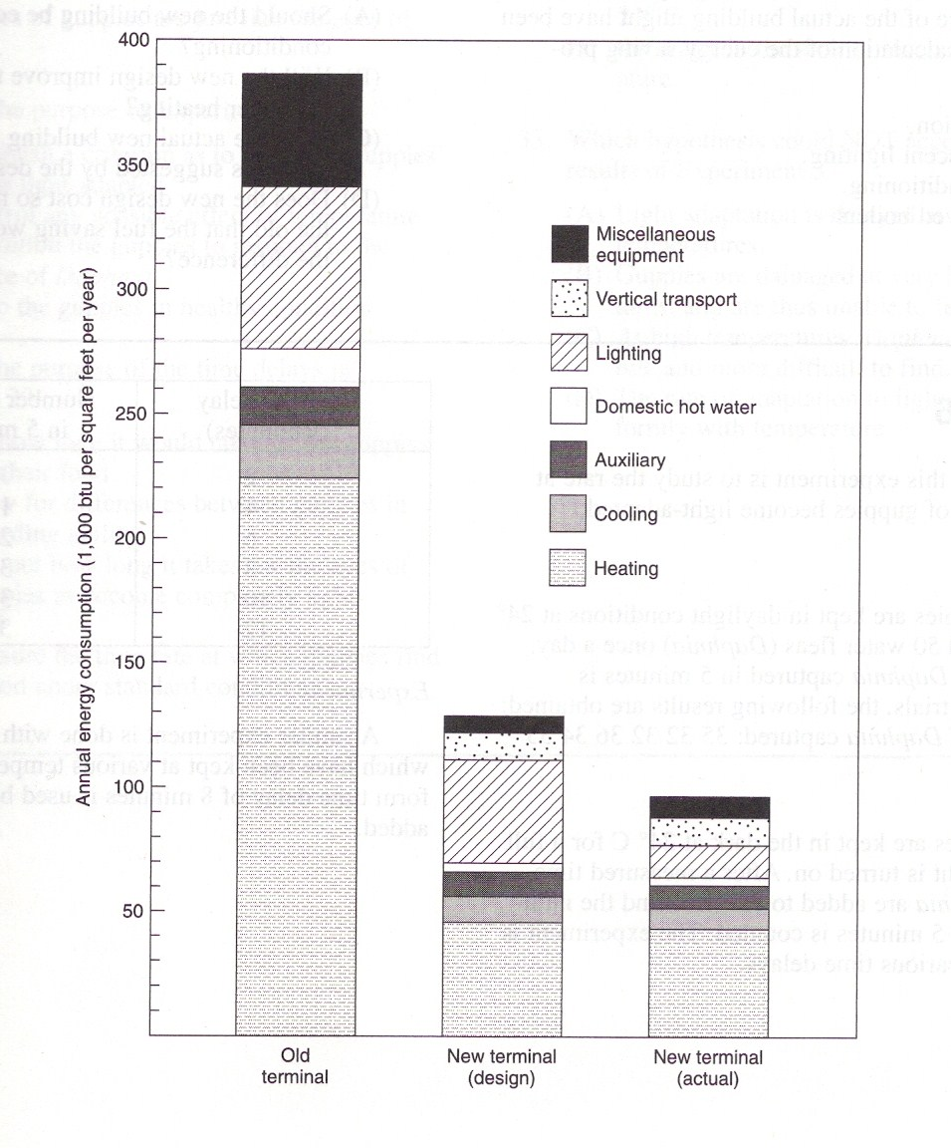
Passage 5 - C
The diagram below represents the forms of energy consumption in an old building, in the design for a new building, and in the actual new building after it was built.

Slide 36
Passage 5 - C
23. How effective was the new design in improving the efficiency of energy use?
A. It reduced the amount of energy use by about 15%.
B. It was a great improvement, but did not accomplish all that was expected of it.
C. It was so good that the new building actually performed better than expected.
D. It was unnecessary, since the new building was so much better than the old one.

Slide 37
Passage 5 - C
24. What service was provided in the new building that was not available in the old one?
F. Elevators
G. Fluorescent lighting
H. Air conditioning
J Electronic energy control
What’s missing in the old one that’s in the new?
vertical transport - elevator

Slide 38
Passage 5 - C
25. The difference between the new design and the performance of the actual building might have been due to miscalculation of the energy saving provided by:
A. insulation
B. fluorescent lighting
C. air conditioning
D. improved boilers

Slide 39
Passage 5 - C
26. What approach to future problems of design of energy efficiency is suggested by these results?
F. Since heating is the largest part of the energy cost even in the new building, this design did little to improve heating efficiency.
G. Design emphasis should be placed on heating because this is the area where the major savings can be made.
H. Better designs must be sought because this one did not produce a result better than the one achieved in the actual new building.
J. Little additional research is needed because this design provided the maximum possible saving of heating fuel

Slide 40
Passage 5 - C
27. Which of the following questions had to be answered before a decision was made as to whether or not to use the new design in constructing the new building?
A. Should the new building be equipped with air conditioning?
B. Will the new design improve the efficiency of hot water heating?
C. Does the actual new building accurately reflect the gains suggested by the design?
D. Does the new design cost so much more than the old that the fuel saving would not make u the difference?

Slide 41
Test B passage 1
Page 598

Slide 42
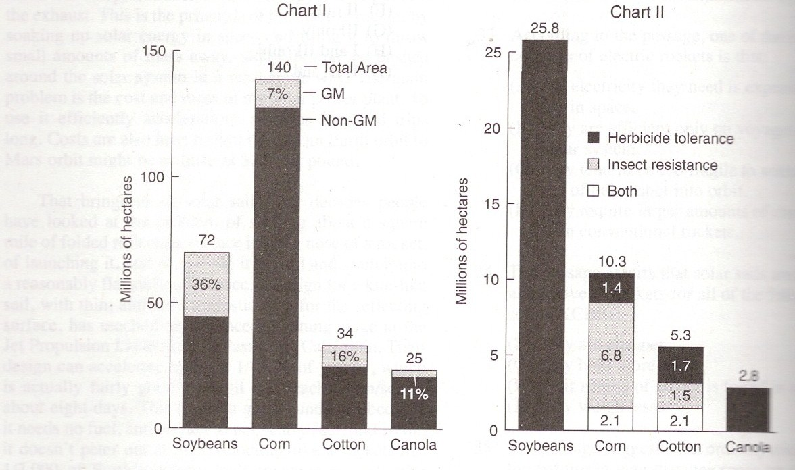
Passage 1 - B
Chart I shows the total areas planted in genetically modified (GM) and unmodified crops in 2002. Chart II breaks down the GM crops into the type of modifications: 1) insect resistance to protect the crop against insect damage, and 2) weed-killer tolerance to allow chemical weed-killers to be used without damage to the crop.

Slide 43
Passage 1 - B
How much area was planted in soybeans that had not been genetically modified?
A. 12 million hectares
B. 26 million hectares
C. 43 million hectares
D. 70 million hectares

Slide 44
Passage 1 - B
2. Which of the four crops has the largest area using genetically modified plants?
F. Soybeans
G. Corn
H. Cotton
J. Canola

Slide 45
Passage 1 - B
3. One feature of the use of genetically modified crops is that:
A. the chief result of the program is protection against insect damage.
B. most corn in cultivation has been protected against insect damage.
C. canola is grown less widely than the other three crops.
D. soybeans have not been protected against insect damage.

Slide 46
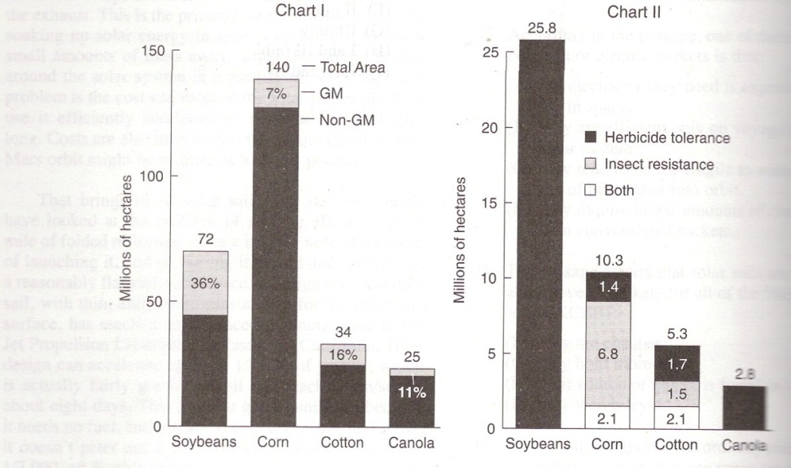
Passage 1 - B
4. A major outcome of the genetic modification program is the decreased need for insect killers in:
F. chiefly, soybean fields.
G. all four crops.
H. soybean fields and cornfields.
J. cornfields and cotton fields.
Anything with soybean can’t be correct.

Slide 47
Passage 1- B
5. An important limitation on the use of GM crops does not apply to:
A. corn because it is so widely cultivated.
B. cotton because it is not a food crop.
C. soybeans because they have not developed GM insect resistance
D. canola because it is not widely cultivated.

Slide 48
Test B passage 2
Page 600

Slide 49
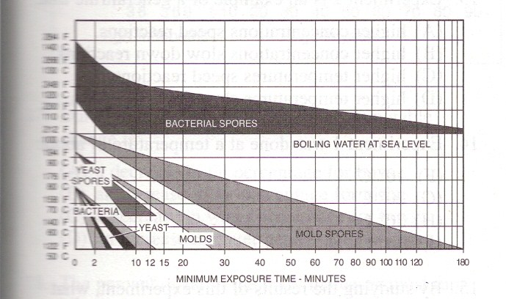
Passage 2 - B
In the sterilizing process, instruments and cultures are exposed to high temperatures for a definite length of time. The diagram below displays the combinations of temperature and time required to kill various kinds of microorganisms. The six graph areas represent the living stages of bacteria, yeasts, and molds, and the spore stages of these kinds of organisms.
Temperature
What are spores?
Labeled without the word “spore” means it’s the living organisms itself.

Slide 50
Passage 2 - B
6. The kind of microorganism that is most difficult to kill is:
F. mold spores
G. bacterial spores.
H. yeasts.
J yeast spores.
How do you know it’s most difficult to kill?
Still living at highest temperature and duration

Slide 51
Passage 2 - B
7. If a laboratory technician keeps instruments in boiling water for 3 hours, the result of the procedure is to kill:
Mold spores
Bacterial spores
All spores
All organisms

Slide 52
Passage 2 - B
8. What procedure could be used to kill off mold spores in a culture, but leave the yeast spores still viable?
f. Hold the culture at 80 ºC for 20 minutes.
g. Keep the culture at 90 ºC for 8 minutes and then at 85 ºC for another 5 minutes.
h. Keep the culture at 70 ºC for 10 minutes.
j. No combination of time and temperature can do this.
To kill mold spores all yeast spores would die.

Slide 53
Passage 2 - B
9. The chart suggests that, by controlling time and temperature, a technician might be able to:
A. kill off bacterial spores while leaving live bacteria viable
B. kill all bacterial spores without destroying all the mold spores
C. kill off certain kinds of bacterial spores and leave other kinds still viable.
D. destroy all living molds without killing off the living bacteria
Process of elimination – all except C cannot be done.

Slide 54
Passage 2 - B
10. What general biological rule might be suggested by the contents of this graph?
F. Microorganisms form spores to enable them to survive all kinds of unfavorable conditions.
G. Molds are more sensitive than bacteria to temperature.
H. Spore formation in microorganisms is a mechanism that protects the species against high temperatures.
J. Spores are a vital mechanism for the reproduction of certain microorganisms.
In every organisms the spore is better adapted to heat than the organisms itself.

Slide 55
Test B passage 4
Page 602

Slide 56
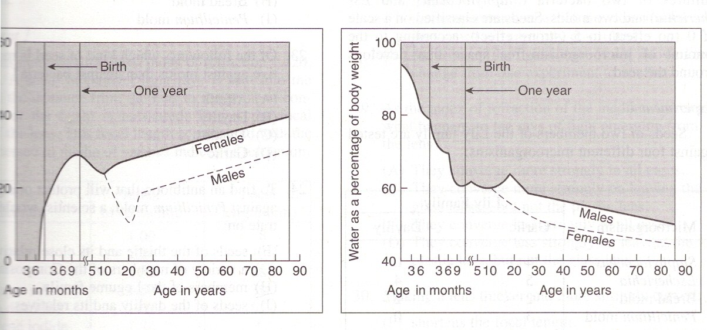
Passage 4 - B
The graphs below represent the percentage of fat and of water in the human body, by age and sex.
Fat as a percentage of body weight.
Water as a percentage of body weight.
17. During the adolescent years, the most notable change is:
A decrease in fat percentage for boys.
An increase in fat percentage for girls.
A decrease in water percentage for boys.
An increase in water percentage for girls.

Slide 57
Passage 4 - B
18. The percent of fat in the body increases most rapidly during:
F. Middle age.
G. Adolescence
H. babyhood.
J. The prenatal period.

Slide 58
Passage 4 - B
19. At age 60, the amount of water in the body of a 150-pound man is:
The same as that in a 150-pound woman.
Twice as much as that in a 150-pound woman.
About the same as that in a 140-pound woman.
About the same as that in a 160-pound woman.

Slide 59
Passage 4 - B
20. As people get older after the age of 40:
F. Men and women become more and more different in the fat content of their bodies.
G. Men and women become more and more different in the water content of their bodies.
H. Both water and fat contents of the bodies of men and women become increasingly different.
J. The difference of both fat and water contents of the bodies of the two genders does not change.

Slide 60
Passage 4 - B
21. What hypothesis about the role of sex hormones during adolescence might be advanced from the graphs?
Both male and female sex hormones cause an increase in the percent of fat in the body.
Male hormones cause a reduction in the percent of fat and an increase in the percent of water.
Female hormones have a much greater influence than male hormones on the percent of water.
Male hormones cause the growth of male secondary sex characteristics.

