Slide 1
RESEARCH SUMMARY
Practice Problems from Barrons Test B and C

Slide 2
What makes a good experiment?
Control – Why? For comparison remember to use it for that.
All things except the variable being tested must be kept constant. You cannot change anything in the middle of the experiment.
You must measure what you set out to determine. If you want to find the effects of light on germination then you cannot measure height of plant.
Experiment must be repeated.

Slide 3
Research Summaries
Understand the problem
- Each description starts with a statement about what the experiment is designed to find out.
- Be sure you understand what the experiments problem is before you go on.
Understand the design
- study the description of the experimental method

Slide 4
Research Summaries
Identify the variables
- some passages are about some aspect of the real world so the scientist is making measurements
- you’re asked to compare these measurements
- others are more experimental and you must know difference between independent and dependant variables - what is it?
(dependent depends on the independent – the growth of plant depends on the amount of light)
Dependent – on y axis independent on x axis

Slide 5
Research Summaries
Identify the controls
- something to compare the experimental data to
Before we start today
- How many mL in one Liter?
1,000
- What is the boiling point of water?
100 ⁰C
When temperature increases, the rate of reactions ______________.
increases

Slide 6
Tips
Look for flaws in the experiment
- are the controls adequate?
- is the conclusion justified?
- are the errors so great that the experiment is really invalid?

Slide 7
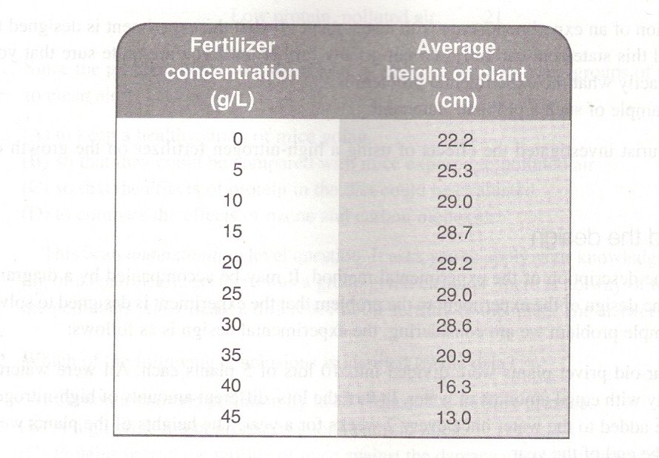
Research Summaries page 400
Most often in a chart like this the independent is the one on the left and the one on the right is dependant on the other.
Which is dependant on which?
Average height is dependant on fertilizer

Slide 8
Research Summaries
What is the control?
What trend do you notice?
It is clear that if too much fertilizer is used, growth is limited.

Slide 9
Research Summaries
What is the most efficient rate for a commercial grower to apply fertilizer to the privet plants?
a. 5 g/L
b. 10 g/L
c. 20 g/L
d. 40 g/L
Tip: When looking at data start at the top

Slide 10
Research Summaries
What is the most efficient rate for a commercial grower to apply fertilizer to the privet plants?
a. 5 g/L
b. 10 g/L
c. 20 g/L
d. 40 g/L
Higher concentrations cost more and will not produce any further improvement.

Slide 11
Research Summaries
2. If a horticulturist is growing chrysanthemums to produce flowers, how would she know how much fertilizer to use?
f. perform an identical experiment with chrysanthemums.
g. use 10 g/L
h. perform a similar experiment with chrysanthemums, but use a different dependent variable.
j. grow the plants in sunlight because it is known that sunlight stimulated the formation of flowers.

Slide 12
Research Summaries
2. If a horticulturist is growing chrysanthemums to produce flowers, how would she know ho much fertilizer to use?
f. perform an identical experiment with chrysanthemums.
g. use 10 g/L
h. perform a similar experiment with chrysanthemums, but use a different dependent variable.
j. grow the plants in sunlight because it is known that sunlight stimulated the formation of flowers.
Best fertilizer for privet may not be best for chrysanthemums.
Experiment deals only with growth, not flower formation

Slide 13
Research Summaries
3. In order for the results of this experiment to be meaningful, which of the following would NOT have to be the same for all the experiment samples?
a. the soil in which the specimens were planted.
b. the amount of time it took for the plants to flower
c. the particular variety of privet used.
d. the number of hours of daylight to which the plants were exposed.

Slide 14
Research Summaries
3. In order for the results of this experiment to be meaningful, which of the following would NOT have to be the same for all the experiment samples?
a. the soil in which the specimens were planted.
b. the amount of time it took for the plants to flower
c. the particular variety of privet used.
d. the number of hours of daylight to which the plants were exposed.
Experiment deals only with growth, not flower formation
The experiment would be invalid if all the others weren't controlled

Slide 15
Research Summaries
4. What part of the experimental design was included for the purpose of determining the smallest concentration of fertilizer that has any effect on growth?
f. giving one group water only
g. using an interval of 5 g/L between concentrations
h. including a 10 g/L sample
j. using plants from a single genetic stock

Slide 16
Research Summaries
4. What part of the experimental design was included for the purpose of determining the smallest concentration of fertilizer that has any effect on growth?
f. giving one group water only
g. using an interval of 5 g/L between concentrations
h. including a 10 g/L sample
j. using plants from a single genetic stock
Unless here is a different outcome between 0 fertilizer and 5 g/L there is no evidence that 5 g/L did anything.

Slide 17
Research Summaries
5. Which of the following situations would NOT invalidate the results of the experiment?
a. accidental destruction of the sample given 20 g/L of fertilizer
b. the discovery that half of the plants had been potted in different soil
c. the discovery that the water used already contained substantial amounts of nitrogen
d. the discovery that some of the plants had been taken from a different variety of privet

Slide 18
Research Summaries
5. Which of the following situations would NOT invalidate the results of the experiment?
a. accidental destruction of the sample given 20 g/L of fertilizer
b. the discovery that half of the plants had been potted in different soil
c. the discovery that the water used already contained substantial amounts of nitrogen
d. the discovery that some of the plants had been taken from a different variety of privet
Results of the experiment are very clear even without the 20 g/L sample

Slide 19
Research Summaries
6. Which of the following hypotheses is suggested by the data?
f. high concentrations of fertilizer damage the roots of plants.
g. Privet plants cannot grow unless there is nitrogen in the soil.
h. if all other conditions are equal, the amount of fertilizer used does not affect plant growth.
j. any addition of fertilizer to the soil slows photosynthesis
Use process of elimination

Slide 20
Research Summaries
6. Which of the following hypotheses is suggested by the data?
f. high concentrations of fertilizer damage the roots of plants.
g. Privet plants cannot grow unless there is nitrogen in the soil.
h. if all other conditions are equal, the amount of fertilizer used does not affect plant growth.
j. any addition of fertilizer to the soil slows photosynthesis
Use process of elimination
F is the only one that can be a possibility

Slide 21
Passages
Passage 2 – test c
Passage 4 – test c
Passage 6 – test c
Passage 3 – test b
Passage 5 – test b
Passage 6 – test b

Slide 22
Passage 4 - C
Read introduction quickly.
Skim each experiment to see the difference between each one – the intro of each should tell you.

Slide 23
Passage 2 - C
Page 668

Slide 24
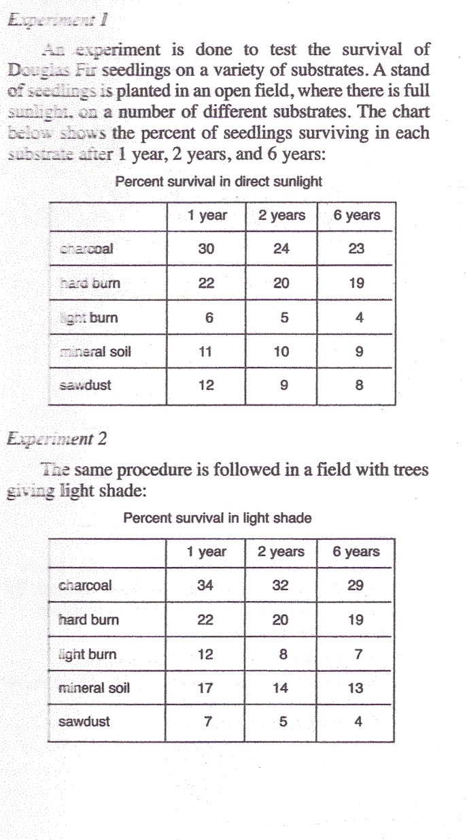
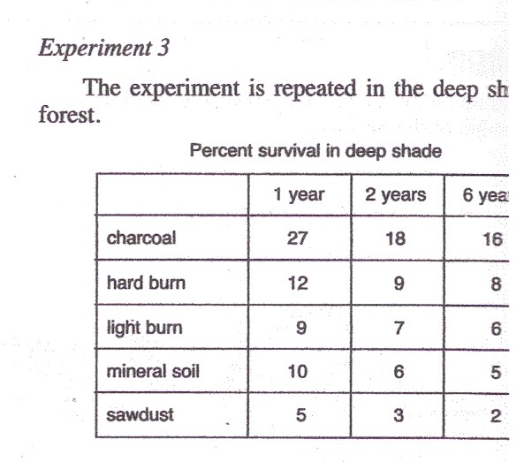
Passage 2 - C
Tip: Always try the first one in the chart first - charcoal

Slide 25
Passage 2 - C
6. The experiments show that:
F. survival improves with the amount of sunlight. (light shade was better than direct light)
G. Charcoal promotes growth of the seedlings. (this was not about growth)
H. seedlings survive best under natural conditions. (nothing in the experiment describes natural conditions)
J. most seedlings die in the first year. (if 34 % survive then 66% die)

Slide 26
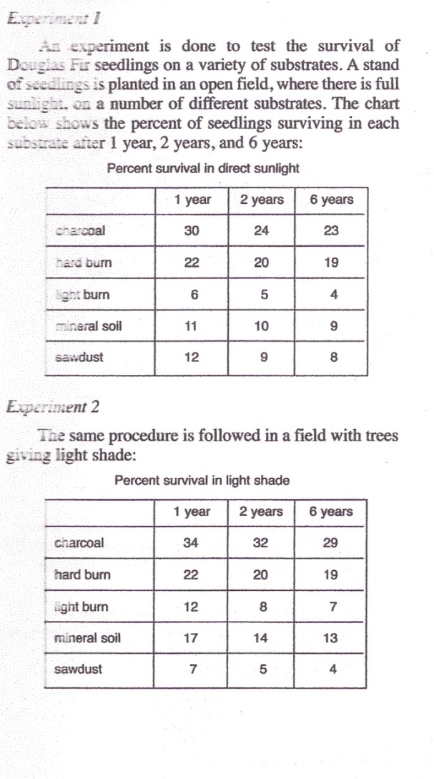
Passage 2 - C
7. When seedlings are grown in charcoal, how do they react to the difference in light?
A. In light shade there is little loss during the second year.
B. They grow to the largest size in light shade.
C. Very few survive in heavy shade.
D. There is substantial loss in the first year.
Look at each choice and ask – is it correct?
If you think the first one is correct be sure to look at the others to be sure.
If you picked D then remember the question asked about the reaction to light so you must compare the 3 types of light – the substantial loss in the 1st year is true of all 3 cases

Slide 27
Passage 2 - C
8. Where survival was poorest on most substrates, the likely cause of loss was:
F. infections and parasites
G. genetic imperfections.
H. lack of sunlight.
J. heat damage
H is the only one that discussed light which is the variable in this experiment

Slide 28
Passage 2 - C
9. One possible reason for the success of plants grown in charcoal is that:
A. the seedlings are genetically programmed to germinate in the shade of a forest.
B. Charcoal is especially rich in minerals.
C. Rabbits and other herbivores do not move onto patches of charcoal
D. Areas heavily burned over are rich in charcoal.

Slide 29
Passage 2- C
A - would indicate a flaw in the experiment.
B – charcoal isn’t more rich in minerals than mineral soil.
C – the only one that could be possible
D – this may be true but has no bearing on the question
9. One possible reason for the success of plants grown in charcoal is that:
A. the seedlings are genetically programmed to germinate in the shade of a forest.
B. Charcoal is especially rich in minerals.
C. Rabbits and other herbivores do not move onto patches of charcoal
D. Areas heavily burned over are rich in charcoal.

Slide 30
Passage 2 - C
10. Which of the following generalizations follows from the data?
F. Seedlings grown in sawdust have an unusually high need for sunlight.
G. Growth is most rapid in regions of light shade.
H. In burned-over areas the heavier the burn, the poorer the seedling survival.
J. If the soil is rich in minerals, the amount of sunlight is not important
Use process of elimination

Slide 31
Passage 2 - C

Slide 32
Passage 2 - C
11. The data seem to indicate that in nature, this species is:
Adapted to life in open forests
Adapted to life on charcoal
Unable to survive in deep forests
Severely damaged by forest fires.
This question asks you to take this data to a different place – in nature open forest would be light shade

Slide 33
Before trying next passage
Remember to read the introduction
Look at passage 2 and see the description of each experiment – be sure to read what the difference is

Slide 34
Passage 4 - C
Page 670

Slide 35
Passage 4 - C
A chemist is investigating the effect of various kinds and amounts of solutes on the boiling point of a solution.
Need to know difference between solute and solvent. (water is the universal solvent)
Skim each experiment to find the difference between each experiment – the intro of each should tell you.

Slide 36
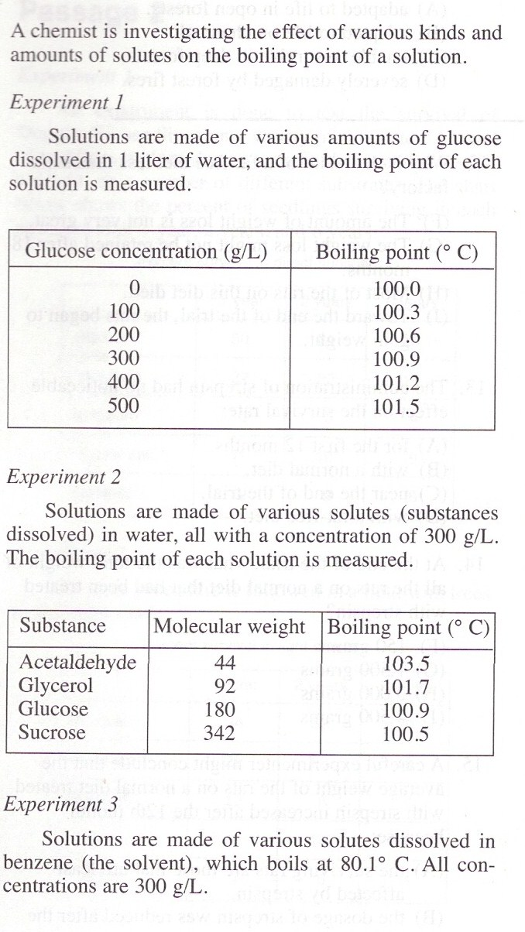
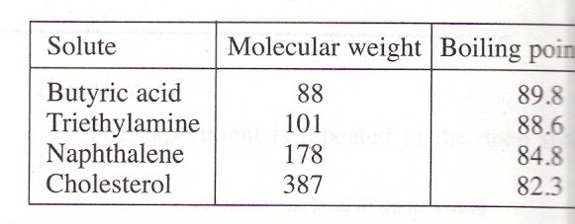
Passage 4- C

Slide 37
Passage 4 - C
Experiment 1 – solutions of varying concentrations of glucose in water
Experiment 2 – Still dissolved in water but different solutes
Experiment 3 – Various solutes dissolved in benzene (they also give you the boiling pt of benzene itself)

Slide 38
Passage 4- C
17. If 200g of glucose are dissolved in 500 mL of water, the boiling point of the solutions will be:
a. 100.3 ⁰ C
b. 100.6 ⁰ C
c. 101.2 ⁰ C
d. 101.6 ⁰ C
Need to know that 500 mL = ½ Liter
Since glucose was dissolved in 1L you need to multiply the 200g of glucose by 2 to get 400g which boils at 101.2

Slide 39
Passage 4- C
18. Three hundred grams of a substance with a molecular weight of 65 are dissolved in 1 liter of water. The boiling point of the solution will be about:
F. 103.5ºC
G. 102.4ºC
H. 101.7ºC
J. 100.3ºC

Slide 40
Passage 4- C
19. For a given concentration and molecular weight of solute, how does the elevation of the boiling point depend on the kind of solvent?
A. It is the same for all solvents
B. It is the same for water and for benzene.
C. It is more for water than for benzene.
D. It is more for benzene than for water.
Which experiments used different solvents?
2 and 3
What should we look at?
Glucose and napthalene – why?
close in molecular wt
Elevation of boiling pt – glucose raised it from 100.0ºC to 100.9ºC while napthalene raised it from 80.1ºC to 84.8ºC

Slide 41
Passage 4- C
20. Of all the variables in this experiment, the one that has the greatest impact on the elevation of the boiling point is:
F. concentration of the solute
G. nature of the solvent
H. molecular weight of the solvent
J. molecular weight of the solute
Nature refers to something specific about the solvent – the 2 solvents were water and benzene
Molecular wt of solvents were not given
Glucose in water raises bp 0.9 ºC, napthalene in benzene with same conc which has similar mol wt raises it 3.7 ºC
Water & glucose in 1L – diff concentrations
benzene & diff solutes – same concentrations
Water & diff solutes – same concentrations

Slide 42
Passage 4- C
21.In Experiment 3, the solution of butyric acid in benzene boiled at a higher temperature than cholesterol in benzene. A possible explanation is:
A. the molecules of cholesterol are larger, so they lower the boiling pt of the benzene
B. the mass of cholesterol in solution was larger than the mass of butyric acid.
C. cholesterol reacts chemically with benzene, but butyric acid does not.
D. the butyric acid solution contains more molecules of solute than the cholesterol solution.
Boiling point of benzene is 80.1 – cholesterol didn’t lower it – it raised it
Mass was the same for all (good experiment – one variable)
No reason to think a chemical reaction occurred
Lower mol wt will have more molecules to make 300g
Water & glucose in 1L – diff concentrations
benzene & diff solutes – same concentrations
Water & diff solutes – same concentrations

Slide 43
Passage 4- C
22. In trying to determine the nature of a newly discovered substance, a chemist might use experiments of this kind to discover its:
F. chemical formula
G. concentration
H. molecular weight
J. boiling point
Remember this is elevation of boiling point not boiling point
There is a clear relationship between elevation of boiling point and molecular weight
J is not right because you wouldn’t have to do all of these experiments to find the boiling point – just boil it!
Water & glucose in 1L – diff concentrations
benzene & diff solutes – same concentrations
Water & diff solutes – same concentrations

Slide 44
Passage 6 - C
Page 672

Slide 45
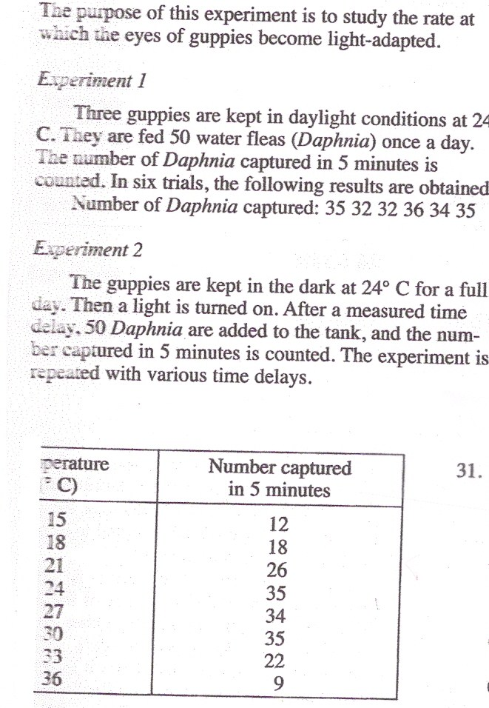
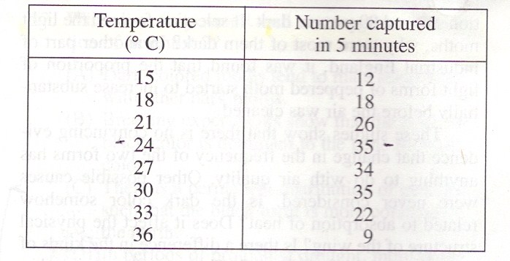
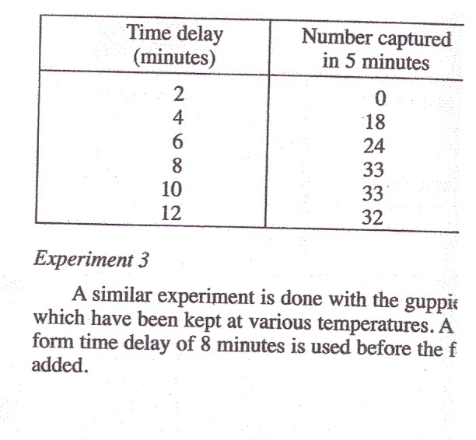
Passage 6
The purpose of this experiment is to study the rate at which the eyes of guppies become light-adapted.
Data

Slide 46
Passage 6- C
Data
28. What assumption underlies the design of these experiments?
F. Guppies are most active when illuminations is high.
G. The ability of guppies to find food depends on their ability to see it.
H. Temperature affects the ability of guppies to find food.
J. The eyes of guppies are just like the eyes of people.

Slide 47
Passage 6- C
Data
29. What was the purpose of Experiment 1?
A. To establish a criterion as to when the guppies eyes are light-adapted.
B. To control any possible effect of temperature.
C. To condition the guppies to respond to the presence of Daphnia.
D. To keep the guppies in healthy condition
Always look for a control. What is a control used for - comparison

Slide 48
Passage 6- C
Data
30. What was the purpose of the time delays in Experiment 2?
F. To see how long it would take for the guppies to find the food
G. To allow for differences between guppies in their feeding ability
H. To find out how long it takes for the eyes of the guppies to become completely light-adapted.
J. To measure the time rate at which guppies find their food under standard conditions
Look at what the experiment is trying to find out

Slide 49
Passage 6- C
Data
31. What evidence is there that guppies depend solely on their eyesight to find food?
A. Experiment 3 shows that they cannot see well at low temperatures
B. Experiment 2 shows that, in the first 2 minutes after being kept in the dark, they cannot find any.
C. Experiment 1 shows that they find food very efficiently in daylight.
D. Experiment 2 shows that the rate at which they find food diminishes as the food supply dwindles.

Slide 50
Passage 6- C
Data
32. A time delay of 8 minutes was selected for Experiment 3 because this is the amount of time required for:
F. the guppies to consume most of the food.
G. the Daphnia to become adapted to the tank.
H. the guppies’ eyes to become light-adapted at 24 ºC.
J. the water in the tank to reach a steady temperature.

Slide 51
Passage 6- C
Data
33. Which hypothesis could NOT account for the results of Experiment 3?
A. Light adaptation is delayed at unusually high temperatures.
B. Guppies are damaged at very high temperatures, and are thus unable to feed well
C. At high temperatures, Daphnia become immobile and more difficult to find.
D. The rate of adaptation to light increases uniformly with temperature.

Slide 52
Practice Test B
Research Summaries

Slide 53
Reminders
Read and understand the introduction paragraph.
Read the explanation of each experiment and know the difference between each one.
See what the variables are and brief look for trends.
Don’t study all the information in the tables or charts just know where to look for the answers.

Slide 54
Passage 3 - B
Page 601

Slide 55
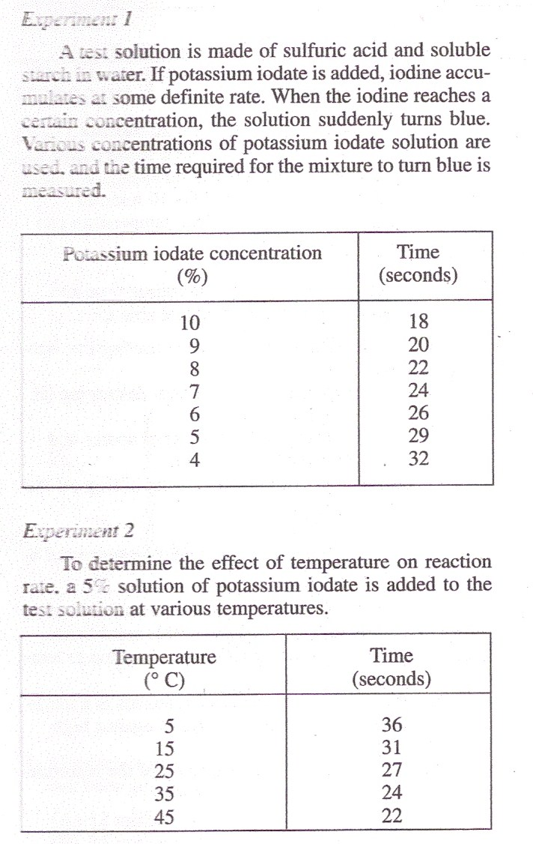
Passage 3 - B
Experiments were done to study some of the factors that determine the rate of a reaction. When sulfuric acid acts on potassium iodate, elemental iodine is released and its concentration increases gradually. Starch is used as an indicator; when the iodine concentration reaches a certain strength it suddenly turns the starch blue.

Slide 56
Passage 3 - B
11. Starch was added to the solution because:
a. it speeds the reaction that produces iodine.
b. it provides a test for the presence of elemental iodine.
c. it slows down the reaction so that the time becomes easily measurable.
d. it prevents the sulfuric acid from destroying the potassium iodate.

Slide 57
Passage 3 - B
12. Experiment 1 shows that:
f. elemental iodine turns starch blue.
g. at higher iodate concentration, iodine is liberated more quickly.
h. the rate of the reaction depends on the concentration of sulfuric acid.
j. the release of elemental iodine occurs suddenly.

Slide 58
Passage 3 - B
13. Experiment 2 is an example of a general rule that:
a. higher concentrations speed reactions.
b. higher concentrations slow down reactions.
c. higher temperatures speed reactions.
d. higher temperatures slow down reactions.

Slide 59
Passage 3 - B
14. Experiment 1 was done at a temperature of about:
F. 10 ºC
G. 20 ºC
H. 30 ºC
J. 40 ºC

Slide 60
Passage 3 - B
15. By studying the results of this experiment, what can be concluded as to the time the reaction would take at a temperature of –15 ºC?
It would take about 48 seconds.
It would take longer than 36 seconds, but it is impossible to predict how long.
It is not possible to make any prediction because the results of the experiment are too scattered.
It might take a long time, or the whole thing might freeze and stop the reaction.

Slide 61
Passage 3 - B
16. About how long would it take for the starch to turn blue if a 10% solution of potassium iodate was used at 45 ºC?
F. 15 seconds
G. 18 Seconds
H. 22 seconds
J. 29 seconds

Slide 62
Passage 5 - B
Page 603

Slide 63
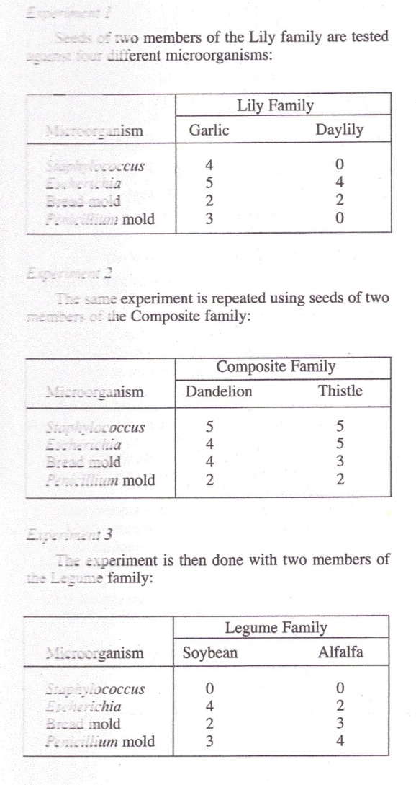
Passage 5 - B
22. Which of the microorganisms is most susceptible to attacks by the chemicals produced by seeds?
F. Staphylococcus
G. Escherichia
H. Bread mold
J. Penicillium mold
Escherichia was greater in 4 of 6 trials

Slide 64
Passage 5 - B
23. Of the following, which kind of seed is more effective against molds than against bacteria?
Alfalfa
Daylily
Thistle
Garlic

Slide 65
Passage 5 - B
24. To find an antibiotic that will protect oranges against Penicillium mold, a scientist would concentrate on:
F. Seeds of the thistle and its close relatives.
G. A variety of members of the Composite family
H. Members of the Legume family.
J. Seeds of the daylily and its relatives.

Slide 66
Passage 5 - B
25. What conclusion can be reached about bread mold?
It can survive by attacking seeds.
It is highly resistant to chemical poisoning.
It cannot be destroyed by seeds of the Composite family.
It is moderately susceptible to attack be many kinds of seeds.
All seeds affected it

Slide 67
Passage 5 - B
26. What hint might a scientist trying to find an antibiotic to control Staphylococcus infections get from these experiments?
F. Looking for seeds that produce such an antibiotic would be a waste of effort.
G. It would be inadvisable to concentrate on seeds of the Legume family.
H. It would be wise to concentrate on Penicillium mold and its close relatives.
J. The scientist should not waste time trying the bread mold and its close relative.

Slide 68
Passage 5- B
27. Which of the following ecological hypotheses is supported by the evidence of these experiments?
Molds are better able to survive than bacteria wherever the two kinds of microorganisms compete.
The Legume family produces valuable fodder crops because its seeds have a high survival rate.
The bacteria Escherichia and Staphylococcus may be highly damaging to leguminous crops.
The Composite family has so many successful sturdy weeds because its seeds destroy microorganisms.
Composites attacked all

Slide 69
Passage 6 - B
Page 604

Slide 70
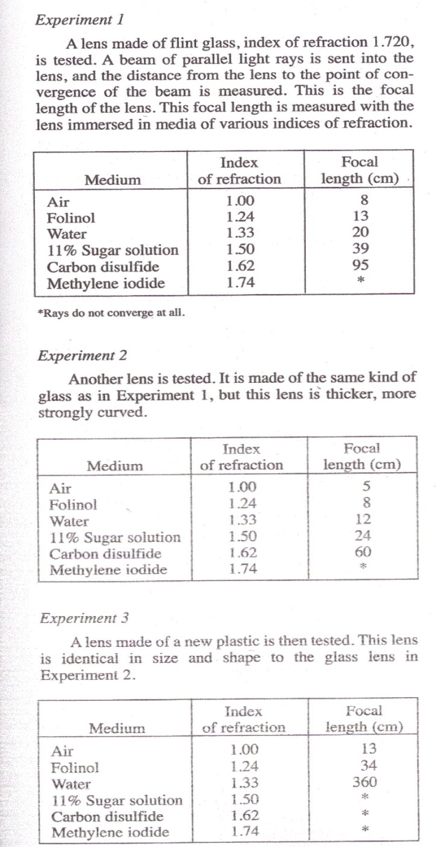
Passage 6- B
Experiments are done to test the optical properties of lenses immersed in media having different indices of refraction.

Slide 71
Passage 6 - B
28. The index of refraction column is the same in all three experiments because:
F. All three lenses have the same basic properties.
G. The same liquids are used in all three experiments.
H. The temperatures at which the experiments are performed are carefully controlled.
J. The color of the light source is not allowed to change from one experiment to another.
Look for similarities

Slide 72
Passage 6 - B
29. As index of refraction of the medium increases, what happens to the rays of light emerging from the lens?
They converge more strongly in all cases.
They converge more strongly on leaving the glass lenses, but not the plastic lens.
They converge less strongly in all cases.
They converge less strongly on leaving the plastic lens, but not the glass lens.

Slide 73
Passage 6 - B
30. Making a lens thicker and more strongly curved:
F. Shortens the focal length.
G. Increases the focal length
H. Increases the index of refraction
J. Decreases the index of refraction.

Slide 74
Passage 6 - B
31. A reasonable hypothesis that can be derived from Experiments 1 and 2 is that:
A lens will not focus light if its index of refraction is lower than that of the medium it is in.
Methylene iodide tends to spread light out so that it does not come to a focus.
The focal length of a lens depends entirely on the index of refraction of the medium it is in.
The thicker a lens , the less the convergence it produces on the light that passes through it.

Slide 75
Passage 6 - B
32. Measurements of the kind made in these experiments would NOT be useful in efforts to find:
F. The index of refraction of a liquid
G. The way a prism in a fluid would bend light rays.
H. The concentration of a sugar solution.
J. The transparency of a newly developed plastic
Transparency is not relevant here.

Slide 76
Passage 6 - B
33. The index of refraction of the plastic lens in Experiment 3 must be:
Less than 1.33.
Between 1.33 and 1.50
More than 1.33.
More than 1.50

