Slide 1
Mrs. Kelley Office Q124
Business Law and Ownership

Slide 2
Objectives
Provide students with the knowledge of law for personal and business use including Civil, Criminal, Juvenile, and Contract Law.
Prepare students for further study and career development in law and other business fields.

Slide 3
Grading Scale
90-100 A
80-89 B
70-79 C
60-69 D
59 or below F

Slide 4
Rules & Procedures
All school policies will be enforced in this classroom.
ID’s must be worn and free of stickers etc.
Tardies will be recorded.
Show respect for yourself and others.
Treat equipment with care.

Slide 5
Arrival and Departure
Please be in your seat when the bell rings.
Present excused passes to teacher
Sign tardy clipboard when entering after bell without an excused pass
Sign tardy clipboard and place unexcused passes in clipboard storage.
Remain in your seat until the bell or teacher releases you.

Slide 6
Attendance
Excused Absences
Makeup work must be completed in a reasonable time.
Work missed due to field trips must be turned in on regular due date or upon your return.
Check uncleared list after an absence. Uncleared students must obtain an admit to return to class

Slide 7
Makeup Work
Generally, makeup tests should be taken before or after school or during your study hall.
Mrs. Kelley’s Hours M-F
7:45 a.m.-8:30 a.m. Q124 Office
1st hour Q120 Accounting & Honors I & II
2nd hour Q120 Business Law/College & Career Prep
3rd hour Q120 College & Career Prep (sem. 1 & 2)
4th hour Q124 Planning
5th hour Q124 Lunch/Plan
1:30-4:00 p.m. Q124 Office Dept. Chair Duties

Slide 8
Unexcused Absences & ISD
A zero will be assigned for any tests or assignments missed due to unexcused absences.
Students returning from unexcused absences will be expected to take any tests being given that day.
Students in ISD are responsible for all work missed and any tests scheduled.

Slide 9
Classroom Materials
Bring text, notebook, pen or pencil every day (even test days) unless instructed otherwise.
Failure to bring materials to class will result in a warning for the first offense and a zero for any daily grades after the warning.
The student may opt to take a tardy to return to their locker for materials.

Slide 10
Classroom Property
Report any problems with school property immediately.
Students will be assigned seats and are accountable for care of their area.
No food, gum, or drinks are permitted in the classroom.

Slide 11
Restroom Passes
Please keep requests to use the restroom pass to a minimum.
All restroom passes will be recorded and monitored for appropriate length.
A rule of thumb is one restroom pass per grading period is given.
Complete agenda book for my signature prior to request.

Slide 12
Utilization of Class Time
Do not plan to sleep, play games, do homework or study for another class during this class time.
Class participation is expected of all students.
Non-class related materials may be confiscated if preventing your full attention to class.

Slide 13
Internet/Computer Usage
Internet Access card must be on file
Teacher permission is required to access the internet.
Violation of school policy will result in denial of future internet usage.
Students are prohibited from accessing email or printing non-class related documents without specific teacher permission.

Slide 14
Homework
Late homework is worth 50% of the original value.
No work may be made up for credit after the assignment has been returned, unless special circumstances exist.

Slide 15
Grooming
School dress code will be enforced.
Please avoid the in class use of makeup, hair care supplies, perfumes and lotions etc.

Slide 16
Cheating
Honesty is an important virtue.
Students caught cheating or caught assisting someone else in cheating will receive a grade of zero for the test/assignment.

Slide 17
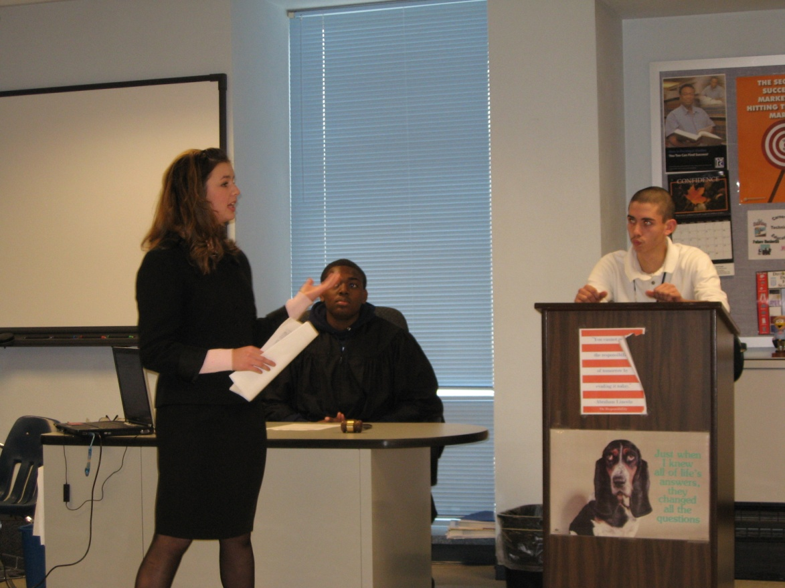
Have a Great Semester!

