Slide 1
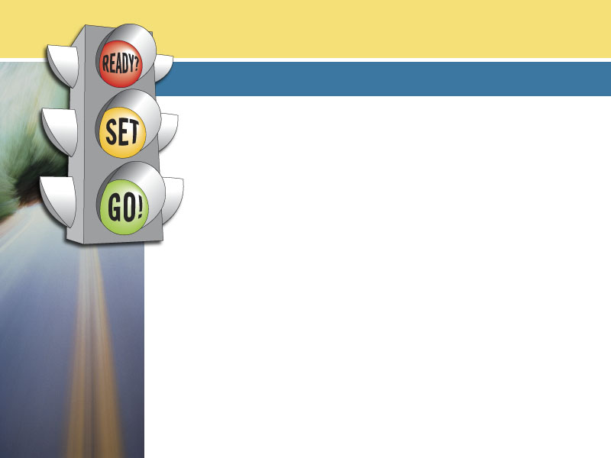


Auto Financing 101: Making Smart
Vehicle Financing Decisions
Brought to you by AWARE
www.AutoFinancing101.org
Notes:
There’s no doubt – financing is a way of life in America. It puts the “American Dream” within our reach, offering opportunities to start a new business, buy a home, or purchase a car to get us to jobs. But if entered into lightly or without good researching or decision-making skills, we can get in over our heads.
Today we’re going to look specifically at the subject of vehicle financing – most likely the first or second largest purchase you’ll make in your lifetime. With prices averaging more than $28,000 for a new vehicle and $15,000 for a used vehicle, most consumers need financing or leasing to acquire a vehicle.
You’re going to get a lot out of today’s class that you will be able to apply not only to your auto financing decisions, but also in nearly all other areas of your financial life. Concepts of sound budgeting, the importance of a solid credit history, researching options, negotiating, and making smart long-term financial decisions are all areas that are crucial components of being financially literate.
The vehicle financing industry is highly competitive, and those of you who take the time to educate yourselves and do your homework will be in the best position to benefit from this competitive marketplace.

Slide 2

Vehicle Ownership
and Your Financial Future
Economic empowerment
  Increased job opportunities
  Increased earning potential
Improved quality of life, time with family
Opportunity to improve overall credit picture
Notes:
Let’s start off by asking yourself – WHY do you want a vehicle? Having the answer to this question will help guide you through some of the decisions you’ll need to make later in this process.
For those who currently do not have a vehicle, there’s no question as to the economic and personal benefits vehicle ownership would bring to your life.
A Washington, DC-based nonprofit group that helps provide vehicles to low-income families – Vehicles for Change – performed a study on the economic impact of vehicle ownership on an individual. The study found that car ownership translates into improved job opportunities and greater earning potential by expanding an individual’s ability to perform their job outside of a geographically-fixed area served by mass transit. Additionally, their recipients felt a boost in the quality time spent with their family, through shorter commute times, ability to drive their kids to school and community events, doctor’s appointments, and other basic quality of life issues.
Another factor in vehicle ownership is its potential impact on your credit score. Securing financing for a vehicle, and following up by making timely payments, will give you a great opportunity to improve your credit score and your overall credit picture. For those with credit history challenges, this could open future doors for you in other areas of your financial life in the form of lower cost of credit and access to financing for things like a home, a small business, or other opportunities.

Slide 3

ARE YOU
GET TO MAKE YOUR DECISION
TO THE DEALERSHIP
Notes:
Let’s get started…
Today we’re going to think of the vehicle financing process in terms of a traffic light:
Red – “Are You Ready?” – This is your prep time - the time when you shouldn’t be making any actual movements, but rather taking the time to make sure you are prepared to make the best possible decision. We’re going to talk here about budgeting, saving for a down payment, your credit history, and determining whether you’ll need a co-signer.
Yellow – “Get Set to make your decision” – Now that you have decided that the time is right to purchase and finance or lease a vehicle, you’re still not ready to go to the dealership quite yet. This is the research and learning phase, where we’ll talk about researching your vehicle and financing options, the differences between leasing and buying, and all of the different factors that are going to ultimately go into your final decision. The better prepared you are during this phase, the happier you’ll be in the end with your vehicle and financing decision.
Green – “Go to the dealership” – Now you’re ready to walk into the showroom, take the test drive, and talk about financing. In this section, we’re going to talk about what you can expect in the financing office of the dealership, negotiating financing, deciding on optional products, reading your contract, and sticking to your price.

Slide 4

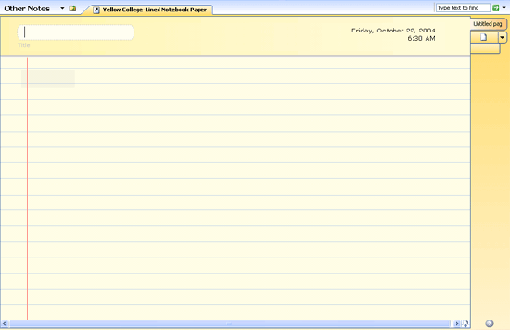
ARE YOU
STEP 1:
Prepare your budget
Item | Amount
INCOME EXPENSES Rent | $1,500 $600
Utilities | $75
Transportation | $260
Food | $275
Medical expenses | $35
Clothing | $75
Leisure activities | $80
Miscellaneous | $50
TOTAL | $1,450
SAVINGS | $50
Notes:
Creating a personal or family budget is the only way to make an informed decision on whether or not this is the right time for you to make a major purchase, and how much you are able to afford.
There are countless free programs online to help you with creating a budget. For the purposes of buying a car or truck, there’s one that is particularly helpful, created by AWARE. (EDUCATOR: this is an Excel spreadsheet that can be found on this CD-ROM, or downloadable from AWARE’s Web site at www.AutoFinancing101.org/LearningSuite). This particular tool walks you through the process of creating your family budget. When you’re done, there’s an attached tool called the “Affordability Gauge” that will help you make your decision on what new car or truck will be affordable for you. The tool wisely looks at more than just the monthly payment – a common mistake of many shoppers. The tool helps you also compare other vehicle-related costs, such as maintenance, insurance and gasoline – all of which can vary vehicle by vehicle and should be a necessary part of your decision making process.

Slide 5
ARE YOU
STEP 2:
Save for a down payment
Down Payment
=
Monthly Payments
Notes:
After you’ve determined what you can afford on a monthly basis, you need to look at your savings to decide how much you can afford to pay up front, in the form of a down payment. The more you’re able to put toward the car up front, the more you’ll be able to lower your monthly payments by reducing the total amount that will be financed. If you already own a car and plan to trade it in, the trade-in value can be used toward the down payment. If you still owe money on the car, be sure to check the value of the car that you’re turning in, and the amount you still owe. If you trade in a car that is worth less than what you owe on it, you’ll be responsible for coming up with the difference to pay off your financing. If the difference is added to your financing for the new vehicle, it will increase your monthly payment for that financing.
It’s also important to know that the amount of your down payment could affect the rate you’re offered.
All of these decisions will help you come up with your final number – the price range of the new car or truck you should be shopping for. There’s a terrific online calculator that you can use to come up with this answer. It allows you to plug in the monthly payment you want, your down payment amount, any trade-in amount, other financing terms (APR, length of contract, etc – more on that later), and it will calculate for you the price you should be shopping for. The calculator was created by a group called YOUNG MONEY, a nonprofit personal finance education group that works primarily with young adults. Access this at http://www.youngmoney.com/calculators/auto_buying/auto_loan. The calculator is flexible in that you can also do the reverse – put in the price of the car and other terms, and it will calculate your monthly payment.
You should keep in mind, however, that there are additional fees, such as taxes, licensing fees, etc., that will be added on to the price of the car or truck, and you need to take that into account when budgeting.

Slide 6
ARE YOU
STEP 3:
Know your Credit Condition
www.AnnualCreditReport.com
or (877) 322-8228
Credit information
Public Record information
Credit Inquiries
Personal Information
Notes:
Now, let’s talk about your credit condition. As in any other credit or lending activity, your credit history has a direct impact on the cost of credit, or the “APR,” or Annual Percentage Rate, you will be offered. Focusing on establishing and maintaining a strong credit history will be important for the purchase of your vehicle – or any other purchase on credit for that matter – in order to receive the most competitive offer possible.
If you haven’t done this at all, or not recently, you should order a copy of your credit report. You are entitled to one free credit report each year, from each of the three national credit reporting companies (Experian, Trans Union and Equifax). The fastest and most secure way to do this is through the Web site www.AnnualCreditReport.com, a site recommended by the Federal Trade Commission and sponsored by all three credit reporting companies. These free reports will not include your credit score, but you will be given an opportunity to purchase that separately if you choose. In most cases, you’ll be able to view your credit report instantly after answering a series of security questions. Reports can also be obtained by calling 1-877-322-8228.
Getting an up to date credit report can help you in a number of ways when making auto financing decisions. You will be able to better evaluate the competitive deals you’re offered. You will also be in a better position to negotiate when shopping for vehicle financing (more on that later).
Tip: Because you’re entitled to one report from each of the three credit reporting companies, you should consider spacing out your three requests over the span of a year, rather than all three at one time. This way, you can observe ongoing changes to your credit record and look for persistent problems.

Slide 7
ARE YOU
STEP 4:
Maximize your credit score
Improve your payment history
Lower your amounts owed
Make the most of the length of your credit history
Shop wisely for new credit
Manage the types of credit you have
Source: Fair Isaac Corporation
Notes:
Now let’s talk about your credit score. Credit score is a numerical score that sums up—at a point in time—what your past and current credit usage predicts about your future credit performance based on statistics. The better your history of credit, the higher your score. In other words, a credit score is a number banks and finance companies use to help them decide: "If I give this person a loan or credit card, how likely is it I will get paid back, and will I get paid back on time?“
Credit scores can be generated by a scoring company like Fair Isaac. Some creditors have their own in-house scoring software. Let’s talk about ways to try to improve your credit score. You should know that there is no quick fix, and that it takes time. In that sense, some have equated this to trying to lose weight. Can be slow going, and takes a good solid effort.
The best advice, of course, is to manage credit responsibly over time. Here are some good suggestions from Fair Isaac Corporation, the creators of the FICO® score.
Improve your payment history
Pay your bills on time. Delinquent payments and collections can have a major negative impact on your score.
If you have missed payments, get current and stay current. The longer you pay your bills on time, the better your score. But also be aware even if you pay off a collection account, it will stay on your report for seven years.
Contact your creditors or a legitimate credit counselor if you're having trouble making ends meet. This won't improve your score immediately, but if you can begin to manage your credit and pay on time, your score will improve gradually.
Lower your amounts owed
Keep your balances low on credit cards and other "revolving credit." High outstanding debt can affect a score.
Pay off debt rather than moving it around. The most effective way to improve your score is by paying down your revolving credit.
Make the most of the length of your credit history
If you've been managing credit for a short time, don't open a lot of new accounts too rapidly. This rapid buildup of credit can make you look risky to a prospective creditor.
Shop wisely for new credit
Do your rate shopping within a focused period of time. Credit scoring software can normally distinguish between a search for a single loan and a search for many new credit lines, so it’s typically a good idea to try to focus your “shopping around” period to a shorter period of time.
Re-establish your credit history. Even if you‘ve had problems in the past, opening new accounts responsibly and paying them off on time will raise your score in the long term.
Manage the types of credit you have
Apply for and open new credit accounts only as needed. Don't open accounts just to have a better credit mix — it probably won't raise your score.
Have credit cards — but manage them responsibly. In general, having credit cards (and paying them on time) will raise your score.

Slide 8
STEP 5:
Do you need a Co-Signer?
Creditor may require if you have little or poor credit history
  Young or first-time buyers often need a co-signer
Co-signer is often beneficial to high credit risk customers:
  Can typically help to secure lower
  finance rates
  Gives an opportunity to improve credit history with demonstration of timely payments
ARE YOU
Notes:
If you have a poor credit history – or little or no credit history, such as with younger consumers – you may want to consider getting someone in a better credit position to co-sign your financing with you. In some cases, you may find that the finance company will require this in order to make up for any deficiencies in your credit history.
If you have a lower credit score, co-signing is often quite beneficial. It will most likely give you an opportunity to secure a lower financing rate. But perhaps more importantly, with timely payments, you will be given an opportunity to improve your score over time, which will put you in a better position to secure more competitive financing on your own in the future.
Now let’s look at the other side – what if you’re asked to co-sign for someone else in a worse credit situation than you. In this case, you will be responsible for the contract, and the account payment history will be reflected on your credit history, even if you’re not the one making the payments. Be cautious if someone asks you to co-sign! Many co-signers are eventually asked to repay the loan. Be sure you can afford to make the payments – and are willing to make the payments – before agreeing to be someone’s co-signer.

Slide 9
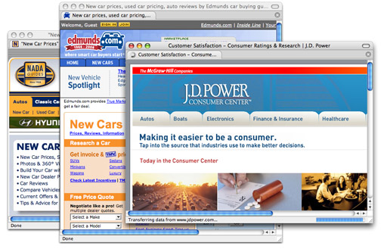
Research vehicles
within your price range
www.nadaguides.com
www.jdpower.com
www.edmunds.com
GET
TO MAKE YOUR DECISION
Notes:
OK, we’re done with all of our initial preparation. We’ve made our budget. We’ve checked and enhanced our credit. We’ve determined what we can afford. Now it’s time to move on to the next phase of this process – GET SET TO MAKE YOUR DECISION!
This is what we’ll call the research phase, where you’re gathering information that will help you make the best decision possible. As mentioned earlier, this is a highly competitive marketplace, meaning that informed, well-researched consumers will benefit the most in the end.
In the “Are you Ready” phase, you determined the price of a car or truck that you want to buy. These days, you’re very fortunate in that there is a lot of information available on vehicles, including pricing, reliability, fuel economy, safety records, performance, resale values, insurance rates, and maintenance costs. There are many online auto buying guides to help you with this research – here are three that are good and easy to use – NADA Guides, JD Power & Associates, and Edmunds.com.
While most of you will conduct this research online on a home computer or at a library, you’ll also find information for researching at the newsstand, or in print form at your local library.

Slide 10
Shop around
for vehicle financing
GET
TO MAKE YOUR DECISION
Banks
Finance
Companies
Credit
Unions
Dealerships
COMPETITION
Provides access to credit for
all credit risks
Economically benefits all consumers
Notes:
Your next step in this process is to start researching and shopping around for vehicle financing – just as you would for the make and model of the vehicle. Today, you have a wide range of choices to finance your automobile purchase. You can first shop around and look into “off-site financing” options, where you would obtain financing directly from a finance company, bank or credit union. In this case, once you and the dealership enter into a contract to purchase the car or truck and agree on a vehicle price, you would use the loan proceeds from this off-site creditor to pay the dealership for the vehicle.
An often-preferred type of vehicle financing, however, is “dealership financing,” which offers you the convenience of buying vehicles and financing in one place. Dealerships have relationships with a variety of banks and finance companies, allowing them to offer a large range of financing options to consumers with varying types of credit histories. Additionally, from time to time, dealerships may offer manufacturer-sponsored low rate programs to buyers.
The vehicle financing industry is highly competitive. As in any other competitive industry, this ultimately benefits you in two key ways. First, this competition among multiple financing sources means more consumer choice and borrowing opportunities for ALL credit risks, including those of you with lower credit scores. Additionally, competition generally translates into lower costs for everyone across the board.

Slide 11
 | Leasing | Buying
Ownership | You do not own the vehicle | You own the vehicle
Up-front costs | May include 1st month’s payment, refundable security deposit, capitalized cost reduction (like down payment), taxes, registration, other fees & charges | Cash price or down payment, taxes, registration, other fees & charges.
Monthly payments | Typically lower than financing – only paying for depreciation. | Typically higher than leasing – paying for entire purchase price.
Early termination | You may have to pay a substantial early termination fee if you end the lease early. | You must pay the pay-off amount if you end the financing early.
GET
TO MAKE YOUR DECISION
Source: “Keys to Vehicle Leasing,” Federal Reserve
Notes:
Your next decision to consider is whether to lease or finance your vehicle. This chart, created by the federal government, will help us compare, side-by-side, the difference between leasing and buying.
Ownership
LEASING: You do not own the vehicle. You get to use it but must return it at the end of the lease unless you choose to buy it. Sometimes leases will have a purchase option before or after lease end, but there may be certain conditions for exercising that option.
BUYING: You own the vehicle and do not need to return it at the end of the financing term.
Up-front costs
LEASING: Up-front costs may include the first month's payment, a security deposit, a capitalized cost reduction (like a down payment), taxes, registration and other fees, and other charges.
BUYING: Up-front costs include the cash price or a down payment, taxes, registration and other fees, and other charges.
Monthly payments
LEASING: Monthly lease payments are usually lower than monthly financing payments because you are paying only for the vehicle's depreciation during the lease term, plus rent charges (like interest), taxes, and fees.
BUYING: Monthly financing payments are usually higher than monthly lease payments because you are paying for the entire purchase price of the vehicle, plus interest and other finance charges, taxes, and fees.
Early termination
LEASING: You are responsible for any early termination charges if you end the lease early – which could be substantial.
BUYING: You are responsible for any pay-off amount if you end the financing contract early.

Slide 12
 | Leasing | Buying
Future value | If you return the vehicle at lease end (and don’t exercise any option to buy), the lessor takes on the risk of future market value. | Because you own the vehicle, you take on the risk of future market value.
Mileage | Most leases limit the annual miles (often 12,000 – 15,000 per year). You can negotiate a higher mileage for a fee. You must pay any excess mileage fees at end of lease. | You may drive as many miles as you want, and take on the risk of a lower resale or trade in value based on the mileage.
Excessive wear | Most leases limit wear and charge extra at lease end for excess wear. | There are no limits to wear, but you take on the risk of a lower resale or trade in value based on wear.
GET
TO MAKE YOUR DECISION
Source: “Keys to Vehicle Leasing,” Federal Reserve
Notes:
Future value
LEASING: The lessor commonly takes on the risk of the future market value of the vehicle. This means that at the end of your lease, you can turn the car back in and not have to worry about what it can be sold for.
BUYING: You have the risk of the vehicle's market value when you trade or sell it. This means that if you decide to sell it, you may get more or less than you had in mind.
Mileage
LEASING: Most leases limit the number of miles you may drive (often 12,000-15,000 per year). You can negotiate a higher mileage limit and pay a higher monthly payment. You will have to pay charges if you exceed those limits when you return the vehicle.
BUYING: You may drive as many miles as you want, but higher mileage will lower the vehicle's trade-in or resale value.
Excessive wear
LEASING: Most leases limit wear to the vehicle during the lease term. You will have to pay extra charges if you exceed those limits when you return the vehicle.
BUYING: There are no limits or charges for excessive wear to the vehicle, but excessive wear will lower the vehicle's trade-in or resale value.
You should also be aware that at the end of a lease term (typically 2-4 years), you may have a new payment either to finance the purchase of the existing vehicle or to lease another vehicle. With buying, however, you have no further financing payments after the lease is complete, and the vehicle is yours to own outright.

Slide 13
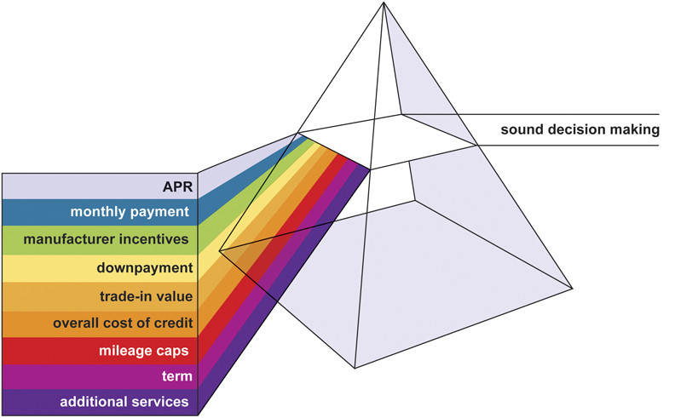
GET
TO MAKE YOUR DECISION
Notes:
There are so many factors that will impact your ultimate vehicle financing decision. For example, one of you may need to focus on getting the lowest monthly payment possible, knowing that having the car will get you to that new job, and kick start your financial future. You might therefore be more willing to look into a longer-term financing agreement, or a lease, or save up for a larger down payment. Others of you might be more focused on your longer-term financial picture and planning for your future. For you, a shorter-term financing contract on a vehicle that has a higher resale value might be of greater interest to you. Still others might make a financing decision based on the make and model of your car because of the manufacturer incentives being offered.
There’s no simple formula to share, for each of your situations are unique, each of your financial goals are your own. Your responsibility in this process, therefore, is to educate yourself on all of the options – putting all of that through a prism will ultimately reveal what the best decision is for you.

Slide 14
Completing a
Credit Application
Name
Social Security number
Date of birth
Current/previous addresses
Current/previous employment
Income sources
Total gross income
Information on existing credit accounts
TO THE DEALERSHIP
Notes:
Now we’re on to the final stages of your vehicle financing process. You’ll take all of your newly-acquired skills, your research, your knowledge of other vehicle financing options available to you, and head to the dealership. Once you’ve taken the test drives and negotiated a selling price for the vehicle of your choice, you will have an opportunity (in most dealerships) to sit down with a Financing & Insurance professional to discuss vehicle financing or leasing alternatives.
As part of this process, you will be asked to complete a credit application. Information on this application may include: name; Social Security number; date of birth; current and previous addresses and length of stay; current and previous employers and length of employment; occupation; sources of income; total gross monthly income; and financial information on existing credit accounts. With your permission, the dealership usually will obtain a copy of your credit report.
To offer vehicle financing, dealers typically sell customers’ contracts to “assignees,” such as banks, finance companies, or credit unions. The dealership will submit your credit application to one or more of these potential assignees to determine their willingness to purchase your contract from the dealer. Each finance company or other potential assignee will evaluate your credit application, and then decide whether it is willing to buy the contract. It notifies the dealership of its decision and, if applicable, offers the dealership a wholesale rate at which the assignee will buy your contract.

Slide 15
You can often negotiate
your APR just as you would the price of the car
Research other financing sources
in advance
Know what kind of a credit risk you are
Make yourself a strong applicant
TO THE DEALERSHIP
Notes:
You can often negotiate financing, just as you would negotiate the price of the car.
And just as you would negotiate any other transaction, you need to be well-informed beforehand. Before attempting to negotiate, you should first make sure you’ve done your homework and research other financing options available to you. This will tell you what’s a fair offer, and a competitive offer – versus an offer you should walk away from.
Your homework on checking your credit will also be helpful in such a negotiation. By knowing, for example, that you’re a good credit risk, chances are that you’ll have more options in this negotiation.
And along these same lines, you should always put your best credit foot forward if you are going to attempt to negotiate. The better credit risk you are, the more financing sources will want to battle for your business and will be less willing to have you “walk away.”

Slide 16

Stay within your price range
Discipline pays off!!
TO THE DEALERSHIP
Notes:
As you’re going through your calculations, your negotiations, and other decisions, be firm in your conviction to stay within your price range. Discipline will pay off for you in the long run! You’ve done a lot of work in preparing, educating yourself, researching, budgeting, to get to this point. Ultimately, only you can decide how much you can afford to pay for a new car. The desire to own a new car cannot be allowed to overwhelm the practical considerations of your budget.
Some financial experts suggest writing down your bottom line number and taking that number with you when you go to the dealership. Having that number firmly in your mind will help you stay within your budget.

Slide 17
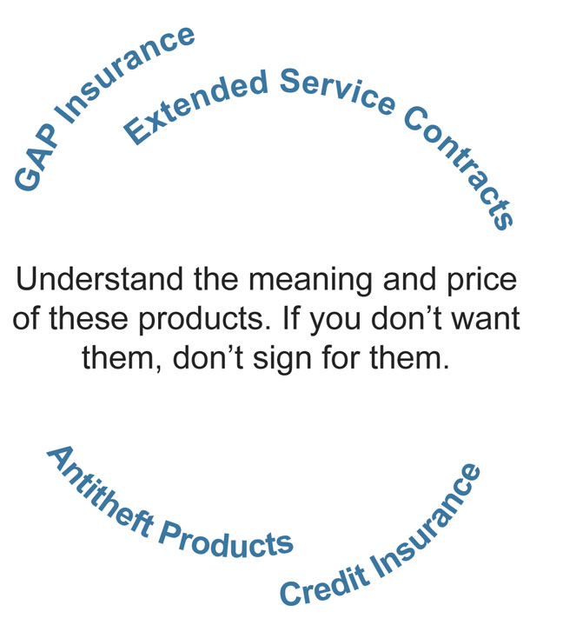
Optional Products
TO THE DEALERSHIP
Notes:
After determining how you will pay for the vehicle, you will likely be offered to consider a number of optional products to add into your contract. Extended service contracts, credit insurance, guaranteed auto protection and antitheft products are all optional products. It is important to understand the meaning and value of these and other optional products. Ultimately, if you don’t want these products, don’t sign for them.

Slide 18
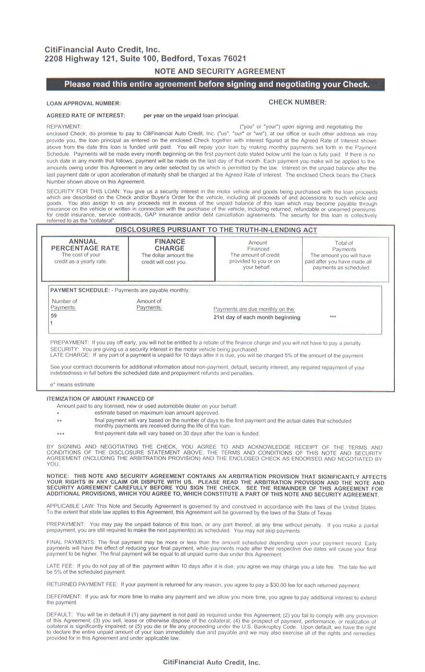
Read Your Contract
Quality Auto Credit, Inc.
12345 Smith Hwy, Springfield, TX 76021
TO THE DEALERSHIP
Notes:
Finally, it’s time to sign your contract. It is very important to read your contract carefully before you sign it. And, don’t be afraid to ask questions about anything you don’t understand.
Interestingly, in a survey performed by AWARE, they found that most consumers say they will carefully read their financing contract before signing it (83%) and will clarify anything they do not understand (89%).
Don’t come this far in the process and skip this important step. And, dealers will want you to read this closely, and ask questions for clarity. Like in many other businesses, the most successful dealerships have satisfied, informed customers, which results in repeat business and referrals.

Slide 19

Make your payments on time!
Opportunity to build good credit –
or damage your credit
Finance company holds
a lien on the vehicle
Talk to your creditors if having difficulty paying
Notes:
Your job is not done on the financing front once you get your vehicle in their driveway. In fact, the real work has just begun.
Here are a number of tips to make sure you stay on course:
• Make your payments on time. Late or missed payments incur late fees and appear on your credit report, which can impact your ability to get credit in the future.
• If you financed the vehicle, be aware that the bank, finance company or credit union that bought your financing contract from the dealership typically holds a lien on the vehicle (and in some cases will hold on to the actual title) until you have paid the contract in full.
• If you have difficulty making your monthly payments, talk to your creditors. Work out a repayment schedule and, if necessary, seek the services of a non-profit credit counseling agency.
One more noteworthy point. Suppose that several months, several years down the road, your situation has changed. Your credit has improved; financing rates in general are lower; you’ve simply changed your mind on one of the areas of your auto financing decision. You should know that auto financing can be refinanced at any time – sometimes even with your current creditor – and typically there are no penalties to do so. You should check your original contract for any conditions surrounding refinancing.
If you choose to explore this option, follow the same rules as the first time around. Get updated copies of your credit report before deciding to refinance. Shop around and check annual percentage rates and other refinancing terms from the many sources available. Once you understand the terms available to you, you will be able to determine whether or not refinancing makes sense.

Slide 20
Discussion
Brought to you by AWARE
www.AutoFinancing101.org

