Slide 1
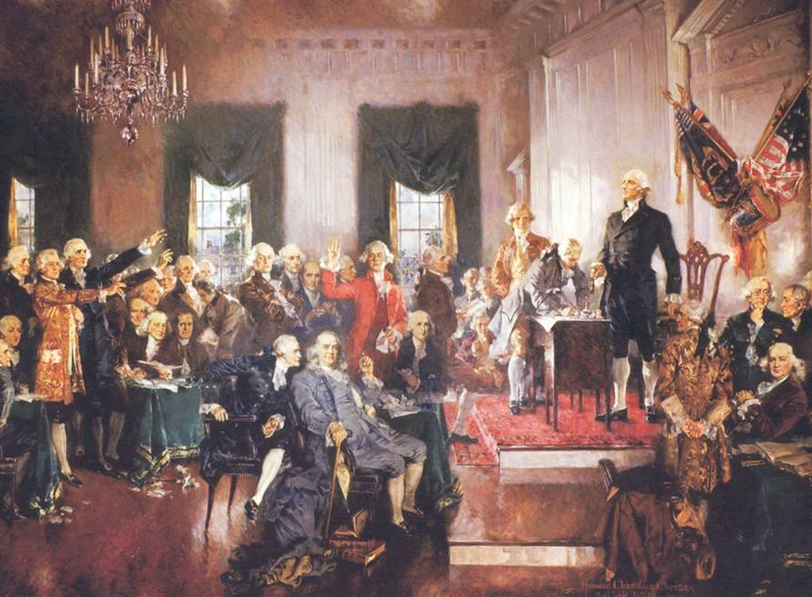
Lesson 8.2: The Constitutional Convention
The Essential Question: What important events and compromises led to the creation of the Constitution?

Slide 2
Vocabulary
event – something that happens
compromise – an agreement in which both sides get some of their goals
convention – a large group of people who come together for a common purpose
amend – to make a change to something, especially a written document

Slide 3
Check for Understanding
What is today’s Essential Question?
What is a compromise that you have made?
What does the ‘con’ in Comic-Con stand for?
Have we ever amended our Assignment Schedule?

Slide 4
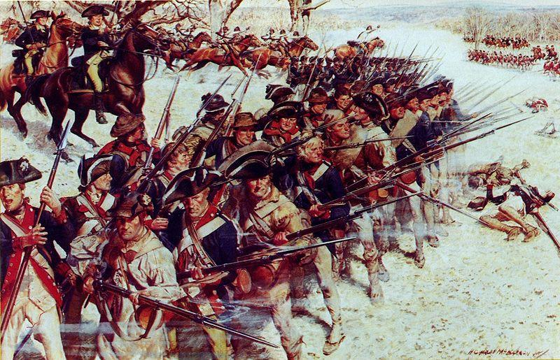
What We Already Know
The Articles of Confederation intentionally created a government that was weak, because Americans had just fought a war against a government that was so strong that it threatened their rights.

Slide 5
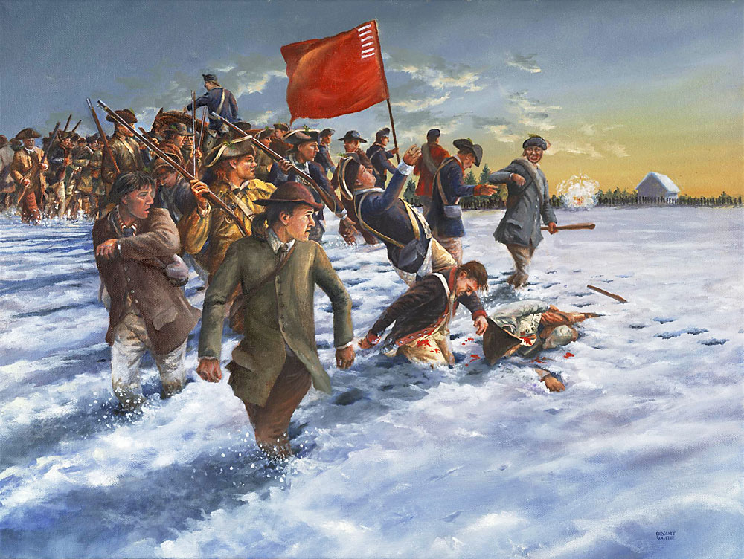
What We Already Know
In 1787, Shays’ Rebellion showed just how weak and ineffective the Articles of Confederation were in dealing with major problems, such as the economy.

Slide 6
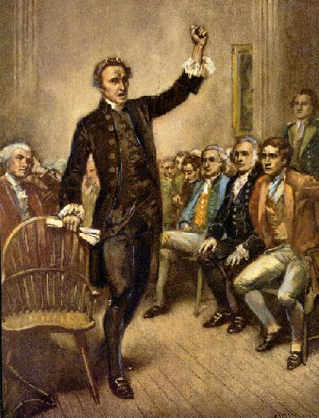
What We Already Know
Many people felt that the nation needed to have a stronger national government to help solve its problems.

Slide 7
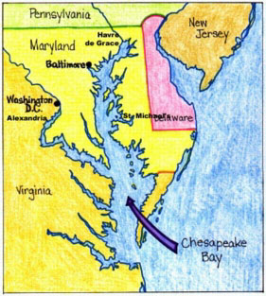
A Constitutional Convention Is Called
The Annapolis Convention (1786)
To discuss ways to improve trade between the states through national trade laws

Slide 8
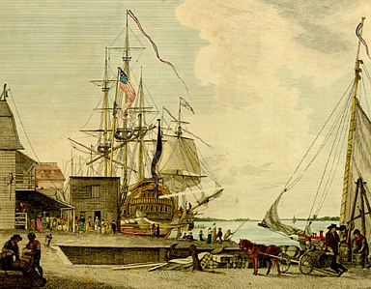
A Constitutional Convention Is Called
National government had no power to make laws controlling trade among the states
Articles of Confederation would need to be amended

Slide 9
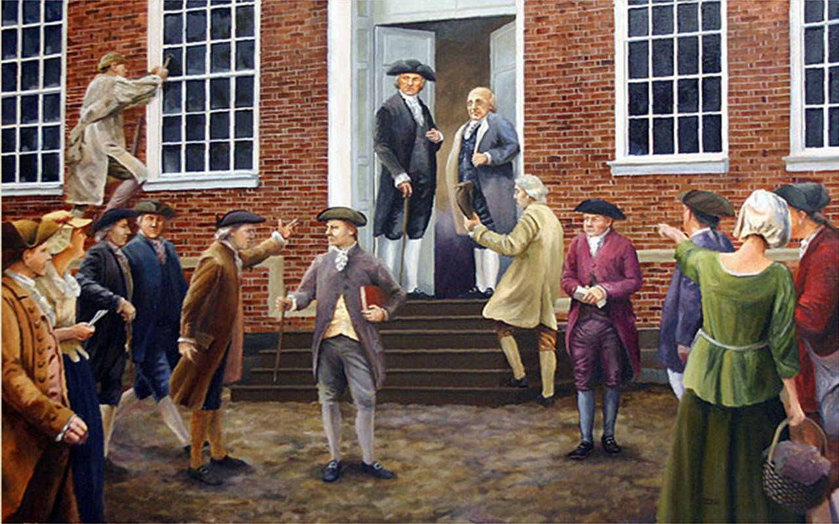
The Annapolis Convention delegates returned home and argued that another convention should be called to discuss changes to the Articles of Confederation.

Slide 10
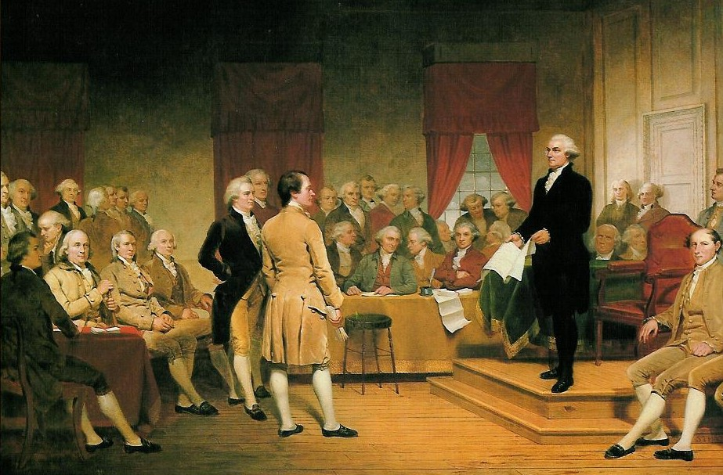
Fearing a strong government would threaten their rights, many Americans didn’t trust any efforts to give Congress new powers.

Slide 11
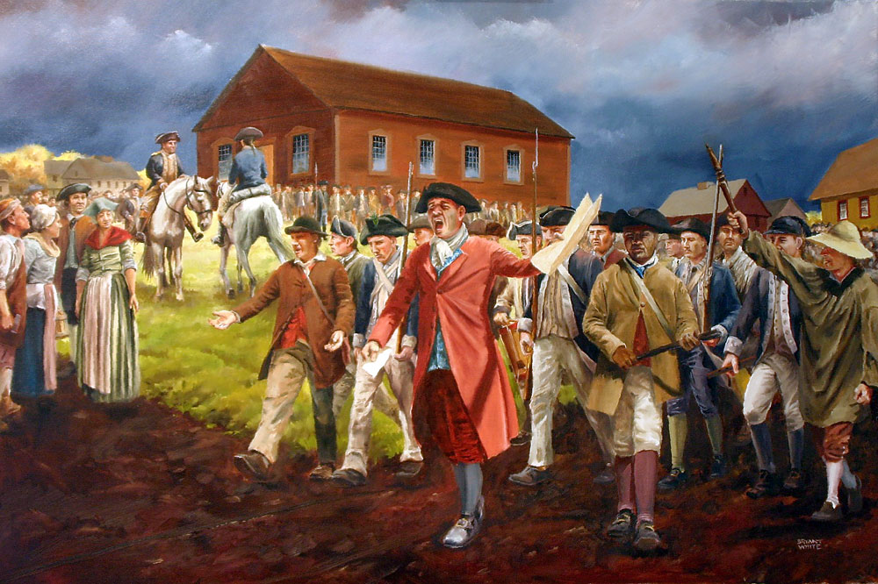
But as word of Shays’ Rebellion spread, they changed their minds.
Twelve of the thirteen states sent delegates to Philadelphia in 1787.

Slide 12
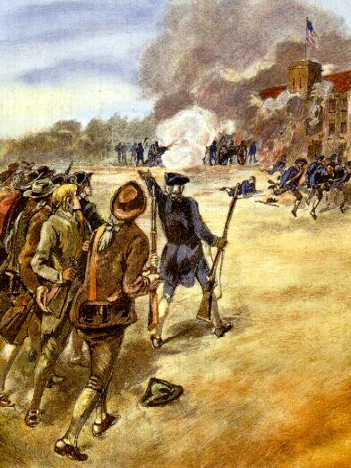
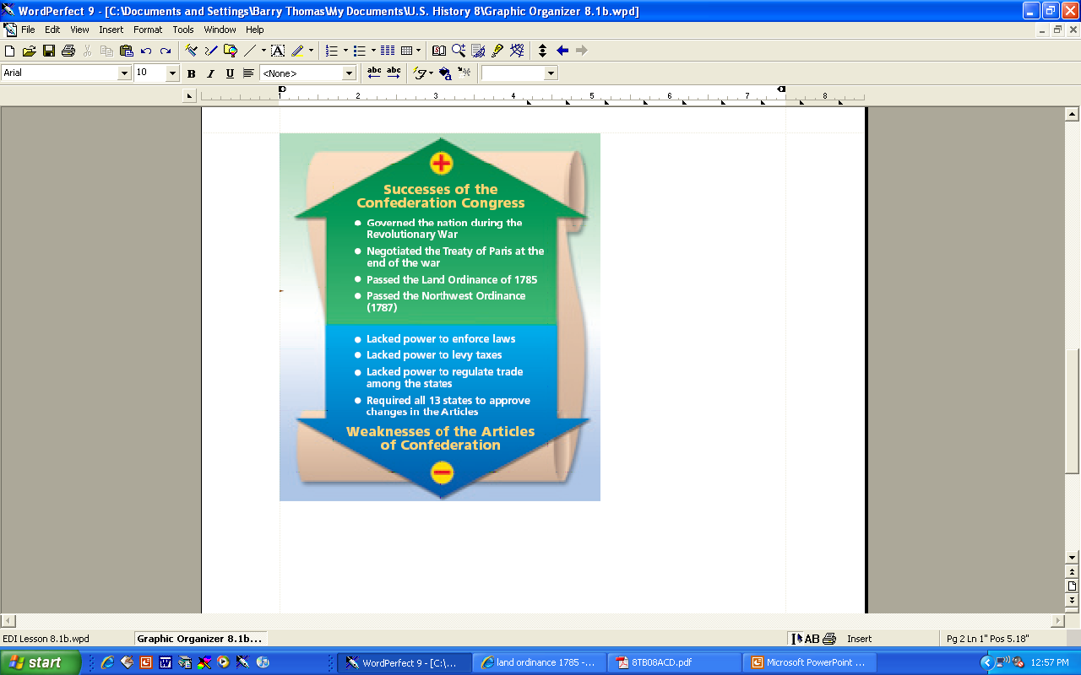
Check for Understanding
What event made many Americans realize that the Articles of Confederation needed to be changed?
What was wrong with the Articles of Confederation?

Slide 13

Get your whiteboards and markers ready!

Slide 14
Why did five states send delegates to the Annapolis Convention?
To amend the Articles of Confederation
To discuss the impact from Shays' Rebellion
To discuss ways to promote interstate trade
To create a plan of action for the Constitutional Convention

Slide 15
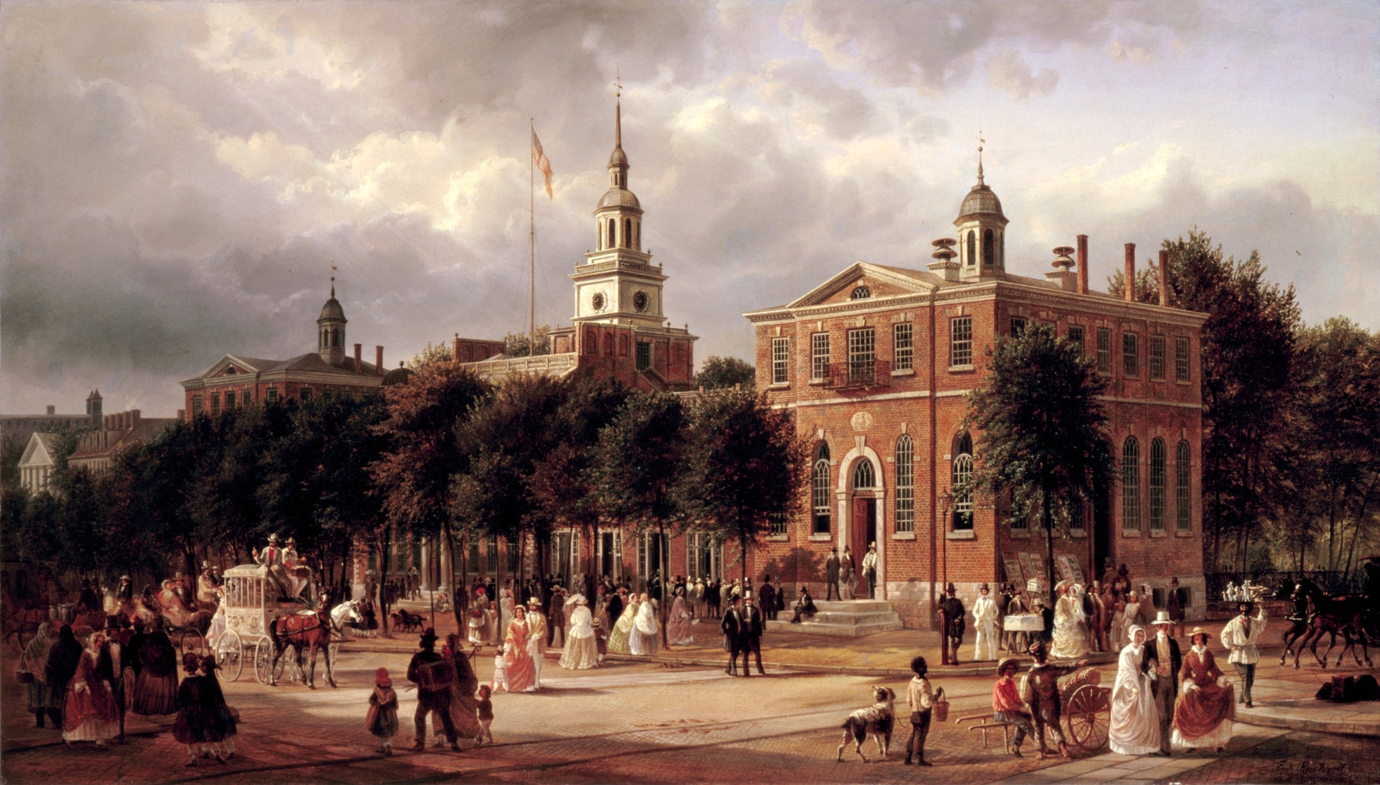
Why did twelve states sent delegates to Philadelphia in 1787?
To participate in the Annapolis Convention
To discuss ways to deal with Shays' Rebellion
To discuss amending the Articles of Confederation
To discuss ways to improve trade

Slide 16
10. What was the relationship between the Annapolis Convention and the Constitutional Convention?
The Annapolis Convention delegates agreed to meet again to amend the Articles of Confederation.
The Annapolis delegates created the new Constitution to replace the Articles.
The Bill of Rights was written at the Annapolis Convention to be added to the Constitution.
Federalists and Antifederalists argued about how strong the new government should be.

Slide 17
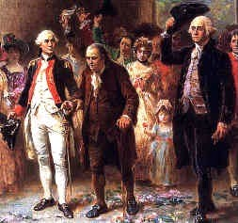
About three-fourths of the fifty-five delegates also had been delegates to the Continental Congress.

Slide 18
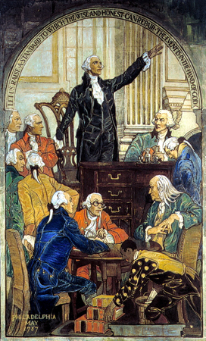
Many had been members of their state legislatures and had helped write their state constitutions.
Delegates to the Constitutional Convention are called the Founding Fathers.

Slide 19
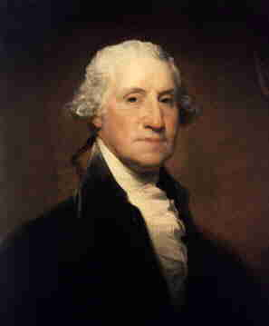
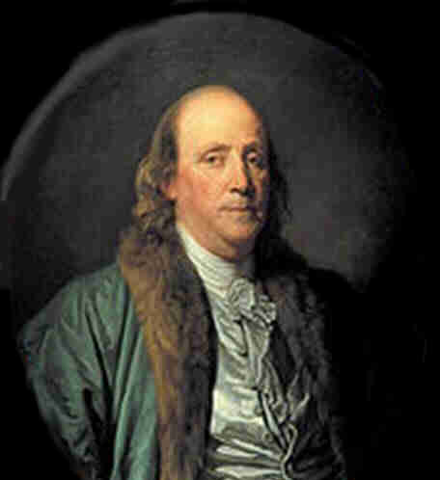
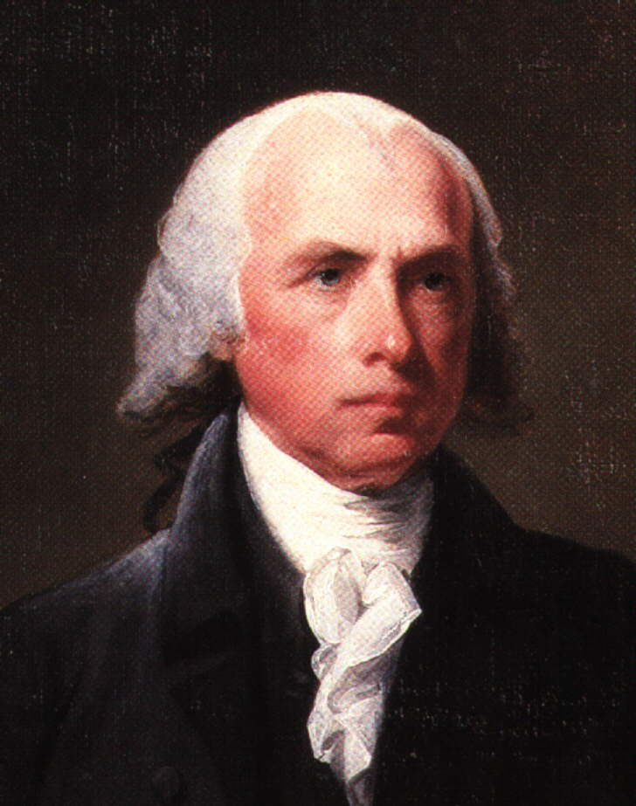
Three of the most famous men at the Constitutional Convention were George Washington, Benjamin Franklin, and James Madison.

Slide 20
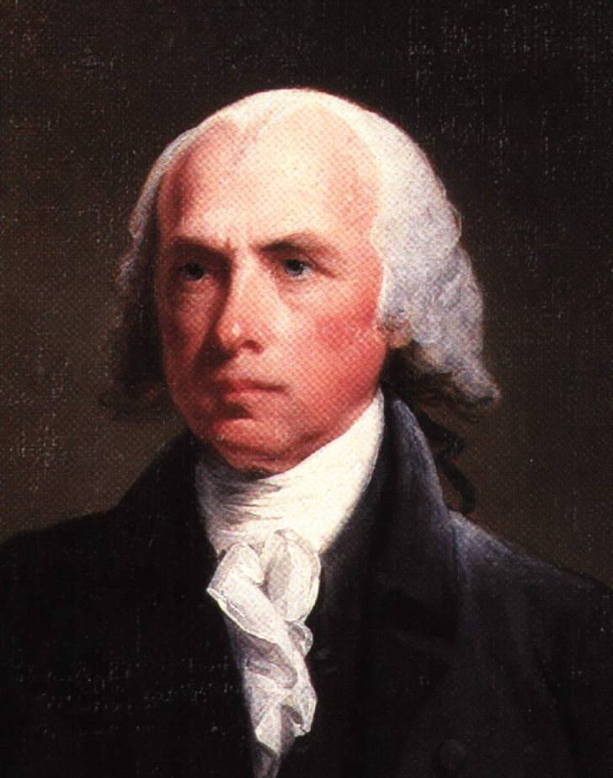
One of the ablest delegates was James Madison.
Took detailed notes throughout the Convention
Worked behind the scenes to create the Virginia Plan
Author of the Federalist papers and the Bill of Rights
Called the Father of the Constitution

Slide 21
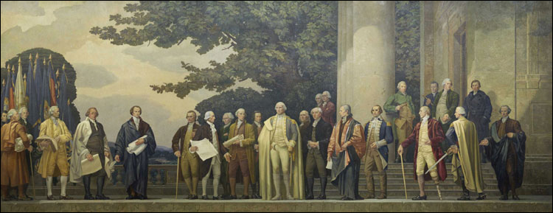
But some of the most famous men in the young nation did not attend the Constitutional Convention.

Slide 22
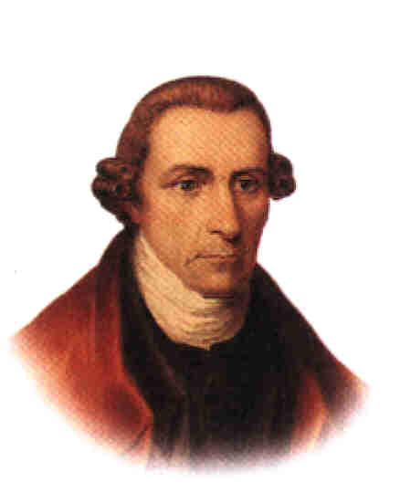
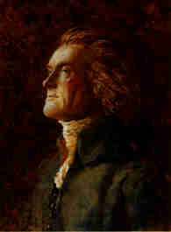
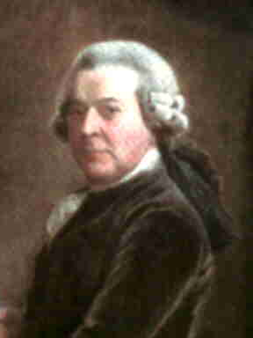
Significant absentees from the Convention included Thomas Jefferson, John Adams, and Patrick Henry.

Slide 23
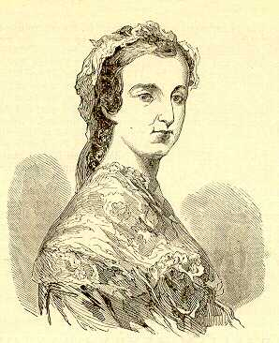
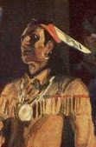
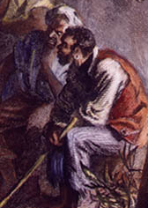
Women, American Indians and blacks were not represented among the delegates.

Slide 24
The big question: should the Articles of Confederation be amended, or replaced with a new form of government?

Slide 25
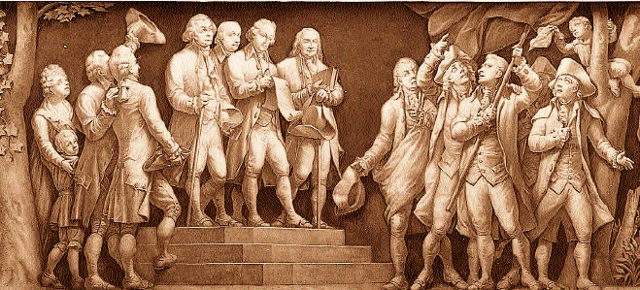
There were many disagreements among the delegates. Some wanted only to make changes that would strengthen the Articles, while others wanted to design an entirely new plan of government.
Read aloud with me.

Slide 26
What did all the delegates agree on?
They all agreed that they needed a government that was strong enough to protect people’s rights, but not too strong to be controlled by the people.

Slide 27
Get your whiteboards and markers ready!

Slide 28
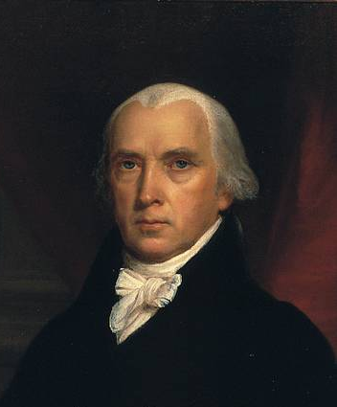
11. Why was James Madison considered the Father of the Constitution?
He helped write the Virginia Plan.
He was the man who organized the Constitutional Convention.
He contributed to The Federalist papers.
He wrote the Bill of Rights.
He sent copies of his notes on the convention to people in all thirteen states.
Choose all that are true!

Slide 29
Which of the following famous men did not attend the Constitutional Convention?
Patrick Henry
George Washington
Benjamin Franklin
James Madison
Thomas Jefferson
John Adams
Choose all that are true!

Slide 30
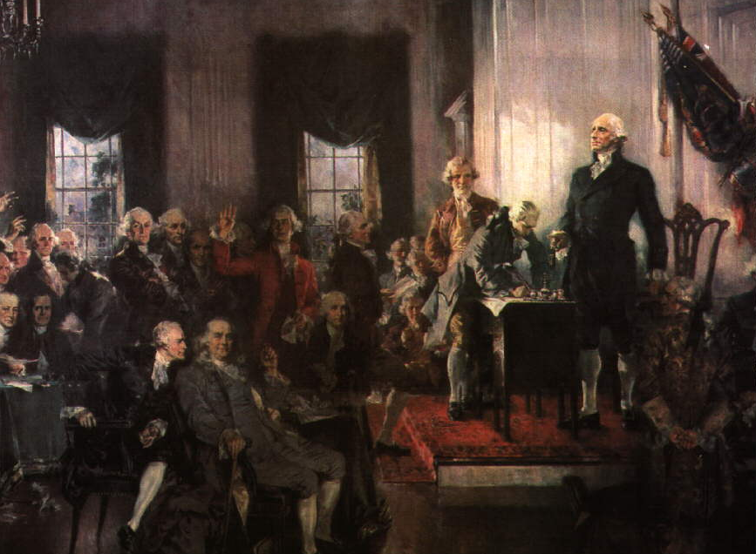
The first order of business was the election of a president for the convention.
George Washington chosen unanimously as president of the convention.

Slide 31
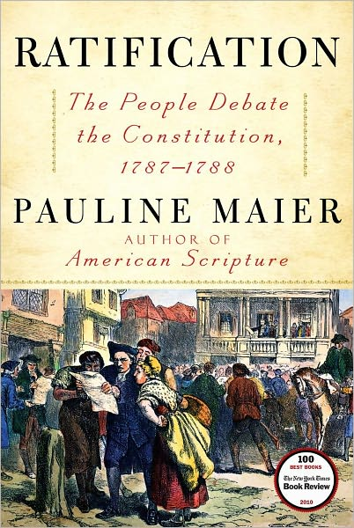
The delegates knew that many Americans were fearful of a strong government.
If the public knew they were trying to create a new, stronger government, there might be protests or even violence.

Slide 32
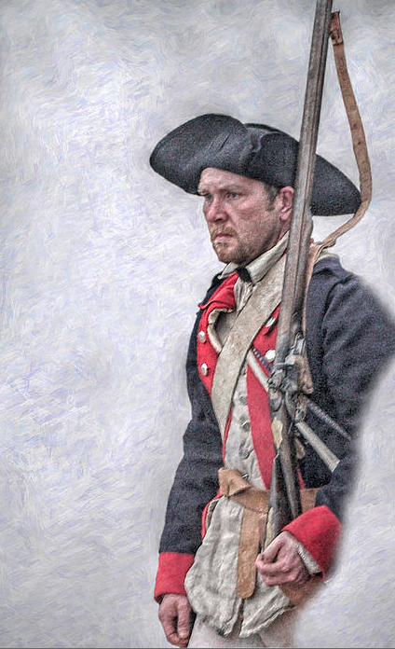
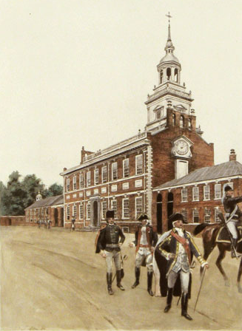
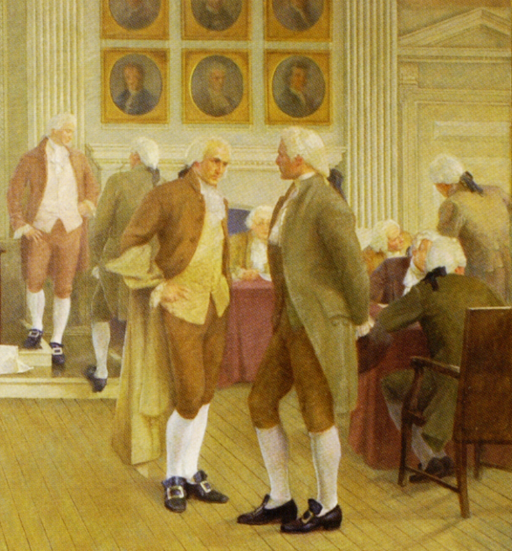
Convention delegates decided to keep what they were doing a secret so they could discuss and debate freely.
Windows in their meeting room were kept shut even though it was summer.
Guards were posted outside the door to keep away the curious.

Slide 33
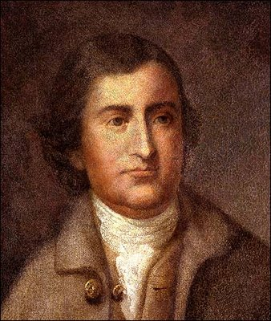
Madison’s Virginia Plan
Government would have three branches:
Legislative branch to make the laws
Executive branch to enforce the laws
Judicial branch to interpret the laws.
Edmund Randolph

Slide 34
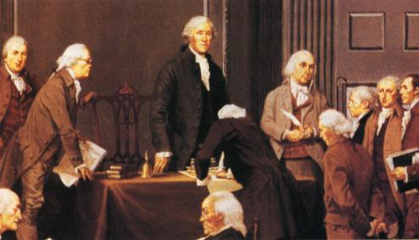
Read aloud with me:
The Virginia Plan proposed a bicameral legislature with two houses.
In both houses, the number of representatives from each state would be based on the state’s population or its wealth.

Slide 35
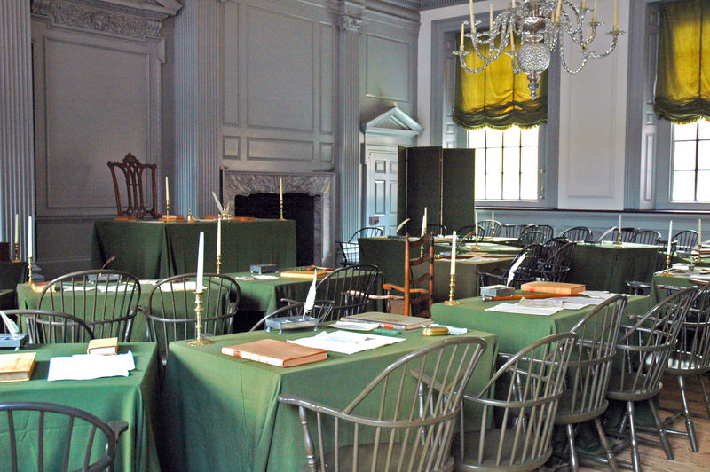
Under the Virginia Plan, Congress . . .
would be bicameral (i.e., be made up of two houses).
have the power to levy taxes, regulate commerce (i.e., trade), and make laws.

Slide 36
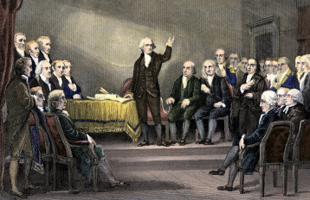
The Virginia Plan led to weeks of debate.
Larger states would have more votes in Congress and could end up ruling the other states.

Slide 37
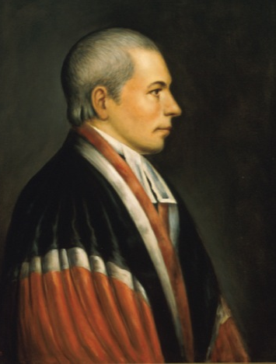
The small states supported William Paterson’s New Jersey Plan.
One-house legislature, with each state having one vote
Congress could regulate trade and tax foreign goods
This plan left Congress almost as weak as it was under the Articles.
William Paterson

Slide 38
Get your whiteboards and markers ready!

Slide 39
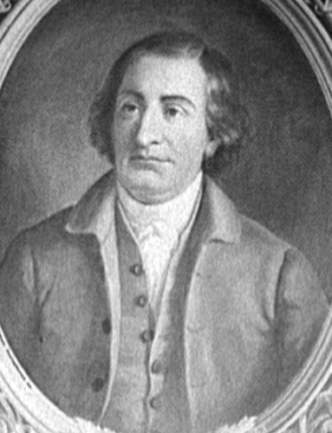
12. How did the New Jersey Plan differ from the Virginia Plan?
The Virginia Plan was supported by most of the smaller states.
The New Jersey Plan would set up a one-house legislature.
The Virginia Plan would create a government with three branches.
The New Jersey Plan wanted representation in Congress to be based on population.
The Virginia Plan called for a strong central government.
The New Jersey Plan became the model for the government created by the Constitution.
The New Jersey Plan gave each state an equal vote in Congress.
Choose all that are true!

Slide 40
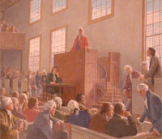
During the rest of June, the delegates argued hotly over representation in the legislature.
A committee was formed to work out a solution that became known as the Great Compromise.

Slide 41
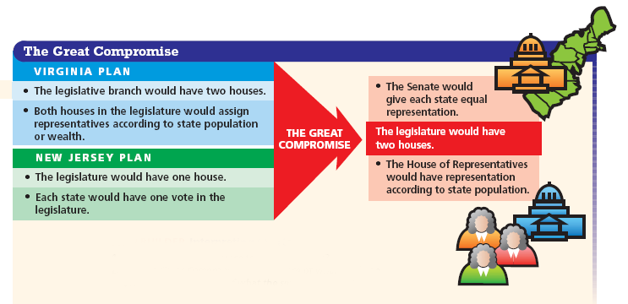
The Great Compromise settled the issue.
(The Great Compromise is also called the Connecticut Compromise.)
What is a compromise?
To satisfy the smaller states, each state would have an equal number of votes in the Senate.
To satisfy the larger states, the committee set representation in the House of Representatives according to state populations.

Slide 42
Get your whiteboards and markers ready!

Slide 43
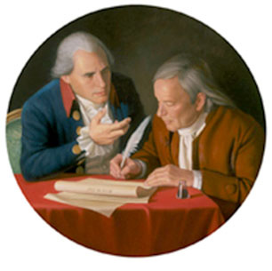
13. By what name is the Connecticut Compromise better known?
The Connecticut Compromise is better known as the Great Compromise.
The Three-fifths Compromise
The Virginia Plan
The New Jersey Plan
The Great Compromise

Slide 44
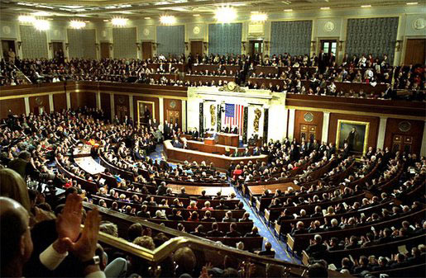
14. How did the Great Compromise settle the issue of representation in the legislature?
It created a House of Representatives that would be based on state populations.
It created a Senate in which each state would have an equal number of votes.
It ended the controversy of how slaves should be counted for representation.
It created a third house of Congress to create a balance between large and small states.
Choose all that are true!

Slide 45
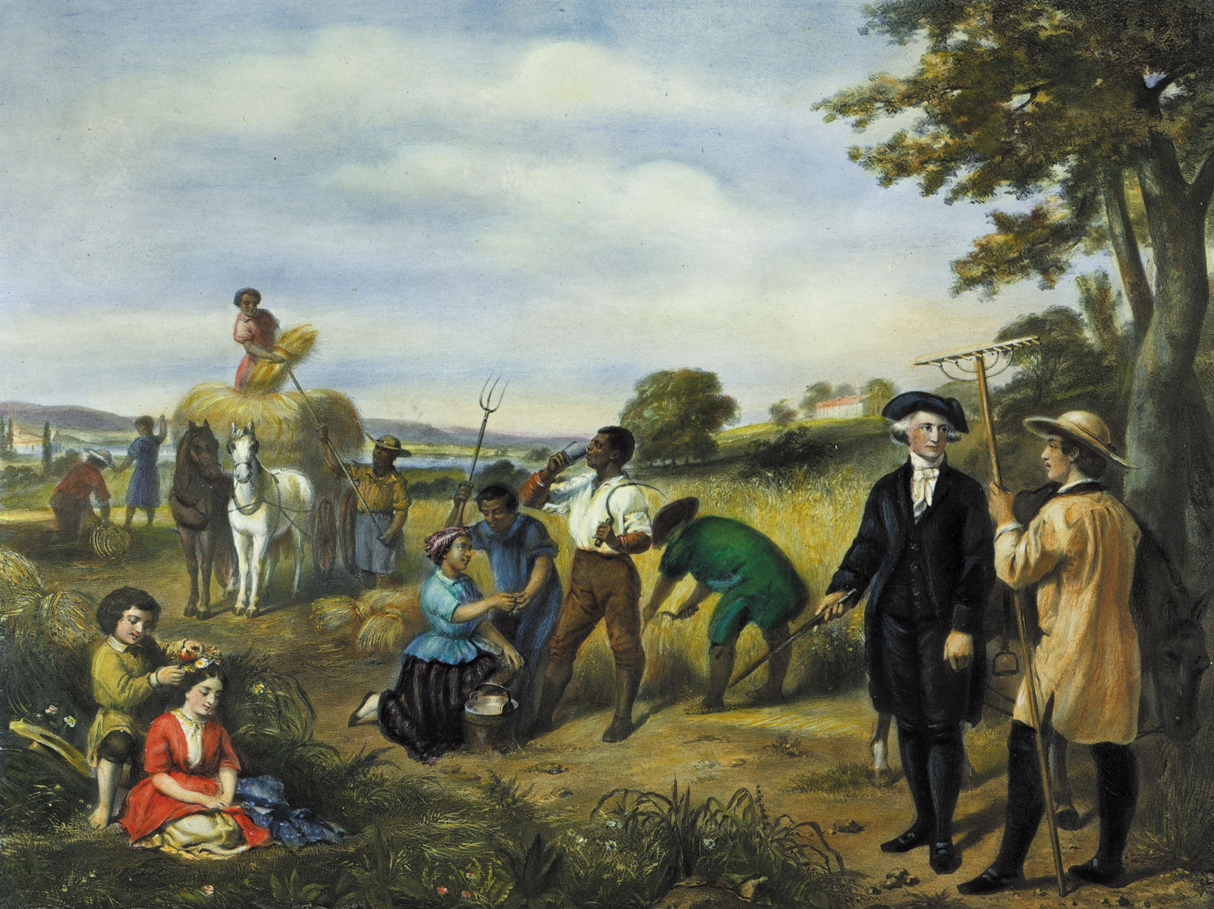
Slavery was at the center of the second major issue of debate.
Because representation in the House of Representatives would be based on the state population of each, how would slaves be counted in that population?

Slide 46
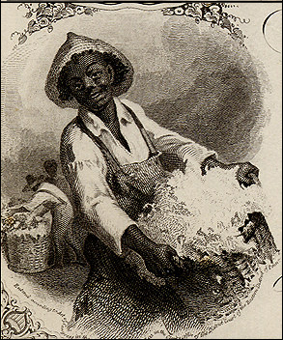
The question: How should slaves be counted?
Southerners – “Slaves should be counted for representation but not for taxation.”
Northerners – “Slaves are property, not citizens, and should be counted only for taxation.”

Slide 47
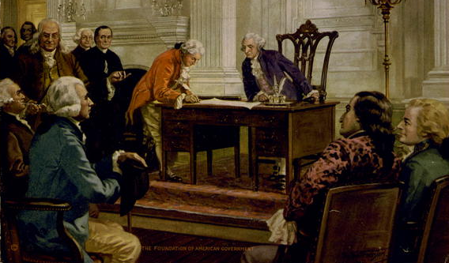
The Three-Fifths Compromise settled the question of how slaves would be counted.
Three-fifths of the slave population would be counted when taxing the states.
This three-fifths ratio also would be used to calculate representation in the House.

Slide 48

The Three-fifths Compromise did not outlaw slavery.
Many Northerners wanted Congress to ban bringing new slaves from Africa.
Southerners objected, and South Carolina and Georgia refused to ratify any constitutional plan that limited their right to import slaves.
Under another compromise, they agreed that Congress could not ban the slave trade until 1808.

Slide 49
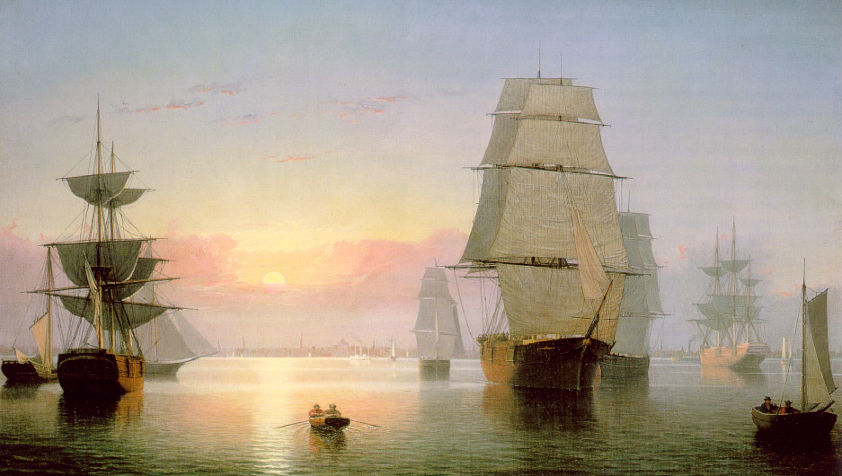
This ban on laws limiting the slave trade was the only limit placed on Congress’ power to regulate trade.
Congress was given all power to make laws on how goods could be shipped between states and be exported to foreign countries.

Slide 50
Get your whiteboards and markers ready!

Slide 51
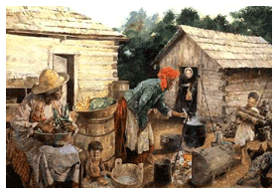
15. How did the Constitutional Convention reach a compromise on the issue of slavery?
Slaves would be freed when they reached the age of 30.
Slaves would be counted as three-fifths of a person for representation in Congress.
Slaves would be counted as three-fifths of a person for taxation.
The importation of slaves could not be restricted until 1808.
Slavery could not be banned by Congress before 1808.
Choose all that true!

Slide 52
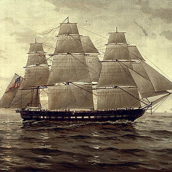
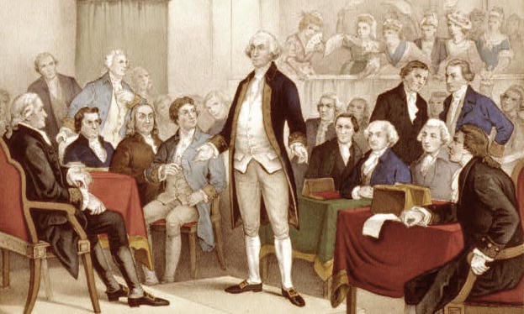
16. According to the new Constitution, who had the power to regulate trade?
The Federal Trade Commission
Congress
The president
The Secretary of State

Slide 53
Use whiteboards to indicate where it belongs!
Two-house legislature with both houses based on state population
Virginia Plan New Jersey Plan
A
B
Great Compromise
Three-fifths Compromise
C
D

Slide 54
Use whiteboards to indicate where it belongs!
Representation in the House of Representatives based on population
Virginia Plan New Jersey Plan
A
B
Great Compromise
Three-fifths Compromise
C
D

Slide 55
Use whiteboards to indicate where it belongs!
Favored most by small states
Virginia Plan New Jersey Plan
A
B
Great Compromise
Three-fifths Compromise
C
D

Slide 56
Use whiteboards to indicate where it belongs!
Equal representation in the Senate
Virginia Plan New Jersey Plan
A
B
Great Compromise
Three-fifths Compromise
C
D

Slide 57
Use whiteboards to indicate where it belongs!
Favored most by large states
Virginia Plan New Jersey Plan
A
B
Great Compromise
Three-fifths Compromise
C
D

Slide 58
Use whiteboards to indicate where it belongs!
One-house legislature, with equal representation for each state
Virginia Plan New Jersey Plan
A
B
Great Compromise
Three-fifths Compromise
C
D

Slide 59
Use whiteboards to indicate where it belongs!
No new restrictions on slavery until 1808
Virginia Plan New Jersey Plan
A
B
Great Compromise
Three-fifths Compromise
C
D

Slide 60
Use whiteboards to indicate where it belongs!
Two legislative houses, one based on state population and equal representation in the other
Virginia Plan New Jersey Plan
A
B
Great Compromise
Three-fifths Compromise
C
D

Slide 61
Use whiteboards to indicate where it belongs!
Each state would have one vote in Congress
Virginia Plan New Jersey Plan
A
B
Great Compromise
Three-fifths Compromise
C
D

Slide 62
Use whiteboards to indicate where it belongs!
Three-fifths of the slave counted for representation and taxation
Virginia Plan New Jersey Plan
A
B
Great Compromise
Three-fifths Compromise
C
D

