Slide 1
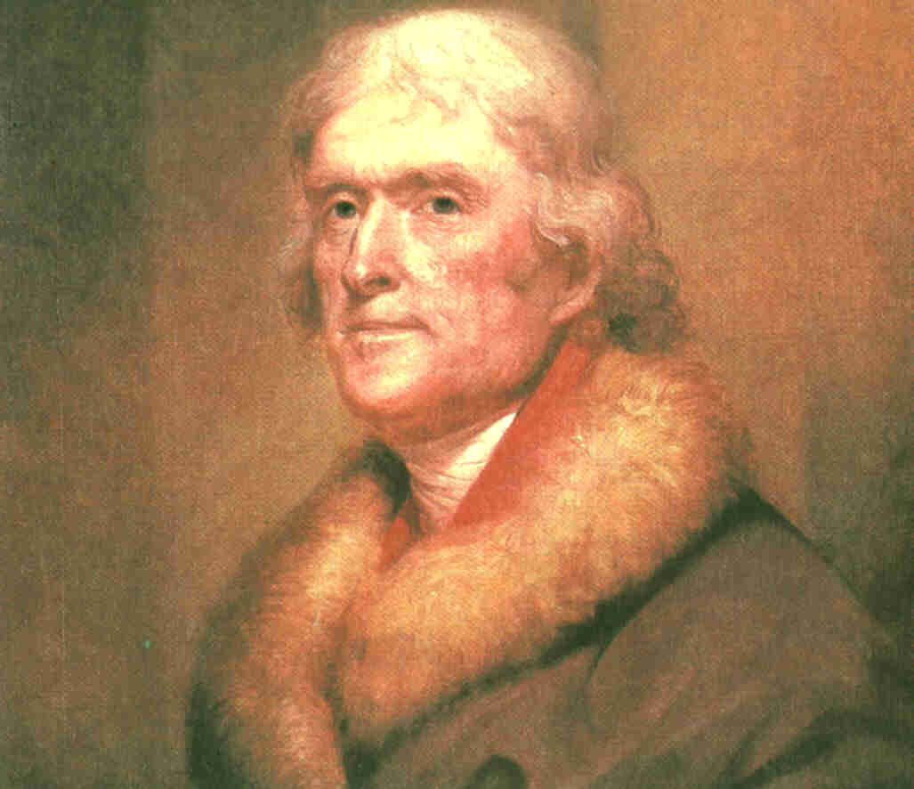
CHAPTER 10 – THE JEFFERSON ERA
Section 1 – Jefferson Takes Office
Today’s Essential Question: How did conflict continue between Jefferson and the Federalists?

Slide 2
Vocabulary
analyze – examine carefully and in detail
radical – person who holds extreme political views
inaugural – referring to the beginning of something, especially a presidency

Slide 3
Check for Understanding
What is today’s essential question?
When does a president give his inaugural address to the country?
Why is a radical never elected to the presidency?

Slide 4
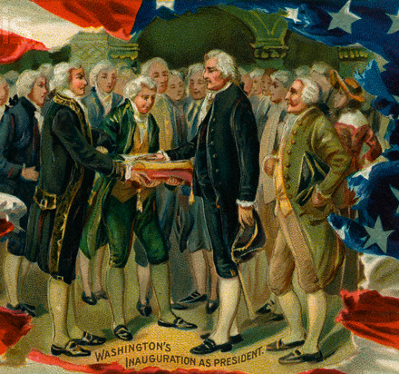
What We Already Know
At the beginning of the nation’s history, the man receiving the second highest number of votes became vice president.

Slide 5
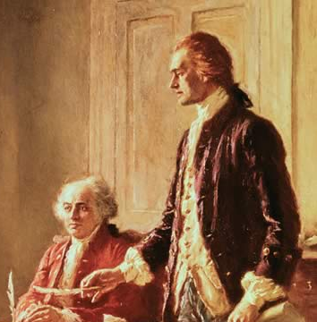
What We Already Know
John Adams won the presidency in 1796, with his close personal friend (but political enemy) Thomas Jefferson serving as his vice president.

Slide 6
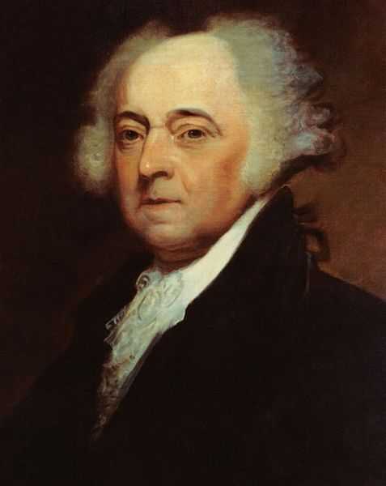
What We Already Know
John Adams’ unwillingness to go to war with France had made him unpopular with his own Federalist supporters.

Slide 7
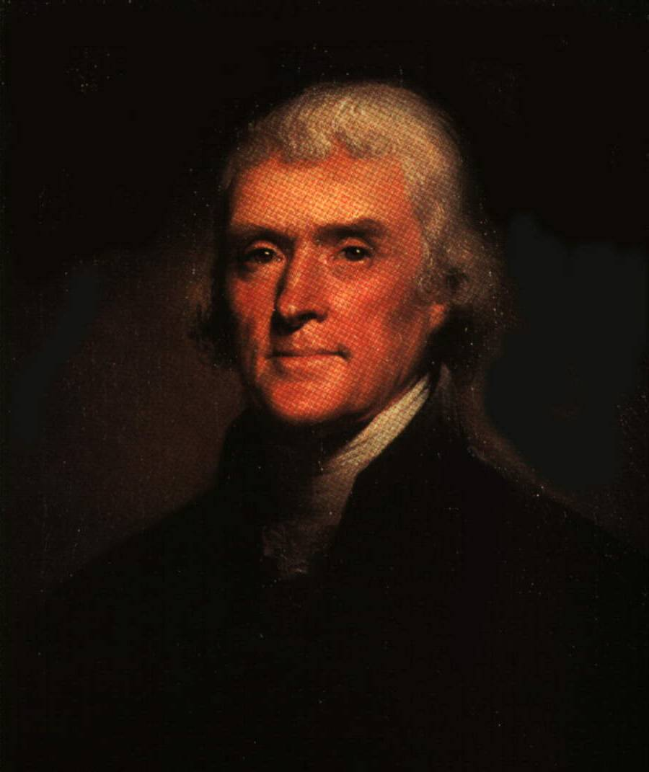
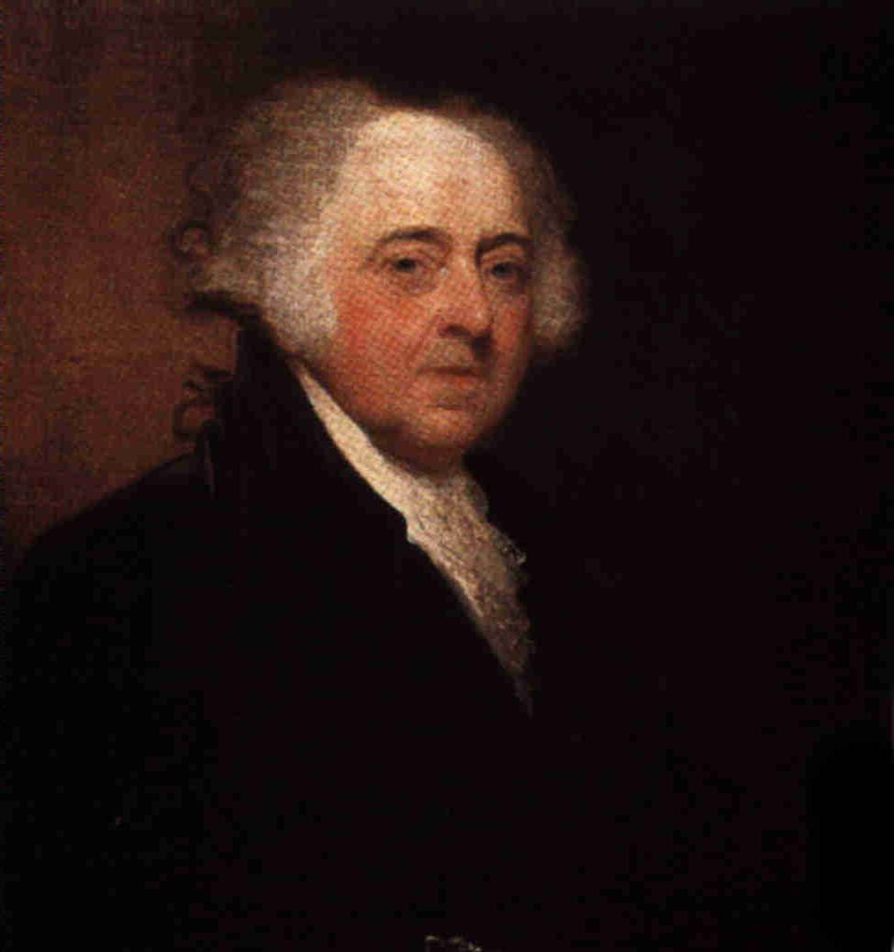
The Election of 1800
President John Adams of the Federalists faced the Democratic-Republicans, represented by Thomas Jefferson.
The Democratic-Republicans thought they were saving the nation from monarchy and oppression.
They believed that the Alien and Sedition Acts violated the Bill of Rights.

Slide 8
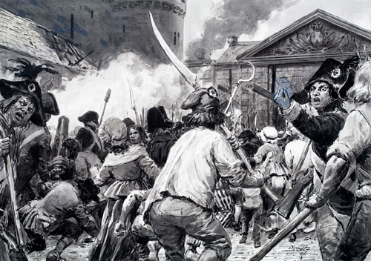
The Election of 1800
Federalists thought they were saving the nation from radicals—people who hold extreme political views.
They remembered the violence of the French Revolution, in which radicals executed thousands in the name of liberty.

Slide 9
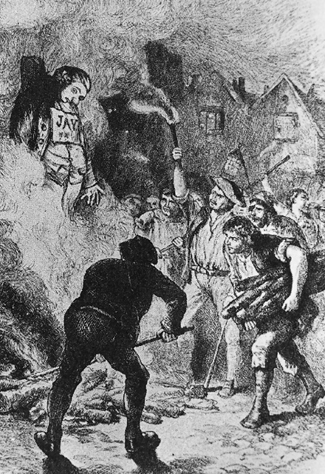
Check for Understanding
B ask A: What is a radical?
A radical is a person who holds extreme political views.

Slide 10
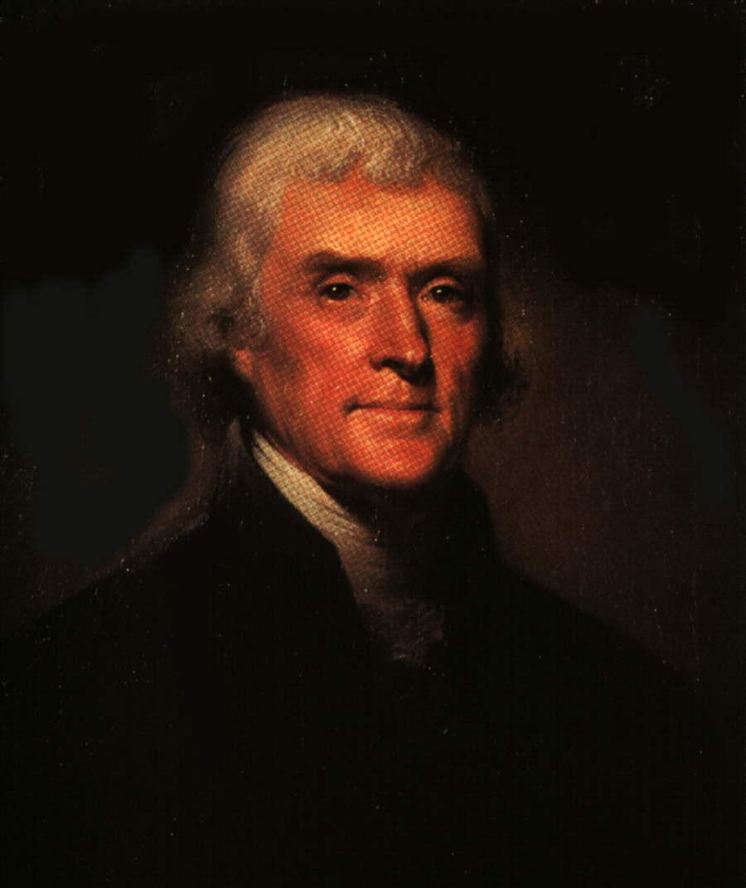
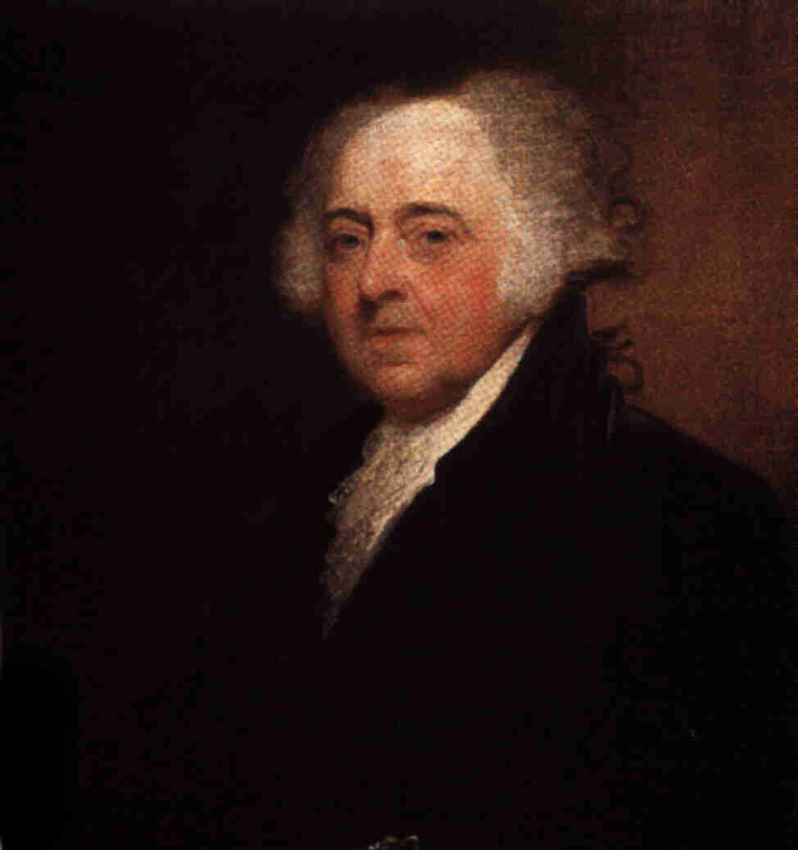
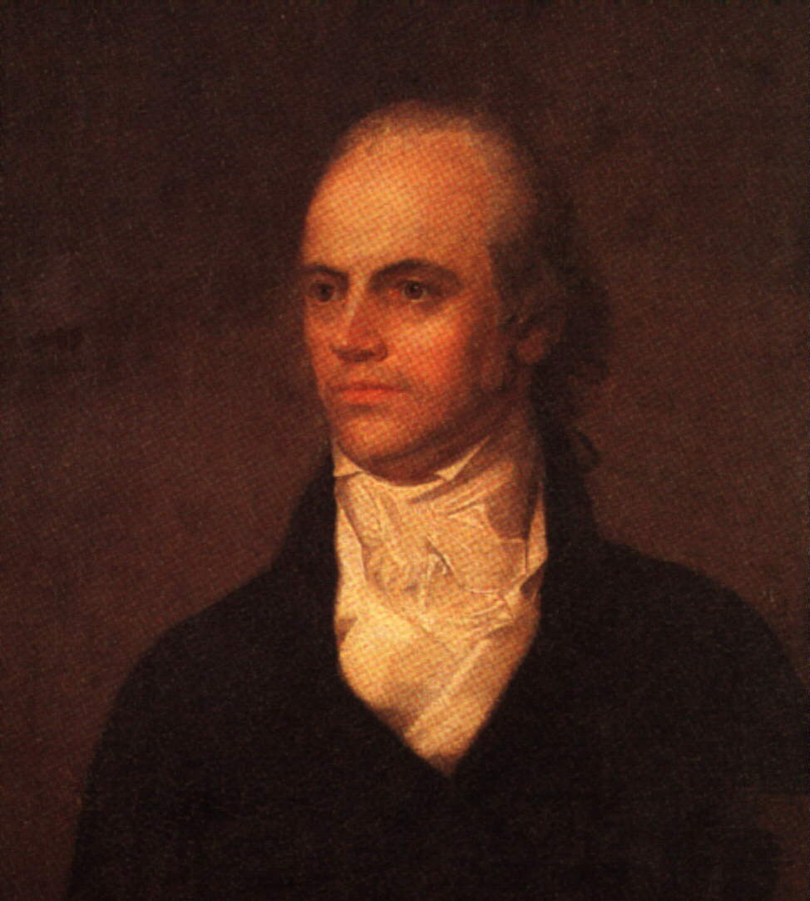
The Election of 1800
When election day came, Jefferson received 73 votes in the electoral college, and Adams earned 65.
But Aaron Burr, whom the Democratic-Republicans wanted as vice president, also received 73 votes.
According to the Constitution, the House of Representatives would have to choose between Burr and Jefferson.

Slide 11
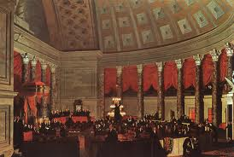
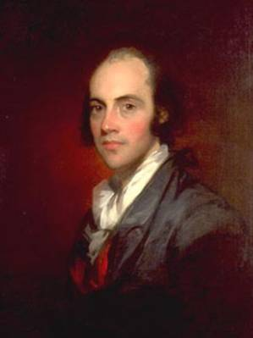
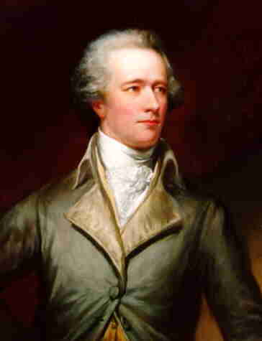
Breaking the Tie
Federalists still held a majority in the House of Representatives, and their votes would decide the winner.
Some Federalists feared Jefferson so much that they decided to back Burr.
Hamilton considered Burr an unreliable man and urged the election of Jefferson.

Slide 12
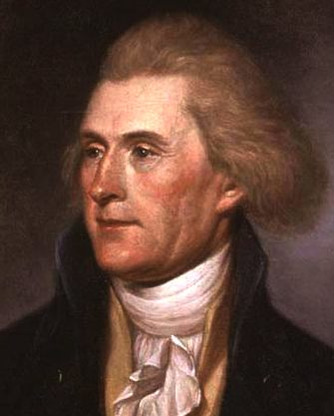
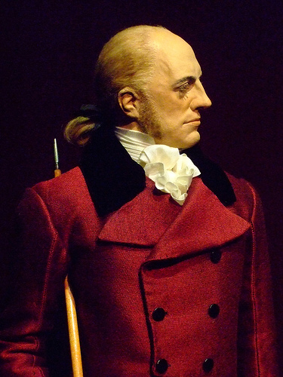
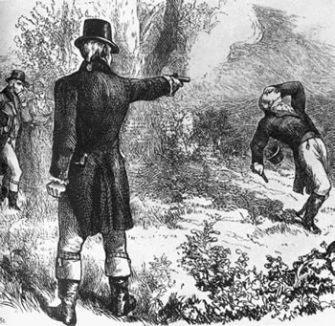
Breaking the Tie
Over a period of seven days, the House voted 35 times without determining a winner. But on the thirty-sixth ballot, Jefferson was elected president.
Aaron Burr, who became vice president, would never forget Hamilton’s insults.
He would later kill Alexander Hamilton in a famous pistol duel.

Slide 13

Get your whiteboards and markers ready!

Slide 14
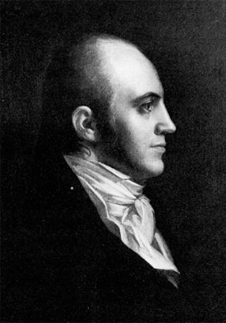
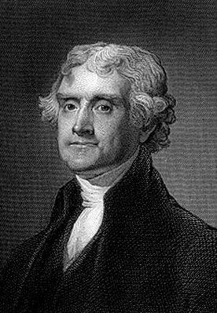
1. How was the tie between Jefferson and Burr settled after the election of 1800?
By a vote in the Senate
By a Supreme Court decision
By a vote in the House of Representatives
According to the terms of the elastic clause

Slide 15
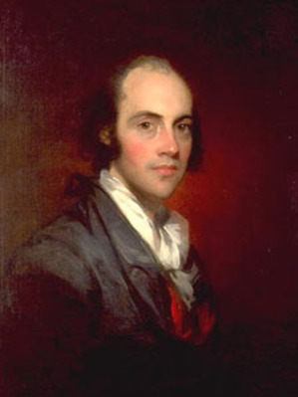
Check for Understanding
A ask B: Who was Aaron Burr?
Aaron Burr was Jefferson’s vice-presidential partner who refused to step aside after earning a tie with Jefferson in the election of 1800.
Be sure to re-state the question in your response!

Slide 16
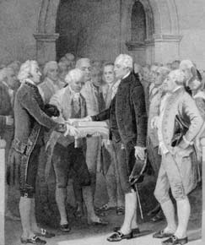
Jefferson’s Philosophy
In his inaugural address, the new president tried to ease the nation’s political quarrels.
“Let us, then, fellow-citizens, unite with one heart and one mind. . . . Every difference of opinion is not a difference of principle. . . . We are all Republicans, we are all Federalists.”

Slide 17
Get your whiteboards and markers ready!

Slide 18
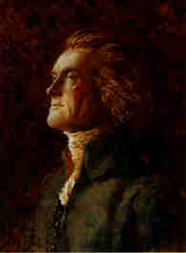
2. What did Jefferson say in his inaugural address to reduce the political quarrels between Federalists and Democratic-Republicans?
"I shall, by Republican principles, sink the Federalists into an abyss . . .“
"We are all Republicans; we are all Federalists.“
"A house divided against itself cannot stand.“
"I am persuaded, by all that is written in God's holy law, that we are all Americans and nothing more."

Slide 19
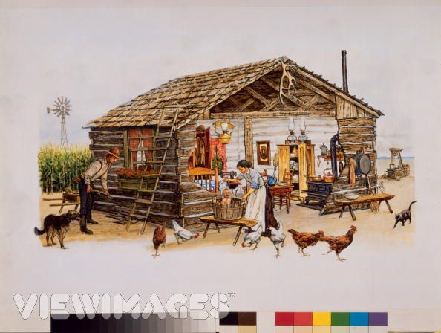
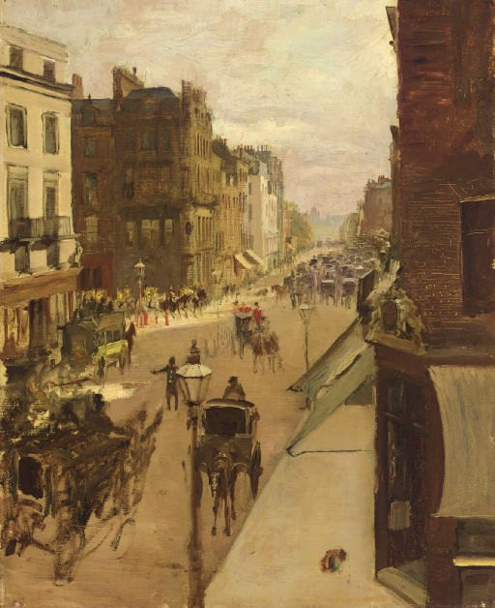
Jefferson’s View for the Future
Jefferson wanted the United States to remain a nation of small independent farmers, who would uphold the strong morals and democratic values that he associated with country living.
He hoped that the enormous amount of available land would prevent Americans from crowding into cities, as people had in Europe.

Slide 20
Check for Understanding
B ask A: What kind of nation did Jefferson want?
Jefferson wanted a nation of independent farmers.
Be sure to re-state the question in your response!

Slide 21
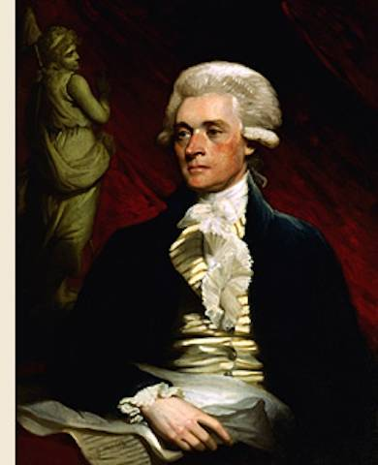
Jefferson’s Personal Style
As president, Jefferson behaved more like a gentleman farmer than a privileged politician.
Instead of riding in a fancy carriage, Jefferson often walked to the Capitol.
Jefferson was very informal and was known to receive guests while wearing slippers.
As president, Jefferson lived a simple life, and believed in a modest role for the central government, too.

Slide 22
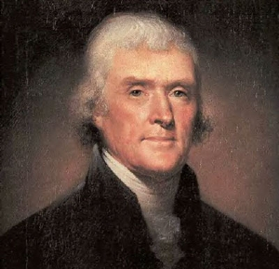
Check for Understanding
B ask A: What was Jefferson’s personal style as president?
As president, Jefferson adopted a modest, informal style.
Be sure to re-state the question in your response!

Slide 23
Undoing Federalist Programs
Jefferson ended many Federalist programs.
He directed Congress to allow the Alien and Sedition Acts to end.
Congress also ended many taxes, including the unpopular whiskey tax.
With less tax revenue, Jefferson reduced the number of federal employees to cut costs, and he also cut the size of the military.

Slide 24
Undoing Federalist Programs
Hamilton had believed that people who were owed money by their government would make sure the government was run properly.
But Jefferson opposed public debt and used revenues from tariffs and land sales to reduce the amount of money owed by the government.

Slide 25
Check for Understanding
A ask B: What Federalist laws were allowed to expire under Jefferson?
The Alien and Sedition Acts and the excise tax on whiskey were allowed to expire under Jefferson
Be sure to re-state the question in your response!

Slide 26
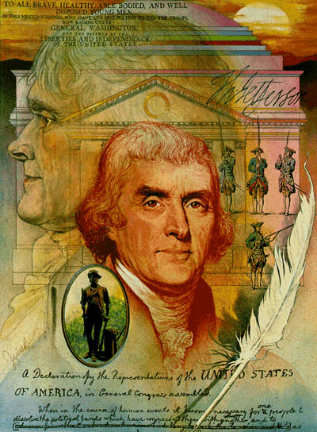
Check for Understanding
B ask A: How did Jefferson make up for the loss of revenue caused by the repeal of the whiskey tax?
Jefferson made up for the loss of revenue by reducing the number of federal employees and the size of the military.
Be sure to re-state the question in your response!

Slide 27
Get your whiteboards and markers ready!

Slide 28
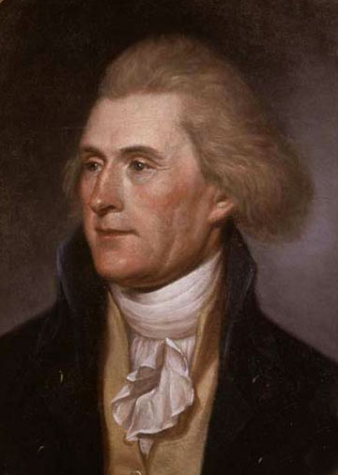
3. How did the opinions of Jefferson and Hamilton regarding the public debt differ?
Jefferson believed that people who were owed money by the government would make sure the government was run properly.
Hamilton thought some public debt gave citizens an interest in good government.
Hamilton was opposed to all public debt.
Jefferson was reluctant to sell public land to reduce the amount of money owed by the government.

Slide 29
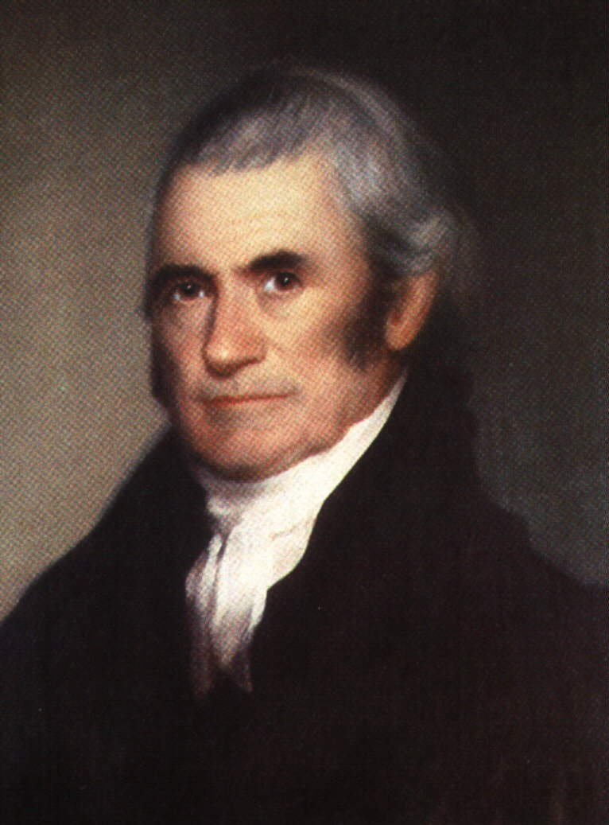
Marshall and the Judiciary
Under the Judiciary Act of 1801, President Adams had appointed as many Federalist judges as he could before Jefferson’s inauguration in 1801.
These ‘midnight judges’ would create a firmly Federalist judiciary that could check the power of Jefferson and the Democratic-Republicans.
Jefferson would have very little power or influence over the courts.
Adams also appointed John Marshall as Chief Justice of the Supreme Court.

Slide 30
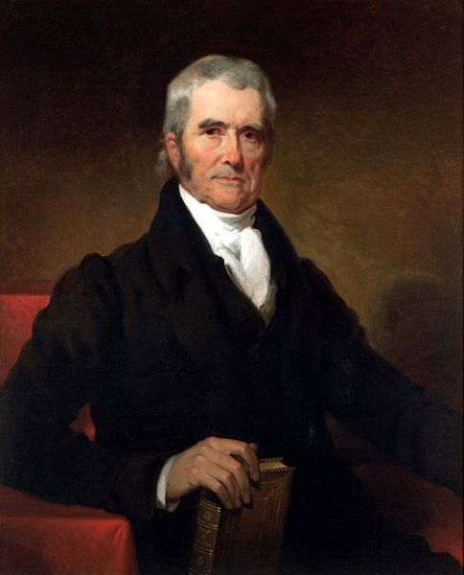
Marshall and the Judiciary
Marshall served as Chief Justice for over three decades. Under Marshall, the Supreme Court upheld federal authority and strengthened federal courts.

Slide 31
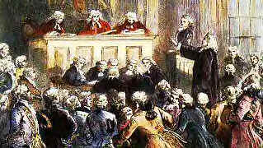
Check for Understanding
A ask B: How did the Judiciary Act of 1801 affect Jefferson’s power over the courts?
The Judiciary Act seriously limited Jefferson’s power over the courts by giving Adams the power to appoint so many new Federalist judges.
Be sure to re-state the question in your response!

Slide 32
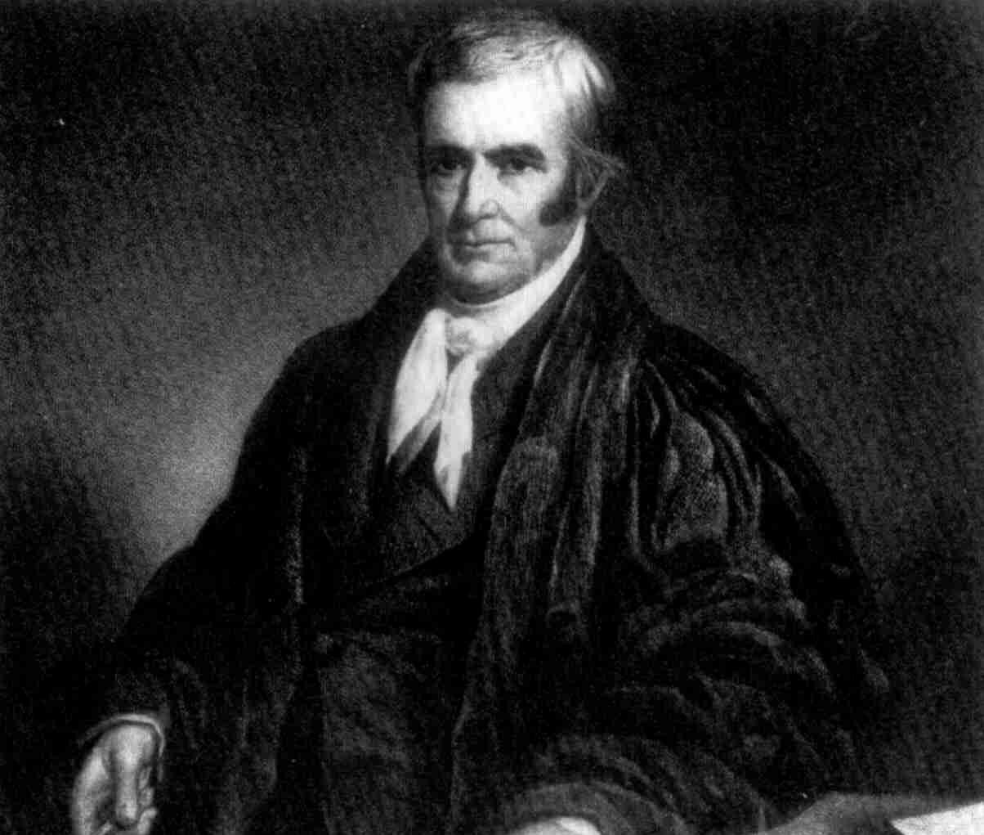
Check for Understanding
B ask A: Who was John Marshall?
John Marshall was a Federalist appointed by President John Adams as Chief Justice of the Supreme Court.
Be sure to re-state the question in your response!

Slide 33
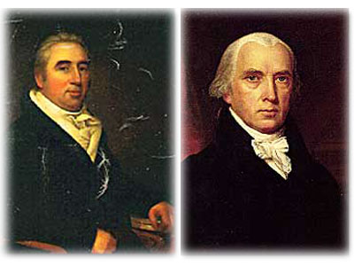
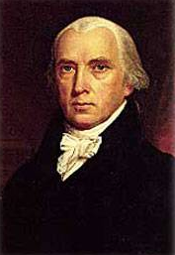
Marbury v. Madison
William Marbury was one of Adams’s last-minute appointments.
When Secretary of State James Madison refused to give him the job, Marbury sued.

Slide 34
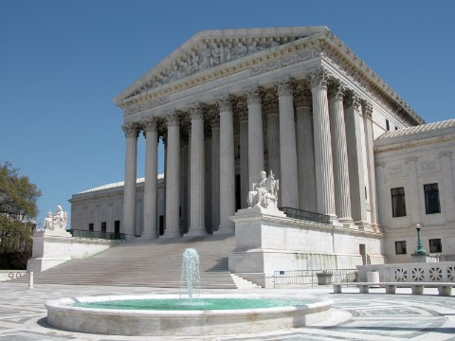
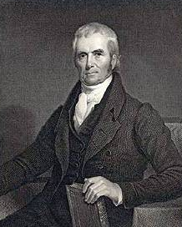
Marbury v. Madison
John Marshall ruled that the law under which Marbury sued was unconstitutional. This decision established the principle of judicial review.
This principle states that the Supreme Court has the final say in interpreting the Constitution.
By establishing judicial review, Marshall helped to create a lasting balance among the three branches of government.

Slide 35
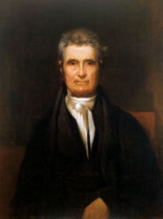
Check for Understanding
A ask B: How did Marshall rule in Marbury v. Madison?
In Marbury v. Madison, Marshall ruled that the law under which Marbury sued was unconstitutional, so Marbury did not get his appointment as a judge.
Be sure to re-state the question in your response!

Slide 36
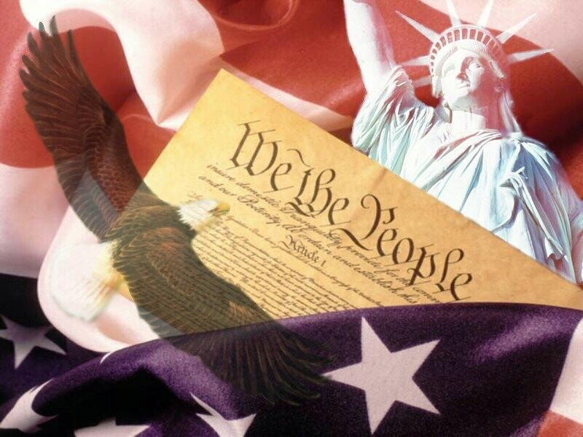
Check for Understanding
B ask A: What does it mean to declare that a law is unconstitutional?
Declaring a law unconstitutional means that the law contradicts the principles of the Constitution.
Be sure to re-state the question in your response!

Slide 37
Get your whiteboards and markers ready!

Slide 38
4. Why was John Marshall’s decision in Marbury v. Madison so important?
It gave the Supreme Court the power of judicial review.
It determined the outcome of the election of 1800.
It increased the number of federal judges, allowing President John Adams to fill most of the new posts with Federalists.
It gave Congress the constitutional authority to settle eminent domain questions.

Slide 39
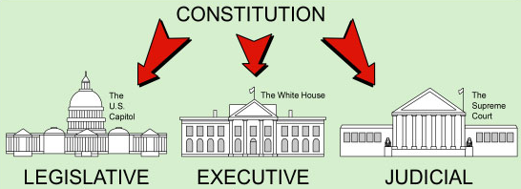
5. How did the principle of judicial review change the Supreme Court?
It changed the process by which the Senate consents to new Supreme Court appointments.
It changed the process by which the Supreme Court hears appeals.
It established the Supreme Court's power to declare a law unconstitutional.
It confirmed the power the Supreme Court has to try impeachment cases.

