Slide 1
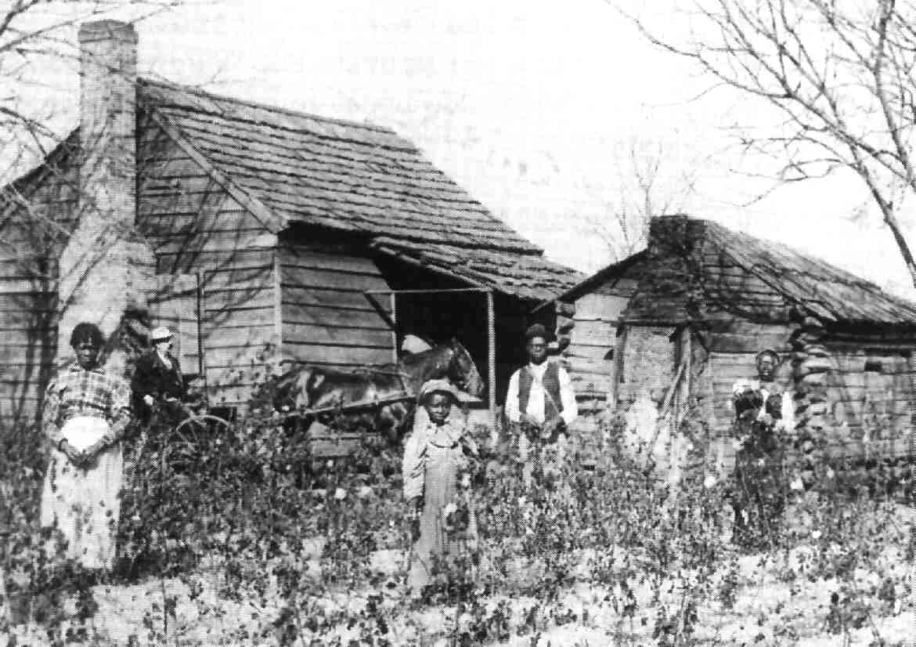
Lesson 18.2: Reconstruction and Daily Life
Today’s Essential Question: What was daily life like for former slaves during Reconstruction?

Slide 2
Vocabulary
freedmen – former slaves
self-sufficient – without need for someone else’s help
land reform – taking land from the rich and distributing it to those who have none
cash crop – a crop grown to sell rather than for the farmer’s personal use
drawback – undesirable feature; a disadvantage

Slide 3
Check for Understanding
What is today’s Essential Question?
What was the most important cash crop in the South: wheat, cotton, or sugar cane?
Who is the most self–sufficient person in this room, and why?
What’s one drawback about being an adult?

Slide 4
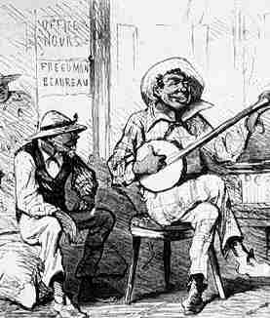
What We Already Know
With the adoption of the Thirteenth Amendment, slavery was abolished and former slaves were free to make new lives for themselves.

Slide 5
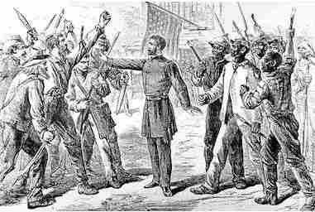
What We Already Know
The Fourteenth Amendment and other laws had been passed to protect the civil rights of freedmen.

Slide 6
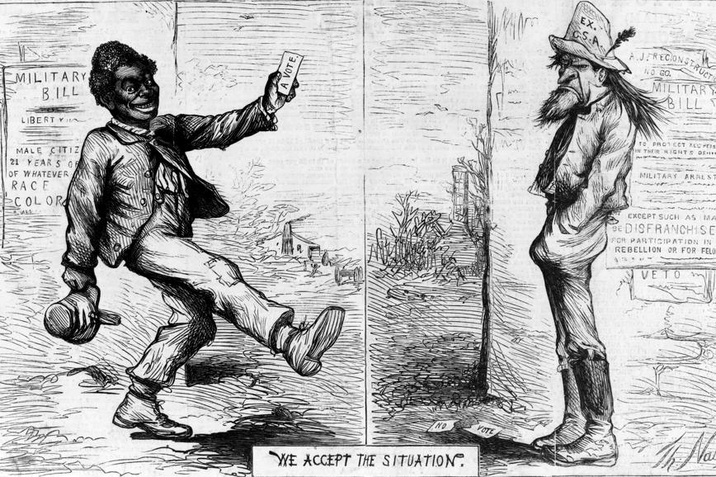
What We Already Know
Many Southern whites were resentful about the economic and political gains African Americans were making after the Civil War.

Slide 7
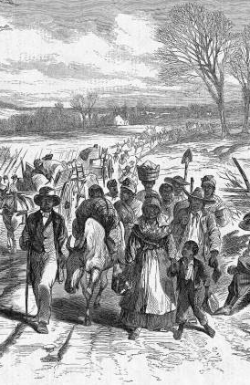
Responding to Freedom
African Americans’ first reaction to freedom, since they no longer needing passes to travel, was to leave the plantations.
Some former slaves returned to the places where they were born.
Others went looking for more economic opportunity in the North and West.
Still others traveled just because they could.

Slide 8
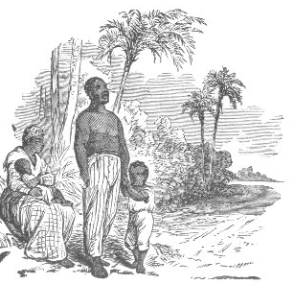
Responding to Freedom
African Americans also traveled in search of family members separated from them during slavery.
To locate relatives, people placed advertisements in newspapers.
The Freedmen’s Bureau helped many families reunite.

Slide 9
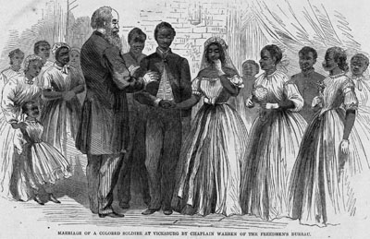
Responding to Freedom
Freedom allowed African Americans to strengthen their family ties.
Former slaves could marry legally.
They could raise families without fearing that their children might be sold.
Many families adopted children of dead relatives and friends to keep family ties strong.

Slide 10

Get your whiteboards and markers ready!

Slide 11
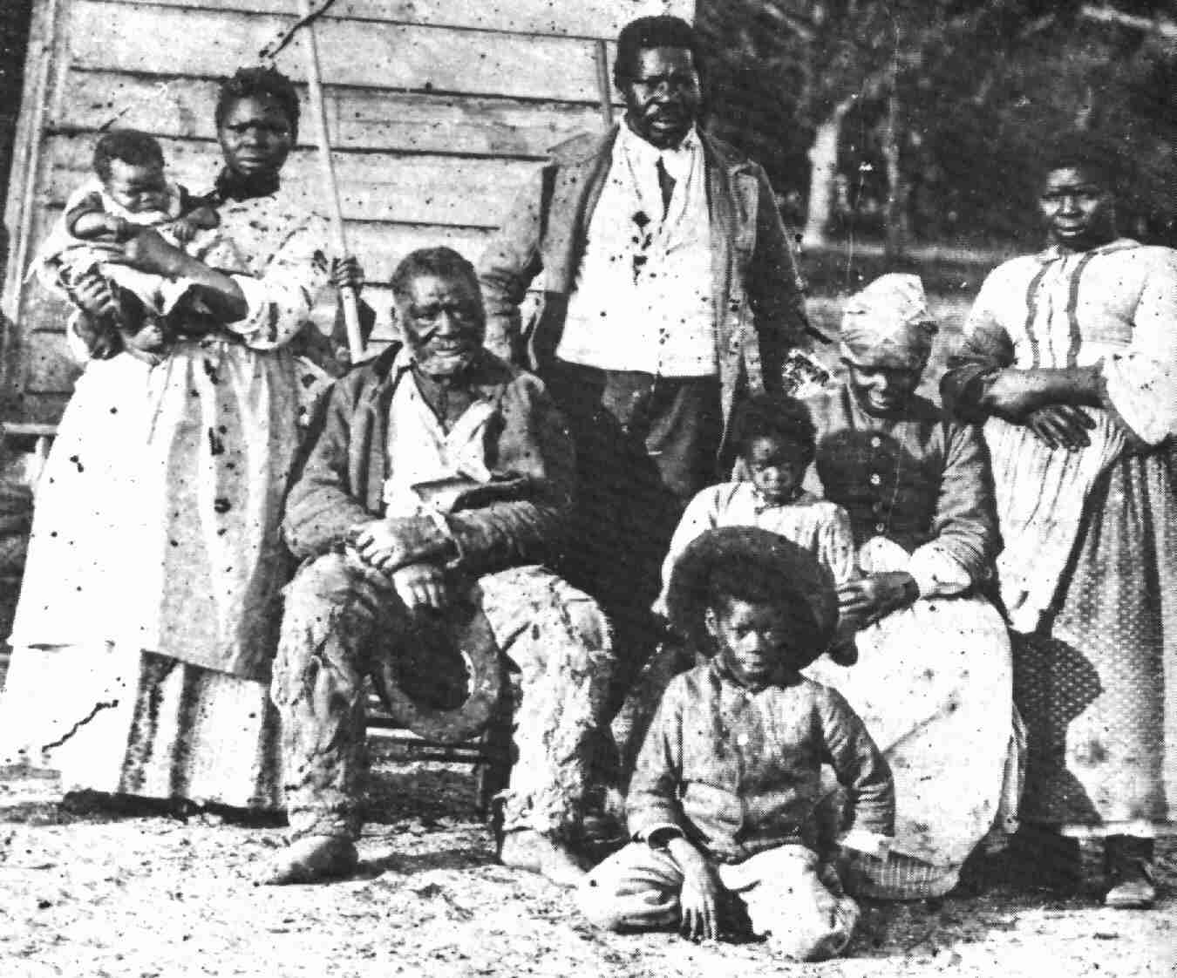
13. How did freedom strengthen African American families?
Choose all that are true!

Slide 12
13. How did freedom strengthen African American families?
Freedmen could marry legally.
African American couples could now have as many children as they wished.
Former slaves could try to locate lost family members.
Black children had more respect for their fathers now that the men were no longer slaves.
Choose all that are true!

Slide 13
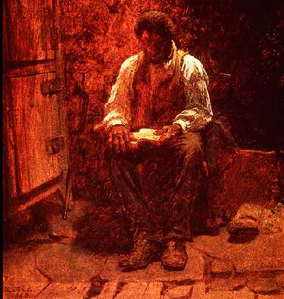
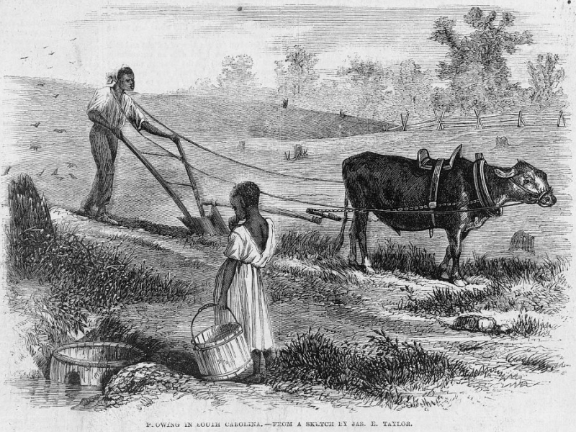
Starting Schools
With freedom, African Americans could now work to provide for their families, not for an owner’s benefit.
Economic independence, however, could not come until they learned to read and write.

Slide 14
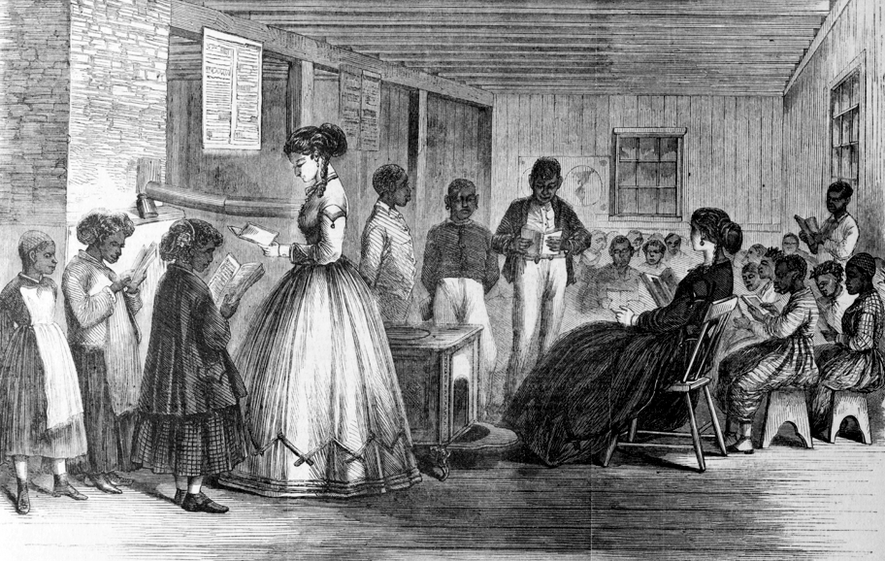
Starting Schools
Both children and adults flocked to freedmen’s schools started by the Freedmen’s Bureau, Northern missionary groups, and African-American organizations.

Slide 15
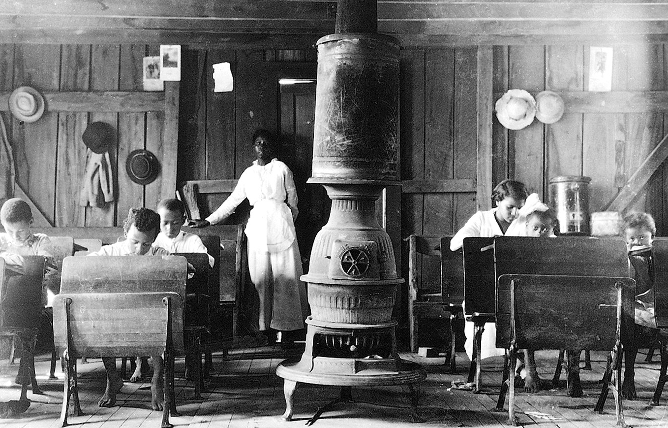
Starting Schools
Freed people in cities held classes in warehouses, billiard rooms, and former slave markets.

Slide 16
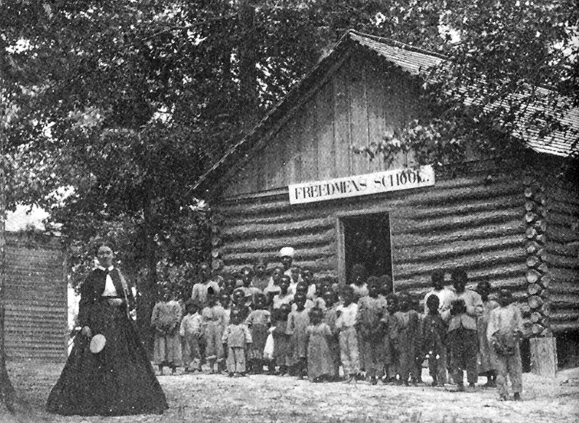
Starting Schools
In rural areas, classes were held in churches and homes.

Slide 17
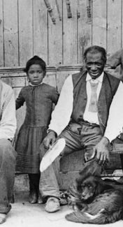
Starting Schools
Children who went to school often taught their parents to read at home.

Slide 18
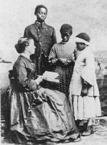
Starting Schools
In the years after the war, African-American groups raised more than $1 million for education.
The federal government and private groups in the North paid most of the cost of building schools and hiring teachers.
Between 1865 and 1870, the Freedmen’s Bureau spent $5 million for this purpose.

Slide 19
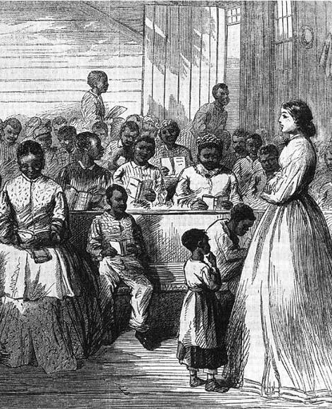
Starting Schools
More than 150,000 students were attending 3,000 schools by 1869, and about 10 percent of the South’s African-American adults could read.

Slide 20
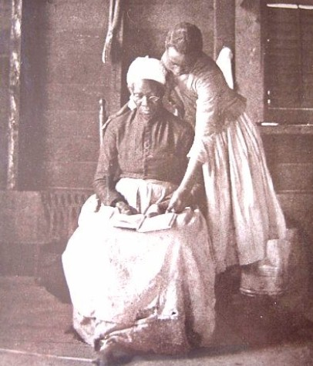
Starting Schools
A number of them became teachers themselves.
Northern teachers, black and white, also went South to teach freed people.

Slide 21
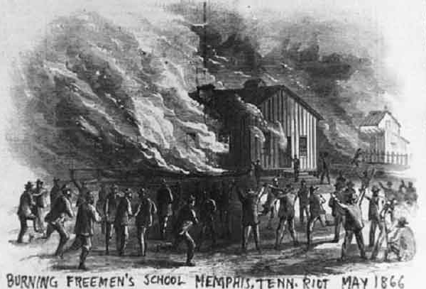
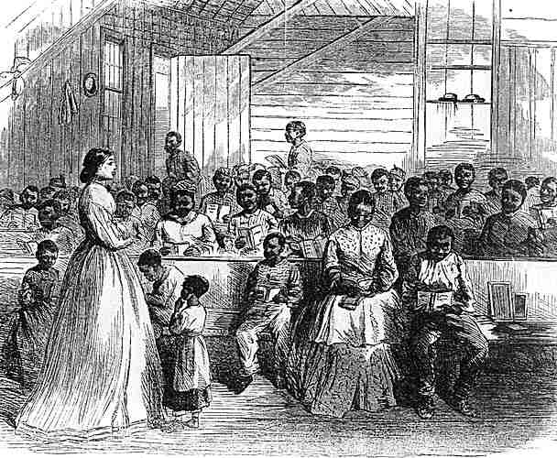
Starting Schools
Many white Southerners, however, worked against these teachers’ efforts.
White racists intimidated black students, burned freedmen’s schools and even killed teachers in some parts of the South.
Despite these setbacks, African Americans kept working toward an education.

Slide 22
Get your whiteboards and markers ready!

Slide 23
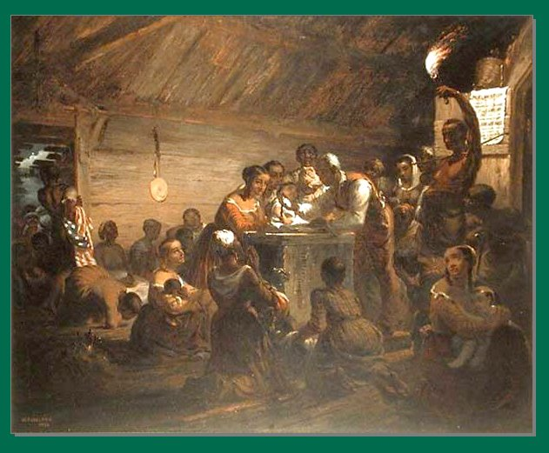
14. What organization served as the foundation for African American education during Reconstruction?

Slide 24
14. What served as the foundation for African American education during Reconstruction?
The home, where they learned from their parents and other older relatives
The United Negro College Association founded by former abolitionists and wealthy free blacks
School systems established by the Freedmen's Bureau, missionaries or African American organizations
The local black church system, which disobeyed laws that still prohibited black education in many Southern states

Slide 25
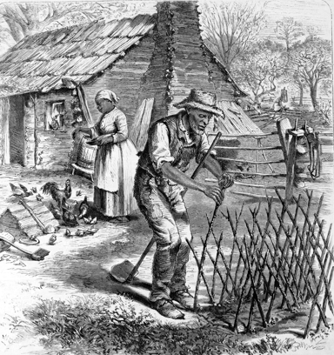
40 Acres and a Mule
More than anything else freed people wanted to own land.
Land ownership could make freedmen self-sufficient, but without land, the old masters could hire them or starve them as they pleased.

Slide 26
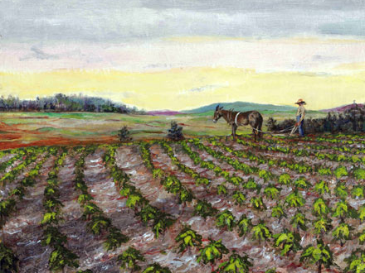
40 Acres and a Mule
A rumor spread that all freedmen would get 40 acres and a mule, but most freedmen never received land.

Slide 27
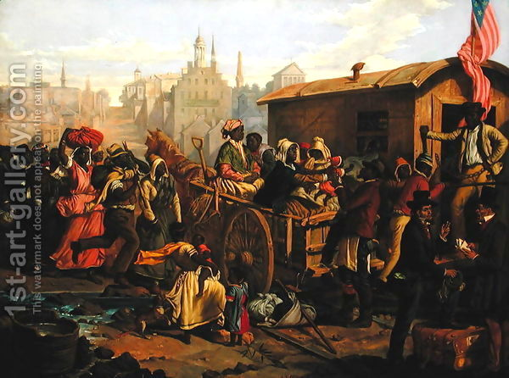
40 Acres and a Mule
Some freedmen felt that, since they and their families had been sold over and over again to purchase plantation land, and since they had cleared the land and raised the crops it produced, they were entitled to own some of it.

Slide 28
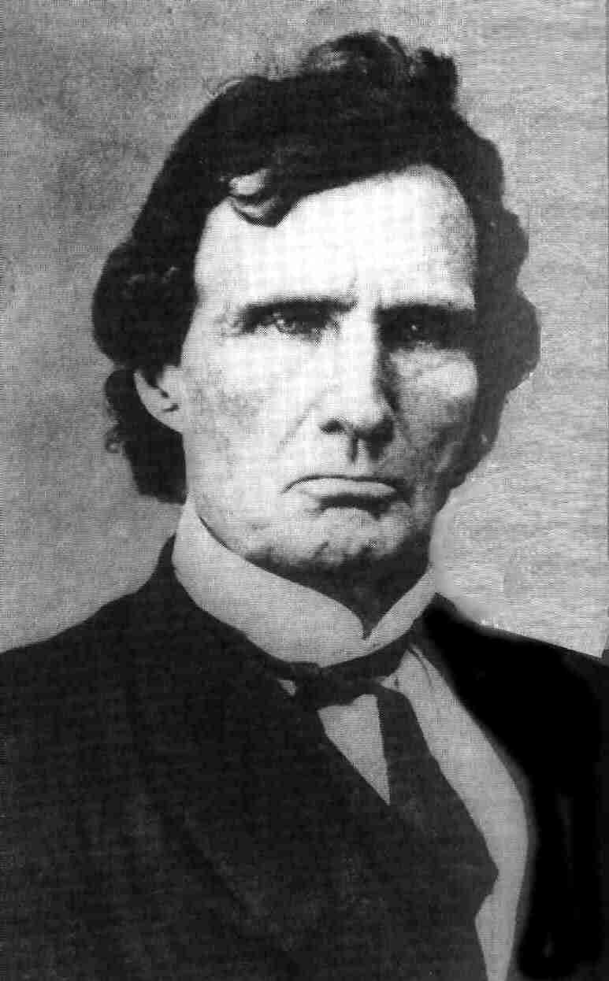
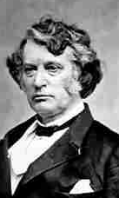
40 Acres and a Mule
Radical Republican leaders Thaddeus Stevens and Charles Sumner pushed to make land reform part of the Reconstruction Acts of 1867.
Stevens proposed a plan to Congress that would have taken land from plantation owners and given it to freed people.

Slide 29
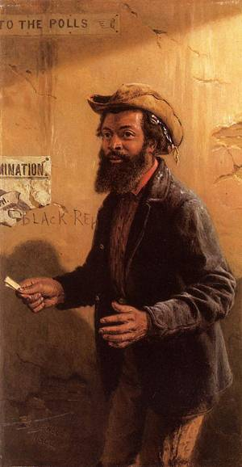
40 Acres and a Mule
Many moderate Republicans and even some Radicals were against the plan because they believed that new civil and voting rights were enough to give African Americans a better life.
Although supporters of the plan argued that civil rights meant little without economic independence, Congress did not pass the land reform plan.

Slide 30
Get your whiteboards and markers ready!

Slide 31
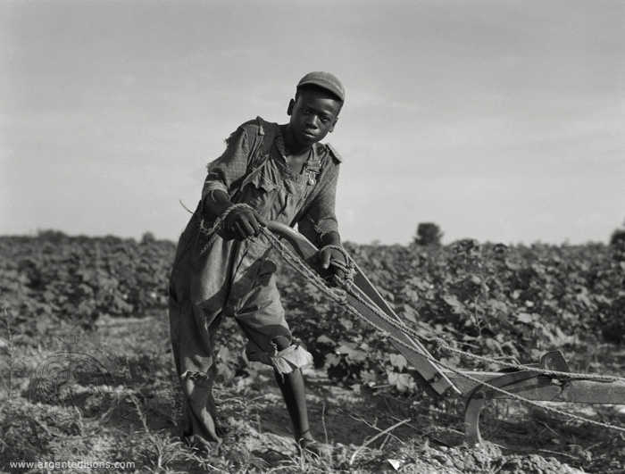
15. What were the main reasons African Americans wanted their own land?
Choose the one that is NOT true!

Slide 32
15. What were the main reasons African Americans wanted their own land?
Taking land from their former masters was an excellent way to get revenge for having been enslaved.
Land ownership was the only way to guarantee that they would not be oppressed by white employers.
It was their right to own land that had been purchased by themselves being sold over and over again.
They wanted to become economically independent and take care of their families.
Choose the one that is NOT true!

Slide 33
16. Why did many in Congress oppose the land reform plan?
It would be too expensive to purchase all the necessary acres.
It didn't go far enough to help the freedmen.
They believed that suffrage and new civil rights were enough to give African Americans a better life.
They felt it was illegal and immoral to give one man's land to someone else.

Slide 34
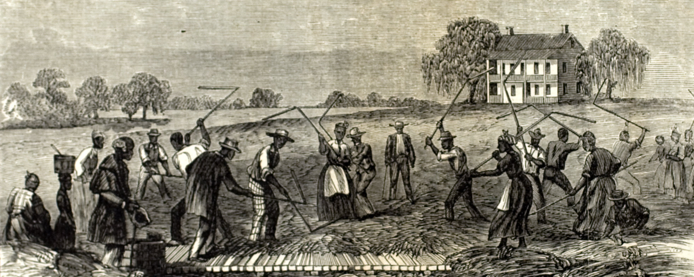
The Contract System
Without their own property, many African Americans returned to work on plantations, not as slaves but as wage earners.
They and the planters both had trouble getting used to this new relationship.

Slide 35
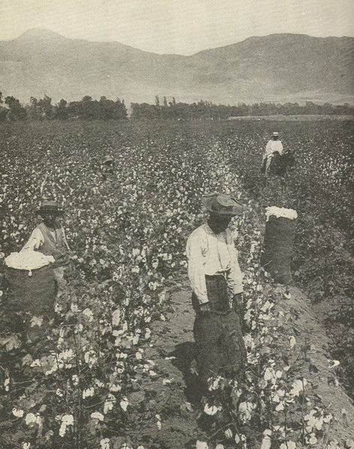
The Contract System
After the Civil War, planters desperately needed workers to raise cotton, still the South’s main cash crop.
African Americans reacted to this demand for labor by choosing the best contract offers.
The contract system was far better than slavery.
African Americans could decide whom to work for, and planters could not abuse them or split up families.

Slide 36
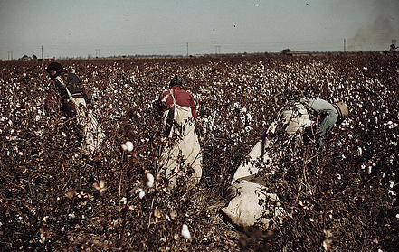
The Contract System
The contract system still had drawbacks.
Even the best contracts paid very low wages.
Workers often could not leave the plantations without permission.

Slide 37
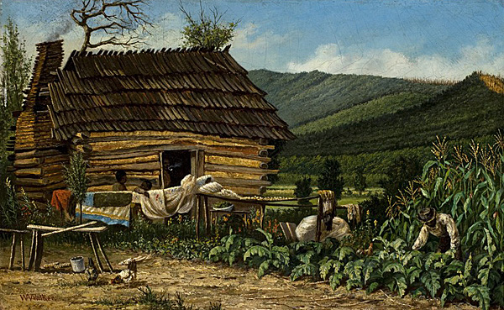
The Contract System
Many owners cheated workers out of wages and other benefits.
Worse yet, laws punished workers for break-ing their contracts, even if the plantation owners were abusing or cheating them.
These drawbacks made many African Americans turn to sharecropping.

Slide 38
Get your whiteboards and markers ready!

Slide 39
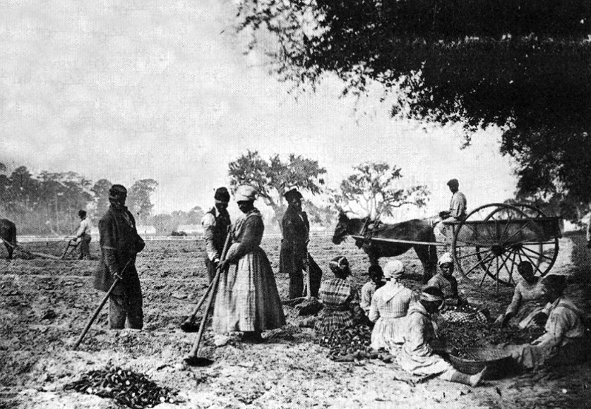
Which of the following was NOT one of the drawbacks of the contract system?

Slide 40
Which of the following was NOT one of the drawbacks of the contract system?
Low wages were common.
Workers were unable to leave the plantation without permission.
Landowners could cheat workers out of their wages.
Workers could not choose whom they worked for.
Workers could not break their contracts, even if the landowners cheated or abused them.

Slide 41
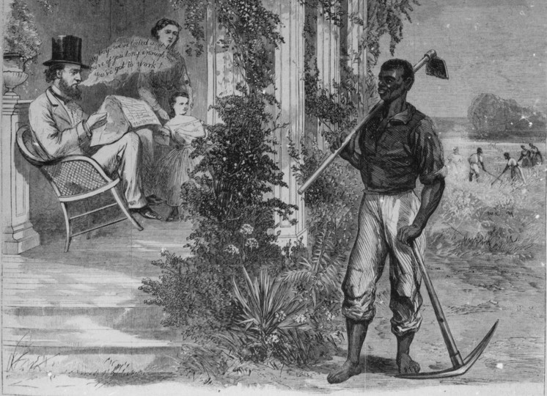
Sharecropping and Debt
Under the sharecropping system, a worker rented a plot of land to farm, and the land–owner provided the tools, seed, and housing.
When harvest time came, the sharecropper gave the landowner a share of the crop.
This system gave families without land a place to farm and gave landowners cheap labor.

Slide 42
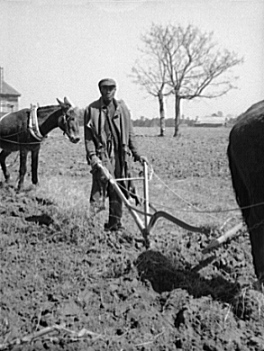
Sharecropping and Debt
But problems soon arose with the sharecropping system.
One cause of these problems was that farmers and landowners had opposite goals.

Slide 43
Sharecropping and Debt
Farmers wanted to grow food to feed their families, but landowners forced them to grow cash crops, such as cotton.
As a result, farmers had to buy food from the local store, which was usually owned by the landlord.

Slide 44
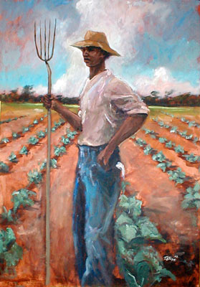
Sharecropping and Debt
Most farmers did not have the money to pay for goods. As a result, many were caught in a cycle of debt.
Often farmers had to use one year’s harvest to pay the previous year’s bills.

Slide 45
Sharecropping and Debt

Slide 46
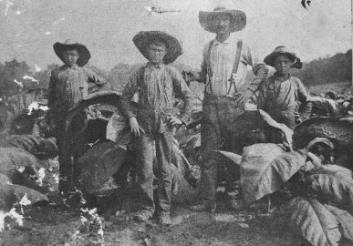
Sharecropping and Debt
White farmers also became sharecroppers.
Many had lost their land in the war, and others had lost it to taxes.
By 1880, one-third of the white farmers in the Deep South worked someone else’s land.

Slide 47
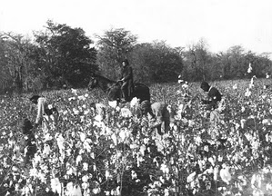
Sharecropping and Debt
Much of what was grown on the plantations was cotton, which wasn’t worth as much after the war.
Southern planters responded by trying to produce more of the cash crop—a move that drove down prices even further.

Slide 48
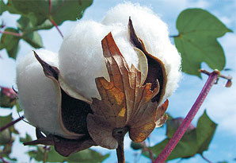
Sharecropping and Debt
Growing cotton exhausted the soil and reduced the amount of land available for food crops.
As a result, the South had to import half its food.
Relying on cotton was one reason the Deep South experienced years of rural poverty.

Slide 49
Get your whiteboards and markers ready!

Slide 50
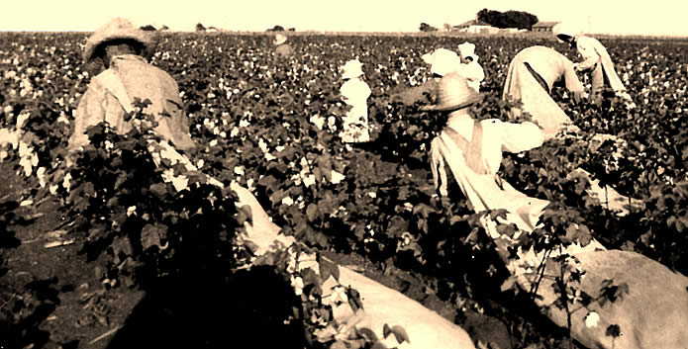
Which of the following was NOT true about sharecropping?

Slide 51
Which of the following was NOT true about sharecropping?
A worker rented a plot of land to farm.
The landowner provided the tools, seed, and housing.
Workers gave the landowner a share of the crop at harvest time.
Workers bought food and clothing from the landowner on credit.
Over the years, most sharecroppers managed to save enough money to buy their own land.

Slide 52
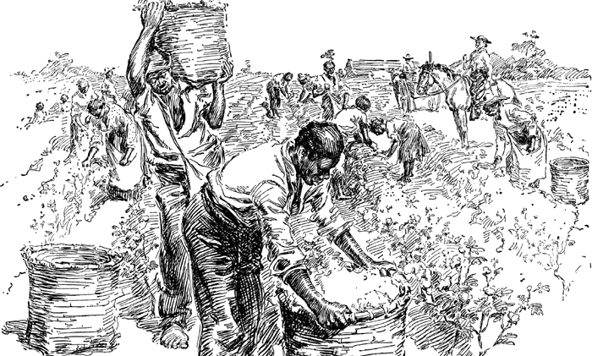
17. How did the goals of sharecroppers and plantation owners conflict?

Slide 53
17. How did the goals of sharecroppers and plantation owners conflict?
Farmers wanted to grow food for their families, but landowners forced them to grow cash crops, such as cotton.
Plantation owners used various laws and tricks to make it impossible for sharecroppers to buy their own land.
Plantation owners wanted sharecroppers to treat them with respect, but they refused.
Sharecroppers wanted to form agricultural unions, but the landowners always prevented them.

Slide 54
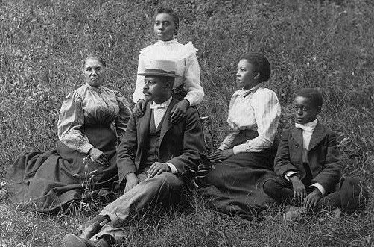
The Ku Klux Klan
African Americans in the South faced other problems besides poverty. They also faced violent racism.
Many planters and former Confederate soldiers did not want African Americans to have more rights.

Slide 55
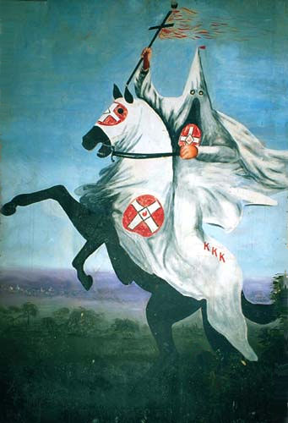
The Ku Klux Klan
In 1866, such feelings spurred the rise of a secret group called the Ku Klux Klan.
The Klan’s goals were to restore Democratic control of the South and keep former slaves powerless.

Slide 56
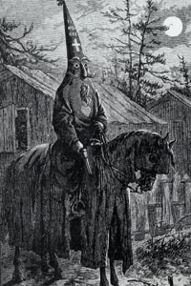
The Ku Klux Klan
The Klan attacked African Americans, targeting those who owned land or had become prosperous.
Klansmen rode on horseback and dressed in white robes and hoods.
They beat people and burned homes.

Slide 57
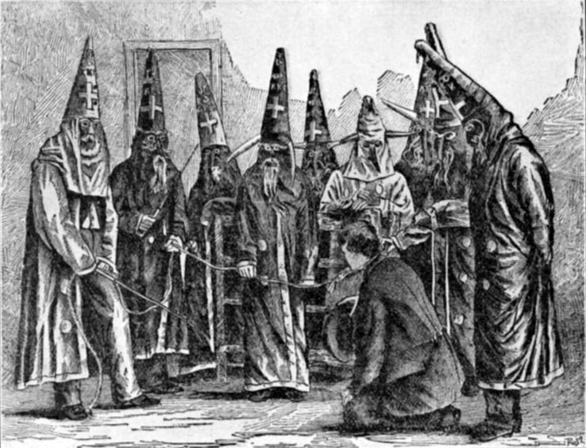
The Ku Klux Klan
They even lynched some victims, killing them on the spot without a trial as punishment for a supposed crime.

Slide 58
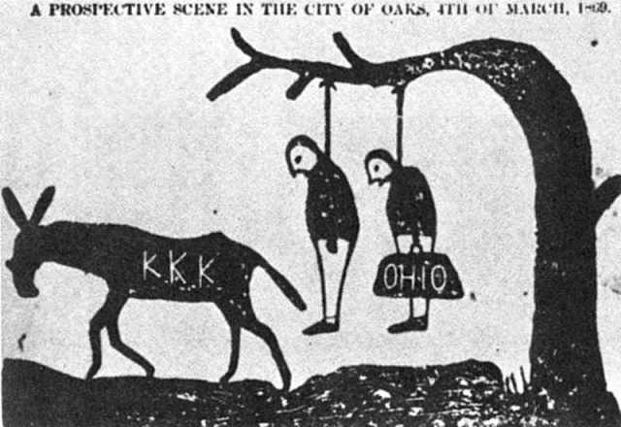
The Ku Klux Klan
To lynch is to punish a person by killing him or her without a trial, often by hanging.
The Klan also attacked white Republicans.

Slide 59
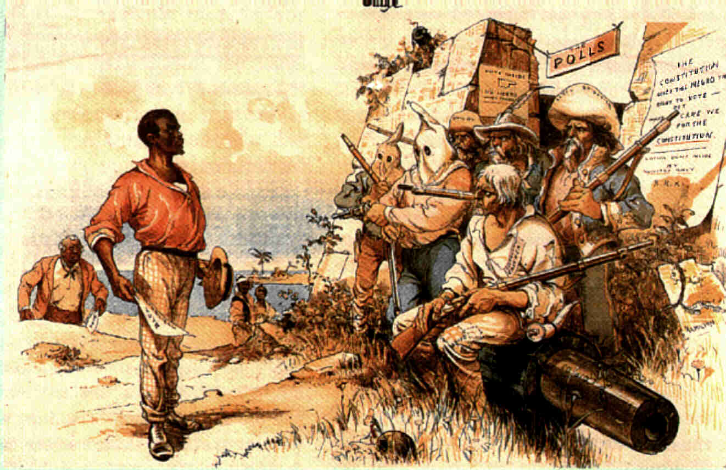
The Ku Klux Klan
Klan victims had little protection.
Military authorities in the South often ignored the violence.
President Johnson had appointed most of these authorities, and they were against Reconstruction.

Slide 60
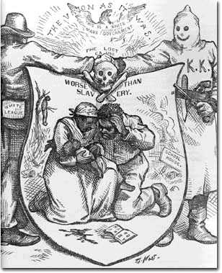
The Ku Klux Klan
The Klan’s terrorism served the Democratic Party.
As armed Klansmen kept Republicans away from the polls, the Democrats increased their power.
Soon, planter class took back control of the South.

Slide 61
Get your whiteboards and markers ready!

Slide 62
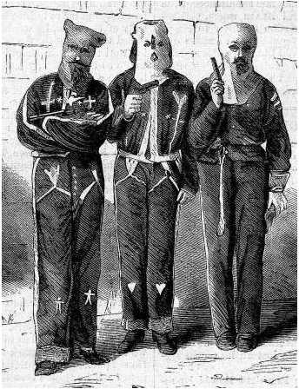
What was the Ku Klux Klan?
The Ku Klux Klan was a secret group whose goals were to restore Democratic control of the South and keep former slaves powerless.

Slide 63
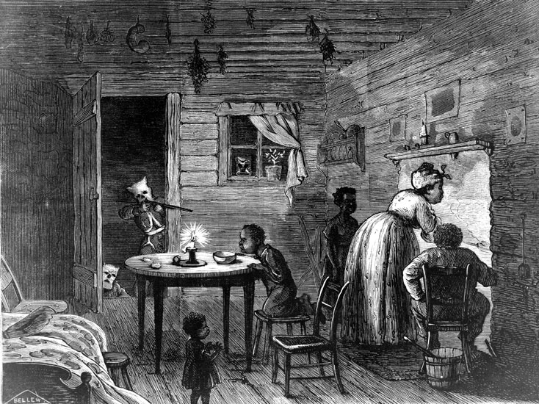
18. What were the goals of the Ku Klux Klan?
Choose all that are true!

Slide 64
18. What were the goals of the Ku Klux Klan?
To keep voting rights for whites only
To make the South ready for the rise of a new Confederacy
To restore Democratic control of the South
To keep former slaves poor and powerless
To expel all blacks from the South
Choose all that are true!

