Slide 1
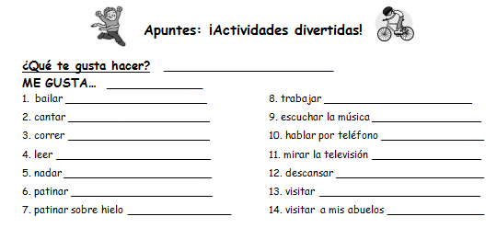
What do you like to do?
I like …
To dance
To work
To sing
To listen to music
To run
To talk on the phone
To read
To watch t.v.
To swim
To rest
To skate
To visit
To skate on ice
To visit my grandparents

Slide 2
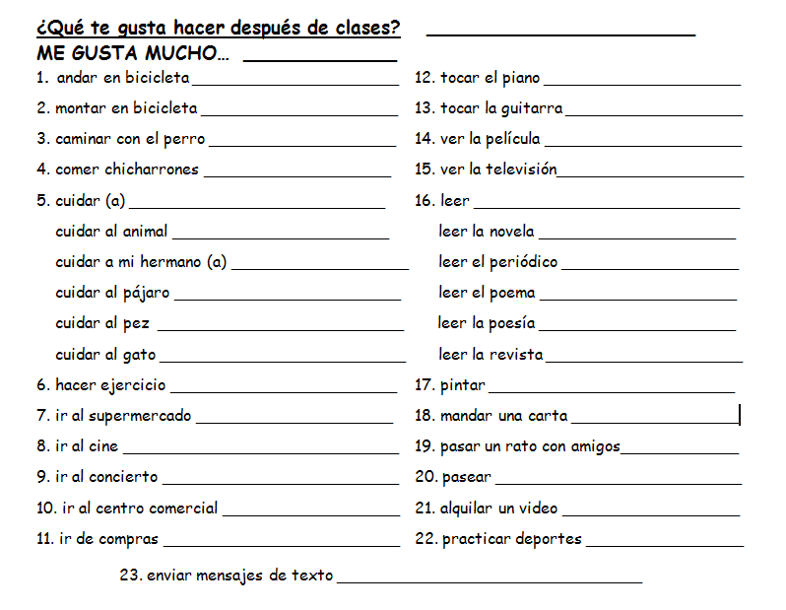
What do you like to do after classes?
I really like …
To ride a bicycle
To play the piano
To ride a bicycle
To play the guitar
To walk the dog
To watch the movie
To eat pork rinds
To watch t.v.
To care for
To read
To care for the animal
To read the novel
To care for my brother/sister
To read the newspaper
To care for the bird
To read the poem
To care for the fish
To read poetry
To care for the cat
To read the magazine
To exercise
To paint
To go to the supermarket
To send a letter
To go to the movies/cinema
To spend some time with friends
To go to the concert
To go for a walk/stroll
To go to the mall
To rent a video
To go shopping
To practice sports
To send text messages/ to text

