Slide 1
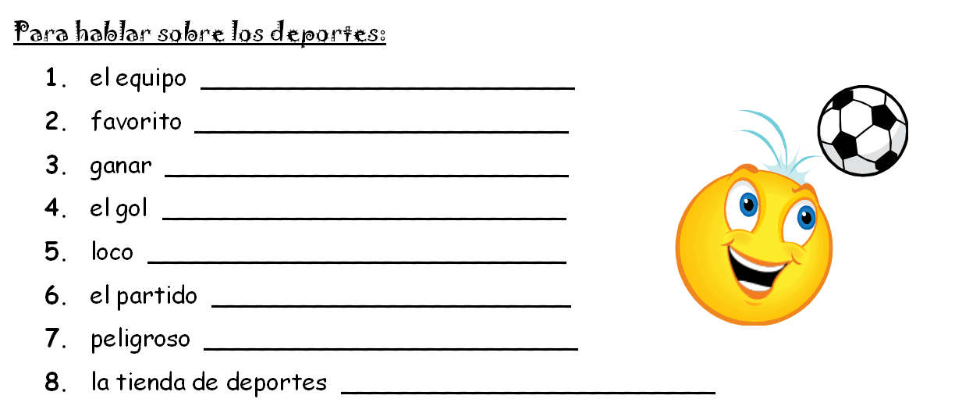
The team
favorite
To win
The goal
crazy
The game
dangerous
The sports store (sporting goods)

Slide 2
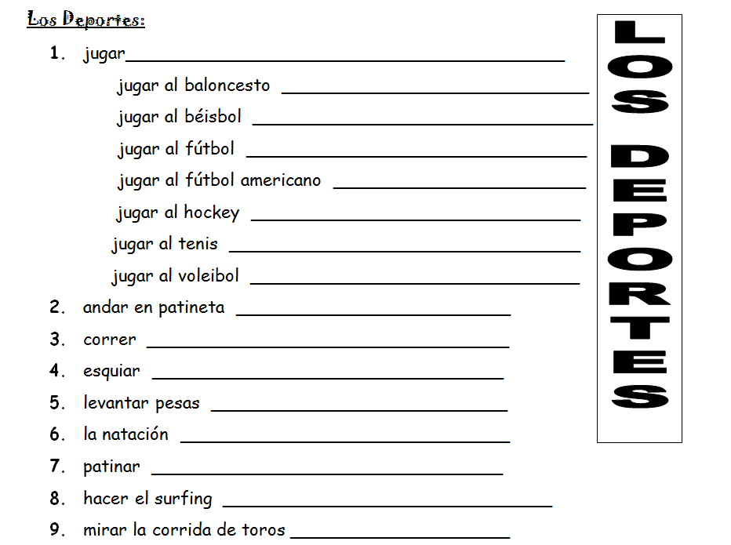
To play
To play basketball
To play baseball
To play soccer
To play American football
To play hockey
To play tennis
To play volleyball
To (ride) a skateboard
To run
To ski
To lift weights
swimming
To skate
To surf
To watch the bullfight

