Slide 1
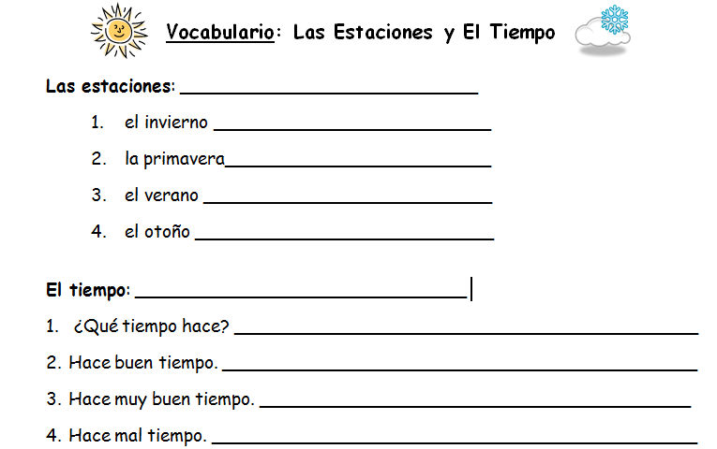
The seasons
The winter
The spring
The summer
The fall
The weather
What’s the weather like?
It’s nice out. (It’s nice weather)
It’s really nice out. (It’s really nice weather)
It’s bad weather.

Slide 2
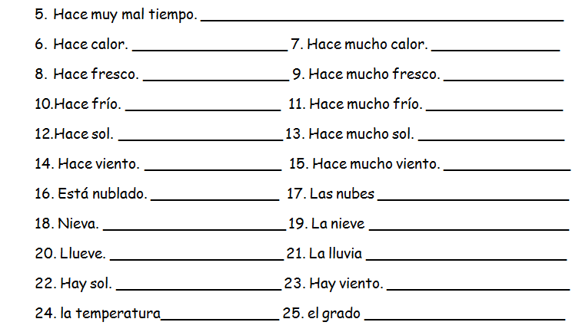
It’s very bad weather.
It’s hot.
It’s very hot.
It’s cool.
It’s very cool.
It’s cold.
It’s very cold.
It’s sunny.
It’s very sunny.
It’s windy.
It’s very windy.
The clouds
It’s cloudy.
It’s snowing.
The snow
It’s raining.
The rain
There is sun.
There is wind.
The temperature
The degree
CAREFUL: These words are nouns & they cannot be used to answer the question, “What’s the weather like?”.

