Slide 1
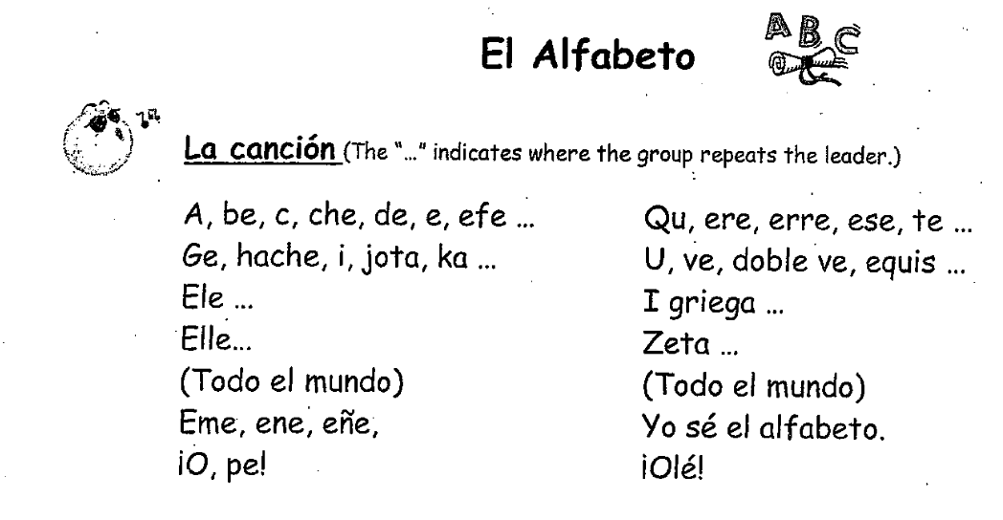

Slide 2
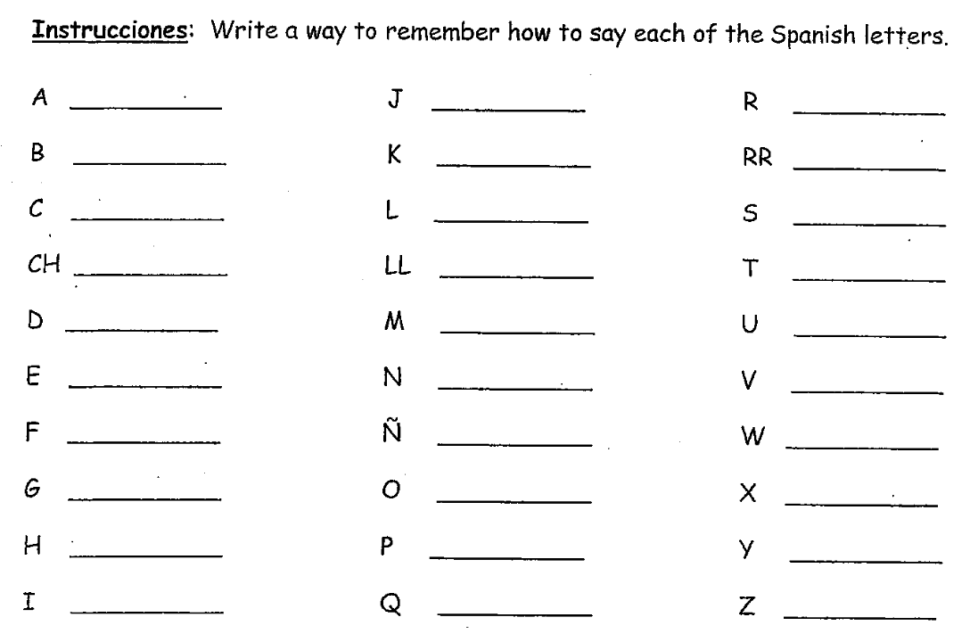
ahh
ho-tah
air-ay
bay (larga)
kah
airr-ay
say
“l”-ay
essay
chay
“ay”-yay
tay
day
“m”-ay
oo
ay
“n”-ay
bay (corta)
“f”-ay
“n”-yay
doblay-bay
hay
oh
ec-kees
ah-chay
pay
ee-gree-ay-gah
ee
koo
zay-tah

Slide 3
