Slide 1
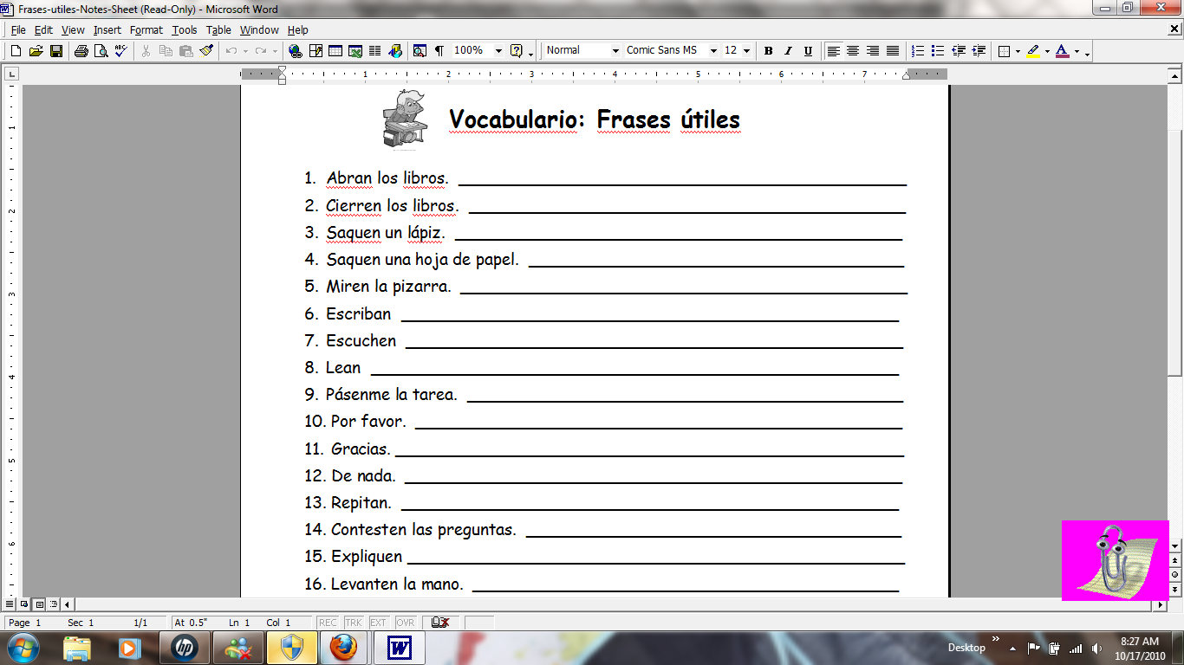
Open your books.
Close your books.
Take out a pencil.
Take out a sheet of paper.
Look at the chalkboard.
Write
Listen (to)
Read
Pass me the homework.
Please.
Thank you.
You’re Welcome.
Repeat.

Slide 2
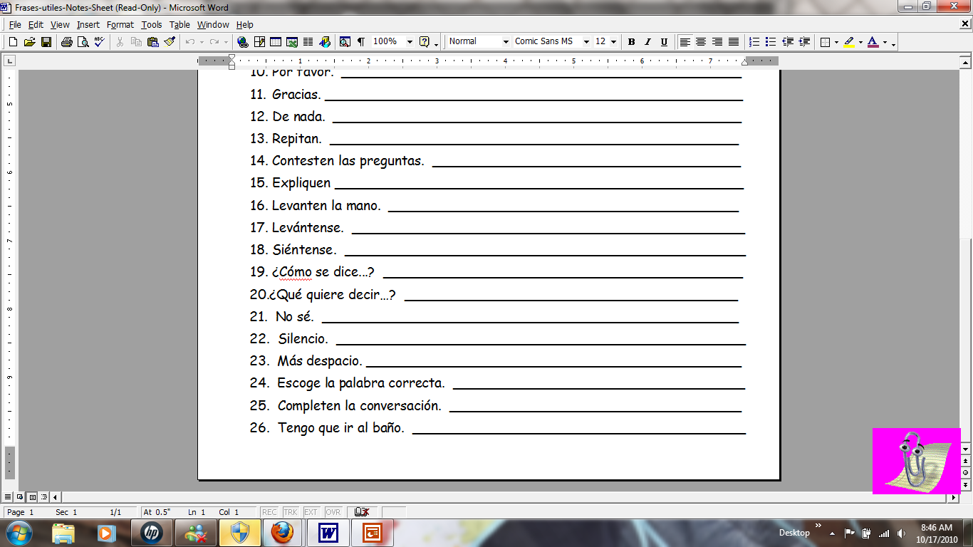
Answer the questions.
Explain.
Raise your hand.
Stand up.
Sit down.
How does one say…?
What does… mean?
I don’t know.
Silence.
More slowly.
Choose the correct word.
Complete the conversation.
I have to go to the bathroom.

