Slide 1
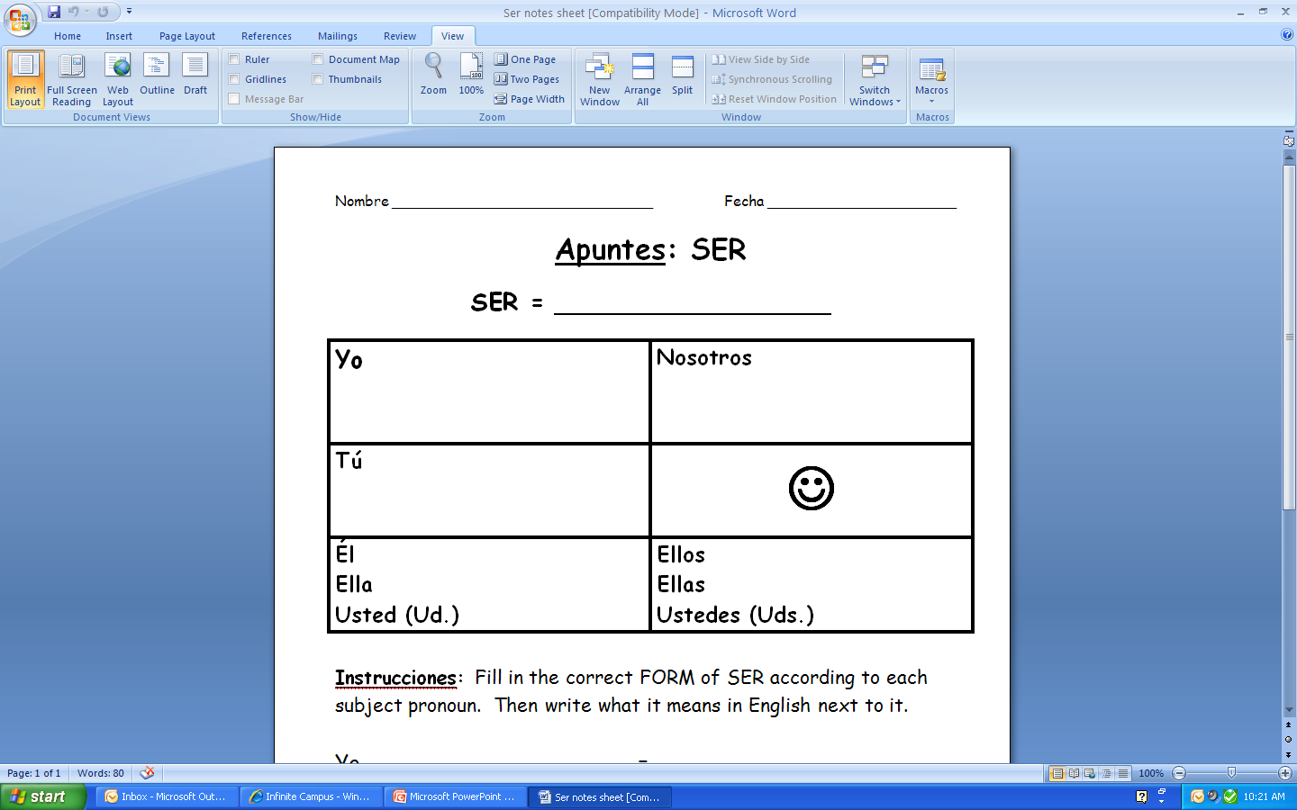
Permanent
  Origin
  Physical description
  Personality traits
to be
I
we
soy
somos
You
(fam.)
eres
es
son
They
(m) They
(f)
Y’all
He
She
You
(formal)

Slide 2
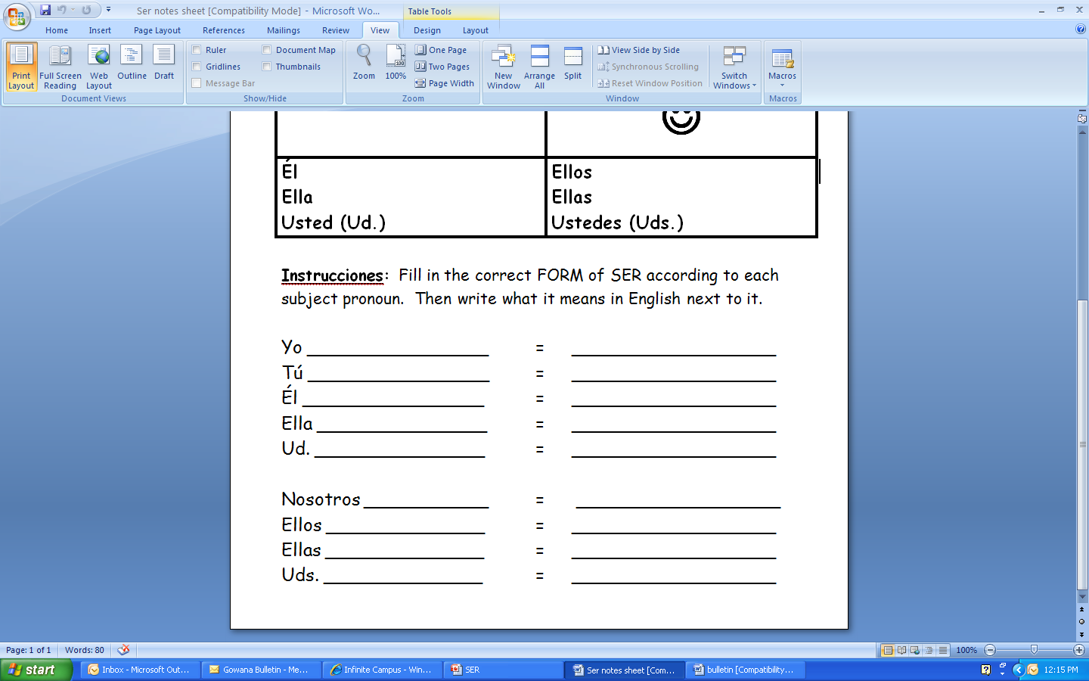
soy
I am
eres
You (fam.) are
es
He is
es
She is
es
You (formal) are (Ud. is)
somos
We are
son
They (m) are
son
They (f) are
son
All of you (y’all) are

