Slide 1
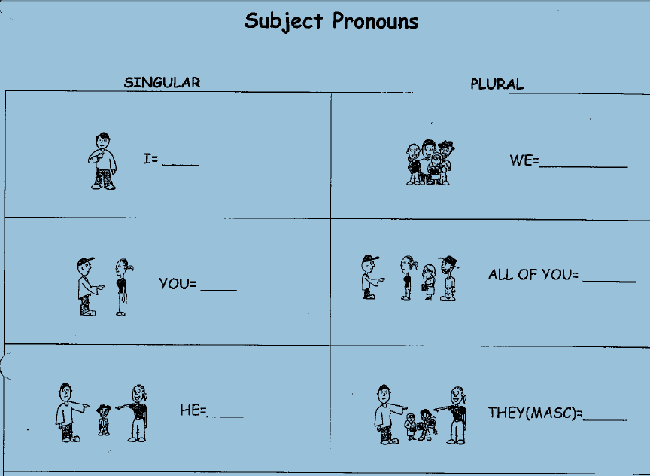
1st - Self
1st – Self + other
Yo
Nosotros
(Nosotras)
2nd – To one friend, family
2nd – To more than one person
Tú
Ustedes
3rd – About one boy
3rd – About 2 or more boys
Él
Ellos

Slide 2
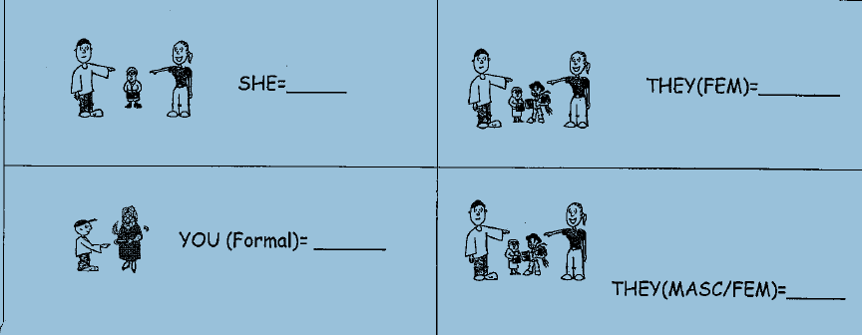
3rd – About one girl
3rd – About 2 or more girls
Ella
Ellas
2nd – To one adult
3rd – About one or more boys and girls
Usted
Ellos

