Slide 1
ESL 8 Vocabulary List
1

Slide 2
strategy
(n.)
plan, policy, technique
Strategize (v), strategic (adj), strategically (adv)

Slide 3

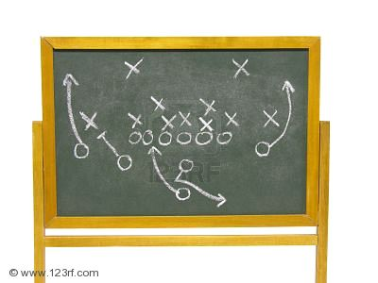

strategy

Slide 4
respond
V.
React, take action, reply, answer
Response (n), responsive (adj), responsively (adv)

Slide 5

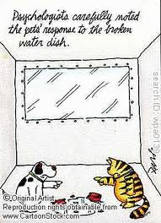
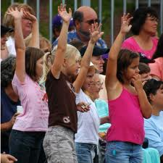
respond

Slide 6
perfect
(v.) /(adj.)
Improve, refine, achieve,
Great, wonderful, flawless
perfection(n.), perfectly (adv.)

Slide 7


perfect

Slide 8
Create
V.
Make, invent, build, design, produce
Creation (n), creative (adj), creatively (adv)

Slide 9
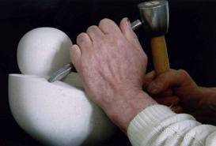
create

Slide 10
excite
(v.)
motivate, feel happy, thrill
excitement (n.), excited/exciting (adj.), excitedly/excitingly(adv.)

Slide 11
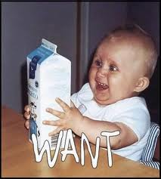

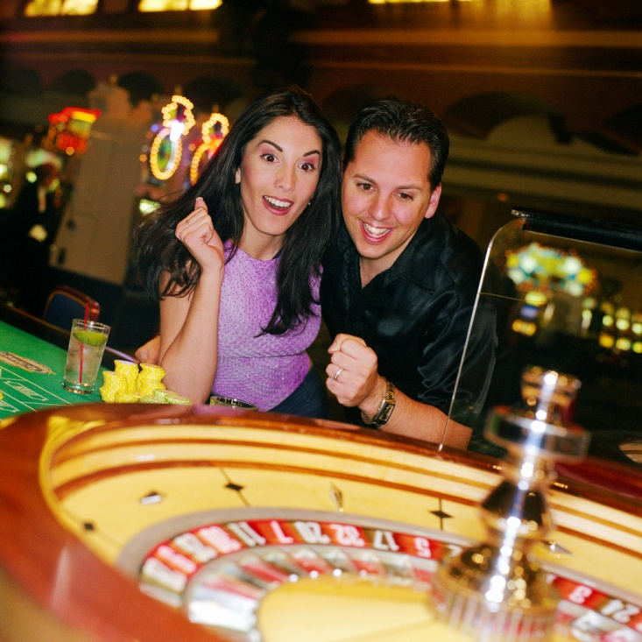
excite

Slide 12
predict
V.
Foretell, say before s.t. happens, guess, forecast, expect

Slide 13
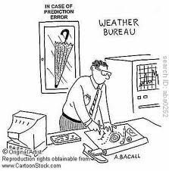

predict

Slide 14
conclude
V.
End, finish, wrap up, complete, decide, assume, achieve,
Conclusion (n), conclusive (adj), conclusively (adv)

Slide 15
conclude

Slide 16
image
(n.)
Picture, representation, illustration, vision
imagination(n.), imagine (v.), imaginative (adj)., imaginatively (adv.)

Slide 17


image

Slide 18
imagine
(v.)
Picture, envision, dream, make up, visualize, think of
imagination(n.), imaginative (adj)., imaginatively (adv.)

Slide 19
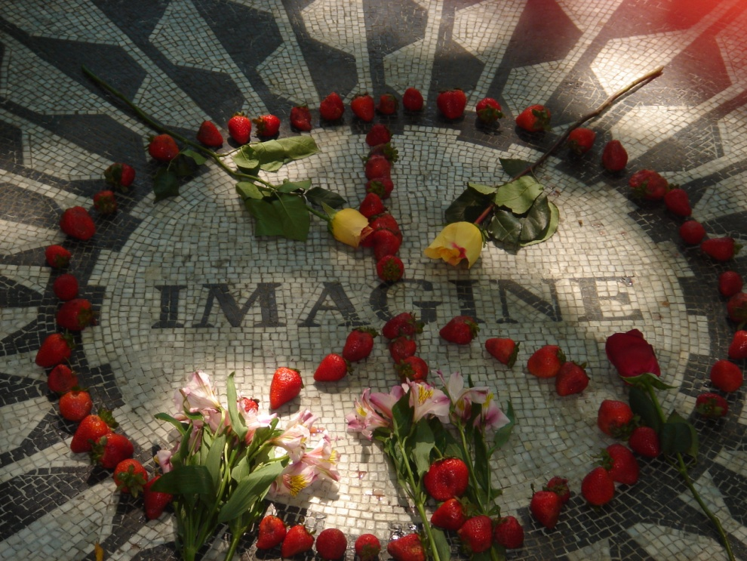
imagine

Slide 20
presume
V.
Suppose, assume, think/believe, consider, guess

Slide 21
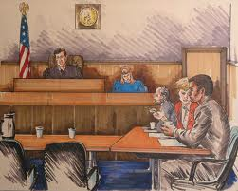
presume

Slide 22
coincide
V.
Agree, match, correspond, overlap, happen together, intersect

Slide 23
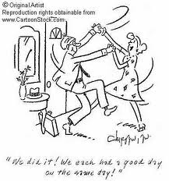
coincide

Slide 24
govern
(v.)
manage, rule, influence, control, administer
government (n.)

Slide 25
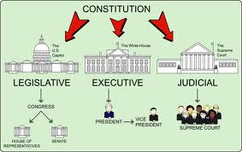
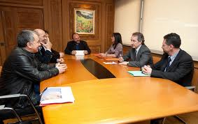
govern

Slide 26
upward
(adv.)/(adj.)
Up, toward higher level
Rising, improving

Slide 27

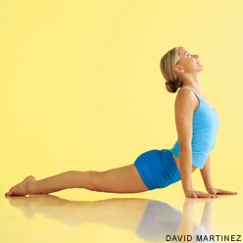
upward

