Slide 1
ESL 8 Vocabulary List
4
Make a Wish
Chapter 5-6
&
Phrasal Verbs (unit 3)

Slide 2
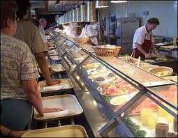
Phrasal Verbs
ask about (separable)
I will ask about the test.
I will ask her about the test
line up
When it’s busy, we have to line up for food in the cafeteria.

Slide 3
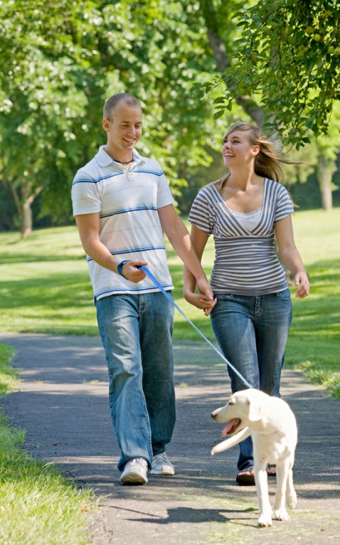

Phrasal Verbs
Stop by
I will stop by your house tonight.
Walk around
Let’s go walk around DC.

Slide 4

Phrasal Verbs
Look forward to
I look forward to hearing from you about the job.
Look at
She likes to look at paintings at the art museum.

Slide 5
accident
n.
“Yes, he’s only had a few accidents in the house.”

Slide 6
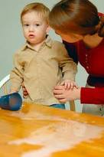
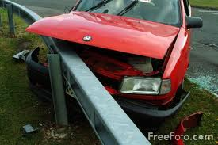
accident

Slide 7
counter
n.
Last week he couldn’t reach the counter, and yesterday afternoon, he reached up and ate a tuna fish sandwich I made for myself.

Slide 8
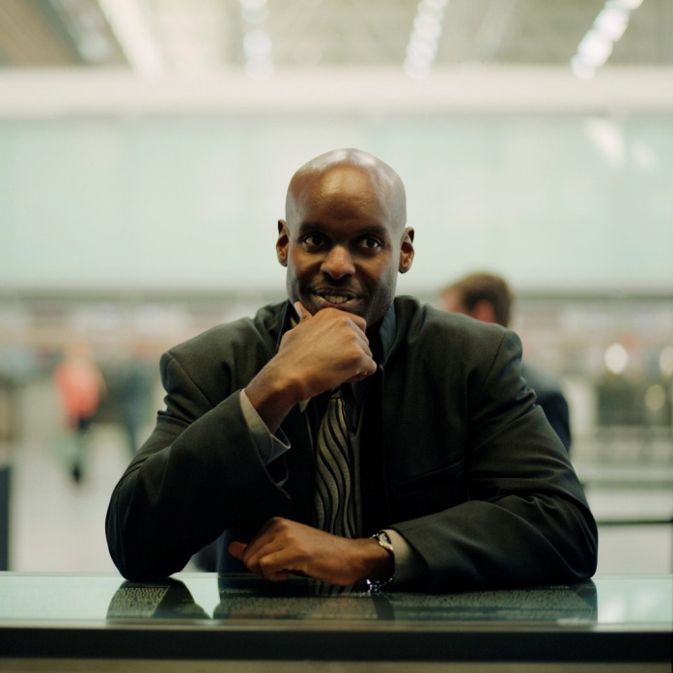
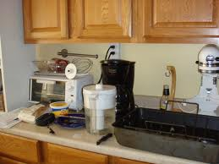
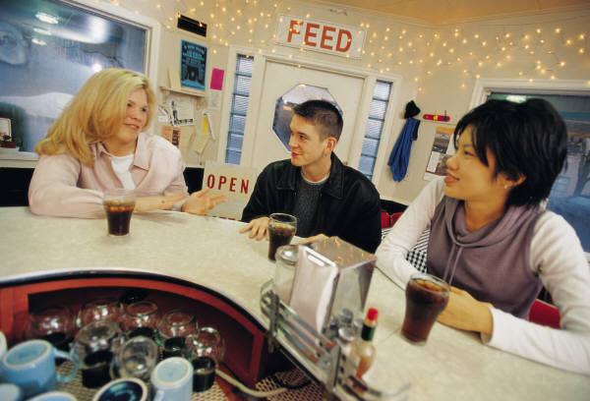
counter

Slide 9
exhausted
adj.
When he got home, he was exhausted.

Slide 10
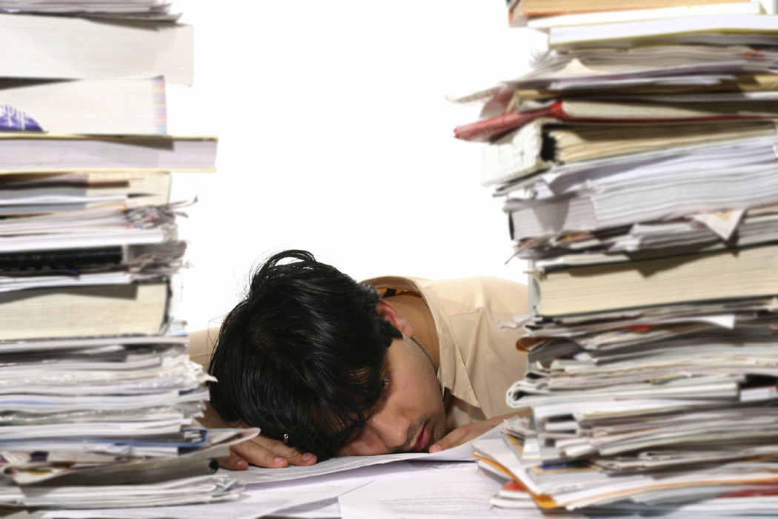
exhausted

Slide 11
job
n.
Abby didn’t mind traveling to her job in the Village, but she knew she’d miss her old neighborhood.

Slide 12
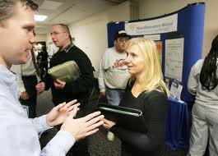
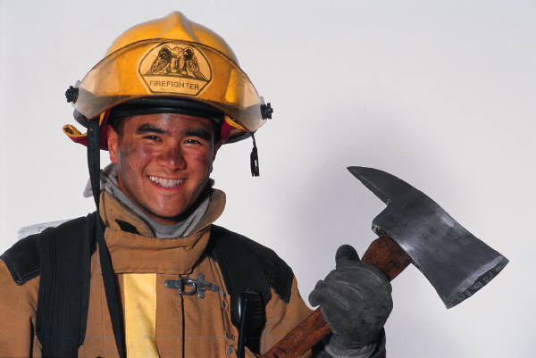
job

Slide 13
thoughtful
adj.
“Thanks, Abby, for being so thoughtful.”

Slide 14
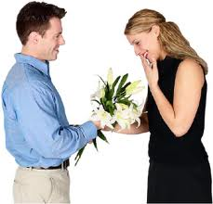
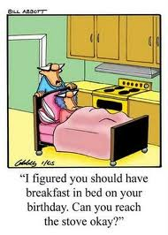
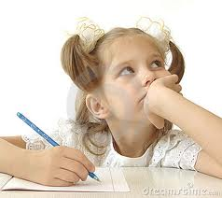
thoughtful

Slide 15
big break
n.
One of these days I’ll get my big break.

Slide 16


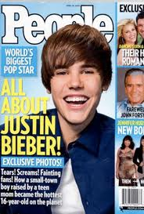
big break

Slide 17
constantly
adv.
I’m used to being a nomad and constantly living out of a suitcase.

Slide 18
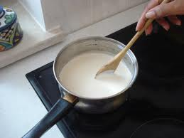
constantly

Slide 19
details
n. (pl.)
“No, I know he has a role, but I don’t have any details.”

Slide 20

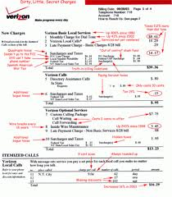
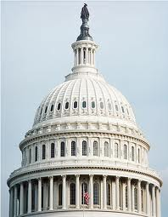
details

Slide 21
embrace
v.
John Miller embraced Lucas and then stared at his son.

Slide 22
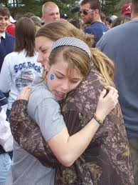
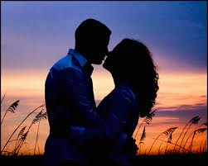
embrace

Slide 23
have the lead
n.
He has the lead [in the play].

Slide 24

have the lead

Slide 25
introduce
v.
He held her hand as he introduced her [to his father].

Slide 26
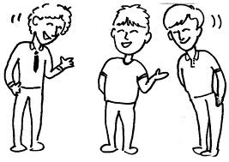
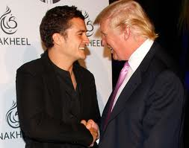
introduce

Slide 27
nomad
n.
I’m used to being a nomad and constantly living out of a suitcase.

Slide 28
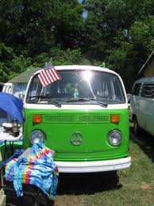
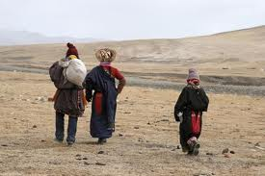
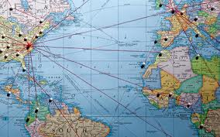
nomad

Slide 29
reservation
n.
Lucas made a reservation at Los Amigos, a new restaurant in Soho.

Slide 30
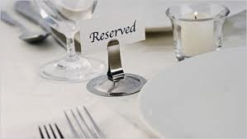

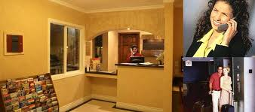
reservation

Slide 31
short notice
n.
Fortunately, a college friend was the manager, and Lucas was able to get a reservation on short notice.

Slide 32
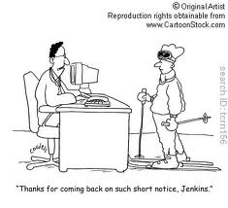
short notice

Slide 33
starved
adj.
“Well, are you two ready to have some dinner?” asked Lucas “Yes, I’m starved, son.”

Slide 34
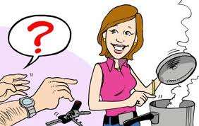
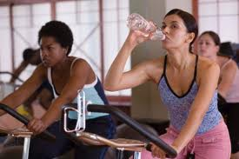
starved

