Slide 1
ESL 8 Vocabulary List
Make a Wish
Chapter 1

Slide 2
audition
n.
Now she was going to auditions at theaters in NYC and hoping to get a role in a play.
v.
Abby auditioned for many plays but still had not gotten a part.

Slide 3
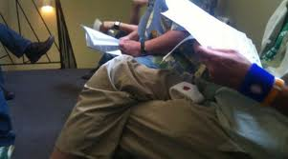
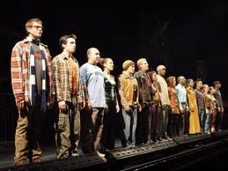
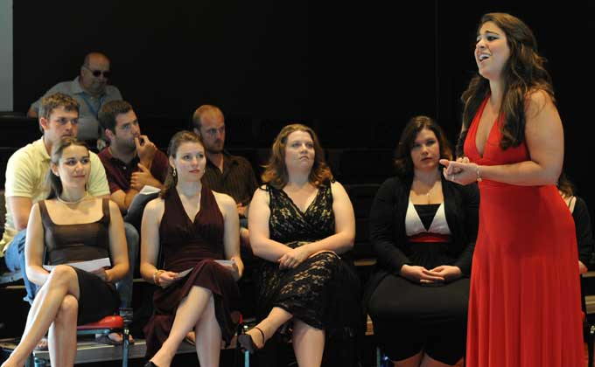
audition

Slide 4
assistant
n.
The casting office assistant looked up from her desk and spoke to Abby.

Slide 5
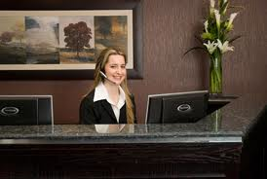

assistant

Slide 6
cast
(v.)
Abby went to auditions in hopes that she would be cast in a play.
n.
Because it was a small play, there were only 3 members of the cast.

Slide 7
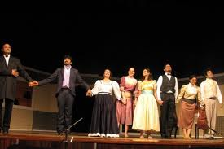
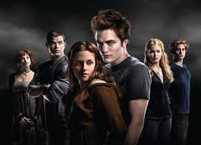
cast

Slide 8
meditate
V.
To keep up her spirits, she practiced yoga and meditated.

Slide 9


meditate

Slide 10
producer
n.
A few times she was called back by a producer, but so far she hadn’t been hired.

Slide 11

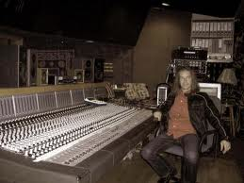
producer

Slide 12
recite
V.
She loved acting in school plays and felt happy being on stage, reciting her part or making up her own words when she forgot the exact words.

Slide 13
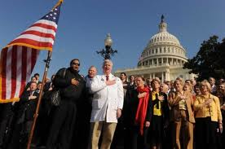
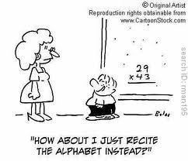
recite

Slide 14
refuse
(v.)
Lucas got up and offered Abby his seat, but she politely refused.

Slide 15

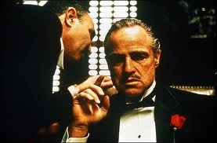
refuse

Slide 16
resume
n.
She handed the assistant her resume and photo and took the forms for the audition

Slide 17
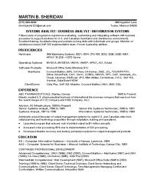
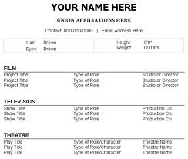
resume

Slide 18
role
n.
Now she was going to auditions at theaters in NYC and hoping to get a role in a play.

Slide 19
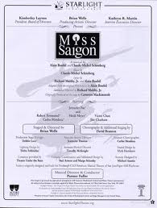

role

Slide 20
ESL 8 Vocabulary List
Make a Wish
Chapter 2

Slide 21
condition
n.
Okay, but on one condition… Will you have a drink with me after work?

Slide 22

condition

Slide 23
get by
ph. V.
How do you get by [without working for five months]?

Slide 24
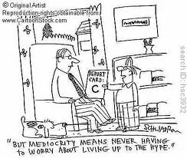
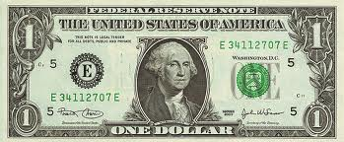
get by

Slide 25
recommend
v.
What do you recommend for dinner?

Slide 26

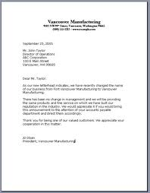
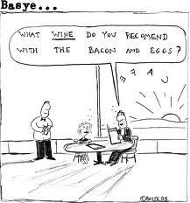
recommend

Slide 27
rehearse
v.
You should always rehearse before you give a presentation.
After rehearsals (n.) every day, he had been hanging out in the Village hoping to see her.

Slide 28
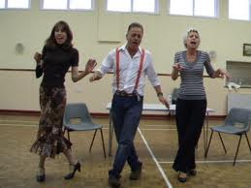
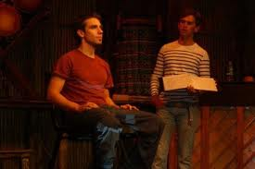
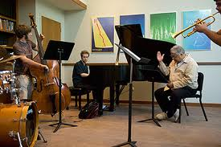
rehearse

Slide 29
tutor
v.
I tutor high school students in French and Spanish. I make more money doing that than acting.

Slide 30
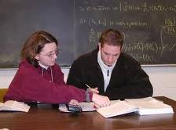
tutor

