Slide 1
Microeconomics
Studying the invisible hand and small decisions in the economy.

Slide 2
Illustrates how the market
sets prices
A section of
Economics
Explains how the government
is involved in price system
Microeconomics
Evaluate effects of
market structures
Demand
Supply
Market Structures
Price Controls

Slide 3
Vocabulary
Resource(Factor) Market- part of Circular Flow where FoP are sold
Product Market- part of Circular Flow where products are sold
Circular Flow-Transfer of products and factors between sectors of the economy

Slide 4
Circular Flow of the Economy
SSEMI1 The student will describe how households, businesses, and governments are interdependent and interact through flows of goods, services, and money.
a. Illustrate by means of a circular flow diagram, the Product market; the Resource (factor) market; the real flow of goods and services between and among businesses, households, and government; and the flow of money.

Slide 5
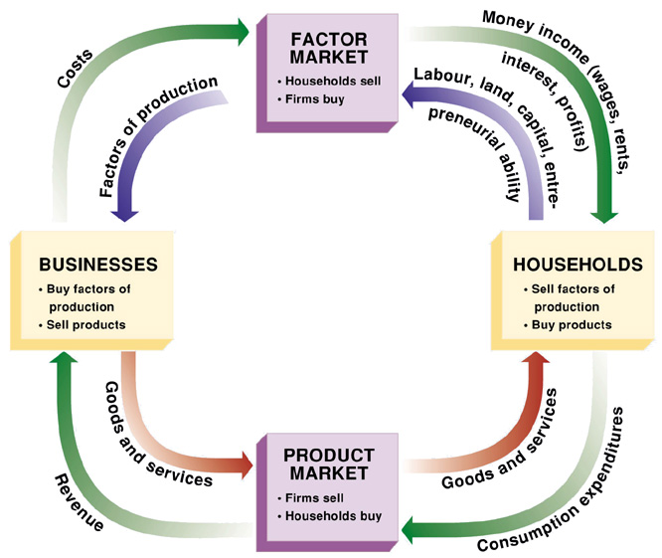

Slide 6
Markets
Factor Market is where the Factor of Production flow from households to businesses in exchange for wages, rent, payments.
Product Market is where the finished goods flow from businesses to households in exchange for payments.

Slide 7
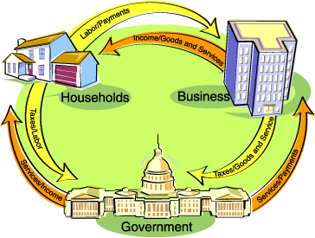
Write this one down!!!

Slide 8
Items to Note
Both are basic models.
These only work in mostly capitalistic economies.
Why doesn’t it work in mostly command economies?
The models are not perfect.
There are some missing items. What are they?

Slide 9
Why is there a need for money?
Something to compare.
No need to barter.
Easier to carry

Slide 10
What is the function of Money
Medium of Exchange- something accepted as payment
Standard of Value- gives a standard of value of things
Store of Value- it stores value because 1)it is nonperishable and 2)it keeps its value over time

Slide 11
Characteristics of Money
Durable-used multiple times
Portable-easily carried
Divisibility-can be divided
Stability in value-keeps value fairly well
Acceptability-people accept it

Slide 12
Review Time
Why aren’t the following considered money?
  Cows
  Rocks
  Services
  Wheat

Slide 13
Sources of Money’s Value
Commodity Money- something that has its own value-example gold, silver
Representative Money- something that can be exchange for something of value
Fiat Money- something of value because a government says so- example U.S. coins and paper money

Slide 14
Vocabulary
Corporation- business with ownership separate from management
Sole Proprietorship- business owned by one individual
Partnership- business owned by 2 or more individuals

Slide 15
Firms
Types of firms
  sole proprietorship
  partnership
  corporation

Slide 16
Sole proprietorship
Single owner
Advantages:
  autonomy
  single taxation
  Easy to start
Disadvantages
  difficult to acquire funds
  unlimited liability
  Less specialization
  Less longevity
Most common form of business organization (by number of firms)
Accounts for a small share of total output.

Slide 17
Partnership
Two or more individuals share ownership
Advantages:
  Pooled wealth and resources
  Single taxation
  Easier to raise money
Disadvantages:
  Loss in autonomy (relative to sole proprietorship)
  Unlimited liability
  Shared profits
  Possible conflict/instability

Slide 18
Corporation
A legal entity separate from its owners
Advantages
  limited liability
  Easier to raise money
  Specialized management
  Unlimited life
Disadvantages
  double taxation
  separation of ownership from control
  Difficult starting
  More bureaucratic
  More government control
Most output is produced by corporations

Slide 19
Corporate Ladder

Slide 20
Other Examples
LLC
Franchise
Coop
Non Profit

Slide 21
Vocabulary
Curve-representation of demand or supply schedule
Demand-amount of a good or service consumers are willing and able to pay at a series of prices
Supply-amount of a good or service producers create at a series of prices

Slide 22
What is Demand?
Will you buy a Mercedes for $20,000?
Will you buy a candy bar for $1?
Why is gold more valuable than glass?
Demand is the amount of a good or service that a consumer is willing and able to buy at various possible prices during a given time period.

Slide 23
Law of Demand
1)A principle that states there is an inverse relationship between the price of a good and the amount of it buyers are willing and able to purchase.
2)A principle that states an increase in a good’s price causes a decrease in quantity demanded.

Slide 24
Law of Demand Concepts
Substitution Effect-Tendency to substitute similar lower priced goods. Ex. The price of Tylenol increases will cause the demand for it to decrease while consumers use substitute generic items. Not all items have substitutes. Milk, gas, etc.
What are some other examples?

Slide 25
Law of Demand Concepts
Income effect-Based on the change in purchasing power (income people have to spend on goods); Ex. If good is on sale, purchasing power is increased, if good’s price rises purchasing power is decreased. This has a strong impact on demand

Slide 26
Law of Demand Concepts
Diminishing Marginal Utility- Natural decreases in the utility of a good or service as more units of it are consumed. Ex. You pay full price for the first and second hamburger, but the third one is not useful because of it diminished utility.

Slide 27
Demand Curve
The representation of the demand schedule on a graph.
The X axis represents number or quantity demanded and the Y axis represents the price or dollar amount.

Slide 28
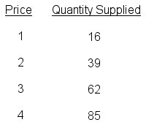
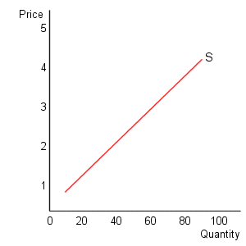
Supply
Supply: the relationship that exists between the price of a good and the quantity supplied in a given time period, ceteris paribus.

Slide 29
Law of supply:
A direct relationship exists between the price of a good and the quantity supplied in a given time period, ceteris paribus.

Slide 30
The law of supply is the result of the law of increasing cost. Since the marginal opportunity cost of supplying a good rises as more is produced, a higher price is required to induce the seller to sell more of the good or service.

Slide 31
Market supply
The market supply curve is the horizontal summation of all individual supply curves. The derivation of this is equivalent to that illustrated for demand curves.

Slide 32
Reminder
Demand=Consumers/Buyers want lowest price
Supply=Producers/Sellers want highest price

Slide 33
Vocabulary
Determinant- factor which shifts demand or supply curve

Slide 34
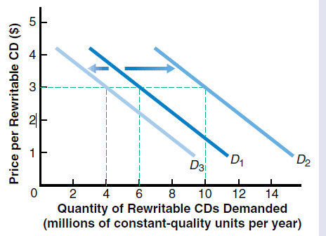
Shifts in Demand
Shifts in the demand curve are dictated by the determinants of demand.
Note-Movement along the curve is due to a price change, not a shift.

Slide 35
Difference between change in demand and quantity demanded
Change in demand is shift of entire curve
Change in quantity demanded is simple change in # on same curve

Slide 36
Important
An increase in demand is a shift to the right (not up)
A decrease in demand is a shift to the left (not down).

Slide 37
Determinants of Demand
The determinants are
  Consumer Tastes and Preferences
  Market Size 1)Business decision 2)Government decision 3)Technology
  Income
  Price of related goods
    Substitute and complimentary(something associated with)(Substitute-replaces Complimentary- go together)
  Consumer Expectations-View of the future

Slide 38
Effects of Determinants
Determinant | Change | Effect on Demand
Taste | Rise | Increase, shift to right
Market Size | Expands | Increase, shift to right
Income | Rise | Increase, shift to right
Substitute Goods | Price increase | Increase, shift to right
Complimentary Goods | Price increase | Decrease, shift to left
Expectations | Future $ Rise | Increase, shift to right
Examples

Slide 39
Effects of Determinants
Determinant | Change | Effect on Demand
Taste | Decline | Decrease, shift to left
Market Size | Shrinks | Decrease, shift to left
Income | Decline | Decrease, shift to left
Substitute Goods | Price decrease | Decrease, shift to left
Complimentary Goods | Price decrease | Increase, shift to right
Expectations | Fall | Decrease, shift to left
Examples

Slide 40
Vocabulary
Subsidy-a benefit given by the government to groups or individuals usually in form of cash or tax reduction

Slide 41
Determinants of supply
the prices of resources(inputs)
technology and productivity,
the expectations of producers,
the number of producers(competition),
the prices of related goods and services.
government tools(taxes, subsidies, and regulation)

Slide 42
Government
Government decisions may affect supply. It has 3 tools which affect the supply curve.
  Taxes
  Subsidies- Government payments to manipulate supply
  Regulation- Safety measures, etc
  Examples
  Video

Slide 43
Note
An increase in supply shifts the supply curve to the right(usually lowers price)
A decrease in supply shifts the supply curve left(usually raises price)

Slide 44
Affect of Determinants of Supply
Determinant | Change | Effect on Supply
Price of Resources | Increase | Decrease
Tech/Prod. | Increase | Increase
# of Producers | Increase | Increase
Price of related goods | Increase | Decrease
Expectation | Depends | Depends
Gov’t Taxes | Increase | Decrease
Gov’t Regulation | More strict | Decrease
Gov’t Subsidy | Increase | Increase

Slide 45
Affect of Determinants of Supply
Determinant | Change | Effect on Supply
Price of Resources | Decrease | Increase
Tech/Prod. | Decrease | Decrease
# of Producers | Decrease | Decrease
Price of related goods | Decrease | Increase
Expectation | Depends | Depends
Gov’t Taxes | Decrease | Increase
Gov’t Regulation | Less strict | Increase
Gov’t Subsidy | Decrease | Decrease

Slide 46
Vocabulary
Elasticity- measurement of how price change affects quantity

Slide 47
Elasticity of Demand
It is the degree to which changes in a good’s price affect the quantity demanded by consumers.
It measures the responsiveness of demand to a change in price.
Elasticity of demand measures the horizontal run by rise or fall.

Slide 48
Elastic Demand
Elastic Demand occurs when a small change in good’s price causes a major, opposite change in the quantity demanded. Ex. If you raise price there is a large reduction in quantity demanded.
Elastic goods are often 1)not necessities 2)available substitutes 3)cost is a large part of consumer’s income
On a graph, the demand curve is more horizontal.
What are some examples?

Slide 49
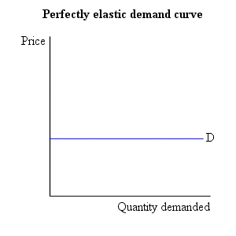
Elastic Demand

Slide 50
Inelastic Demand
Inelastic Demand occurs when a change in a good’s price has little impact on the quantity demanded.
Inelastic goods are often 1)necessities 2)few, if any substitutes 3)cost represents small part of consumer’s income
On a graph, the demand curve is more vertical.
What are some examples?

Slide 51
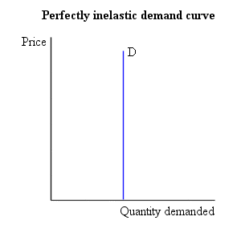
Inelastic Demand

Slide 52
Questions determining elasticity
Elastic Demand | Question | Inelastic Demand
No | Is it a necessity? | Yes
Yes | Are there substitutes? | No
Yes | Is it a large part of consumer income? | No
Opposite | How does Total Revenue relate to a change in price? | Same
More Horizontal | How does is look on a graph? | More Vertical

Slide 53
Who cares about elasticity?
If you run a business, you should because this helps you determine the maximum total revenue and profit.

Slide 54
What’s unusual about the 2008 tax information for the State of Georgia(in millions of dollars)?
Tax | Collection | % Change
Income | 919 | -13.3
Net Sales | 494 | -17.2
Corporate Sales | -4.4 | -117
Motor Fuels | 79 | -2.4
Tobacco | 21 | 15.7
Alcohol | 16.8 | 10.1

Slide 55
10:41 A.M. A U.S. senator is in his office talking with his staff. He is concerned about teenage smoking in America. He wonders whether he, as a U.S. senator, can do anything to reduce the amount of teenage smoking. One member of his staff says that the federal government should increase the tax on a pack of cigarettes. “That way,” he says, “a lot of these kids will stop smoking.” “How so?” asks the senator. “The tax will push up the overall price of cigarettes,” the staffer says, “and that will lead to teens buying fewer cigarettes.” Another staffer enters the conversation. “I am not so sure many teens will stop smoking,” she says. “If they are really hooked on cigarettes, I think they may keep on buying just as many cigarettes, even at the higher price.”
•Will higher taxes on cigarettes cut down on the number of packs of cigarettes teens purchase? Will higher taxes cut down on the amount of money teens spend on cigarettes?

Slide 56
Elasticity of Supply
It is the degree to which price changes affect the quantity supplied.

Slide 57
Inelastic Supply
It exists when a change in goods price has little impact on the quantity supplied. Products usually have one of the following criteria.
  Time
  Money
  Resources not readily available
  Examples are gold and diamonds.

Slide 58
Elastic Supply
It exists when a small change in price causes a major change in quantity supplied. Products usually have one of the following criteria.
  Goods made quickly
  Inexpensively
  Few and readily available resources
  Examples are clothing and cheese.

Slide 59
Vocabulary
Equilibrium Price-place where supply and demand curve meet
Market Clearing Price-same as equilibrium price
Allocate- to distribute
Incentive- a motivation

Slide 60
Price
Price is generally determined by the intersection of supply and demand. Due the constant shifting of supply and demand, price constantly changes. Price is also called market equilibrium or market clearing price.
In a market economy, prices often determine how resources are allocated.

Slide 61
Benefits of the Price System
Information
Incentives
Choice
Efficiency
Flexibility

Slide 62
Impact of Single Shifts in Supply or Demand
Curve | Direction of Shift | Affect on Price | Affect on Quantity
Demand | Left | Decrease | Decrease
Demand | Right | Increase | Increase
Supply | Right | Decrease | Increase
Supply | Left | Increase | Decrease

Slide 63
Vocabulary
Shortage- situation where quantity demanded exceeds supply
Surplus- situation where quantity supplied exceeds demand
Price Control-situation in which government sets a price for good not at equilibrium
Price Floor- government set price above equilibrium causing a surplus
Price Ceiling government set price below equilibrium causing a shortage

Slide 64
Setting Prices
The government sometimes sets prices to protect consumers and producers from price swings
Price controls set prices through price ceilings and price floors

Slide 65
Price Ceiling
A government regulation that sets a maximum price below equilibrium for a good that producers cannot change.
Some examples include rent control.
Consequences- Tend to create shortages, “helps” consumer.

Slide 66
Price Ceiling
Price
S
P_{e}
PC
PC
D
Excess Demand
Quantity
Q_{S}
Q_{e}
Q_{D}

Slide 67
Price Floors
Government regulation that sets a minimum level above equilibrium for prices
Price floors are more common than price ceilings
Examples of price floors are set prices for agricultural products. The government will set a base price for a product that will guarantee farmers an income

Slide 68
Price Floors con’t
Another example of price floors are the government setting a minimum wage, the lowest amount a worker can legally be paid by an employer
Consequences- Tends to create surplus, “helps” producers
Nashville Limos

Slide 69
Price Floor
Price
S
Excess Supply
PF
PF
P_{e}
D
Quantity
Q_{D}
Q_{e}
Q_{s}

Slide 70
Vocabulary
Monopoly-situation in which one firm controls the market
Market- interaction of supply and demand
Pure Competition- situation in which there are many firms in the market
Profit- Total Revenues minus Total Losses ; works as an incentive to enter market

Slide 71
Market Structure
Market structure refers the number of producers in the market. It affects the supply curve.

Slide 72
Market Structure | # of Firms | Influence over Price
Pure Competition | Many | None
Monopolistic Competition | Many | Limited
Oligopoly | Few | Some
Monopoly | One | Extensive

Slide 73
Market Structure | Product Differentiation (Non-Price) | Advertising
Pure Competition | None | None
Monopolistic Competition | Fair Amount | Fair Amount
Oligopoly | Fair Amount | Some
Monopoly | None | None

Slide 74
Market Structure | Entry into Market | Examples
Pure Competition | Easy | Farming
Monopolistic Competition | Easy | Gas Stations
Oligopoly | Difficult | Car makers
Monopoly | Almost Impossible | U.S. Post office

Slide 75
Types of Monopolies
Natural Monopoly-market situation where the costs of production are minimized by having a single firm produce the product
Geographic Monopoly- based on absence of other sellers in a certain geographic area(only gas station in town)
Technological Monopoly-monopoly based on ownership or control of a manufacturing method, process, or advancement(copyrights and patents)
Governmental Monopoly-monopoly government owns and operates(trash collection in NYC)

