Slide 1
Biology
2.1 Day 2

Slide 2
What is a trait?

Slide 3
What is a variant?

Slide 4
Which of the characteristics of dogs that you compiled are traits?
Are there variants of these traits?

Slide 5
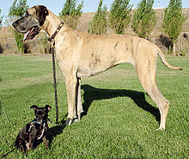
Name a trait of these dogs. Name variants of that trait.

Slide 6
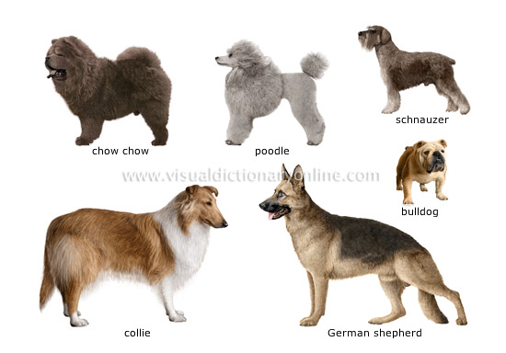
Chose two breeds. Create a venn diagram to compare and contrast variants of traits.

Slide 7
Use COMPARE AND CONTRAST language from the flip book to write about the variants of traits. Be sure to use the terms TRAIT and VARIANT in your paper.

Slide 8
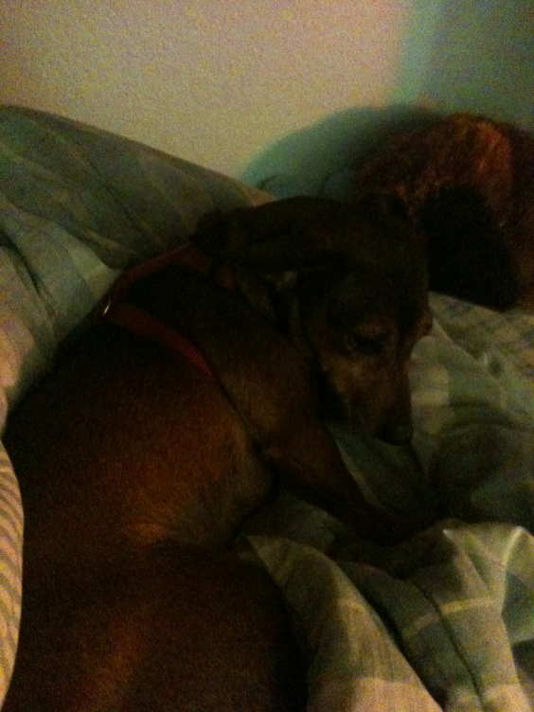
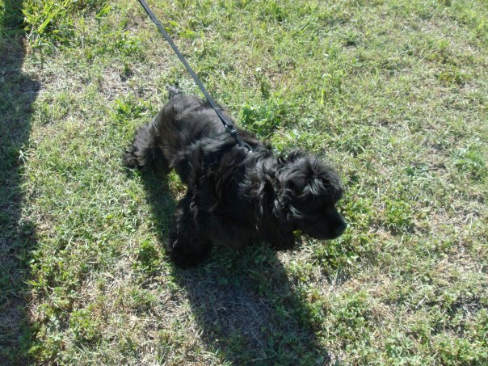
Proficient Example
At my house we have two dogs. DumDum is a Cocker Spaniel, while Holly is a Dachshund. Since they are both dogs, they have many traits in common. A distinction between them is that Holly has short, straight fur, as opposed to Dumdum’s coarse curly fur. Fur texture is the TRAIT and straight is one VARIANT and coarse curly is another VARIANT. Another difference is that while Holly has brown fur, Dumdum’s fur is black. Another TRIAT is leg length. Although they are both small dogs, Holly’s legs are very short, in contrast to Dumdum’s legs which are longer. There are many VARIANTS of leg length for dogs. One last distinction between these two dogs concerns the trait of energy level. Although both dog breeds enjoy hunting small prey, Dachshunds are more docile and lazy than Cocker Spaniels which are energetic and exuberant.

