Slide 1
MI
1.1.1

Slide 2
What is a MEDICAL INTERVENTION?

Slide 3

Look around
Someone in the class is probably wearing glasses or contact lenses.

Slide 4
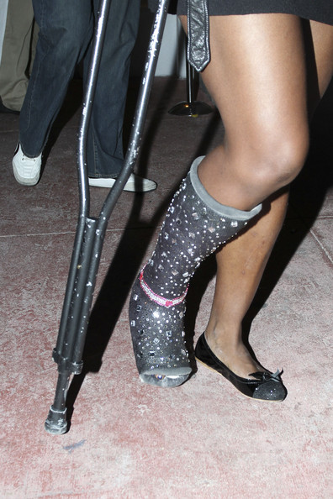
Most likely someone in your school is sporting a cast or using crutches.

Slide 5

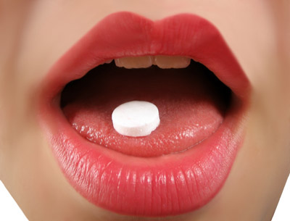
Maybe you took an aspirin this morning for a raging headache or chugged a sports drink after your morning workout.

Slide 6

In some way, each of these devices, medications or treatments, helped people improve their quality of life.

Slide 7
Medical interventions are any measure whose purpose is to improve health or alter the course of a disease.
Unless faced with a serious illness or injury, we often forgot about the variety of medical interventions that function to keep us well.

Slide 8

Medicine is changing at a rapid pace.
Many diseases that were lethal hundreds of years ago can now be controlled or even cured.

Slide 9
New devices, medications, procedures, and tests help to extend and improve our quality of life. In both Principles of the Biomedical Sciences and Human Body Systems, you examined interventions related to specific illnesses or diseases.

Slide 10

In this course,
you will explore medical interventions of the past, present, and even the future.

Slide 11
In this activity
  You will brainstorm the vast array of medical interventions, big and small, new and old, which function to maintain health and homeostasis in our bodies.

Slide 12
  You will then work with your team to organize your ideas and group these interventions into categories.

Slide 13
  This year, you will become acquainted with the members of the Smith family.
  Their stories will introduce you to modern medical interventions as well as help you visualize the future of medicine.
  As you follow their family, through good times and bad, be on the lookout for medical interventions.

Slide 14

Activity
Post it notes

Slide 15
Brainstorm the term “Medical Interventions. ”
Identify devices, treatments, medications, or other support items which qualify as a medical intervention. The intervention could be as complicated as a surgery or as simple as a Band-Aid. The intervention can occur before, during or after diagnosis of a disease.
Write each idea, phrase or topic you come up with on a separate Post-it® note.

Slide 16
Place the sticky notes around the room.
You may make new ones if more ideas come to you.

Slide 17
You will be assigned a group.
Come up with a title for the interventions you are assigned.
Write the title on the sentence strip.

Slide 18
Share, agree, take notes

Slide 19
Success Check
Describe at least two medical interventions you have encountered in the past week. How did these medical interventions relate to your overall wellness and body homeostasis?

