Slide 1
MI
1.1.3

Slide 2
Hypothesized?
What illness did you think that Sue and her friends were infected with?

Slide 3
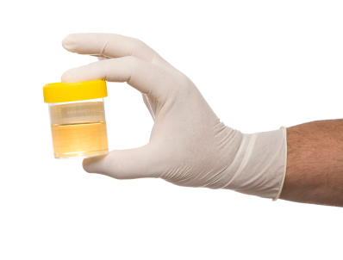
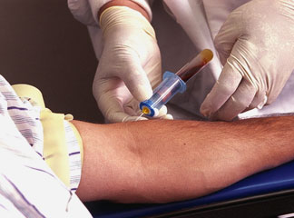
Samples
Samples of Sue’s blood, urine, and lymph are collected at the first infirmary visit and are sent off for diagnostic laboratory tests.

Slide 4
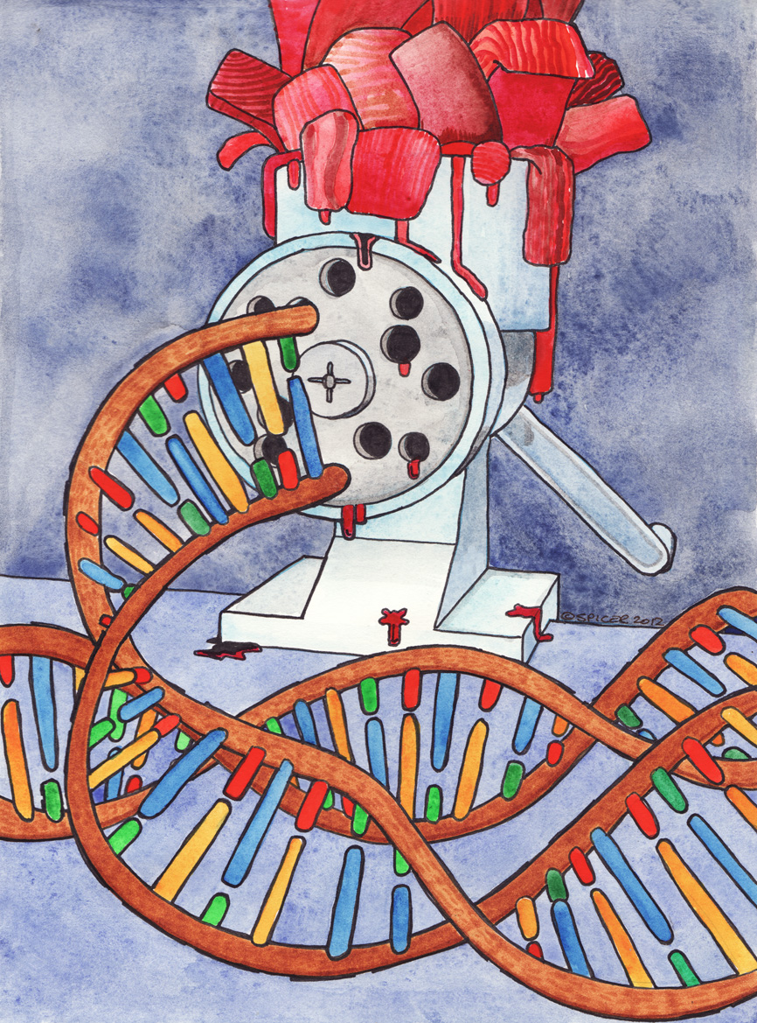
DNA sequence
As part of a pilot study, the college infirmary is working with the molecular biology department at the college to identify pathogens by their DNA sequences.

Slide 5
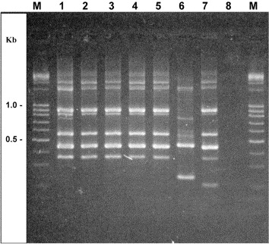
The lab isolates primers, small segments of DNA, which attach to key genes in bacteria and viruses and allow amplification and sequencing of the DNA. Sue’s samples have been sent out for molecular testing.
Little did the scientists know what they would find.

Slide 6
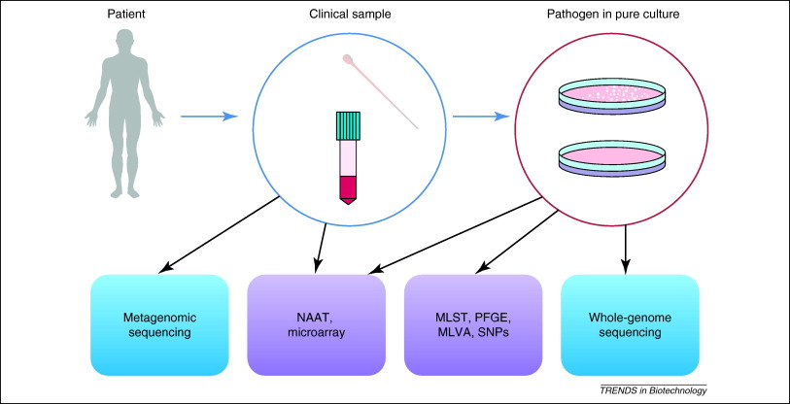
Computer advances now let researchers search through extensive sequence databases to find gene variations that could lead to disease, to track strains of various viruses or bacteria, and to design 3-D models of important human proteins.

Slide 7
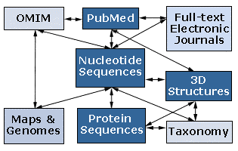
Bioinformatics is the field of science that combines biology, computers and information technology to store and analyze genetic data.

Slide 8
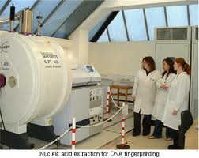
In this course, you will observe many of the medical interventions that are made possible by the teaming of computers and biology.

Slide 9
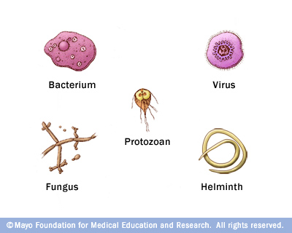
Bioinformatics can be used to help identify infectious agents, such as viruses and bacteria, involved in disease outbreaks.

Slide 10
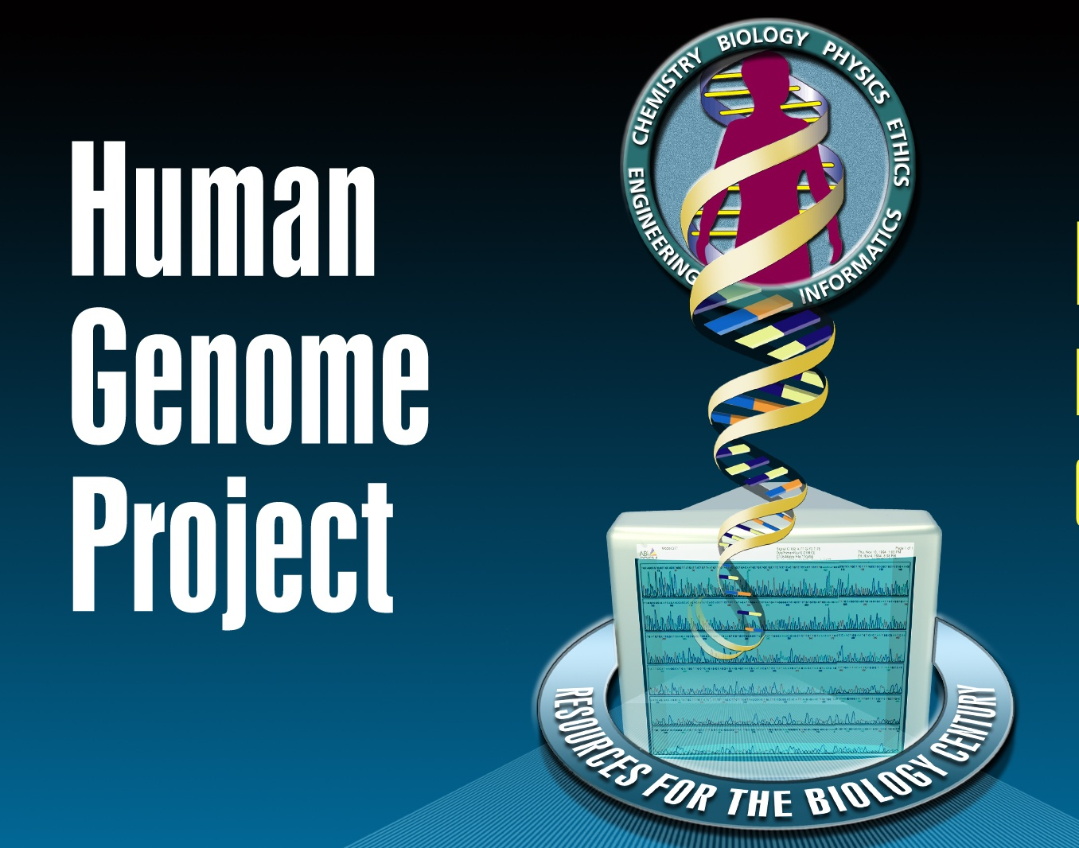
In 1990, scientists working on the Human Genome Project embarked on a mission to map the human genome, the complete genetic layout of a human being.

Slide 11
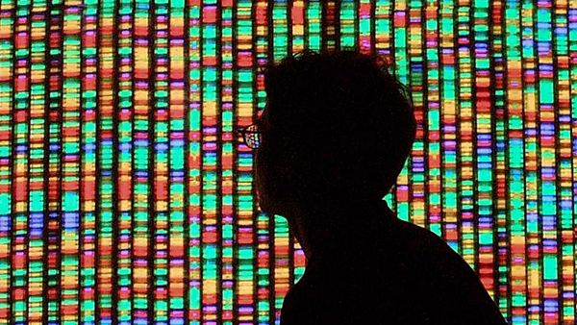
Through this project, completed in 2003, scientists have determined the complete nucleotide sequence of the DNA of each human chromosome.

Slide 12
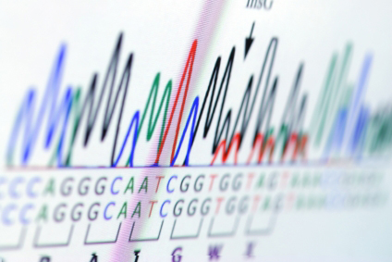
In addition to mapping human DNA, the Human Genome Project has helped map the genomes of other species, including mice, the fruit fly, and various bacteria..

Slide 13
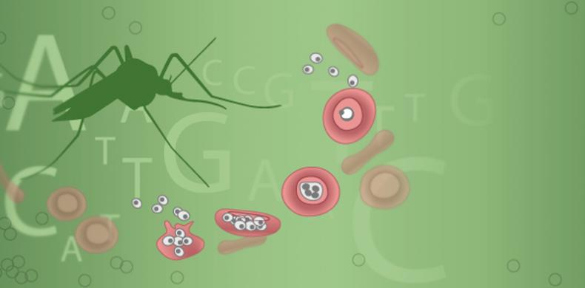
Knowing the nucleotide sequence of other living organisms, especially viruses and bacteria, allows scientists to identify and to research potential pathogens

Slide 14
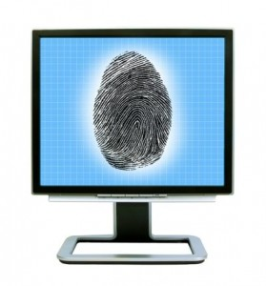
Modern techniques also allow scientists to sequence the DNA of living organisms and to store this information in large computer databases.

Slide 15
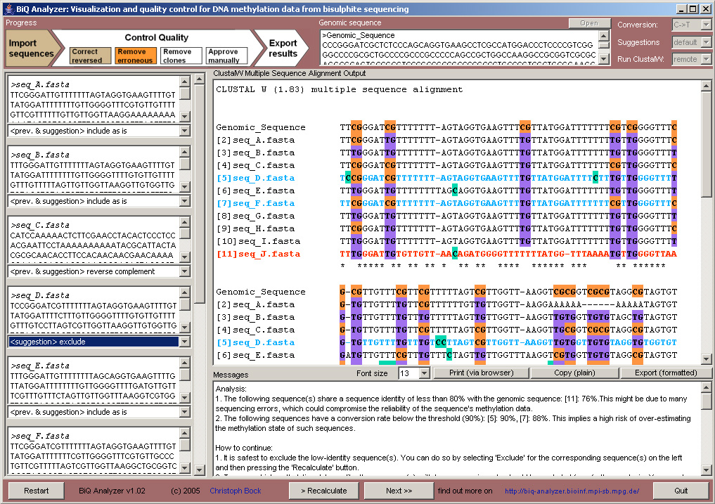
DNA sequencing used to be an extremely tedious task

Slide 16
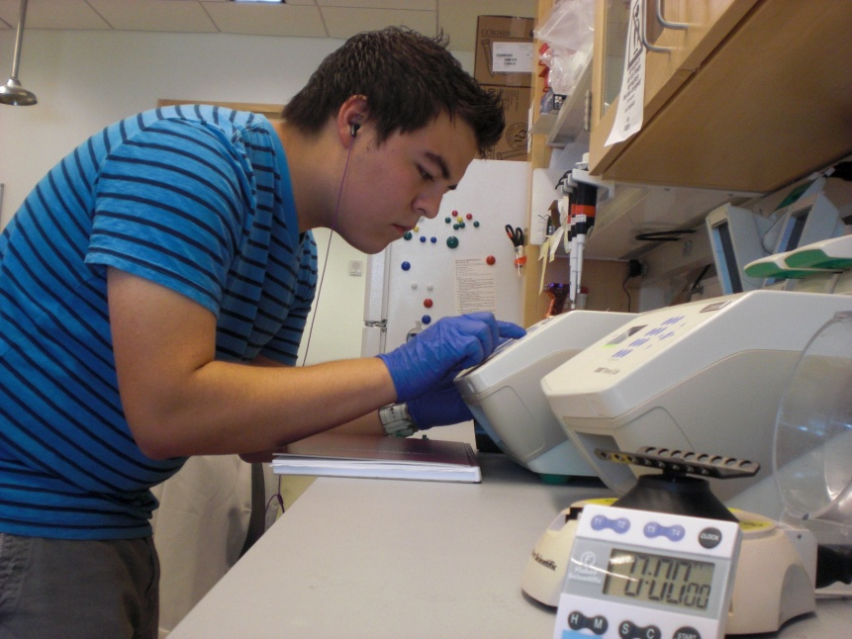
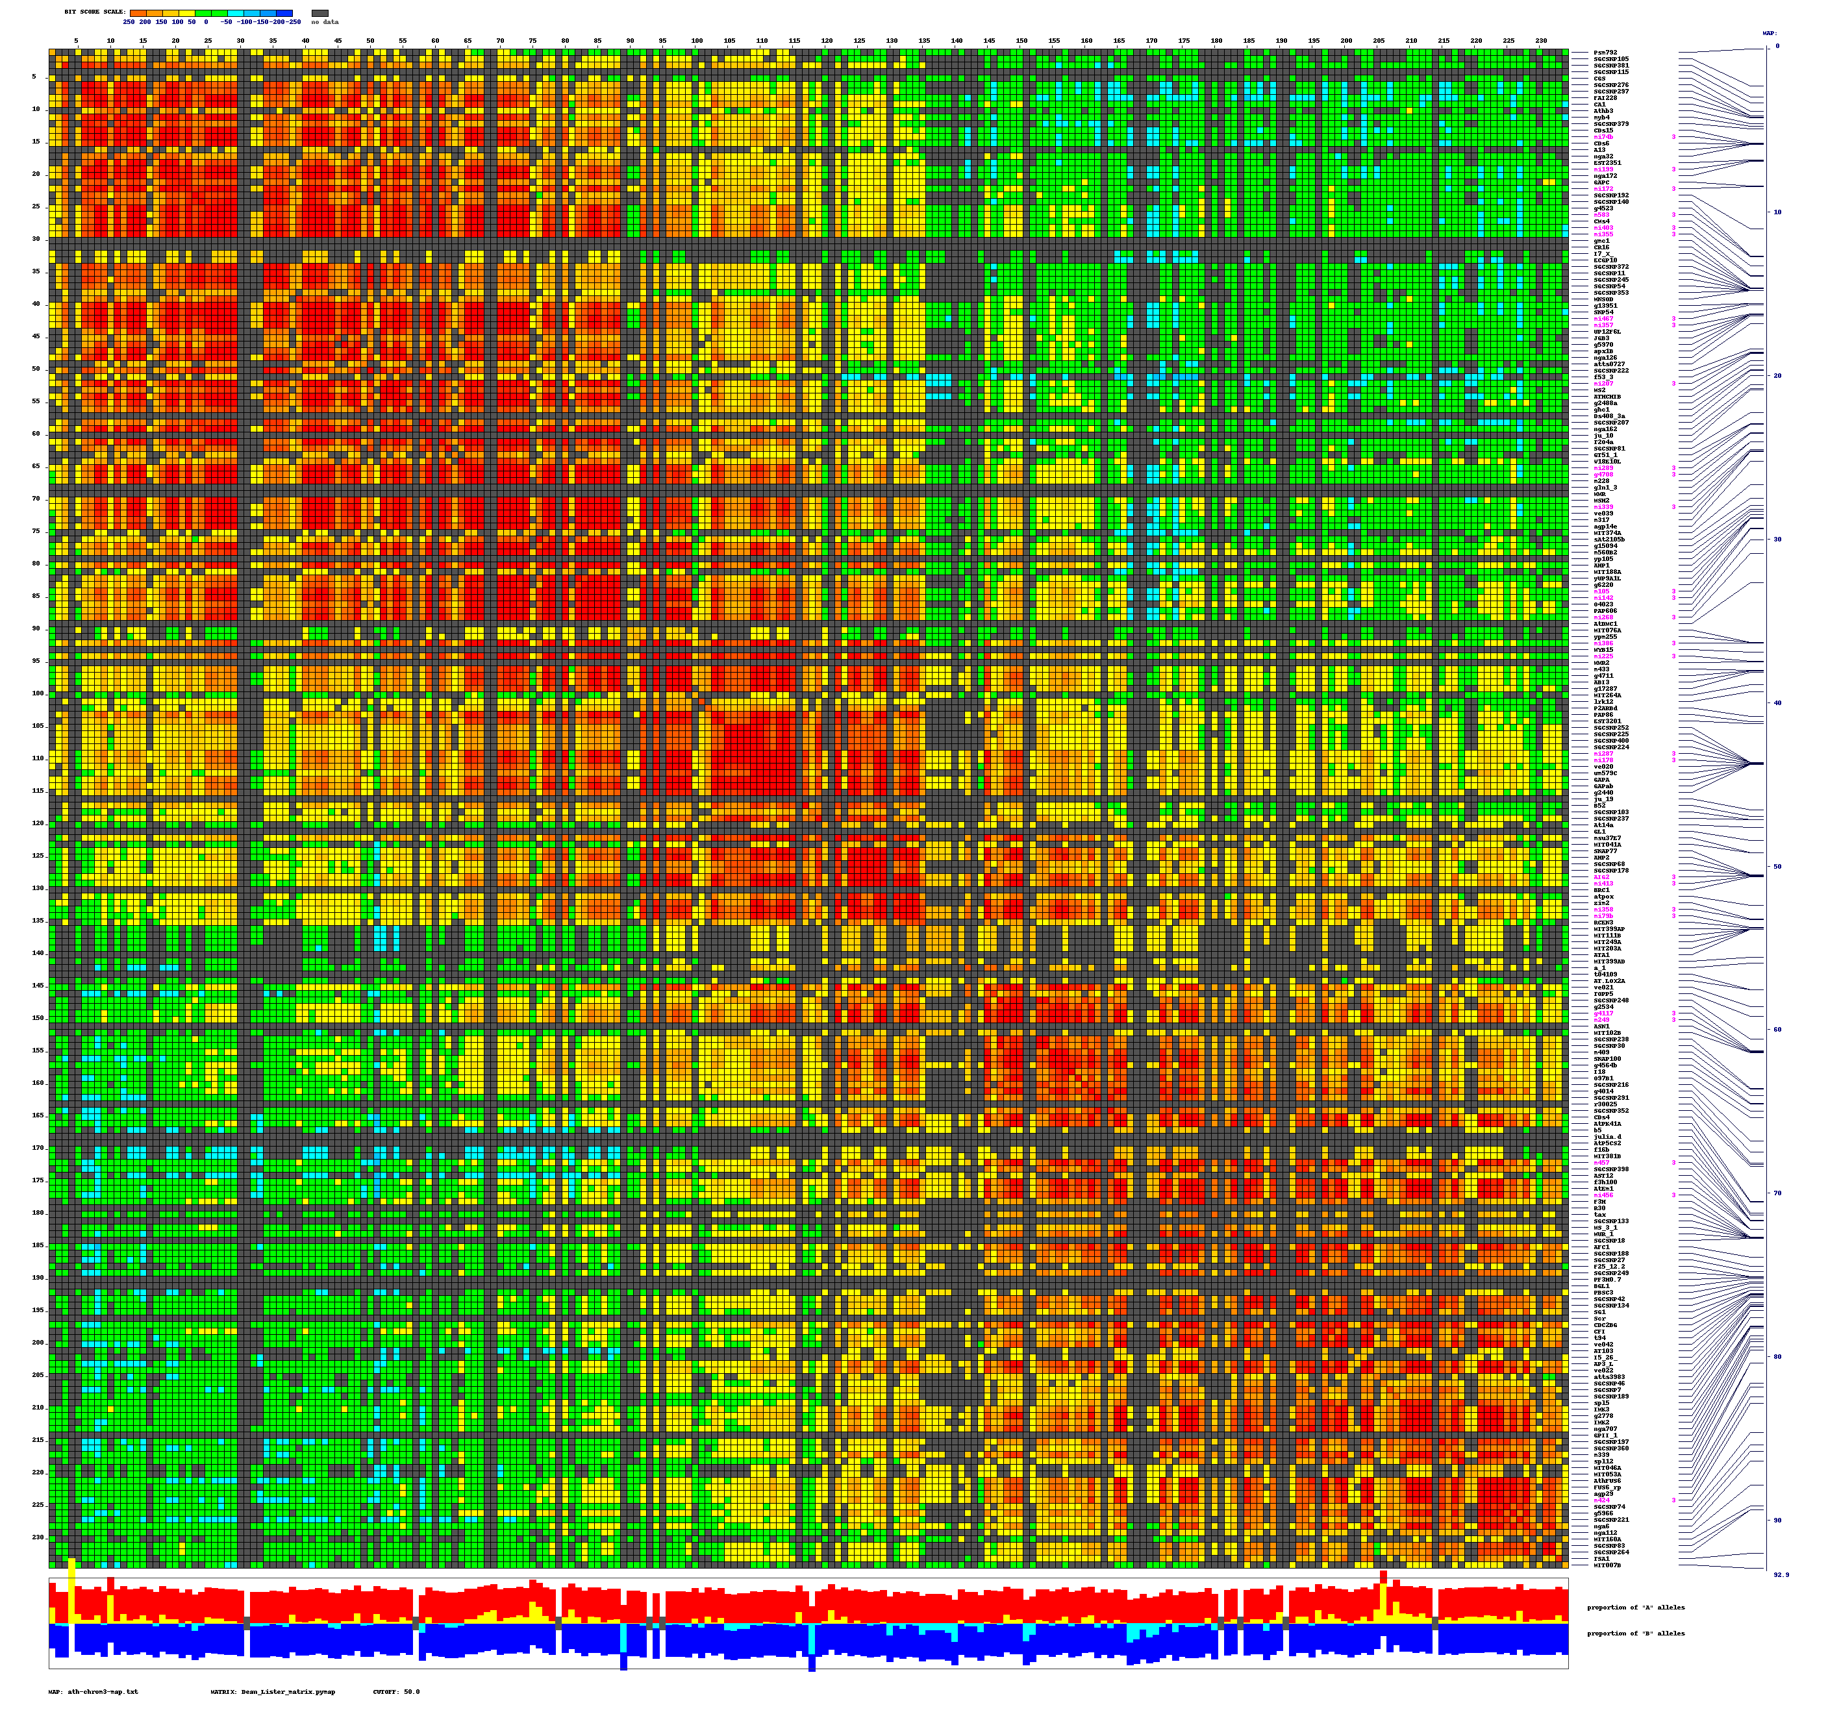
Computer technology, however, has automated the process.
The sequence of A’s, C’s, G’s and T’s in a genome, all of the genetic information possessed by an organism, can now be visualized as fluorescent displays on a computer screen.

Slide 17

This data is compiled and submitted to national molecular databases.
This genetic information can be viewed and explored by scientists and by the general public.

Slide 18
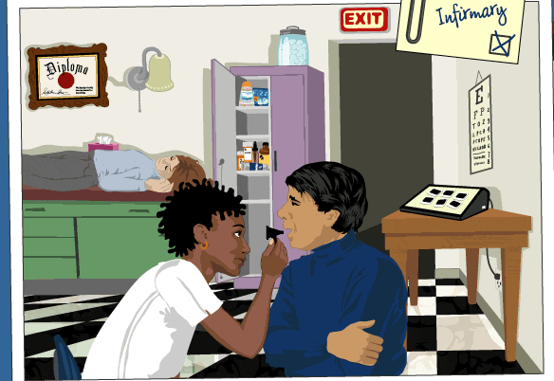
Back to our outbreak….
Additional students are showing up at the infirmary.

Slide 19
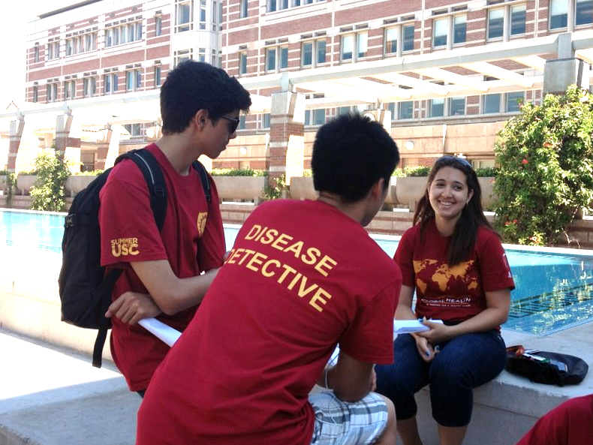
Time is running out and it is up to you to determine what is causing the outbreak on campus.

Slide 20
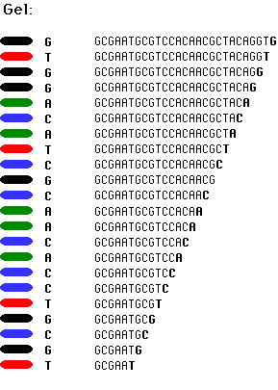
Luckily, the laboratory on campus has finally returned DNA sequence data for patient Sue Smith.

Slide 21
Explore the process of DNA sequencing, learn the techniques necessary to analyze DNA sequence data to identify agents of disease, and use your additional research and lab data to help diagnose Sue.

Slide 22
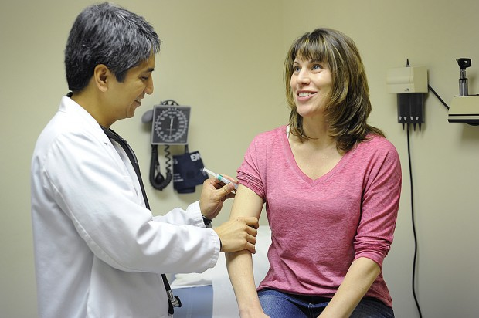
The sooner you know what is making Sue ill, the sooner you can treat her, and take steps to stop the spread of disease on campus.

Slide 23
1.1.2 begin with number 4
4. Learn about using DNA sequences to identify pathogens by exploring the Howard Hughes Medical Institution Biointeractive virtual lab at http://www.hhmi.org/biointeractive/vlabs/index.html.
5. Click on the icon for the Bacterial Identification Lab.
6. Read the Introduction presented on the right side of the screen.
7. Copy the basic steps for isolating and analyzing pathogen DNA sequences into your laboratory journal.
8. Answer Conclusion question 1.
9. Click on the picture on the left side of the screen to enter the virtual lab.
10. Follow the directions on the screen to complete the virtual experiment.
11. Pay attention to the factual information presented on the right side of the screen. Use this information to complete the following tasks in your laboratory journal:
· Describe the limitations of traditional methods of identifying bacteria.
· Summarize the goal of each of the six parts of the lab.
o Sample Prep
o PCR Amplification
o PCR Purification
o Sequencing Prep
o DNA Sequencing
o Sequence Analysis
· Explain how fluorescent markers help determine a nucleotide sequence.

