Slide 1
Medical Interventions
1.2.1

Slide 2
Essentials
EQ: How can bacterial infections like meningitis be treated?
LO: Understand the structure and function of bacterial cells and the mode of action of antibiotics.
SC:
  DAY 1: Draw and label a bacterial cell. Explain the function of the structures within the cell.
  DAY 2: Distinguish between gram positive and gram negative bacteria. Discuss four classes of antibiotics, their mode of action and what kind of bacteria they would be successful against.

Slide 3
Sue Smith
Is only 18, and she has been diagnosed with a potentially fatal infectious bacterial meningitis.
How should we treat it?
  Will any antibiotics work?
  How do we know what antibiotics to use?

Slide 4
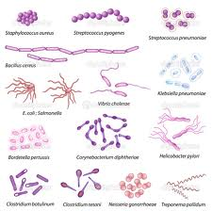
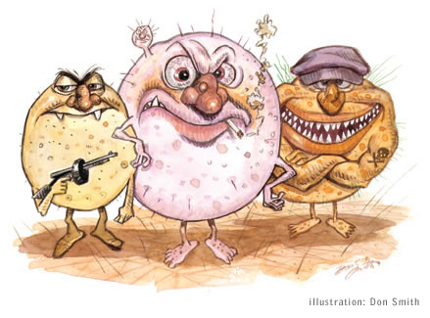
UNDERSTANDING BACTERIA
Bacterial cells are relatively simple.
Research and draw a bacterial cell.
Label the following:
  NUCLEOID, PLASMIDS, RIBOSOMES, CELL WALL, PLASMA MEMBRANE, CAPSULE, FLAGELLA, PILI, and ENDOTOXINS
Create a text box for each of
structure and write the
function of it in the
box.
When there are five minutes left,
I will draw sticks to see if you learned them all.

Slide 5
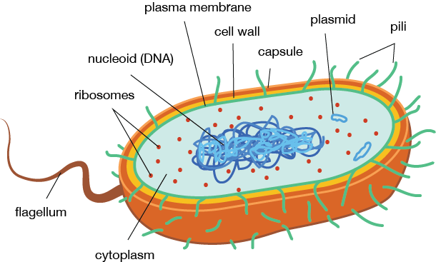
What is it?
Structure involved in protein synthesis.
Facilitates joining of amino acids.
Ribosomes

Slide 6
What is it?
Rigid Barrier
Surrounds the cell.
Rigidity provided by peptidoglycan
Cell Wall

Slide 7
What is it?
Protein appendages that are anchored in the membrane and protrude out from the surface.
Spins like a propeller
Moves the bacteria forward
Flagella

Slide 8
What is it?
Gel-like region within the cytoplasm
Contains SINGLE, CIRCULAR, DOUBLE-STRANDED DNA molecule, supercoiled, packed, twisted.
DNA contains the genetic material for normal cell function
NUCLEOID

Slide 9
What is it?
Semipermeable
Surround the cytoplasm
Phospholipid bilayer embedded with proteins
Acts as a barrier between the cytoplasm and the environment
PLASM
MEMBRANE

Slide 10
What is it?
Circular DOUBLE stranded DNA molecules
Can have many in a bacterial cell
Normal function of the cell not dependent on the genetic information in this DNA, but it often codes for advantageous proteins
Can be transferred from one bacterial cell to another
PLASMIIDS

Slide 11
What is it?
A gelatinous layer, called glycocalyx, enveloping the cell.
Enables cell to adhere to specific surfaces
Sometimes protects bacterial cell from human immune system
CAPSULE

Slide 12
What is it?
Lipoploysaccharide molecules that make up the out leaflet of the outer membrane of Gram negative bacteria
Endotoxins

Slide 13
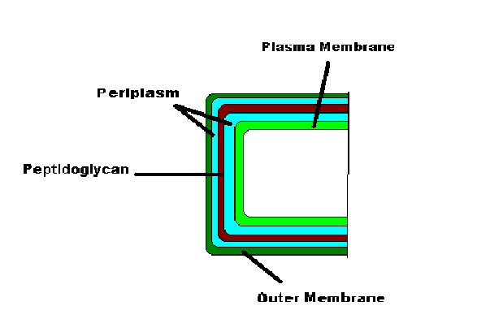
Gram negative or Gram positive?

Slide 14
Gram Negative Bacteria
The cell wall contains multiple layers, including a thin layer of peptidoglycan.
The outside layer is called the outer membrane, which is made of a lipid bilayer whose outside is composed of lipopolysaccharides called endotoxins.
The outer membrane serves as a barrier to the passage of most molecules and contains specialized proteins, called porins, which allow certain molecules to pass through the membrane.
The region between the plasma membrane and the outer membrane is called the periplasm and is filled with a gel-like fluid and proteins involved in a variety of cellular activities.
The Gram-stained cell is reddish-pink

Slide 15
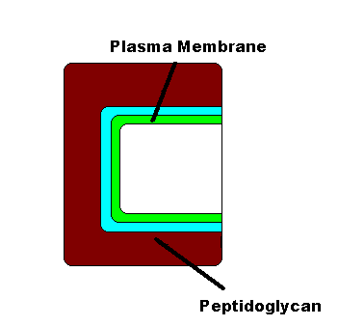
Gram negative or gram positive

Slide 16
Gram Positive Bacteria
The cell wall contains a thick layer of peptidoglycan and teichoic acids. There is approximately twenty times more peptidoglycan than the Gram negative bacteria.
There is no outer membrane present.
There are no porins present.
The Gram-stained cell is purple.

Slide 17
Mechanisms of Action of Antibiotics
A number of bacterial processes, including the synthesis of bacterial cell walls, proteins, metabolic pathways, and the integrity of the cytoplasmic membrane, are the targets of most antibacterial drugs.

Slide 18
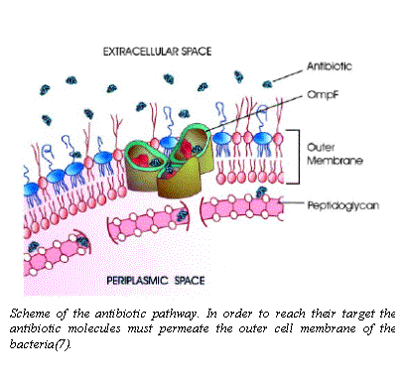
β-Lactam Antibiotics
Irreversibly inhibit enzymes involved in the final steps of cell wall synthesis.
The enzymes inhibited by these drugs mediate the formation of the peptide bridges between adjacent strands of peptidoglycan.
These drugs vary in their spectrum of activity; some are more active against Gram positive bacteria; whereas, others are more active against Gram negative bacteria.

Slide 19
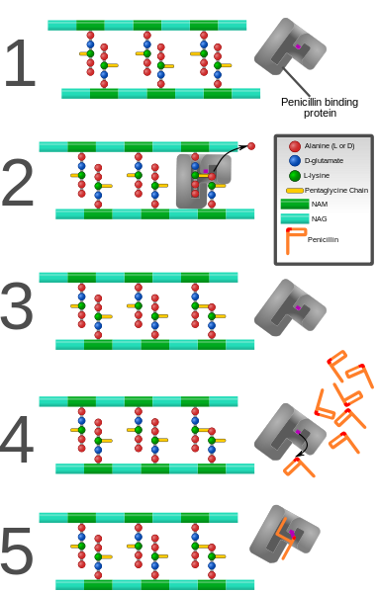
Penicillin and most other β-lactam antibiotics act by inhibiting penicillin-binding proteins, which normally catalyze cross-linking of bacterial cell walls.

Slide 20
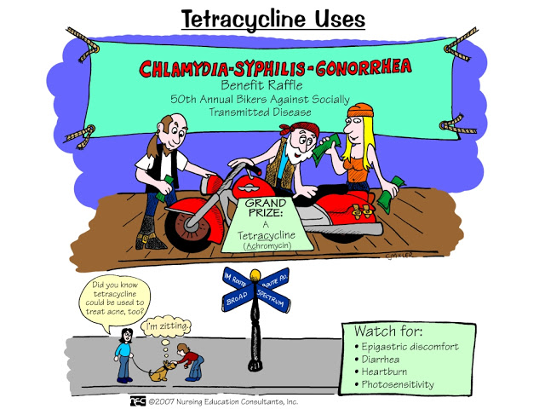
Tetracyclines
Reversibly bind to the 30S ribosomal subunit, blocking the attachment of tRNA to the ribosome and preventing the continuation of protein synthesis.
They are effective against certain Gram positive and Gram negative bacteria.

Slide 21
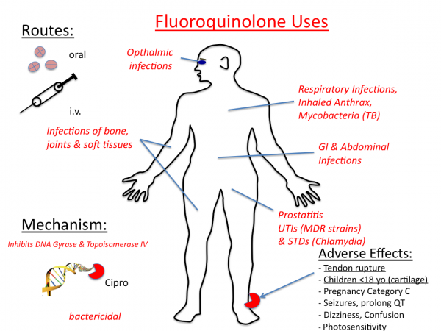
Fluoroquinolones
Inhibit one or more of a group of enzymes called topoisomerases, which maintain the supercoiling of the chromosomal DNA within the bacterial cells.
The inhibition of these enzymes prevents essential cell processes.
The fluoroquinolones are active against a wide variety of bacteria, including both Gram positive and Gram negative bacteria.

Slide 22
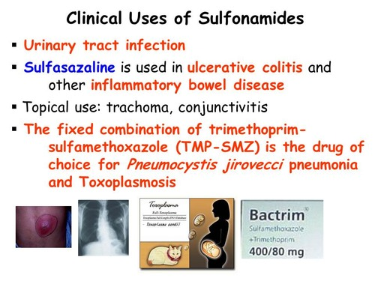
Sulfonamides
Inhibit the growth of many Gram positive and Gram negative bacteria.
They are structurally similar to paraminobenzoic acid (PABA), a substrate in the pathway for folic acid biosynthesis.
Because of this similarity, the enzyme that normally binds with PABA preferentially binds with the sulfonamide drugs, resulting in its competitive inhibition.
Human cells are not affected by these drugs because they lack this enzyme.

Slide 23
