Slide 1
Diagnostic Imaging
This is a copyrighted Presentation. It is on the page only for the days that my students will use it, then it will be removed.

Slide 2
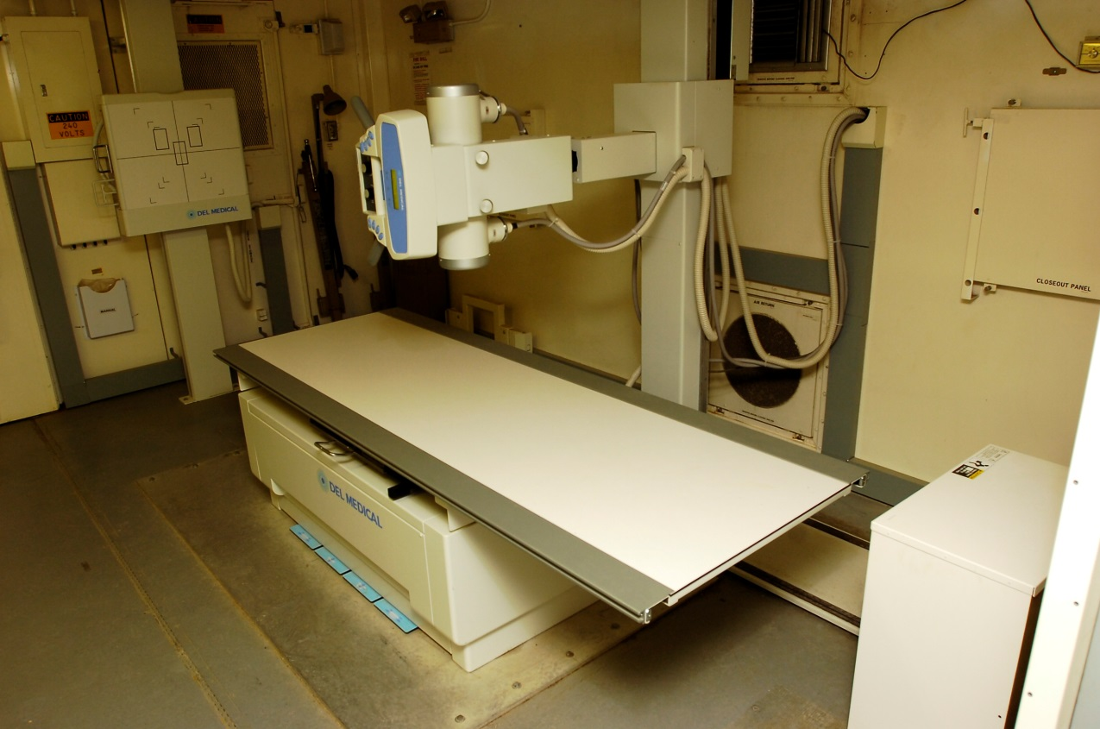
X-Ray
Noninvasive medical test used to produce images of the inside of the body to help diagnose medical conditions.
X-rays are a form of electromagnetic radiation that is sent through the body.
gray.

Slide 3
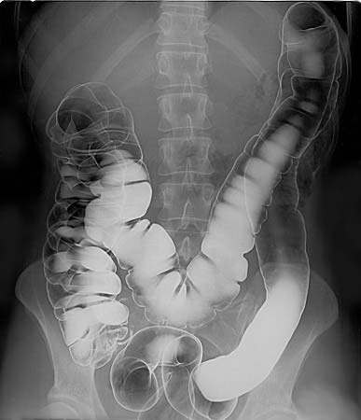
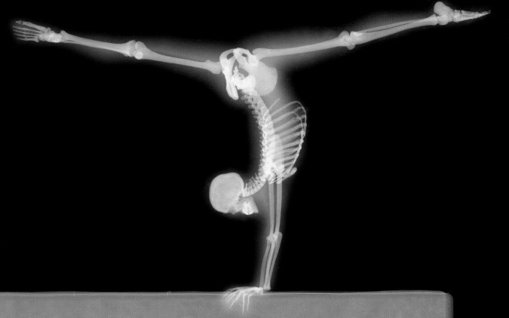
X-Ray
Structures that are dense, such as bone, will block most of the X-ray particles and appear white.
Metal and contrast media, a special dye used to highlight areas of the body, will appear white.
Structures containing air will appear black and muscle, fat, and fluid will appear

Slide 4
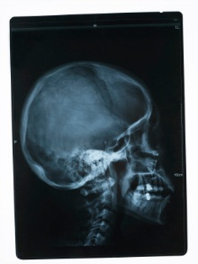
X-Ray
Produces two-dimensional images.
Examines bones, teeth, lungs, breasts, heart, blood vessels, and the digestive tract.
Uses ionizing radiation which can increase risk of developing cancer.
©iStockphoto.com

Slide 5
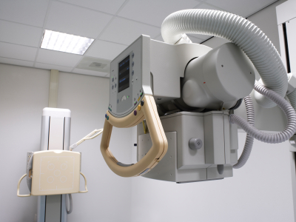
X-Ray – The Procedure
X-ray is performed by a machine that sends individual X-ray particles, called photons, through the body.
  The photons pass through the body and the resulting images are recorded on a computer or special film.
©iStockphoto.com

Slide 6
Advantages and Disadvantages
Advantages
  Quick, painless, noninvasive test
  Relatively inexpensive
Disadvantages
  Small amount of radiation exposure
  Contrast materials sometimes used might produce an allergic reaction

Slide 7
CT Scan – Computerized Tomography
Also called Computerized Axial Tomography (CAT Scan).
Noninvasive medical test used to produce images of the inside of the body to help diagnose and treat medical conditions.
A series of X-ray views taken from many different angles are combined to produce cross-sectional images of the bones and soft tissues inside your body.

Slide 8
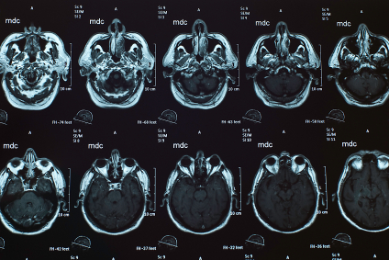
CT Scan
Produces cross-sectional images of the body.
Examines the chest, abdomen, pelvis, spine, and other skeletal structures.
Uses ionizing radiation which can increase your risk of developing cancer.
©iStockphoto.com

Slide 9
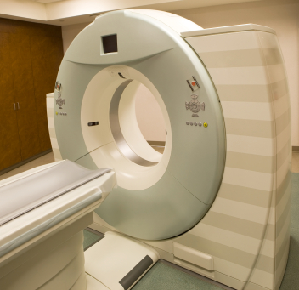
CT Scan – The Procedure
CT scan is performed inside a large tube that looks like a large doughnut standing on its side, and the person lies on the table in the center.
  The X-ray tube rotates around the body.
  The table slowly moves through the inside of the machine.
  Each rotation yields several images of thin slices of the body.
©iStockphoto.com

Slide 10
Advantages and Disadvantages
Advantages
  Painless, noninvasive, and accurate test that is fast and simple
  Able to image bone, soft tissue, and blood vessels all at the same time
  Can be performed if patient has an implanted medical device of any kind
Disadvantages
  Small amount of ionizing radiation exposure
  Contrast materials sometimes used might produce an allergic reaction

Slide 11
MRI – Magnetic Resonance Imaging
Noninvasive medical test used to produce images of the inside of the body to help diagnose and treat medical conditions.
Unlike X-rays and CT scans, which use radiation, MRI uses powerful magnets and radio waves.
Detailed images produced of soft tissue, versus X-rays and CT scans, which produce images of hard tissues such as bones and teeth.

Slide 12
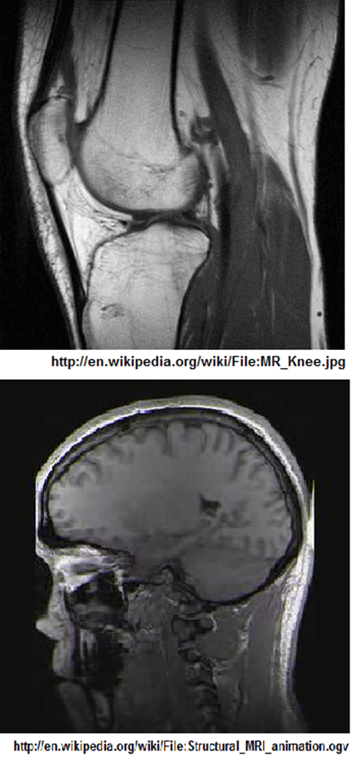
MRI
Produces cross-sectional images of the body.
Used to examine the brain, spine, joint, abdomen, blood vessels, and pelvis.
Is very safe as the magnetic field itself does not hurt people (unless they have certain types of metal implanted in their body).

Slide 13
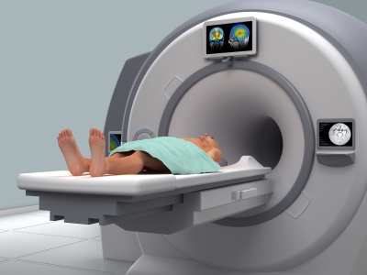
MRI – The Procedure
MRI scan is performed inside a large magnet, and the person lies on the table in the center.
  The machine scans the body by turning small magnets on and off.
  Radio waves are sent into the body.
  The machine then receives returning radio waves and uses a computer to create pictures of the part of the body being scanned.
©iStockphoto.com

Slide 14
Advantages and Disadvantages
Advantages
  Noninvasive test that poses almost no risk when safety guidelines are followed
  Does not involve exposure to ionizing radiation
  Images of the soft tissue structures of the body are more likely to identify and accurately characterize diseases than other imaging methods
  Contrast materials sometimes used less likely to produce an allergic reaction than those used in x-rays and CT scans
Disadvantages
  Implanted medical devices that contain metal may malfunction or cause problems during an MRI exam
  Very slight risk of an allergic reaction if contrast material is injected
  Confined space may induce panic or feelings of claustrophobia in some patients

Slide 15
Bone Scan
Noninvasive medical test used to produce images of the bones that help diagnose and track several types of bone disease.
Bone scan is a nuclear imaging test.

Slide 16
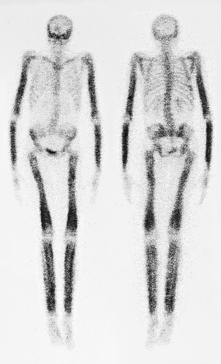
Bone Scan
Produces two-dimensional images of the body.
Used to examine the skeleton to detect abnormalities.
Uses tiny amounts of radioactive materials called tracers (radionuclides).
©iStockphoto.com

Slide 17
Bone Scan – The Procedure
An injection of tracers is administered to the patient and allowed to circulate and be absorbed by the bones.
Once absorbed, the patient lies on a table while a machine passes a gamma camera over the body to record the pattern of tracer absorption by the bones.
Radiologists look for abnormal bone metabolism on the scan, areas that show up as darker or lighter where tracers have or have not accumulated.

Slide 18
Advantages and Disadvantages
Advantages
  Noninvasive
  Extremely sensitive to abnormalities and variations in bone metabolism
  Can scan the entire skeleton
Disadvantages
  Cannot determine cause of bone metabolism abnormalities
  Tracers used produce a small amount of radiation exposure

