Slide 1
Procedural Sedation
Christopher Aiudi, MD, PharmD
Department of Anesthesia
Lowell General Hospital

Slide 2
Objectives
Discuss the practice of moderate and deep sedation
Preoperative assessment essentials
Monitoring practices during sedation
Safe administration of sedative medications
Discharge criteria for patients

Slide 3
Levels of Sedation
Minimal Sedation: Anxiolysis
Moderate Sedation: Conscious/Procedural Sedation
Deep Sedation: Controlled unconsciousness
General Anesthesia: Complete unconsciousness
**It is always important to know how to treat and rescue a level of sedation deeper than intended**
Parameter | Minimal Sedation | Moderate Sedation | Deep Sedation | GA
Responsiveness | Verbal stimulus | Tactile stimulus | Painful stimulus | Unarousable
Airway | Unaffected | No intervention | May need interventions | Needs intervention
Spont Ventilation | Unaffected | Adequate | May be inadequate | Often inadequate
CV Function | Unaffected | Maintained | May need intervention | May need intervention

Slide 4
Pre-Procedural Evaluation
Review of relevant patient history
PMH (risks - major cardiopulmonary disease, OSA, obesity)
Sedation and anesthetic history
Medications and allergies
Last oral intake
Focused physical exam (heart, lungs, airway)
Airway exam - Mallampati Class, mouth opening, neck movement, mandibular protrusion test
Laboratory testing based on patient condition

Slide 5
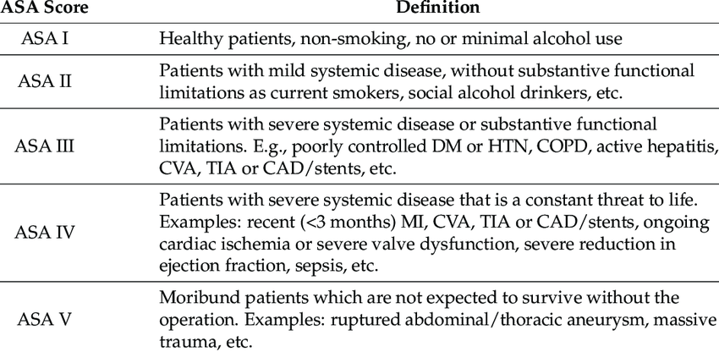
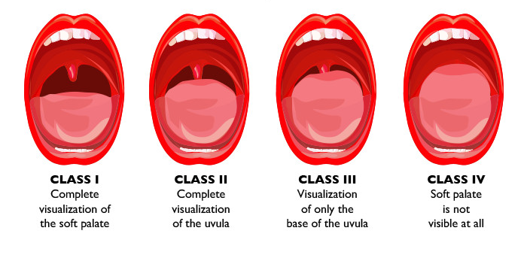
Pre-Procedural Evaluation

Slide 6
Fasting Guidelines
Intake | Fasting Duration
Clear liquids | 2 hours
Breast milk | 4 hours
Non-human milk | 6 hours
Solid food | 8 hours
Fasting prior to sedation is essential to reduce the risk of pulmonary aspiration.
GLP1 agonist
Delay gastric emptying
Recommendations
  Daily dose – hold 1 day
  Weekly dose – hold 1 week

Slide 7
Monitoring During Sedation
Moderate Sedation
Goals | Patient relaxation Patient cooperation, Easy arousal Rapid recovery
Risks | Loss of consciousness Airway obstruction, hemodynamic instability
Moderate Sedation: level of consciousness, O2, BP
  Level of consciousness - patients should respond to verbal/tactile commands
  02 - pulse oximetry, assess breathing (observation, auscultation), CO2 prn
  BP - record at 5-10 minute intervals
  Others - EKG if significant CV disease, CO2 monitoring when separated from caregiver
Deep Sedation: same as moderate sedations
  In addition: CO2 and EKG for all patients, record BP at 3-5 minute intervals

Slide 8
Personnel Requirements
Moderate sedation
Designated individual for patient monitoring
May assist with minor interruptible tasks if patient is stable
This individual is separate from the proceduralist
BLS personnel present in the room, ACLS personnel available within 5 minutes
Deep sedation
Designated individual for patient monitoring
May not assist with minor interruptible tasks if patient is stable
ACLS personnel present in the room

Slide 9
Emergency Equipment
Moderate Sedation
Suction, airway equipment, oxygen delivery system (give prn)
Should have ability to provide positive pressure ventilation (AMBU)
IV access, resuscitative medications, and pharmacological antagonists
Defibrillator available for patients with cardiovascular risk
Deep Sedation
All of the above
Oxygen given to all patients
Defibrillator immediately available for all patients

Slide 10
Pharmacological Agents (moderate sedation)
Agents for sedation
  Sedatives – decrease anxiety, creates somnolence
    Benzodiazepines (BZD) – midazolam (typical dose 0.5-1 mg at a time)
  Narcotics – pain relief
    Fentanyl (typical dose 25-50 mcg at a time)
Reversal Agents: important to have immediately available
  Sedative reversal
    Flumazenil: Benzodiazepine reversal (typical dose 0.2 mg)
      Used to reverse acute BZD given. Caution if on chronic BZD (seizure risk)
  Narcotic reversal
    Naloxone: Opioid reversal (typical dose 40-400 mcg)

Slide 11
Pharmacological Agents (deep sedation)
Additional agents for sedation – use with caution
Propofol, Ketamine, Etomidate
These agents have risk of inducing general anesthesia
Clinicians must have ability to rescue from unintended general anesthesia

Slide 12
Recovery and Discharge Criteria
Observation until cardiorespiratory stability
Monitoring oxygenation until no risk of hypoxemia
Predetermined discharge criteria to prevent post-sedation complications

Slide 13
Special Situations
Consultation with specialists for high-risk patients
Severe underlying cardiopulmonary disease or airway anomalies
Procedure with risk of severe cardiopulmonary compromise
Procedures needing complete unresponsiveness
Immediate intervention for airway obstruction or aspiration
Airway obstruction – have equipment available and plan ahead
Aspiration – turn patient to side, suction, intubate and bronchoscopy prn
No prophylactic antibiotics or steroid treatment
Risk mitigation in cases of severe underlying medical conditions
Consult appropriate specialists

Slide 14
Summary
Emphasis on patient safety through comprehensive monitoring
Preparation for emergencies with appropriate personnel and equipment
Individualized care and recovery criteria for all sedation levels

